Slide 1
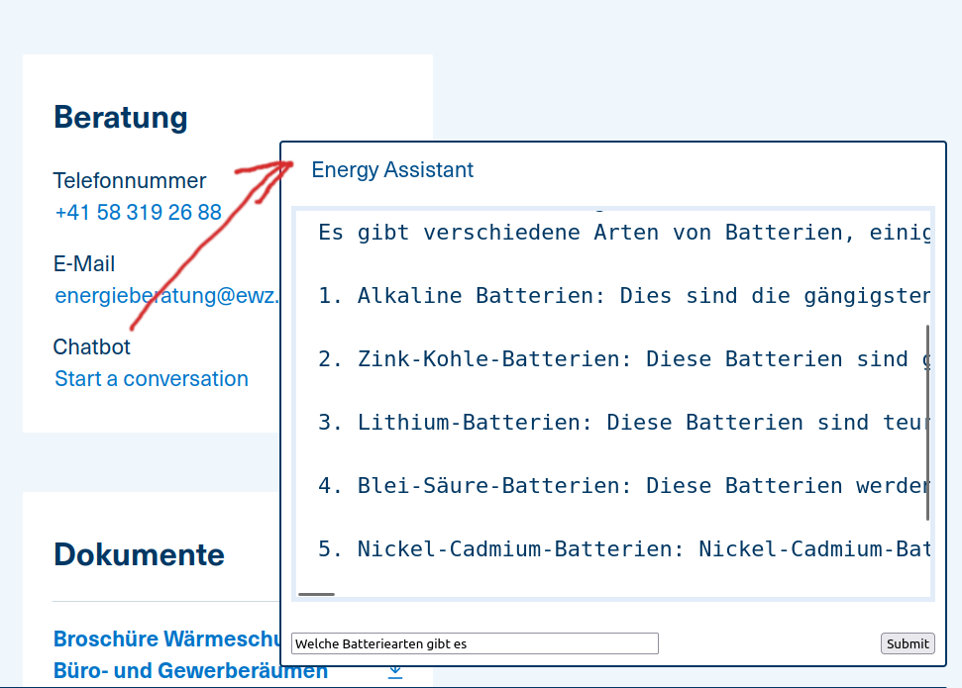
EnyBoty
A chatbot that is fun to use and helps to save energy.

Slide 2
Problem Definition
Two use-cases:
  Advice from a Website
  Smart Home Hub Plugin
1. Energy saving cognizant assistant
2. AI based IoT device integration

Slide 3
Target Persona
Mr. and Mrs. Joe Average who want to save the environment (and money of course)
Technical person who wants additional energy saving advice based on smart home appliances

Slide 4
Demo

Slide 5
Next Steps
Determine the correct method to add IoT data to a Large Language Model (LLM)
Form correct “system prompts” to condition the ChatBot as a real energy assistant
Incorporate a retail “Home Assistant”

Slide 6
Team Members
Michel Racic
Derric Oswald
Cristian Calu

