Slide 1


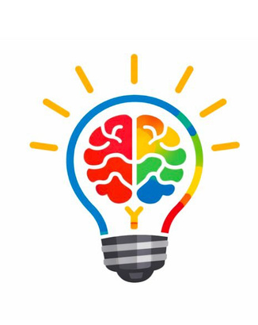



THINKATHON 9.0
Innovate.Ideate.Inspire.
ZENO
  Problem Statement ID : GGC06
  Problem Statement Title: AI-Powered Cognitive Wellness Monitoring System
  Team ID: TH09-77-GGCHITS-26
  Team name: Daemons
THINKATHON- Template
1

Slide 2
PROBLEM STATEMENT
74% of Gen Z report burnout symptoms; chronic stress at epidemic levels (APA, 2024)
Existing wellness apps (Headspace, Calm, Wysa) require the user to manually show up
Stressed users are least likely to open a wellness app — creating a fundamental engagement gap
No solution today passively detects cognitive decline or builds genuine emotional attachment
Industry average Day-7 retention for wellness apps is only 25% — users abandon quickly
Pain point itch score: Lack of proactive mental health tools rated 91/100 in HealthTech validation
THINKATHON- Template
2
Notes:
2

Slide 3
SDG ALIGNMENT
SDG 3 — Good Health & Well-Being: ZENO addresses mental wellness for Gen Z and young professionals
SDG 3 Target 3.4: Promote mental health and well-being through innovative digital interventions
SDG 9 — Industry, Innovation & Infrastructure: ZENO pioneers passive AI health monitoring on mobile
SDG 9 Target 9.b: Supports domestic technology development in the HealthTech AI domain
Proactive detection reduces downstream burden on mental healthcare systems
Freemium model ensures accessibility — making cognitive wellness tools available to all income groups
@SIH Idea submission- Template
5
THINKATHON- Template
8
Notes:
5

Slide 4
PROJECT OVERVIEW
ZENO is a gamified AI cognitive wellness companion app for iOS and Android (Flutter)
Core innovation: passively detects stress via typing behavior, phone usage, and optional facial scan
Mochi — a Tamagotchi-style AI companion — reflects user mental state with evolving personality
CogniPulse Score: proprietary 0–100 wellness metric computed on-device every 2 hours
Daily quests, XP rewards, and streak tracking drive engagement without clinical friction
Target users: Gen Z digital natives and young professionals aged 16–30
THINKATHON- Template
3
Notes:
2

Slide 5
NOVELTY
Zero-input detection: ZENO monitors stress passively — no journaling, no manual check-ins required
CogniPulse Score fuses 4 signals: typing behavior (35%), phone usage (30%), facial scan (20%), mood tap (15%)
Mochi develops a unique personality archetype (Night Owl, Achiever, Anxious) over 30 days
Mochi Memory System: references past user events to create intimacy no wellness app achieves today
Mochi Playdates: social feature where companions interact based on mutual stress data
All biometric ML runs entirely on-device — raw data never leaves the user’s phone
@SIH Idea submission- Template
3
THINKATHON- Template
4
Notes:
3

Slide 6
TECHNICAL STACK
Frontend: Flutter (Dart) — single codebase for iOS and Android; Riverpod for state management
On-Device ML: TensorFlow Lite (CogniPulse MLP model, <2MB, INT8 quantized, <50ms inference)
Facial Analysis: MediaPipe Face Mesh — 468 landmarks; stress AUs extracted fully on-device
AI / NLP: Claude API (Anthropic) — powers Mochi’s contextual dialogue, vibe checks, weekly letters
Backend: FastAPI (Python) — minimal REST API for auth, sync, social features
Database: SQLite (on-device) + Supabase (optional encrypted cloud sync); Auth via Supabase + FCM
@SIH Idea submission- Template
3
THINKATHON- Template
5
Notes:
3

Slide 7
SYSTEM ARCHITECTURE
Step 1 — Signal Collection: phone usage, typing patterns, facial scan captured via Flutter background isolates
Step 2 — CogniPulse Computation: TF Lite MLP model aggregates 12 signals into 0–100 score on-device
Step 3 — Mochi Personality Engine: local state machine maps CogniPulse bands to mood; Claude API for dialogue
Step 4 — Cloud Sync (Optional): only aggregated scores synced; end-to-end encrypted via Supabase
Privacy-first design: no raw biometric data ever leaves the device by architectural constraint
Offline-first: core Mochi interactions and quests function fully without internet connectivity
@SIH Idea submission- Template
4
THINKATHON- Template
6
Notes:
4

Slide 8
FEATURES & FUNCTIONALITY
Mochi Companion: 4 mood states (Thriving / Balanced / Drifting / Struggling) with contextual AI dialogue
CogniPulse Dashboard: 7-day trend charts with AI-generated plain-language pattern insights
Daily Quests: 5 contextual micro-challenges (Box Breathing, Screen Sabbath, Micro Walk) with XP rewards
Stress Alert System: Mochi visually changes state and sends gentle voice-style push notifications
Weekly Letter: AI-written Sunday summary in Mochi’s evolving personality voice via Claude API
Mochi Playdates: social feature — two users’ companions interact based on mutual CogniPulse data
@SIH Idea submission- Template
5
THINKATHON- Template
7
Notes:
5

Slide 9
FEASIBILITY AND VIABILITY
Technical: Flutter + TF Lite stack is production-proven; on-device ML eliminates server cost at scale
Privacy compliance: GDPR-aligned by design — no raw biometrics stored or transmitted
Market: $140B global mental wellness market by 2030; 74% Gen Z report burnout — massive TAM
Monetization: Freemium — free core; premium for avatar skins, Mochi Lore, deep analytics
Retention advantage: Day-7 target >55% vs. industry average of 25% (gamification + passive detection)
MVP buildable within 2 months with current team; Phase 2 features roadmapped for Month 3–4
@SIH Idea submission- Template
5
THINKATHON- Template
9
Notes:
5

Slide 10
RESEARCH AND REFERENCES
Gen Z Burnout (2025 Int’l Study): 83% of Gen Z frontline workers report burnout vs. 75% for other groups; 98% of 18–24 year-olds show at least one burnout symptom; 25% face unmanageable stress
Mental Health App Market (2025–2030): Market grows from $9.94B (2025) to $22.73B (2030) at 18.0% CAGR; North America holds 47% share; employer-sponsored apps fastest-growing at 19.2% CAGR
Wellness App Retention (JMIR 2019 + Industry Data): Headspace retains ~25% at Day 1, dropping to 4.7% at Day 30; median 30-day retention across mental health apps is 3.3%; mindfulness apps average 4.7%
Typing as Cognitive Stress Proxy (Validated Research): Typing dynamics (speed, interkey intervals, errors/backspaces) reliably indicate mental fatigue; accuracy drops first, speed declines later; validated in office settings over weeks; correlates with neural fatigue markers
Facial Stress Detection — MediaPipe Face Mesh (Google): 468-landmark real-time detection; AU1, AU7, AU17 modelled via SVM classifiers with high F1 scores; stress tasks measurably increase AU intensities (chin raiser, lid tightener) for automatic detection
@SIH Idea submission- Template
6
THINKATHON- Template
10
Notes:
6

Slide 11
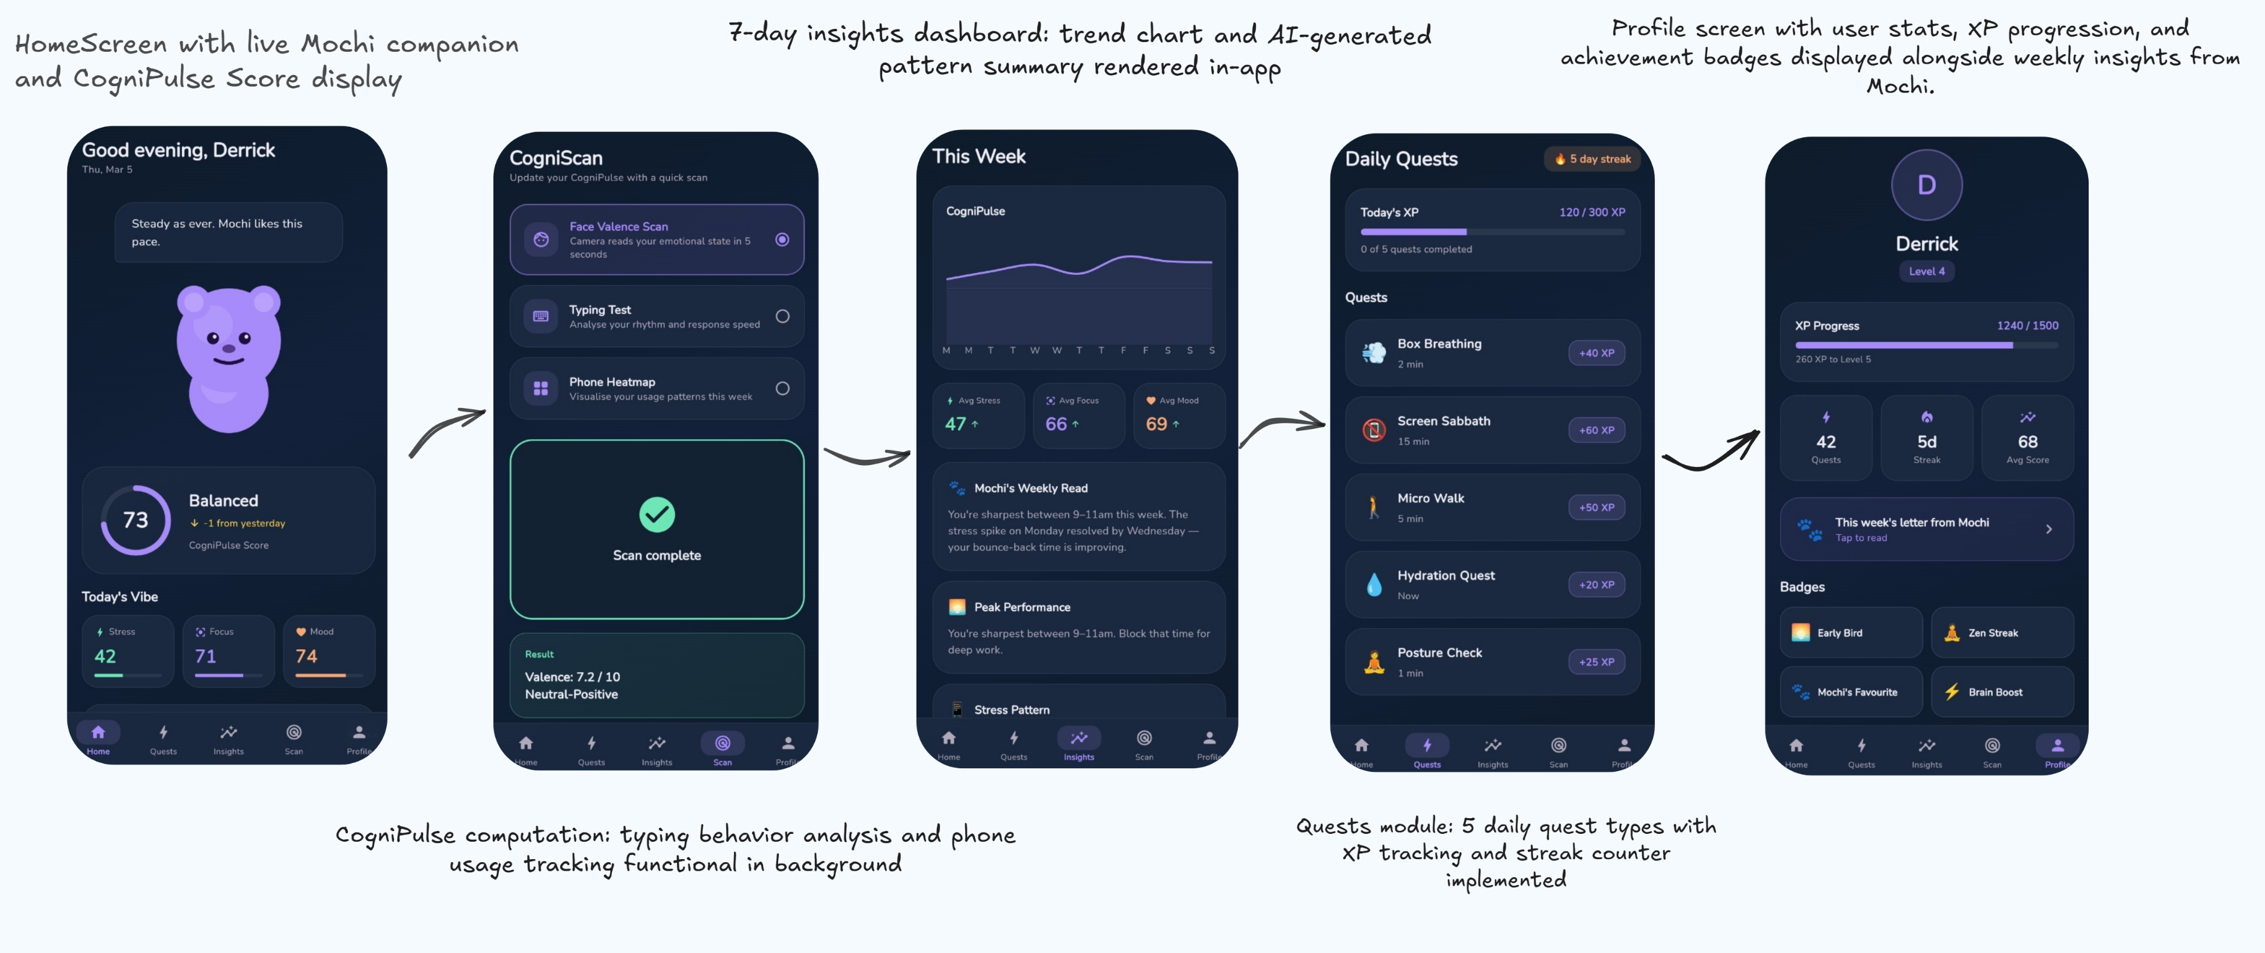
PROTOTYPE(optional)
@SIH Idea submission- Template
4
THINKATHON- Template
11
Notes:
4

Slide 12
FUTURE SCOPE
Phase 2 (Month 3–4): Facial micro-expression scan, Mochi Playdates, calmness leaderboard, 5-avatar roster
Phase 3 (Month 5–6): Mochi Memory Cards, personality archetypes, unlockable premium skins
Smartwatch integration: Apple Watch / Wear OS HRV and SpO2 data to enhance CogniPulse accuracy
Therapist Mode: opt-in anonymized data sharing with licensed professionals for guided wellness
Enterprise / Campus edition: aggregate stress dashboards for universities and HR teams
Multilingual Mochi: localized personality dialogue for global markets (India, SEA, LATAM)
THINKATHON- Template
2

Slide 13
IMPACT
Addresses a $140B mental wellness market with a product Gen Z will actually use daily
Targets Day-7 retention of >55% vs. industry average of 25% — 2x the engagement of existing apps
Reduces silent burnout progression by intervening before users consciously recognize stress
Privacy-first architecture sets a new ethical standard for AI-powered health monitoring on mobile
Freemium model democratizes cognitive wellness tools for students and early-career professionals
Potential to reduce downstream mental health costs for institutions through early-stage intervention
THINKATHON- Template
2

Slide 14
CONCLUSION
ZENO solves the #1 failure of wellness apps: requiring effort from users who are already overwhelmed
Passive detection + gamification + living AI companion — a combination no existing app has achieved
Built on a privacy-first, on-device ML architecture that is both ethical and technically superior
Powered by Claude API for genuine, evolving personality — not scripted chatbot responses
MVP is live and demo-ready: Mochi, CogniPulse, quests, insights, and onboarding all functional
ZENO doesn’t just track your mental health. It befriends it.
THINKATHON- Template
2

Slide 15
THANK YOU
Team Daemons
TH09-77-GGCHITS-26 | GGC06 | THINKATHON 9.0
contact@zeno.app | zeno.app
“ZENO doesn’t just track your mental health. It befriends it.”
THINKATHON- Template
2

