Slide 1
Advanced Git for Beginners
Derrick Stolee
Microsoft
@stolee
https://stolee.dev/docs/git.pptx

Slide 2
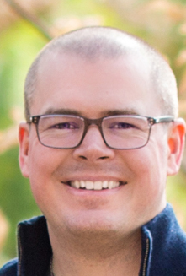
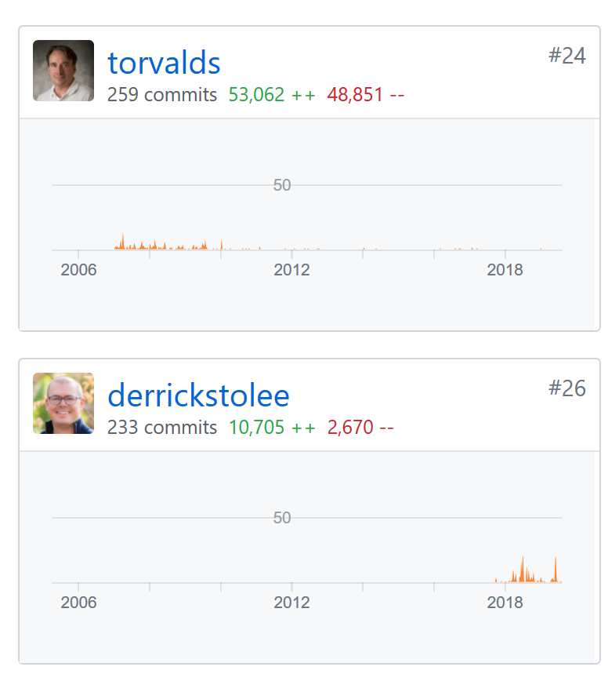
About me
Derrick Stolee
Software Engineer
Git Ecosystem
Git
Git for Windows
VFS for Git
https://github.com/git/git/graphs/contributors

Slide 3
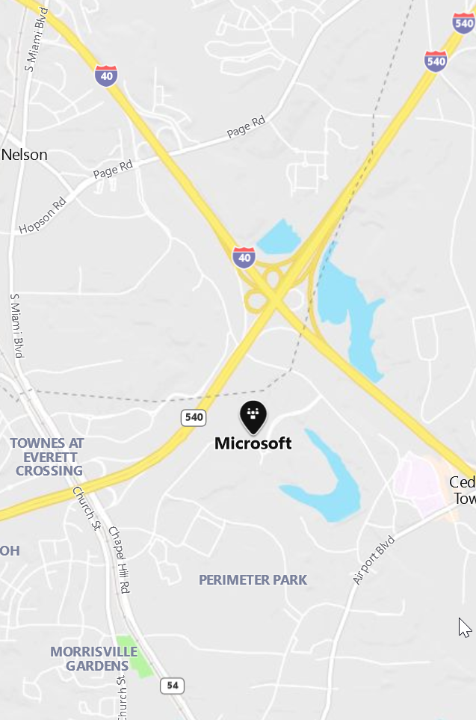

About me
Derrick Stolee
Live in Raleigh
Work in RDU
Dr. Kathryn Stolee
SE Faculty at NCSU
Looking for RAs!

Slide 4




Available roles and opportunities
Explore Microsoft
SE & Program Manager (PM) Internship
Full-Time
SE & PM
Links to these applications are also found at https://microsoft.com/university

Slide 5

How to Learn Git?
Play with it!
Read about it.
Use it with other people!
Free e-book:
https://git-scm.com/book/en/v2
10.2 Git Internals - Git Objects
2.3 Git Basics - Viewing the Commit History
2.2 Git Basics - Recording Changes to the Repository

Slide 6
Where to Get Git?
Linux: sudo apt-get install git
Windows: https://github.com/git-for-windows/git/releases
Mac: brew install git
https://git-scm.com/book/en/v2/Getting-Started-Installing-Git

Slide 7
How to follow along?
$ git clone https://github.com/git/git
$ cd git
$ git reset --hard v2.23.0

Slide 8
How to follow along?
$ git clone https://github.com/git/git
$ cd git
$ git reset --hard v2.23.0

Slide 9
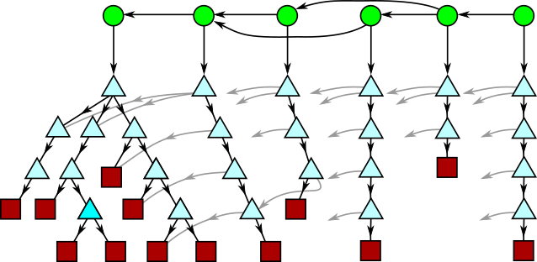
Object Model

Slide 10
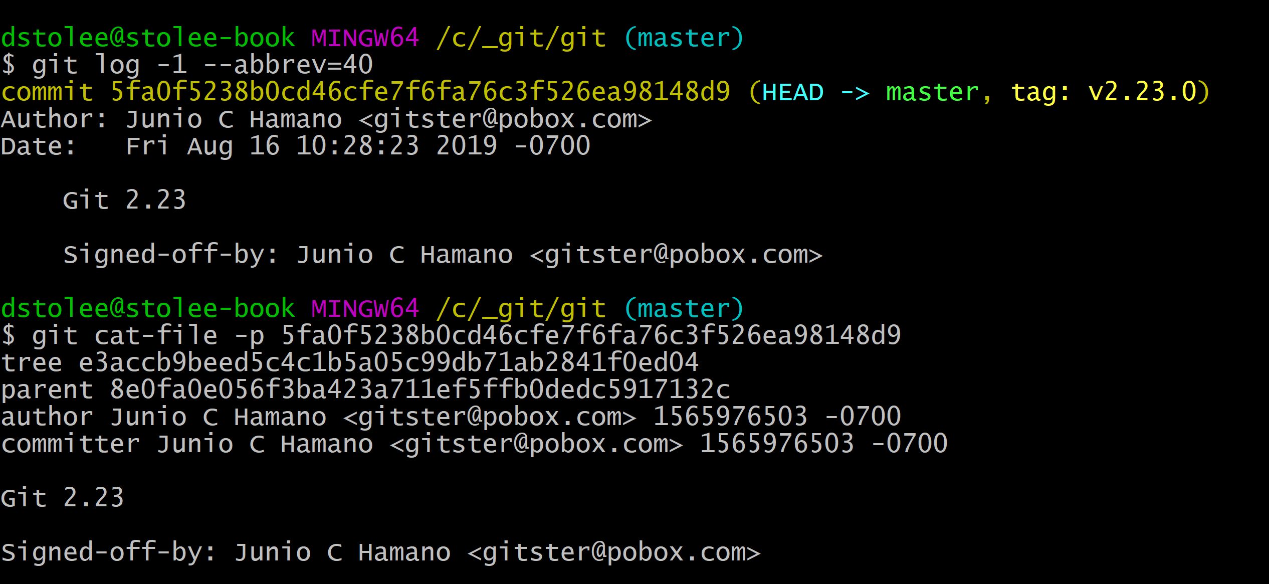
Object Model: Content-Addressable Data Store
Every object has a SHA-1 hash: 40 hex characters.
Given 40 hex characters, we can find the unique object with that hash.

Slide 11
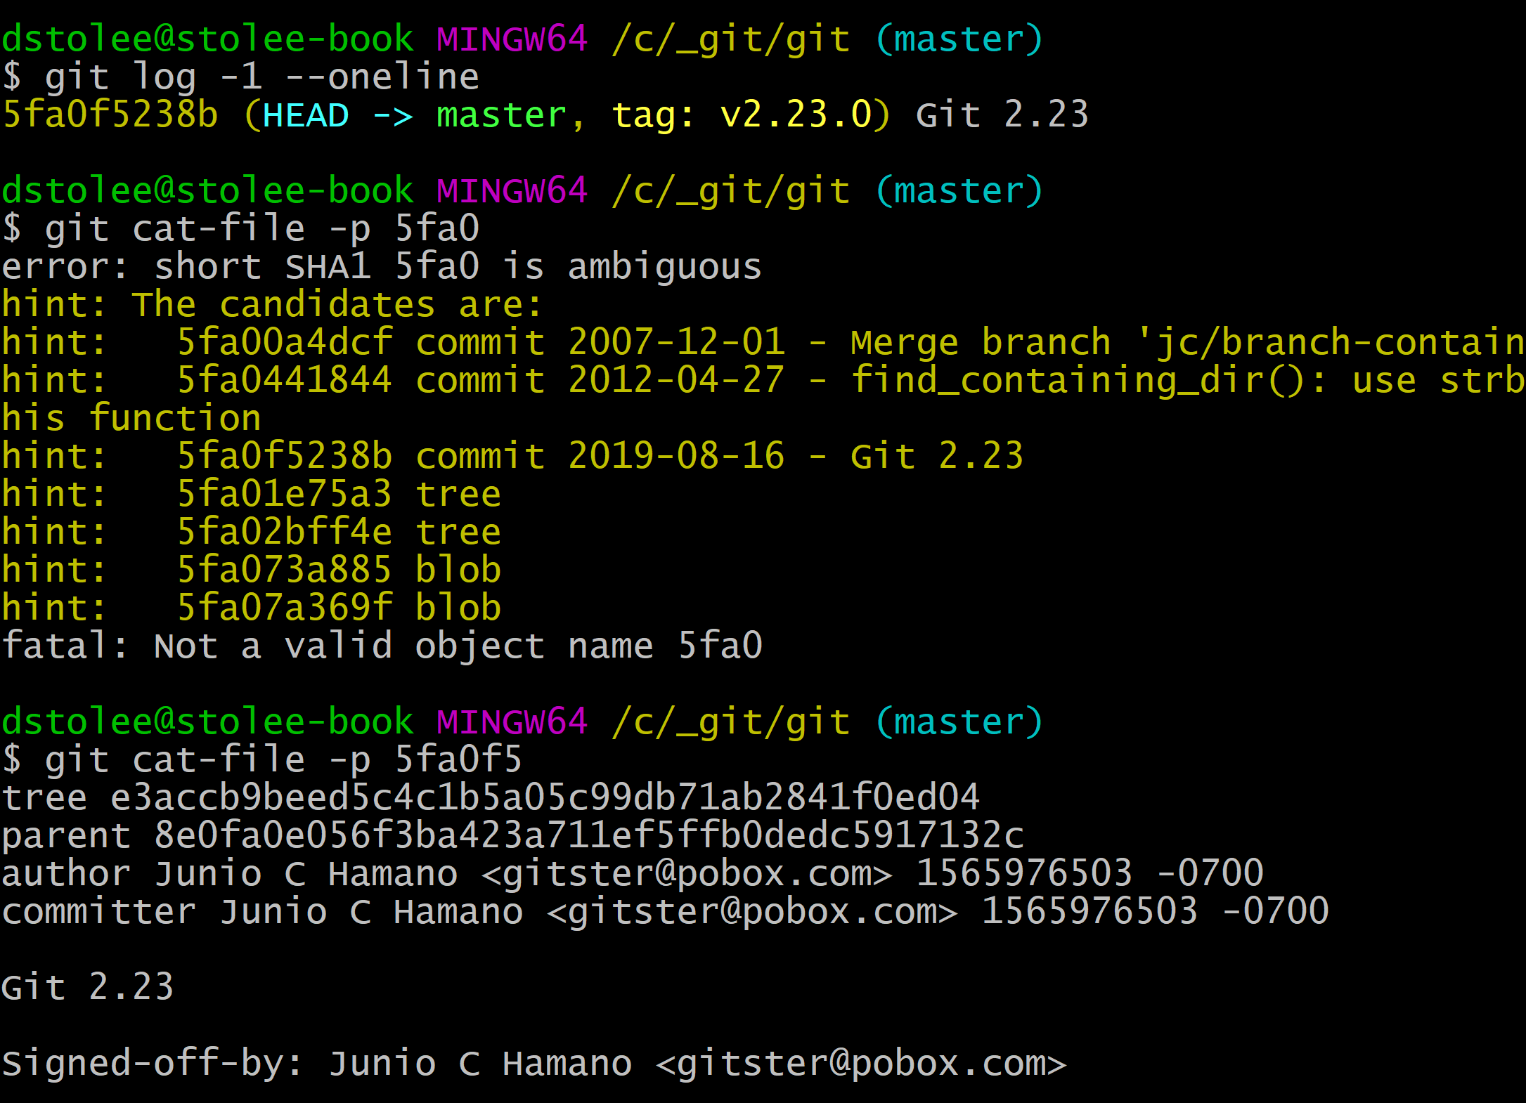
Object Model: Content-Addressable Data Store

Slide 12
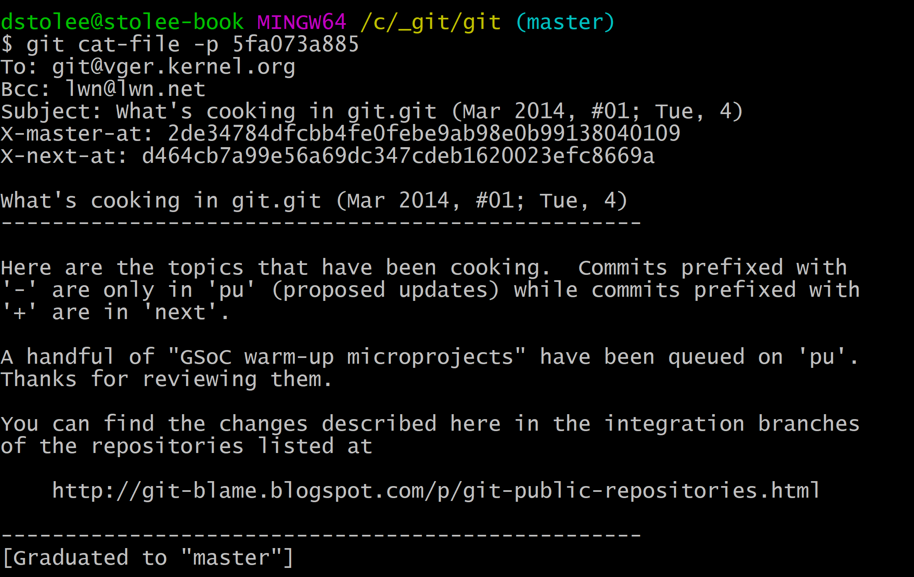
Object Model: Blob (Block)
A blob contains file contents.
Note: the file name is
not part of the object!

Slide 13
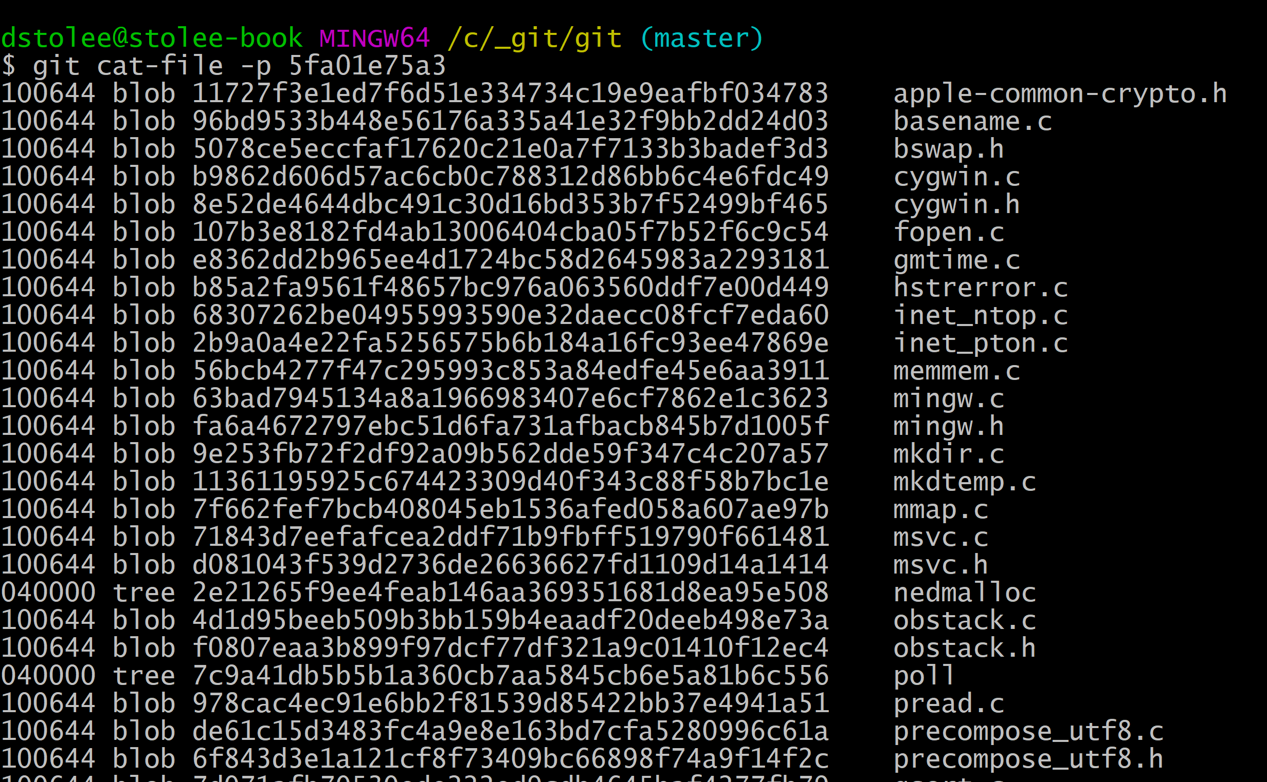
Object Model: Tree (Triangle)
A tree contains folder contents.
Contains names of files
and folders inside
Contains blobs (files)
and trees (folders)
Includes file mode
(Unix file permissions)

Slide 14
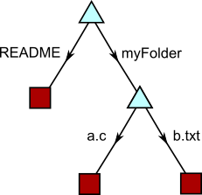
Object Model: Tree (Triangle)
A tree contains folder contents.

Slide 15
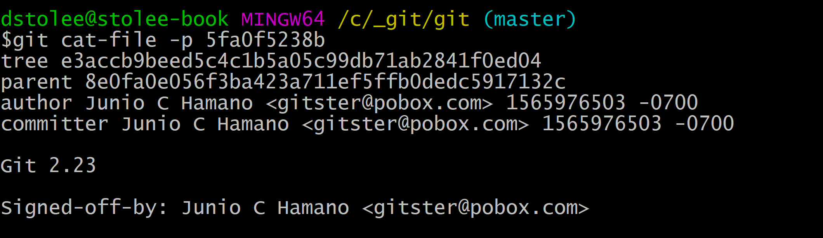
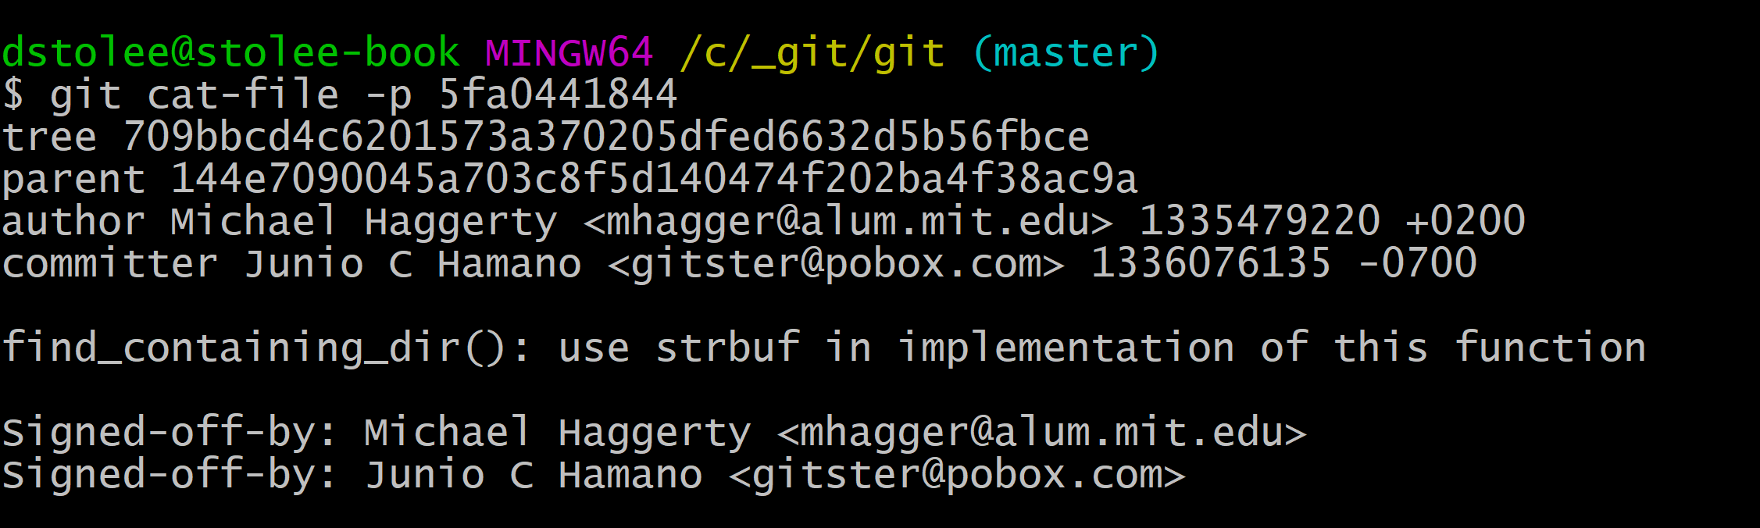
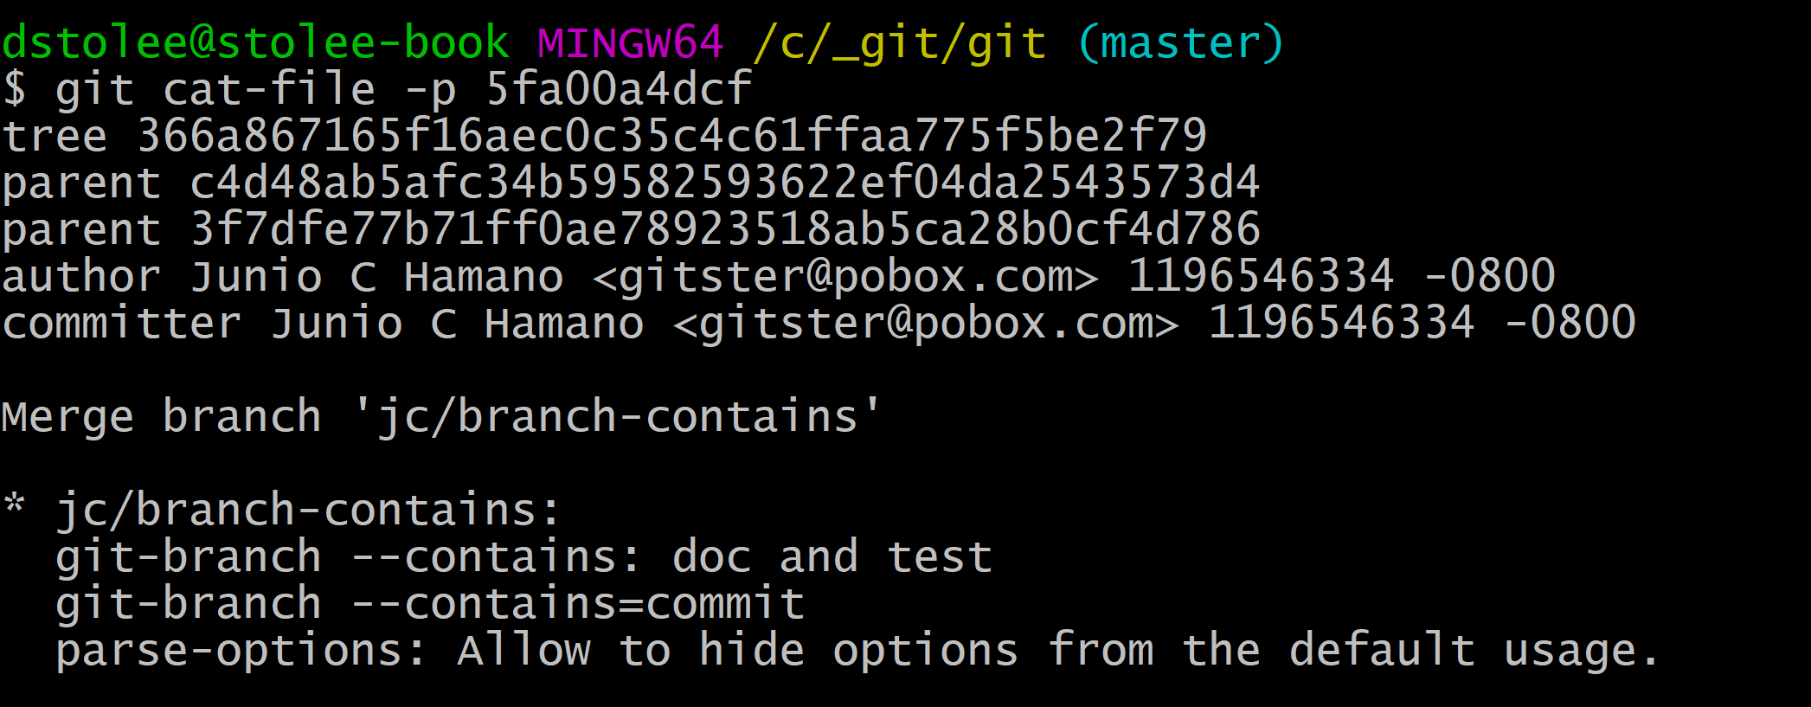
Object Model: Commit (Circle)
A commit contains many things:
A root tree.
A list of parent commits.
A commit message
An author name, email, time.
A committer name, email, time.
git config –global user.name “My Name”
git config --global user.email me@place.com

Slide 16
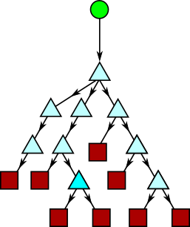
Object Model: Commit (Circle)
A commit contains many things:
A root tree.
A list of parent commits.
A commit message
An author name, email, time.
A committer name, email, time.

Slide 17
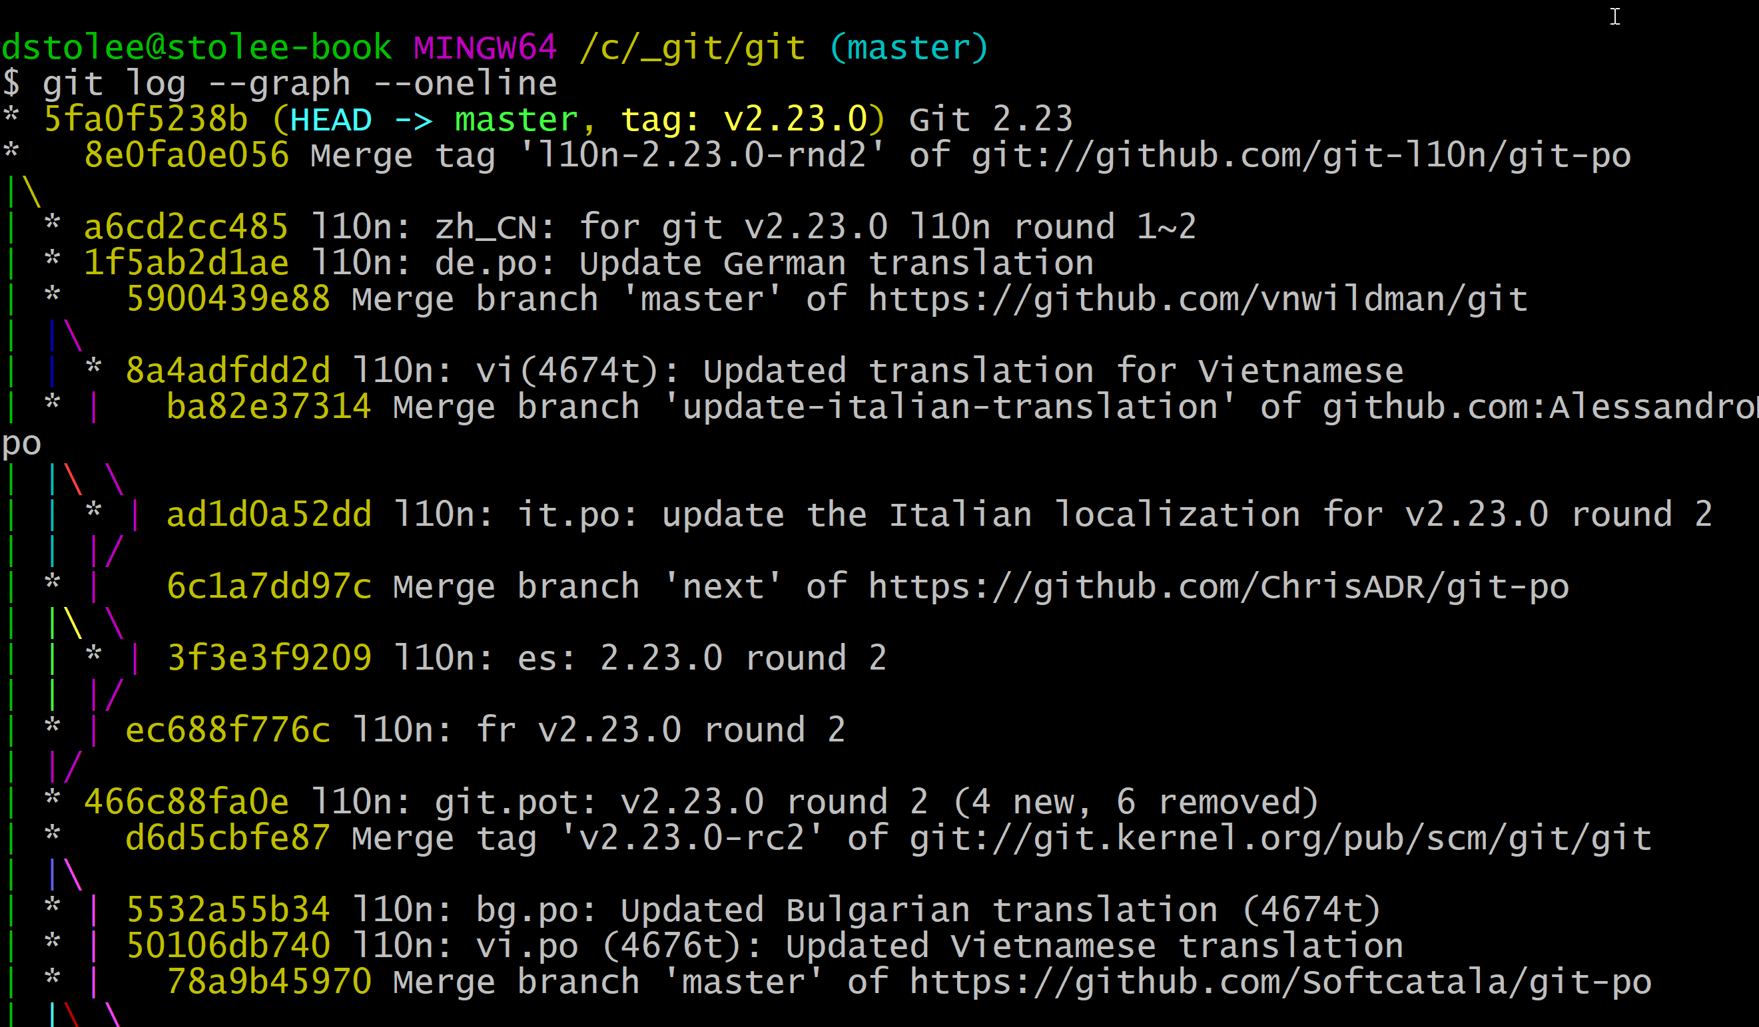
Object Model: Commit (Circle)
A commit contains many things:
A root tree.
A list of parent commits.
A commit message
An author name, email, time.
A committer name, email, time.

Slide 18
Object Model: Merkle Tree

Slide 19
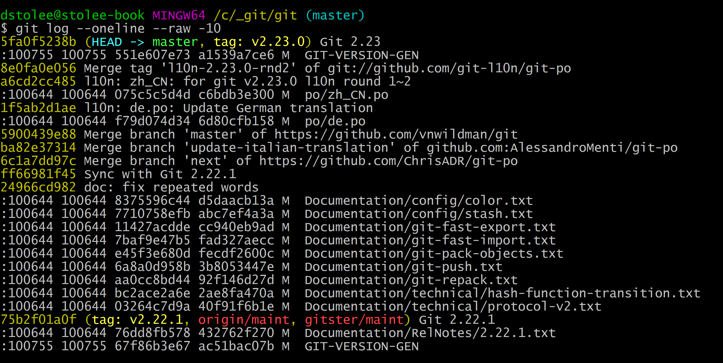
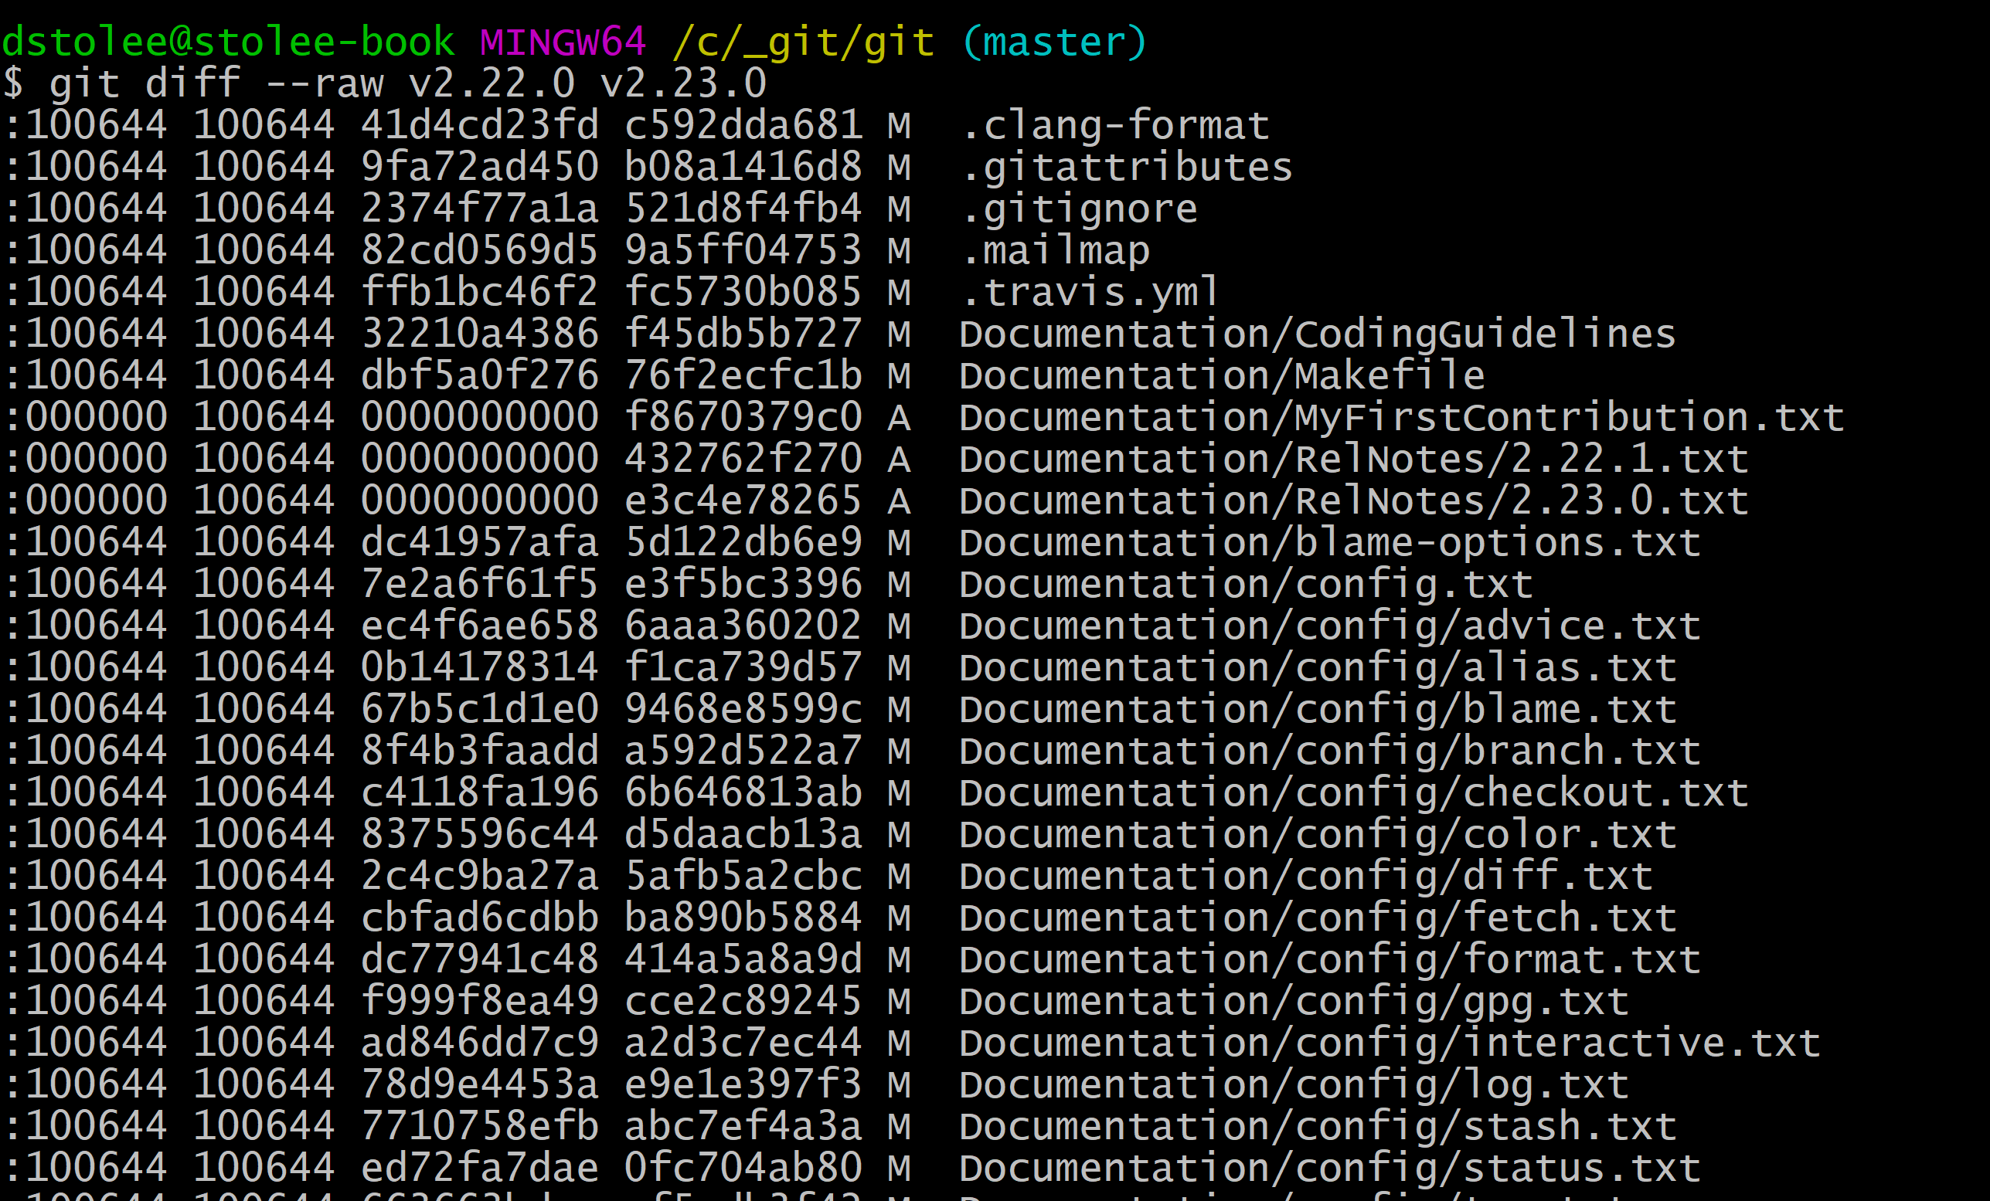

IMPORTANT: Commits are NOT diffs!
File renames are
Detected dynamically!

Slide 20
Branches: Pointers to commits
HEAD
shipped
master
topic

Slide 21
git is DISTRIBUTED version control!
HEAD
shipped
master
topic

Slide 22
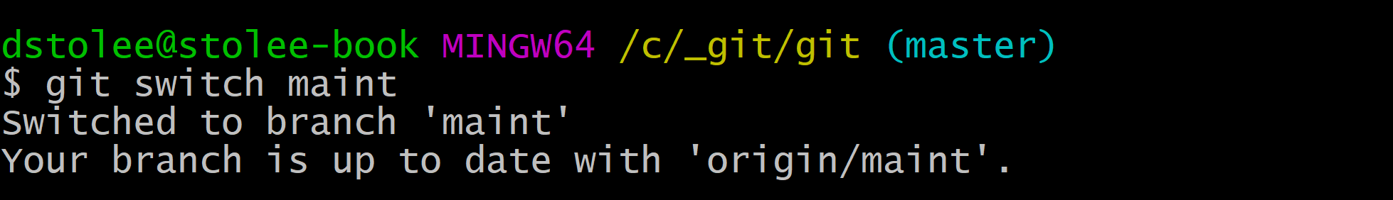
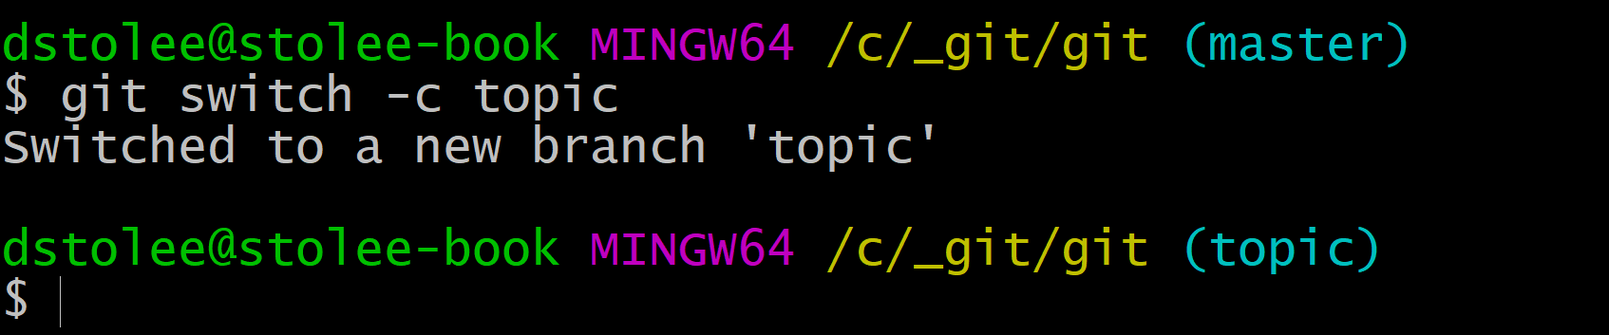
git switch : move between branches
(New in v2.23.0, replaces half of “git checkout”)
Change HEAD to point to new branch
Updates working directory to match commit’s tree

Slide 23
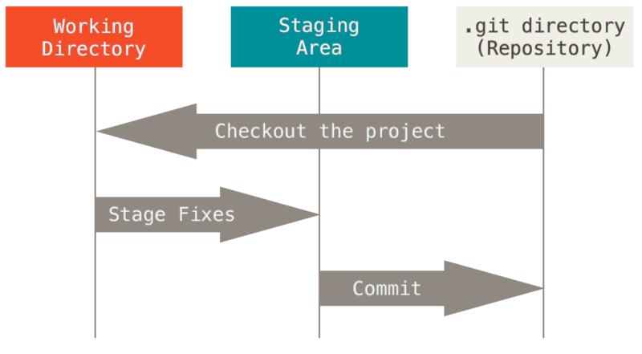
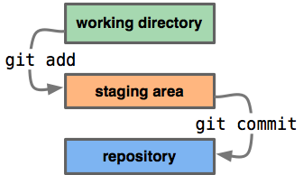
Working Directory, Staging, Committed
EXAMPLE!
https://stackoverflow.com/questions/3689838/whats-the-difference-between-head-working-tree-and-index-in-git

Slide 24
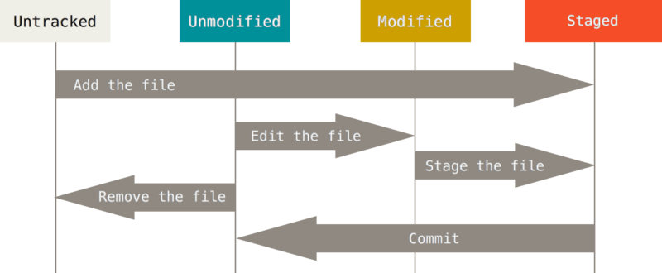
Working Directory, Staging, Committed
EXAMPLE!
https://git-scm.com/book/en/v2/Git-Basics-Recording-Changes-to-the-Repository

Slide 25
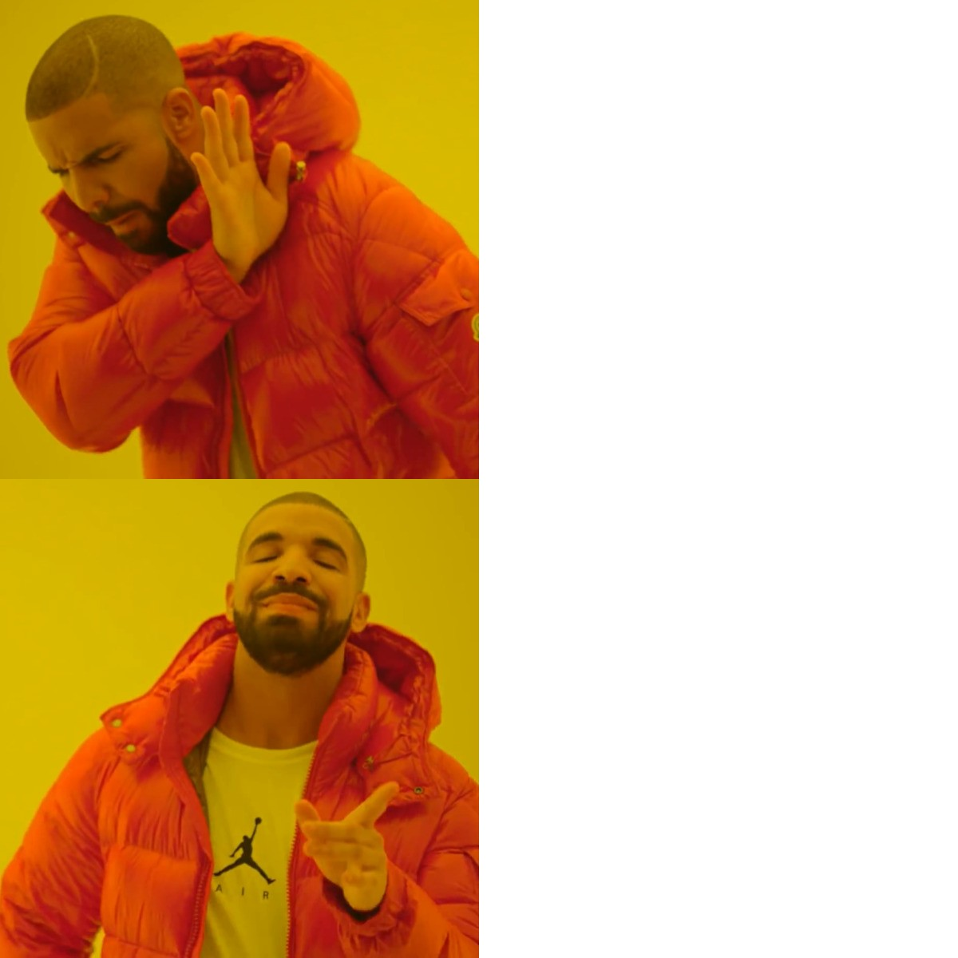
Advanced! Working Directory, Staging, Committed
Interactive add: git add -p
Presents the patch-diff in parts that you can add in pieces, or even modify in-place!
EXAMPLE!
git commit -a
git add -p
https://git-scm.com/docs/git-add#Documentation/git-add.txt-patch

Slide 26
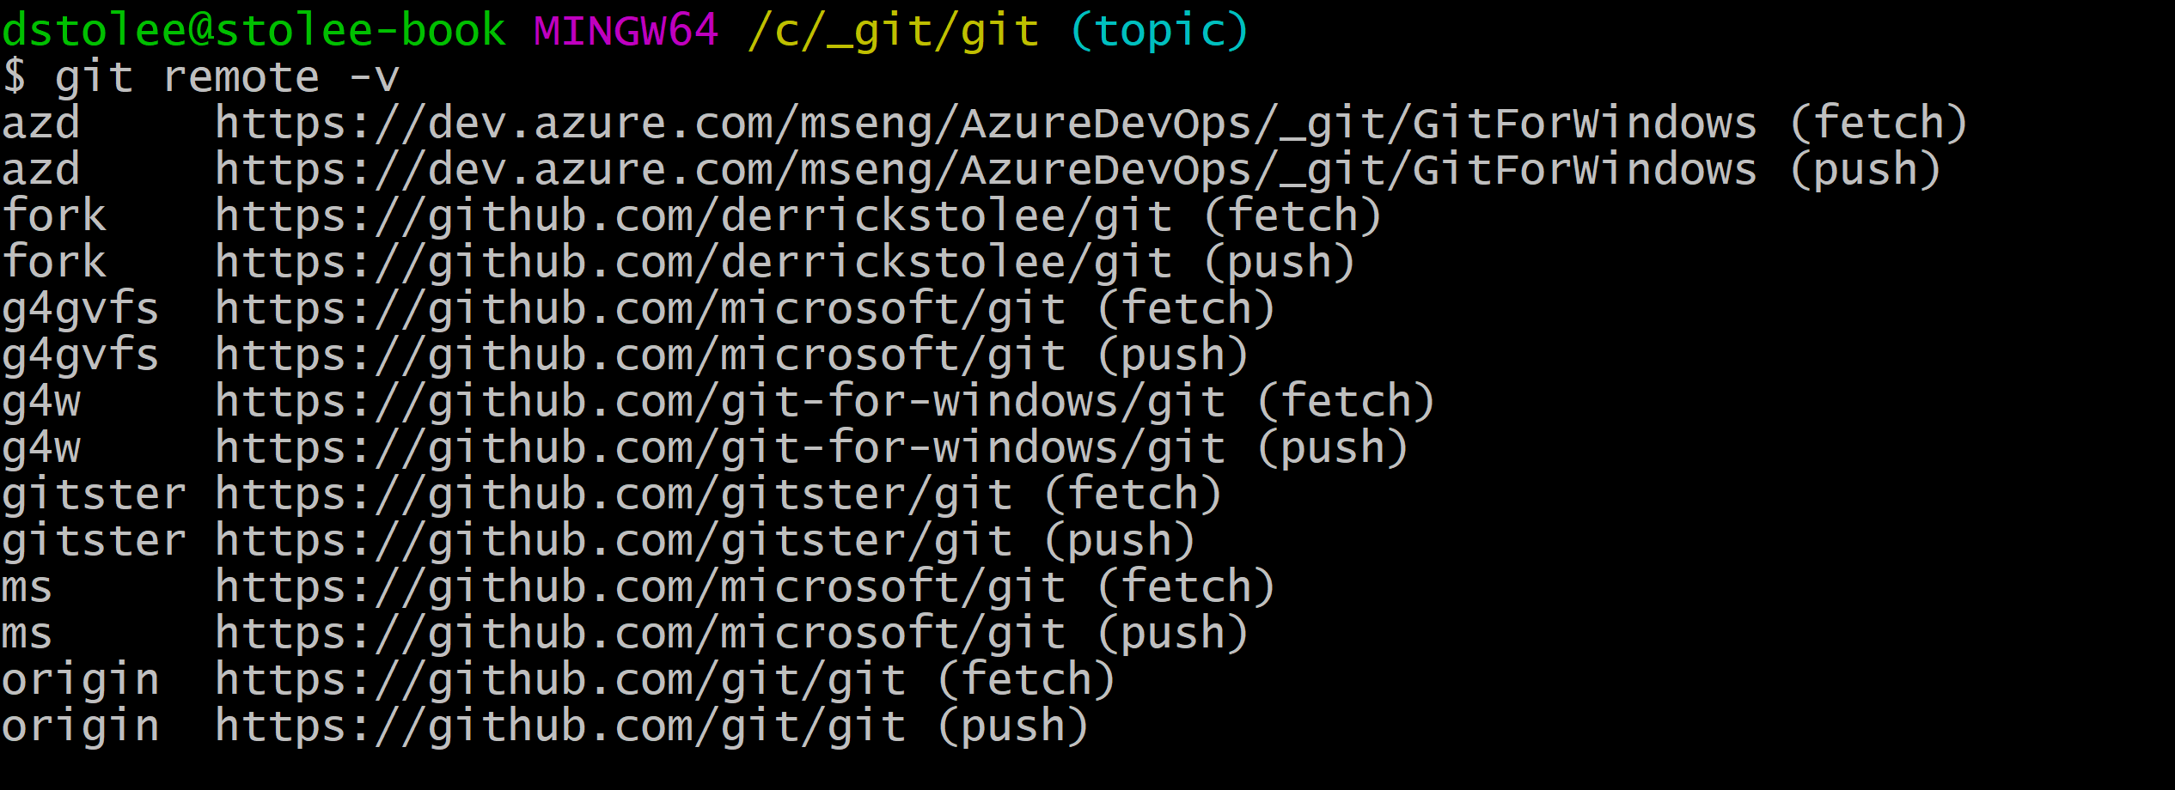
Working with Remotes
If you clone, you create special remote ‘origin’.
You can have a LOT of remotes!

Slide 27
Working with Remotes
Get new data: git fetch <remote> [branch]
Upload your data: git push <remote> <branch>
Hot Take: Don’t use git pull! This does the following:
1. git fetch
2. git merge
This can have unexpected results! Instead, do your merges yourself!

Slide 28
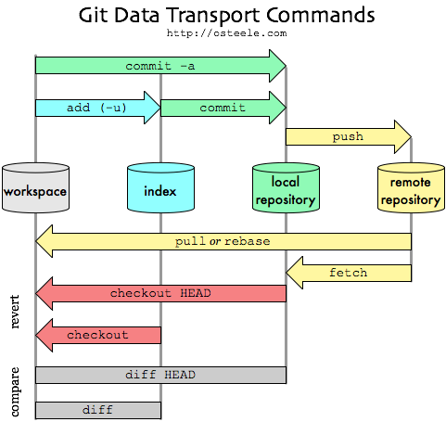
https://stackoverflow.com/questions/3689838/whats-the-difference-between-head-working-tree-and-index-in-git

Slide 29
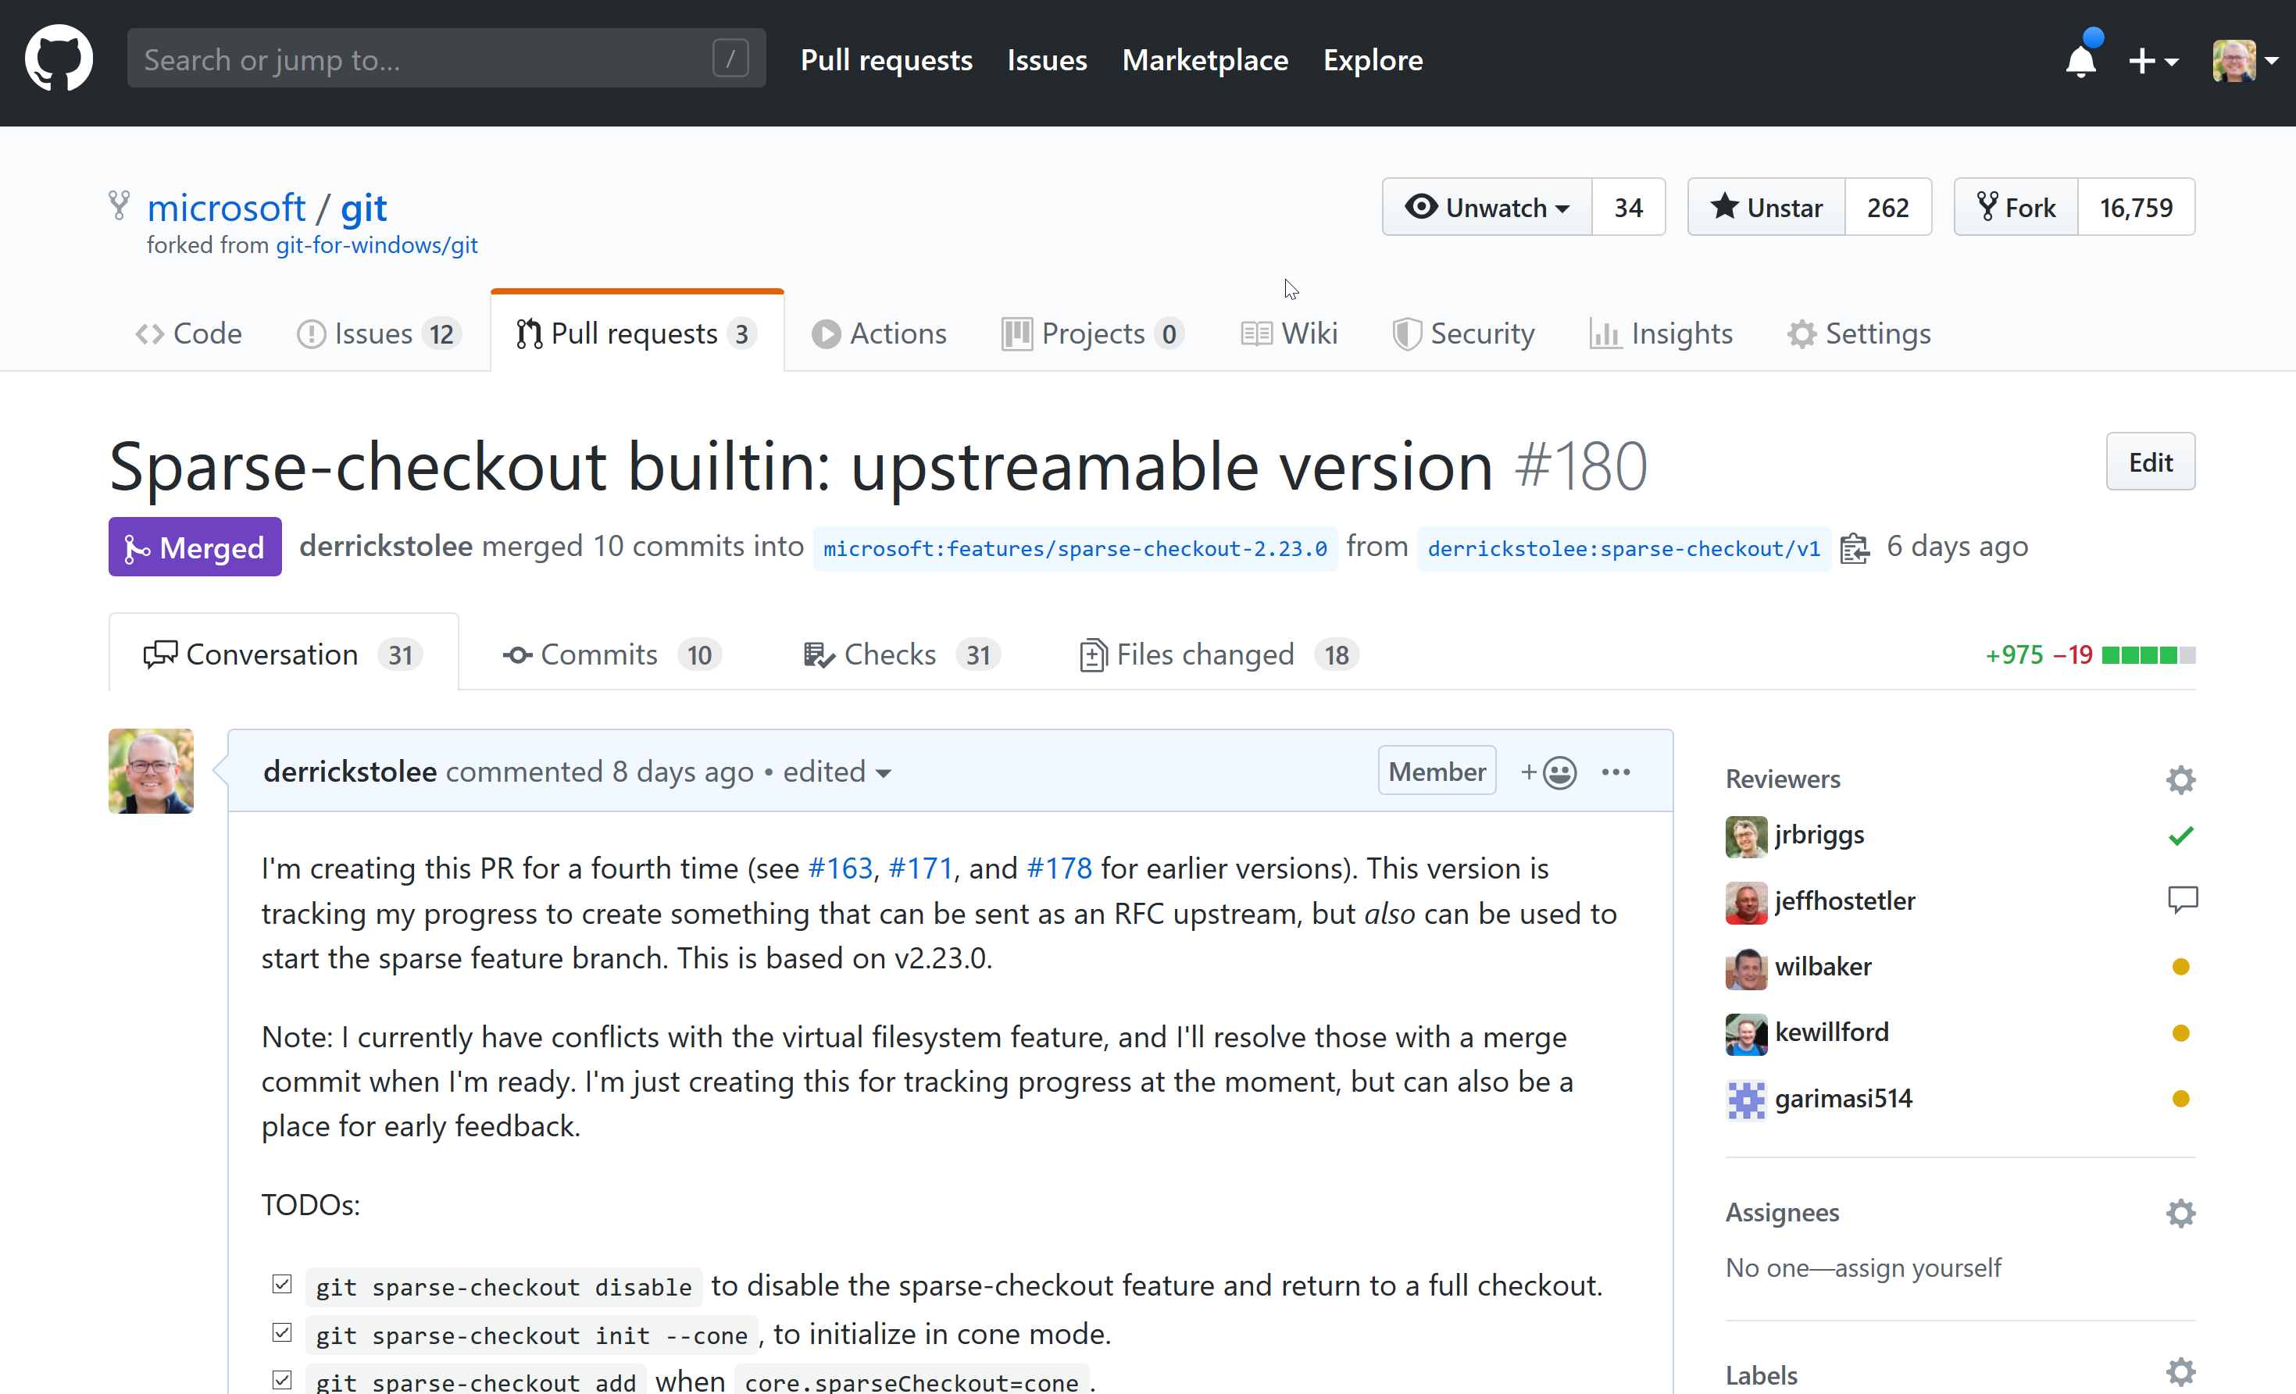
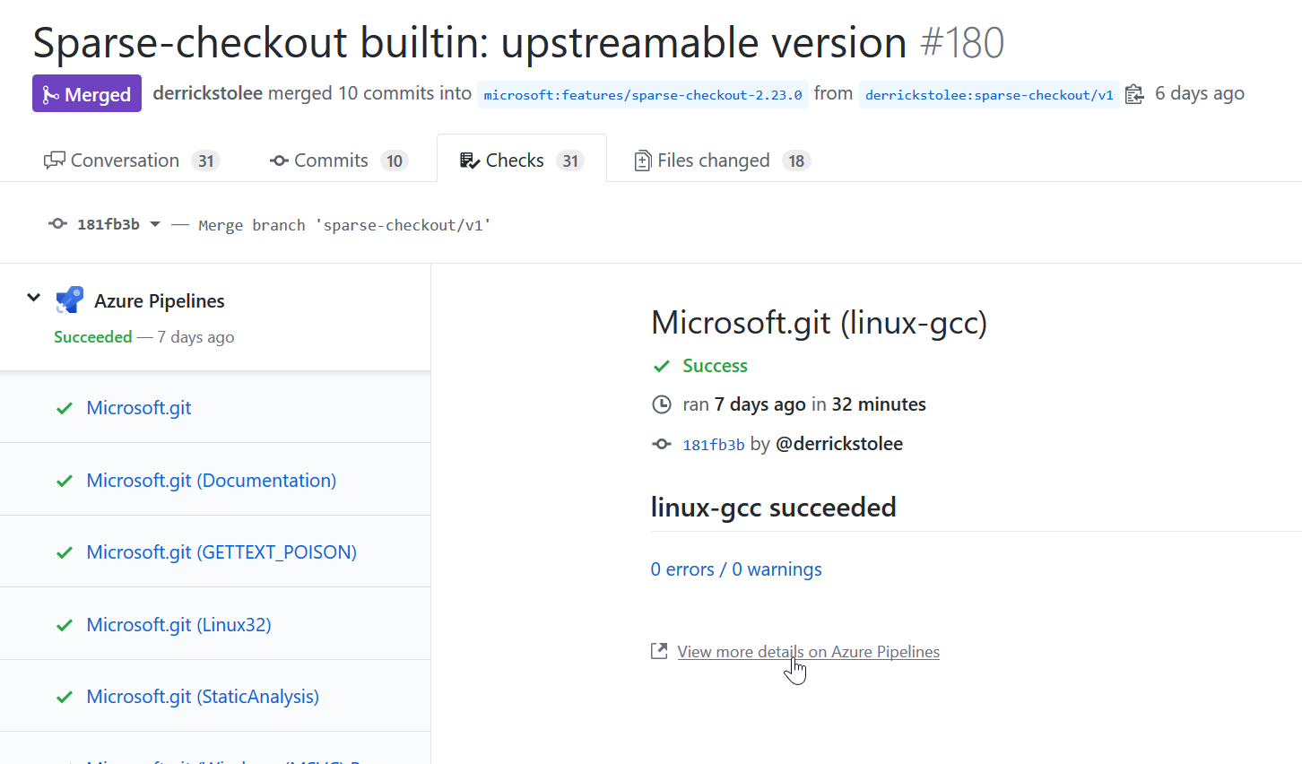
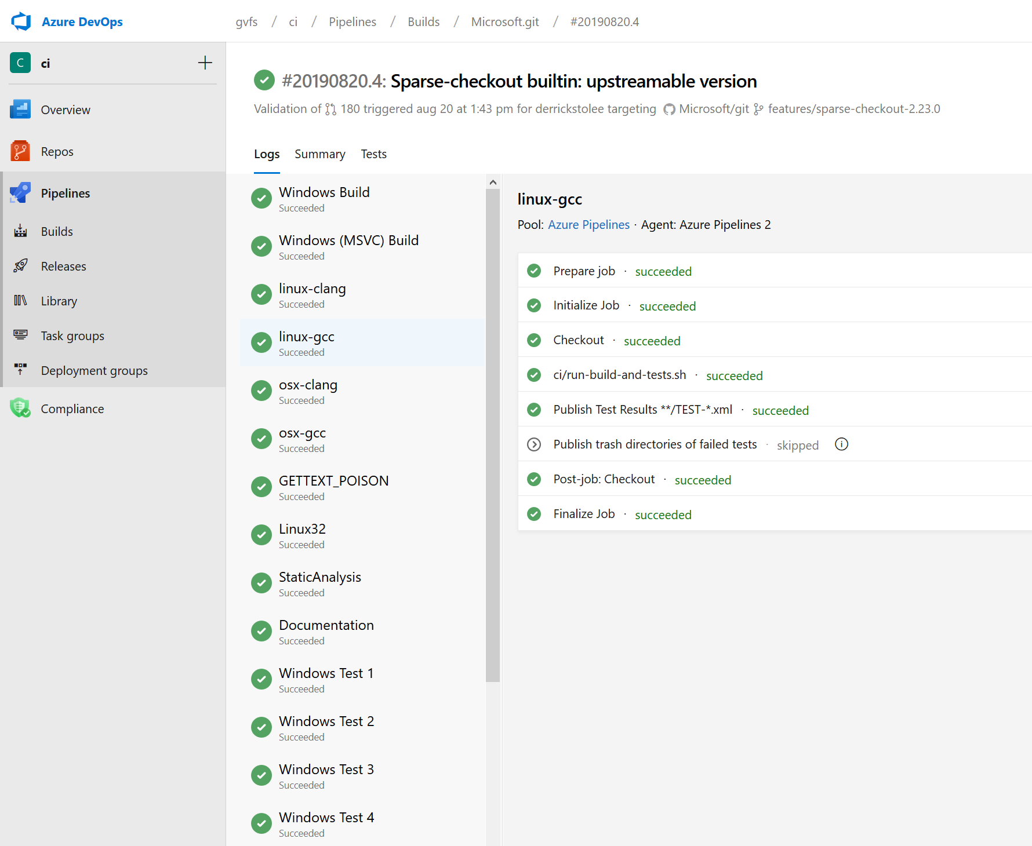
Stop! Collaborate! Listen!
https://github.com/microsoft/git/pull/180

Slide 30
Git Commands to Look Up
git config
git log
git rebase
git merge
git fetch
git push
git add
git status
git reset
git checkout
git switch
git restore
git diff
git remote

Slide 31
Reading List
Supercharging the Git Commit Graph
Part I
Part II
Part III
Part IV
Exploring new frontiers for Git push performance
These slides: https://stolee.dev/docs/git.pptx
https://git-scm.com/doc
https://ohshitgit.com/
http://stevelosh.com/blog/2013/04/git-koans/
File History Simplification
What’s the difference between HEAD, working tree and index?
Write Yourself a Git

Slide 32
Available roles and opportunities
Explore Microsoft
SE & Program Manager (PM) Internship
Full-Time
SE & PM
Links to these applications are also found at https://microsoft.com/university

Slide 33
Bonus! Tags: pointers to anything
t1
t2
t3

