Slide 1
Programming for Engineers Excel Automation with VBA Session 1: “Eat Your Vegetables”
Derrick W. Turk
terminus data science, LLC

Slide 2
Thanks for filling out the survey!
Where are you from? [ Houston, TX ]
Where do you live and work now? [ Houston, TX ]
Gender: [ M ]
Age: [ 27 ]
Highest degree [ BS, University of Texas ]
Educational field or major [ Mechanical engineering ]
Current title or professional discipline [ Data science consultant ]
Who do you work for? [ My one-man company: terminus data science, LLC ]
Do you write programs as part of your work? [ Yes ]
Do you automate Excel (e.g. with VBA) as part of your work? [ Yes ]
Have you programmed before? [ Yes ]
For how long? [ 18 years ]
Languages: (limited) assembly, C, C++, C#, Excel formulas, (limited) Haskell, Java, Javascript, Lisp, MATLAB, (limited) ML, F#, or OCaml, Perl, Python, R, Visual Basic
What languages do you know "well"? C, C++, C#, Javascript, Python, R, Visual Basic
Largest program? [ ~20000 lines ]
Hello world:
#include <stdio.h>
int main(void)
{
puts("hello world.");
}

Slide 3
Is this an “Excel Macro class”?
They’re not macros.
They’re programs…
… and this is a programming class
webinar

Slide 4
Programming
programming: the expression of computations in a formal notation, executable by a real or abstract machine, and understandable by a human reader
I made that up, but I like it.
Programming is also:
applied math
an engineering discipline
an art
a craft
a communications medium

Slide 5
Digression: Why VBA?
I hate Visual Basic.
No, I really can’t overstate it: I loathe it.
BUT:
Many petroleum engineers learn VBA in college
It’s a development environment that’s installed on most of your machines, and requires no IT support
We deal with a lot of spreadsheets, and automating Excel is a convenient way to enhance them
VBA is the “native language” of Excel…
… but we’ll explore some other options at the end
Think of VBA as a “first step”

Slide 6
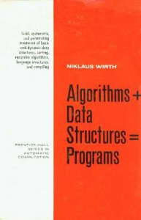
Programming
Wirth, 1976
SPE YPs, 2016
functions +
data types =
programs

Slide 7
Interactive Interlude
Hello VBA & editor configuration

Slide 8
Types
type system: “a tractable syntactic method for proving the absence of certain program behaviors by classifying phrases according to the kinds of values they compute.” (Pierce, 2002)
type system: a set of rules for labeling “things” by the kind of “things” they are, so that you don’t add bananas to a Lamborghini (YPs, 2016)

Slide 9
A Useful Lie
dynamic typing: values have types; variables store values; type-checking happens at execution
Examples: Python, Javascript, Perl, Visual Basic with Variants everywhere and no Option Explicit

Slide 10


Dynamic Typing
>>> x =
>>> y =
>>> x + y
TypeError: unsupported operand type(s) for +: ‘car’ and ‘fruit’

Slide 11
A Useful Lie
static typing: variables/names have types; these types constrain the values assigned; type-checking happens prior to execution
Examples: C, C++, Java, Haskell, FORTRAN, Visual Basic with Option Explicit

Slide 12
Static Typing
#include <iostream>
int main()
{
car x = ;
fruit y = ;
std::cout << x + y << '\n';
}
In function 'int main()':
error: no match for 'operator+' (operand types are 'car' and 'fruit')

Slide 13
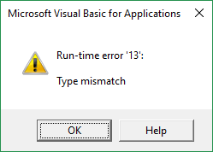
Static Typing
Dim x As Car
Dim y As Fruit
Set x =
Set y =
Debug.Print x + y

Slide 14
VBA: Primitive Types
primitive type: a type that’s not a composite (e.g. array, structure, or object) type, usually built into a language
I’m leaving some out because you should never* use them.
* well, hardly ever

Slide 15
VBA: Primitive Types
Type | What It Is | Example / Literal
Long | a 32-bit integer | 721734
Double | a 64-bit floating point value | -17.56
String | a character string (i.e. text) | "hello world"
Boolean | a true or false value | True
Variant | a "boxed" value of any other type | any of the above

Slide 16
Functions (aka subroutines, procedures, methods, blocks, lambdas...)
function: a subprogram with specified inputs and outputs which may be invoked multiple times from elsewhere in the program
pure function: a function whose outputs depend only on its inputs (i.e. a function with no side effects)
functional decomposition: the fundamental skill of engineering… and of software design

Slide 17
VBA: Functions (& “Subs”)
Option Explicit
Public Sub WriteCell(ByVal cell As Range, ByVal contents As Variant)
cell.Value = contents
End Sub
Public Function Factorial(ByVal x As Long) As Long
If x <= 0 Then
Factorial = 1
Else
Factorial = x * Factorial(x - 1)
End If
End Function

Slide 18
VBA: Functions (& “Subs”)
Public Sub UseFunctions()
Debug.Print "original value: " & ActiveSheet.Range("A1").Value
WriteCell ActiveSheet.Range("A1"), 17
Debug.Print "new contents: " & ActiveSheet.Range("A1").Value
Debug.Print "factorial(5) = " & Factorial(5)
End Sub
original value:
new contents: 17
factorial(5) = 120

Slide 19
VBA: Functions
Use Functions when you need to compute output(s) from input(s), and try to keep them pure functions
[Public|Private] Function Name([ByVal|ByRef] Arg1 [As Type], …) As Type
…
Name = value
End Function
result = Name(arg1, …)

Slide 20
VBA: Sub(routine)s
Use Subs when you need to perform side effects (read a database, write to the spreadsheet…) and delegate computation to functions
[Public|Private] Sub Name([ByVal|ByRef] Arg1 [As Type], …)
…
End Sub
Name arg1, …

Slide 21
VBA: Control Structures
Conditional statements are used to branch, depending on a Boolean condition
If Condition Then
…
[Else If OtherCondition Then]
…
[Else]
…
End If

Slide 22
VBA: Control Structures
Loops are used to iterate a fixed number of times, while a condition holds, or until a condition is met
Dim i As Long
For i = 1 To 10
…
Next i

Slide 23
VBA: Control Structures
Do [While|Until] Condition
…
Loop
Do
…
Loop [While|Until] Condition

Slide 24
Example: Pseudopressure
Pseudopressure: a computed value used to (somewhat) re-linearize the diffusivity equation for compressible fluids (i.e. gas)
http://petrowiki.org/Flow_equations_for_gas_and_multiphase_flow
There’s an integral, which we’re going to compute using the trapezoidal rule
https://en.wikipedia.org/wiki/Trapezoidal_rule

Slide 25

Pseudopressure
In short, we want to calculate:
$$p_{p}(p)=2\int_{p_{0}}^{p}{\frac{p}{μz}dp}$$
We’re going to assume constant $μz$, which is wrong and defeats the entire purpose… but this is a short class. The mathematically astute (or reservoir engineers) among you will notice this is just the pressure-squared approximation.
We’ll come back to this later.

Slide 26
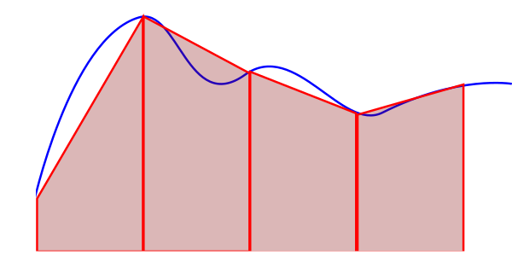




Trapezoidal Rule
$$h_{1}$$
$$h_{2}$$
$$w$$
$$A=w\frac{h_{1}+h_{2}}{2}$$

Slide 27
Interactive Interlude
Pseudo-pressure function & calling functions from Excel

Slide 28
Appendix
(For later reading)

Slide 29
Typographic key
Vocabulary: usually followed by a definition
Program text
Program, compiler, or interpreter output
Corrections

