Slide 1
Programming for Engineers Excel Automation with VBA Session 2: “Composite Materials”
Derrick W. Turk
terminus data science, LLC

Slide 2
Composite Types
composite type: a data type composed of one or more primitive (or composite) types arranged in a specific structure
Most “interesting” types in our programs will be composite types: “array of daily well records”, “dictionary of Double indexed by String”, …

Slide 3
Arrays
array: a composite data type containing multiple elements of the same type arranged sequentially and accessible by an integral index
Dim temperatures(0 To 99) As Double
…
temperatures(17) = 98.6
Debug.Print temperatures(23)

Slide 4
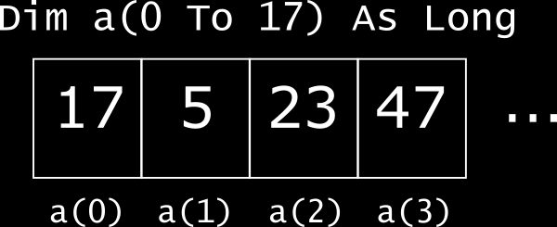
Arrays

Slide 5
Arrays
Arrays provide fast random access…
… but relatively slow insertion and deletion (this is the “computer science” answer; reality is messy)
VBA arrays can be statically allocated (as on last slide) or dynamically allocated (with ReDim or ReDim Preserve)
VBA arrays can be arbitrarily “based”
Dim crazy(-23 To 102) As Boolean

Slide 6
Arrays
I used to suggest using Option Base 0 (or 1 if you insist, but be explicit)… but it turns out not to matter much
Always explicitly indicate lower and upper bounds when allocating arrays
Always use LBound() and UBound() when looping over arrays
Dim squareMe(0 To 10) As Long
…
Dim i as Long
For i = LBound(squareMe) To UBound(squareMe)
squareMe(i) = squareMe(i) ^ 2
Next i

Slide 7
Records (“UDTs”)
record: a composite data type containing one or more named elements of arbitrary types
Records contain multiple data elements that conceptually pertain to the same “entity”
VBA’s record types are called “user-defined types”; they’re almost exactly like C’s structs (and partway to Java’s classes)

Slide 8
Records (“UDTs”)
Public Type Well
API As String
SurfaceX As Double
SurfaceY As Double
ProducingDate() As Date
Volume() As Double
End Type
Dim w As Well
…
w.SurfaceX = -105.4
Debug.Print w.Volume(17)

Slide 9
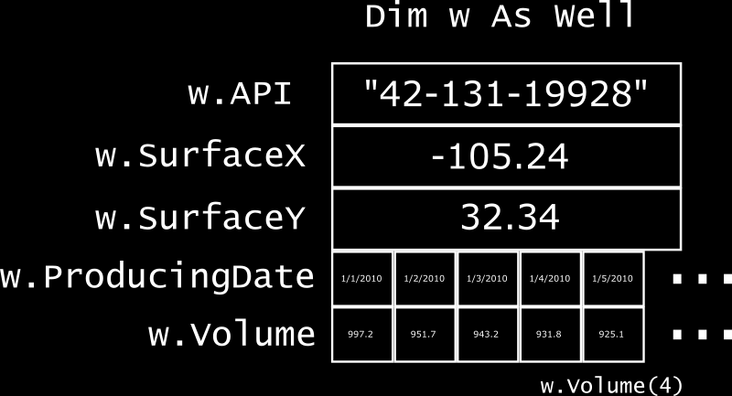
Records (“UDTs”)

Slide 10
Records (“UDTs”)
Use records to bundle up data that’s used simultaneously
They let you give a name to a previously “hidden” concept, making implicit structure and relationships explicit
They’re useful for defining clean interfaces to functions and modules
Consider using arrays of records instead of multiple arrays

Slide 11
Records (“UDTs”)
Dim time() As Date
Dim rate() As Double
Dim pressure() As Double
…
For i = LBound(time) To UBound(time)
logFlowbackRecord time(i), rate(i), pressure(i)
Next i
…
Dim flowback() As FlowbackRecord
…
For i = LBound(flowback) To UBound(flowback)
logFlowbackRecord flowback(i)
someotherFn flowback(i).Rate
Next i

Slide 12
Example: Decline Curve Forecasting
Arps hyperbolic decline: an empirical equation relating production rate to time; commonly used in well forecasting
http://www.fekete.com/SAN/WebHelp/FeketeHarmony/Harmony_WebHelp/Content/HTML_Files/Reference_Material/Analysis_Method_Theory/Traditional_Decline_Theory.htm

Slide 13

Example: Decline Curve Forecasting
Three parameters:
Initial rate $q_{i}$ (bbl/d or mcf/d)
Initial decline $D_{i}$ (nominal / year)*
Hyperbolic exponent $b$ ($b≥0$)
* most software works in terms of effective decline, but nominal keeps the math easy

Slide 14

Arps hyperbolic decline
$$q\left(t\right)=\left\{\begin{aligned}q_{i}e^{−D_{i}t}, b=0 \\ \frac{q_{i}}{1+D_{i}t}, b=1 \\ q_{i}\frac{1}{{(1+bD_{i}t)}^{1/b}}, otherwise\end{aligned}\right.$$
$$N_{p}\left(t\right)= \left\{\begin{aligned}365.25q_{i}t, D_{i}=0 \\ \left\{\begin{aligned}\frac{365.25q_{i}}{D_{i}}\left(1−e^{−D_{i}t}\right), b=0 \\ \frac{365.25q_{i}}{D_{i}}\ln{(1+D_{i}t)}, b=1 \\ \frac{365.25q_{i}}{D_{i}\left(1−b\right)}\left(1 −{\left(1+bD_{i}t\right)}^{1−\left(\frac{1}{b}\right)}\right), otherwise\end{aligned}\right.\end{aligned}\right.$$

Slide 15
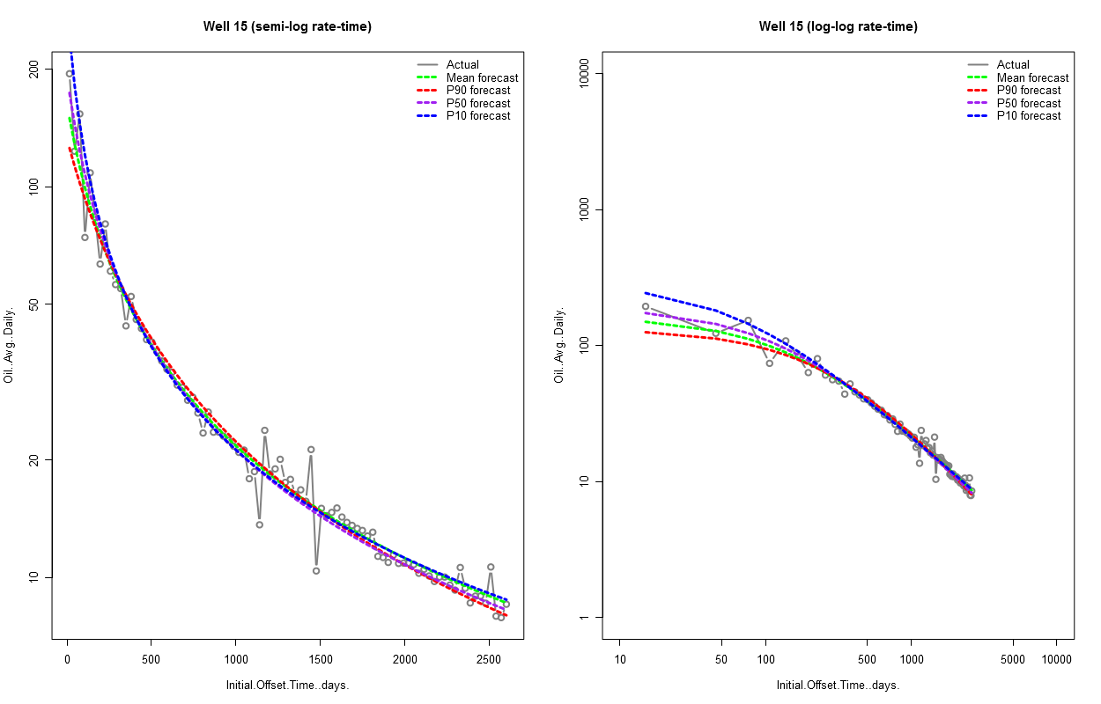
Arps hyperbolic decline

Slide 16
Example: Decline Curve Forecasting
We receive a spreadsheet containing well names and hyperbolic decline parameters…
… and we want to generate an Excel workbook containing monthly production forecasts for each well

Slide 17
Interactive Interlude
Decline curve forecasting I

Slide 18
Argument Passing Modes
pass by value: the callee receives a “new copy” of the argument; any changes* made to the argument in the callee are not reflected in the caller (ByVal)
pass by reference: the callee receives a reference to the argument; changes made to the argument in the callee are reflected in the caller (ByRef)
* I’m lying; wait for it; it’d be more accurate to say that rebinding the argument in the callee does not affect the caller

Slide 19
Argument Passing Modes
Public Function Fn(ByVal x As Long, ByRef y As Long)
x = x - 2
y = x * 3
Fn = y - x
End Function
Public Sub UseFn()
Dim x As Long, y As Long, z As Long
x = 5
y = 7
z = Fn(x, y)
Debug.Print "x =", x, "y = ", y, "z = ", z
End Sub
x = 5 y = 9 z = 6

Slide 20
Objects I: State + Behavior
object₁:
a composite data type,
defined by a class,
containing zero or more elements of primitive or composite type,
potentially limited in visibility outside the class,
and with behavior specified in zero or more methods

Slide 21
Objects I: State + Behavior
object₁: a bundle of stuff that knows how to do things to or with its own stuff, such that its users can worry about the things and not the stuff.
This view is about encapsulation and data abstraction: users of the object don’t need to worry about what data it contains, only what it can do.
This keeps interfaces clean and simple.

Slide 22
Objects I: Classes
class: a specification of an object type; that is, a definition of the state and behavior shared by all objects of a given type
Under the object₁ definition, you can think of a class as a record type + some associated functions

Slide 23
VBA: Class Modules
' in class module HyperbolicDecline
Public qi As Double
Public Di As Double
Public b As Double
…
Public Function Rate(ByVal t As Double) As Double
…
Rate = qi * …
End Function

Slide 24
VBA: Using Objects
' in an ordinary module
Dim decline As HyperbolicDecline
Set decline = New HyperbolicDecline
decline.qi = 500
…
Debug.Print decline.Rate(365.25)

Slide 25
Excel Object Model
The Excel API (application programming interface) is entirely exposed through objects; e.g.
ActiveSheet
is an object of type Worksheet;
ActiveSheet.Cells(1, 1)
is an invocation of the Cells method (member function of an object) on the ActiveSheet object, returning a Range object

Slide 26
To be continued…

Slide 27
Appendix
(For later reading)

Slide 28
Typographic key
Vocabulary: usually followed by a definition
Program text
Program, compiler, or interpreter output
Corrections

