Slide 1
Javascript and Node Tooling (plus more)
Site Technology TOI Fest
Q1 2015 Celebration

Slide 2
Lesson Plan
Brief history and intro
Node, NPM, Bower
Code style guides
Modules and module loaders
ES6
Utility libraries

Slide 3
Lesson Plan
Async flow management
Testing
Task management
Web frameworks
Other stuff (maybe)
…and demos

Slide 4
History of JS
Created in 10 days for Netscape in 1995
Sent to Ecma in 1996 for standardization
ECMA-262 (ECMAScript) in 1997
ES3 in 1999

Slide 5
History of JS
The AJAX revolution Mid-2000s
Ability to build more responsive, real-time UI
Front end Library wars (jQuery won)
Rise of the front end frameworks
SPAs everywhere!

Slide 6
JS: The Language
Dynamically-typed, interpreted
Prototypical inheritance
First class functions
Closures
Concurrency via event loop.

Slide 7
Node
JS platform built on V8
Created by Ryan Dahl (2009)
“Javascript on the server”

Slide 8
NPM
NPM: Node Package Manager
Create custom modules
Publish custom modules
Manage third party dependencies
Ruby’s Bundler for Node

Slide 9
Bower
NPM for the front end

Slide 10
Style Guides: Why?
JS is very dynamic and flexible
Many styles/approaches to solve a problem
Bad style could = problematic code
Async workflow
can be very unreasonable
can be hard to debug

Slide 11
Style Guides: What’s the payoff?
Consistency
Simpler code
Lower mental overhead
Easier onboarding

Slide 12
Style Guides: Yes, Your Tests Too
Your tests need love too!
Style and organization can increase testing benefits
More on this later:
Time to first “it”
Assert closer to action under test

Slide 13
Style Guides: Should be
An important part of code review
Agreed upon and respected
Mainly a means to ensure consistency
Based on good solid reasoning
Designed for readability

Slide 14
ES6
Template strings
Destructuring
Arrow functions
Class syntax

Slide 15
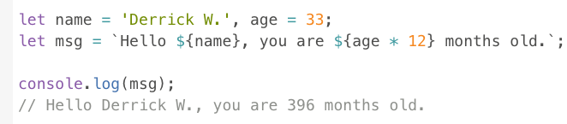
ES6: Template Strings
AKA string interpolation
No more string concatenation (makes me happy!)

Slide 16
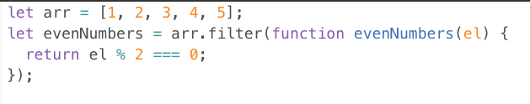

ES6: Arrow Functions
replaced by:

Slide 17
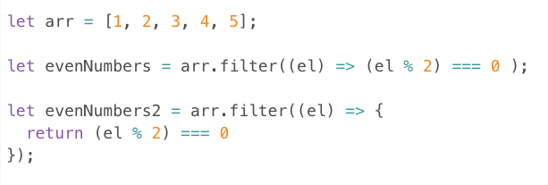
ES6: Arrow Functions
Differences in single vs. multi-line syntax

Slide 18
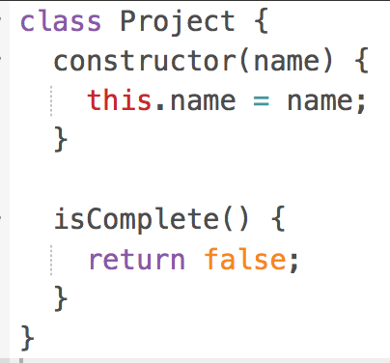
ES6: “class”

Slide 19
Modules
Code organizational
Revealing module
Definition and dependency management
Node
Browser
ES6

Slide 20
Revealing Module Pattern
Coding pattern to:
Encapsulate private state and functionality
Expose an interface to module’s core functionalit

Slide 21
Modules: CommonJS / Node
First module definition syntax for JS
Adopted by Node
Syntaxes for defining single- vs. multi-valued modules
Synchronous module loading
Used in the browser (via Browserify)

Slide 22
Modules: AMD / RequireJS
Asynchronous Module Definition
Require.js (most popular implementation of spec)
Mainly used in the browser
Requires some to a lot of configuration
Allows for JIT loading of modules
r.js for server side optimization

Slide 23
Modules: ES6
First natively-supported module definition pattern
Syntax similar to commonJS
Support for sync and async loading (reference?)

Slide 24
UMD: Universal Module Definition
https://github.com/umdjs/umd

Slide 25
Utility Libraries
Lodash / Underscore
Lazy.js
Bluebird (Promise/A+ implementation)
httpster
ngrok

Slide 26
Utility Libraries
Lodash / Underscore
Lazy.js
Bluebird (Promise/A+ implementation)
httpster
ngrok

Slide 27
Utility Libraries: _
To the internet!

Slide 28
Async Flow Management
Callbacks
Promises
Generators and Async functions

Slide 29
Async Flow Management: Callbacks
Event handling – specify event name and fn to handle it
$(‘#someElem’).on(‘click’, fn);
“Node style” – err as first parameter, results as second
fs.readFile(‘somefile.txt’, function(err, fileContent) {…})
OK when flow is simple
Deeply nested callbacks: bad!
No spec around callbacks other than function signature

Slide 30
Async Flow Management: Promises
Better flow readability
Better error management
A+ spec
Extensive API for async task management
Part of the ES6 language

Slide 31
Testing
Easier to harder
Testing framework (Jasmine)
Mocks / stubs / spies
Test runners
Debugging

Slide 32
Task Management
So many modules
Repeatable processes
Source-controllable
Tooling written in and for JS
Options
Grunt
Gulp
Broccoli
Webpack
etc….

Slide 33
Task Management: Grunt
Management by configuration
Consecutively running tasks
Better fit for non-programmers
Large ecosystem of plugins

Slide 34
Task Management: Gulp
Management with code
Stream-based
Parallel running tasks
Fast and efficient
For programmers

Slide 35
Web Frameworks
Lightweight options
Full(er) stack
Real-time

Slide 36
Web Frameworks: Lightweight
Low-level abstractions on http module
Routing and middleware
http://expressjs.com/
https://github.com/mcavage/node-restify
http://hapijs.com/

Slide 37


Web Frameworks: Full Stack
Routing, view layer, data model, etc.
One framework back to front
Real time out of the box
http://sailsjs.org/
https://www.meteor.com/

Slide 38
Web Frameworks: Real Time
Websockets
Socket.io and express.io
SignalR
http://socket.io/
http://express-io.org/
http://signalr.net/

Slide 39
Scaffolding and Generators
express-init
Yeoman
Demo!

Slide 40
Visual Studio Integration
Node Tools v1
Task Manager

Slide 41
Other things
Front end frameworks
Angular (Dependency Injection)
React (Flux and Virtual DOM)
Famo.us (Render tree and Matrix3D Transforms)

