Slide 1

AI Final Presentation: Minimax Backgammon AI
Patrick D'Errico

Slide 2
Introduction
We've used minimax to solve Connect 4
Minimax can be used to solve most 2 player games
  “Solve” - determine the best move for a player
Added layers of complexity
  Randomness in dice rolls
  Difficulty of determining moves (more options)

Slide 3
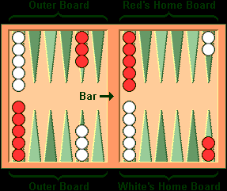
How to Play (1)
15 pieces per player
Roll 2 dice a turn
You can move one piece per roll
Doubles – 2 moves per roll
Once you get all of your pieces home, you can remove them through further rolls to win the game

Slide 4
How to Play (2)
When you roll dice, you can't move pieces on spaces where your opponent has more than one
You can capture opposing individual pieces (blots)
If captured, you must move that piece off or forfeit your turn
If you can only move with one die, you must use the higher one

Slide 5
Implementation
Data structure – board object
  Holds board state (as an int array) and functions manipulating it
StdDraw – draws the board as it is updated
Minimax – main AI function
Command prompt for player to input moves

Slide 6
The CPU's Turn
Given the state of the board, call minimax for the board, and what player the CPU is
Get list of available moves, given a board state through the board's functionality
  Complicated, beyond extent of this presentation
With the linked list, compare the minimax score for each move
  Each calls a chance node to calculate expected values...

Slide 7
Chance Nodes?
Intermediate step between minimax nodes
Calculates, for a given board, the expected value of the position
  Gets the minimax value of each possible position * the chance of each die roll occurring
  That sum is the EV
Mini and max alternate as usual, until depth limit is reached

Slide 8
Finishing up
Once depth limit is exceeded, heuristic is used to get expected value of the board
Is passed (with the new board array) up to chance nodes and so on
The top minimax call extracts the board and updates the position
Player simply enters moves until he/she enters one on the move list on its turn
Repeats until game ends

Slide 9
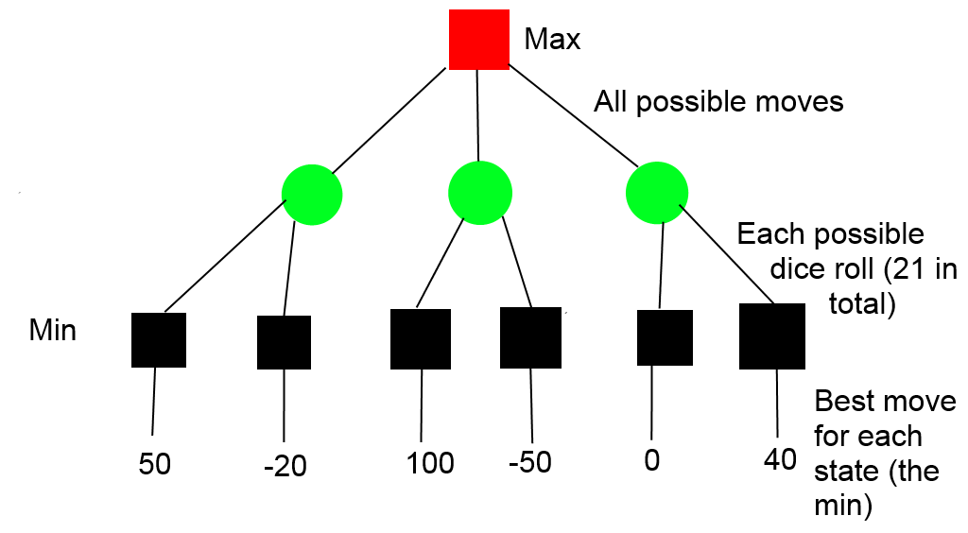
Shortened Tree
Notes: There are many possible options for a move
Tree in runtime runs deeper than this

Slide 10
Results/Analysis
Good move selection, but slow
Doubles have so many move options, so complexity balloons quickly
Array ops are expensive too
Possible future ideas:
  String board states, with string hashing during iteration
  Parallelism (MATLAB again?!)
  Another faster language

Slide 11
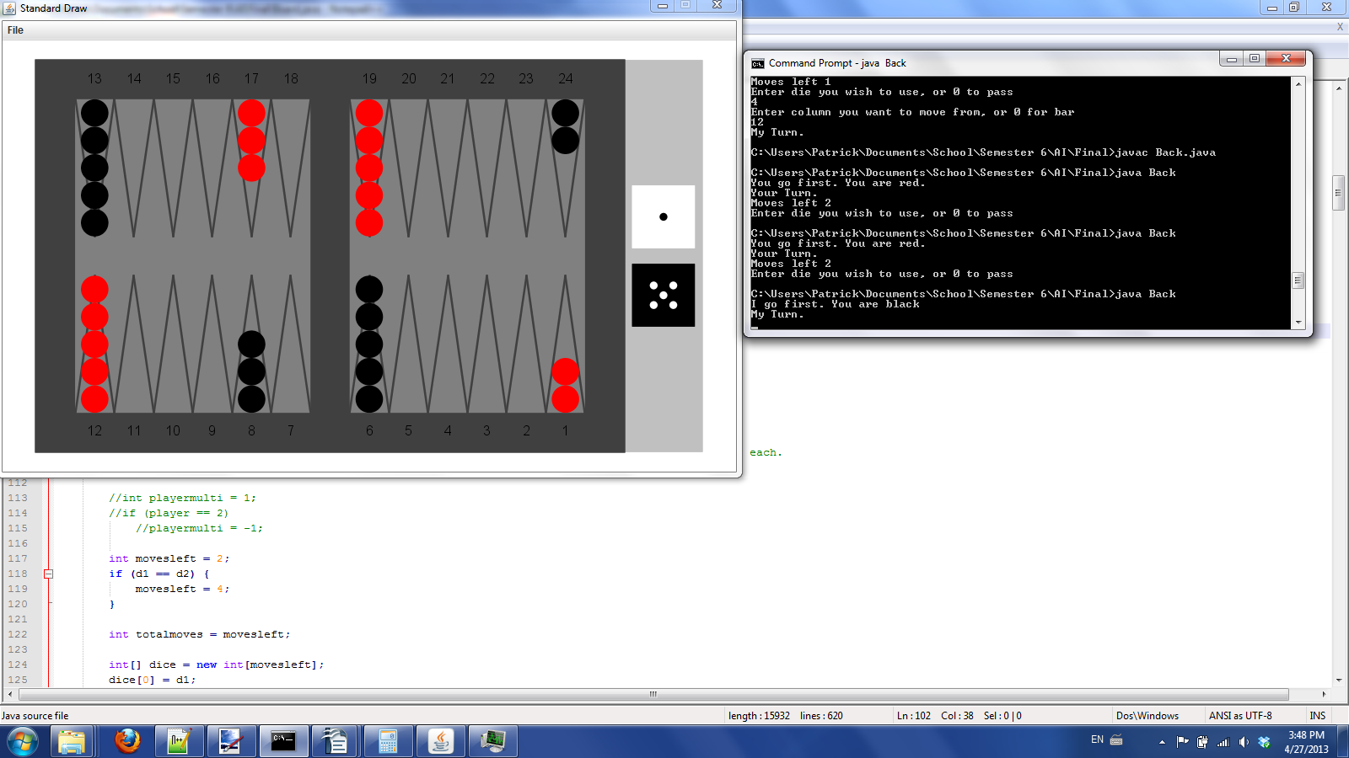

Slide 12
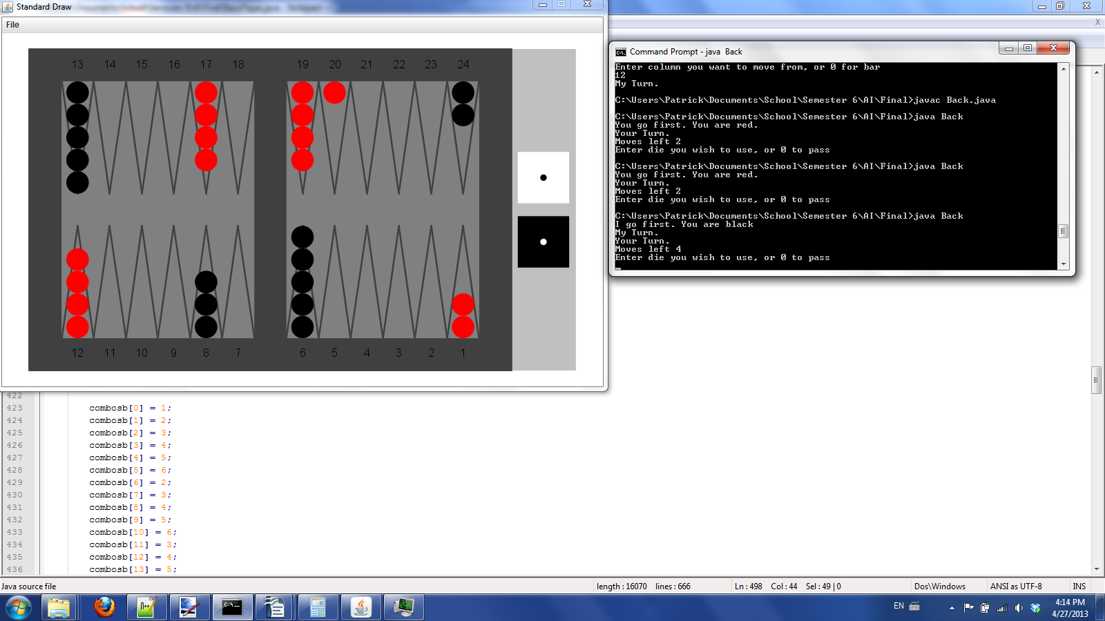

Slide 13
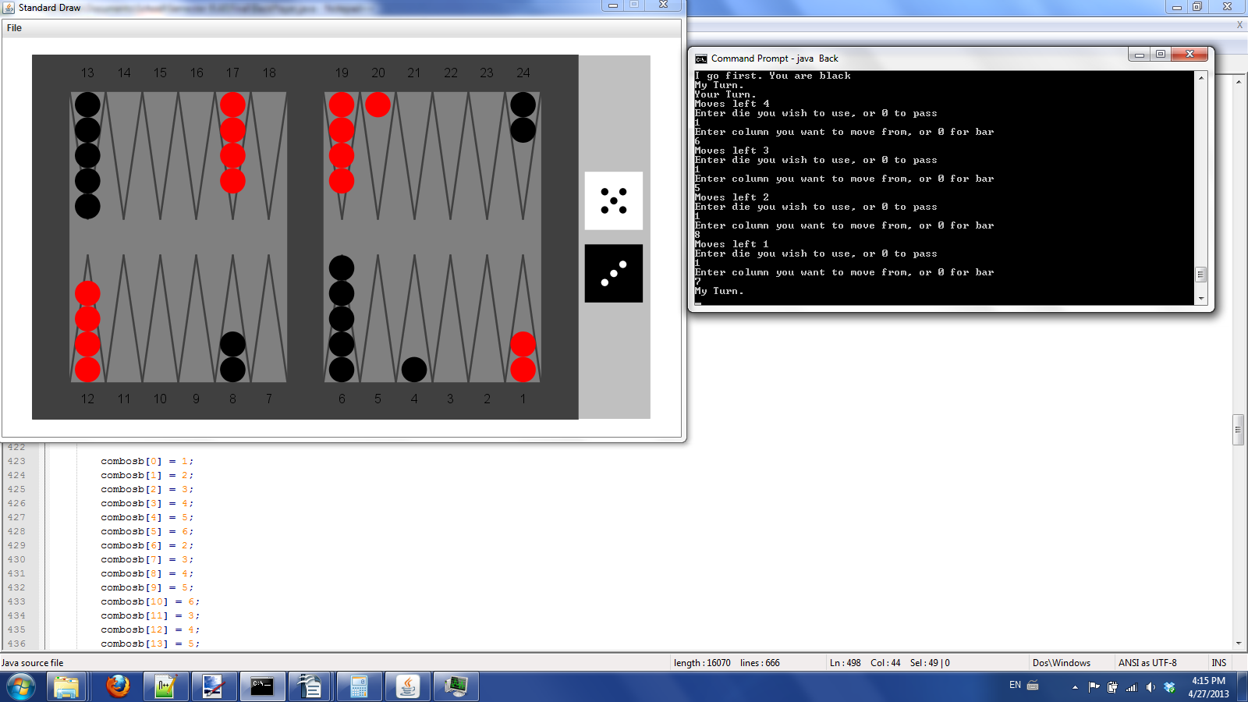

Slide 14
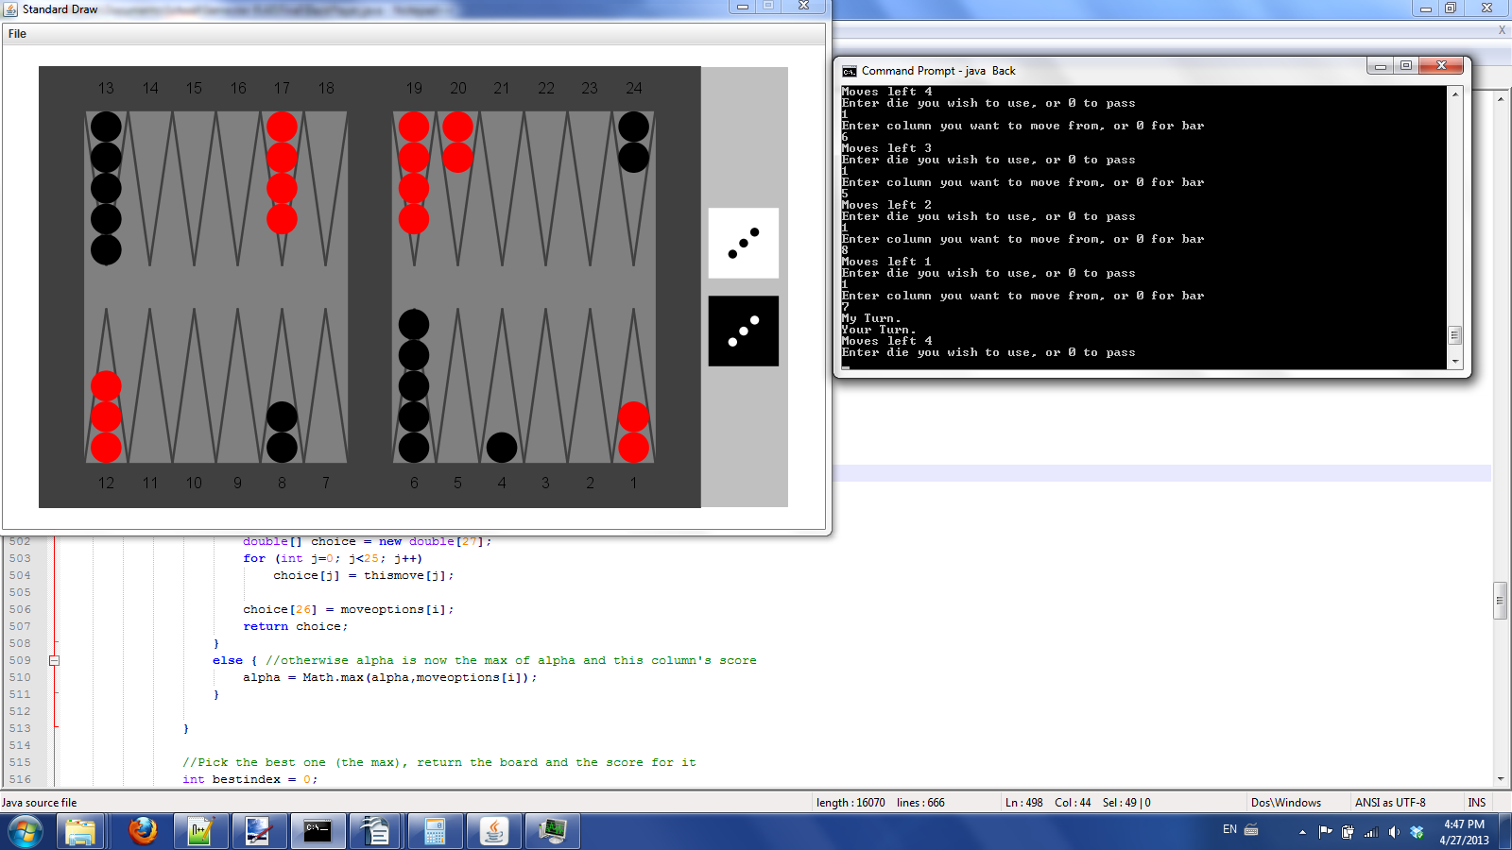

Slide 15
