Slide 1
Code output
MUWULYA DERRICK 2023-B072-31713

Slide 2
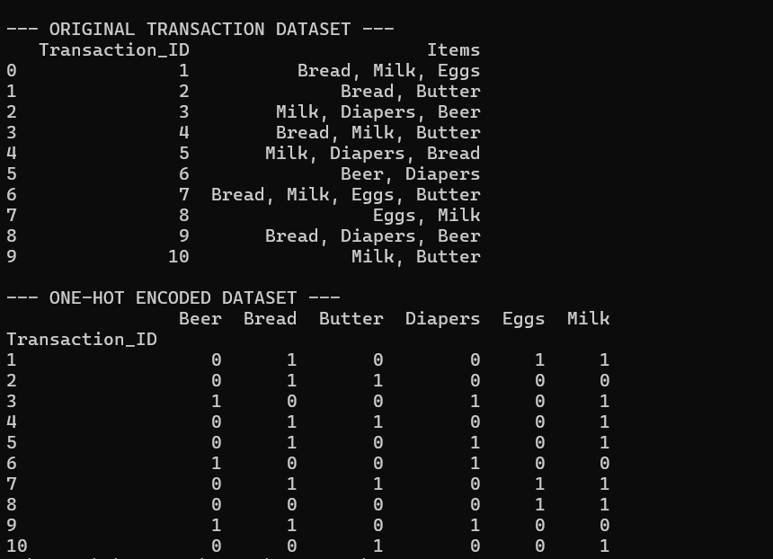
PART A DATASET AND TRANSACTION

Slide 3
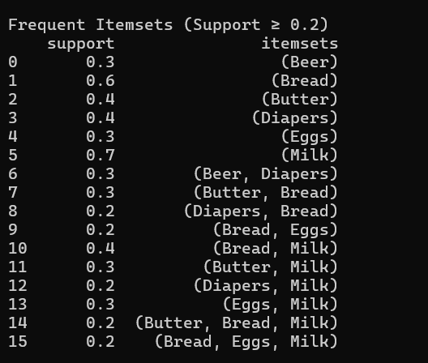
PART B APRIORI ALOGORITHM= FREQUENT ITEMSETS

Slide 4
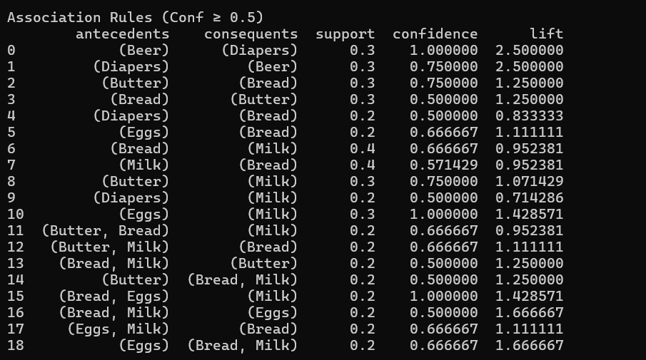
ASSOCIATION RULES

Slide 5
PART C: INTERPRETATION: Strongest Association Rules Based on Lift
{Diapers} → {Beer}
This rule indicates that customers who purchase diapers are highly likely to also purchase beer in the same transaction. The high lift value shows a strong positive relationship between these two items, suggesting that they are frequently bought together more than expected by chance.
{Bread, Milk} → {Butter}
This rule shows that customers who buy bread and milk together have a high probability of also buying butter. This reflects a common household purchasing pattern where complementary food items are bought together.
{Eggs} → {Milk}
This rule suggests that customers purchasing eggs are likely to also purchase milk. The strong association indicates that these are staple items commonly bought together for home consumption, especially for breakfast.

Slide 6
Business Recommendations
Product Placement and Cross-Selling
The supermarket should place strongly associated items such as diapers and beer closer to each other on shelves or promote them together. This can encourage impulse buying and increase the overall basket value.
Bundle Promotions
The supermarket can introduce bundle offers or discounts for related items such as bread, milk, and butter. Bundling these products can increase sales volume and improve customer convenience.

