Slide 1
Introduction to R Markdown and Git Hub Workflows
Renan Saraiva & James Clay

Slide 2
Today’s Session
Slides and materials are available to download at: https://osf.io/aqsm5/
We will cover:
How to install R and R Studio.
The basics of R.
The benefits of using R Markdown versus typical R scripts for analysis.
How to effectively back up your work via Git Hub.
This session will NOT:
Be a comprehensive guide for how to do every type of analysis in R (this would be impossible in one session). HOWEVER, once you have the basics down, R becomes relatively easy to use.

Slide 3
Software set up
On a personally owned machine:
Download and install the latest version of the R language from https://www.r-project.org/
Download and install the latest version of R Studio from https://rstudio.com/
Download and install the latest version of Git Hub Desktop from:https://desktop.github.com/
Create a Git Hub account and log in.
On a university owned machine:
Open AppsAnywhere in a web browser by navigating to https://appsanywhere.port.ac.uk/
Log in with your university credentials.
On the top right, use the “Search Apps” box to search for R Studio.
Press the green “Launch” button.
Repeat this process but this time search for “Git Hub Desktop”.
Create a Git Hub account and log in.

Slide 4
Basics of R
Before we start, who has used R before?

Slide 5
Basics of R
R is a programming language which was originally created by Ross Ihaka and Robert Gentleman at the University of Auckland, New Zealand.
Version 1 (v1.0) was released in Febuary 2000
Since then, it has become a popular choice for data analysis in both academia and industry.

Slide 6
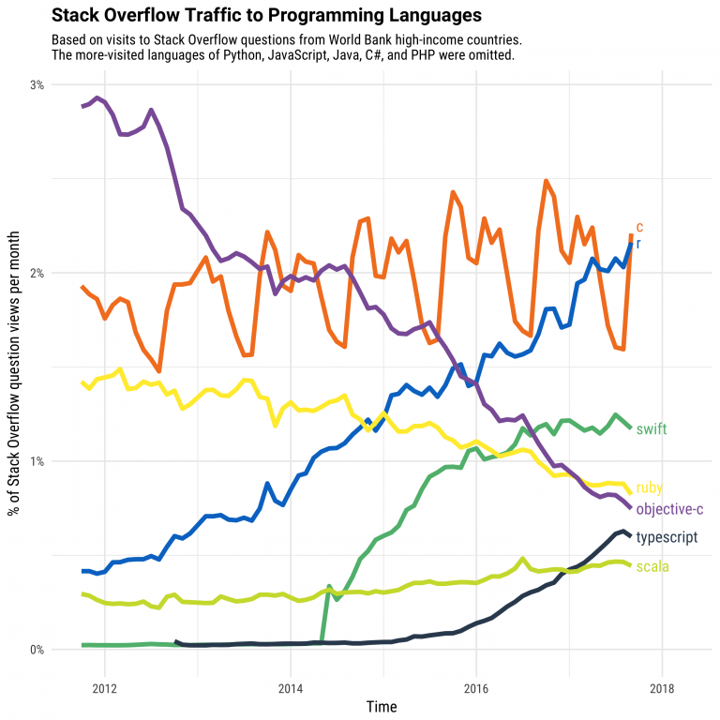
The Growth of R

Slide 7
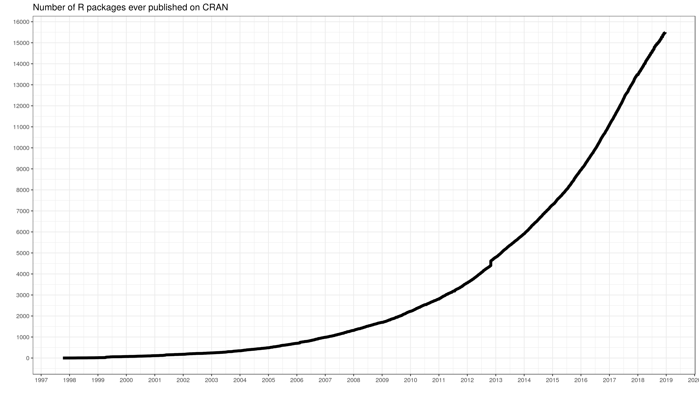
The Growth of R

Slide 8
Benifits of R
R is Open Source. This enables rapid development and facilitates transparency.
R is Free. Benefiting you and your institution.
R is Cross-platform. Working on both Windows, Mac, and Linux.
R is Scalable. Allowing for analysis of big data.
R is Fast. You no longer have to endure the slow start up time of SPSS.
R is Versatile. It can be used for data analysis, the creation of documents, websites, and presentations.

Slide 9
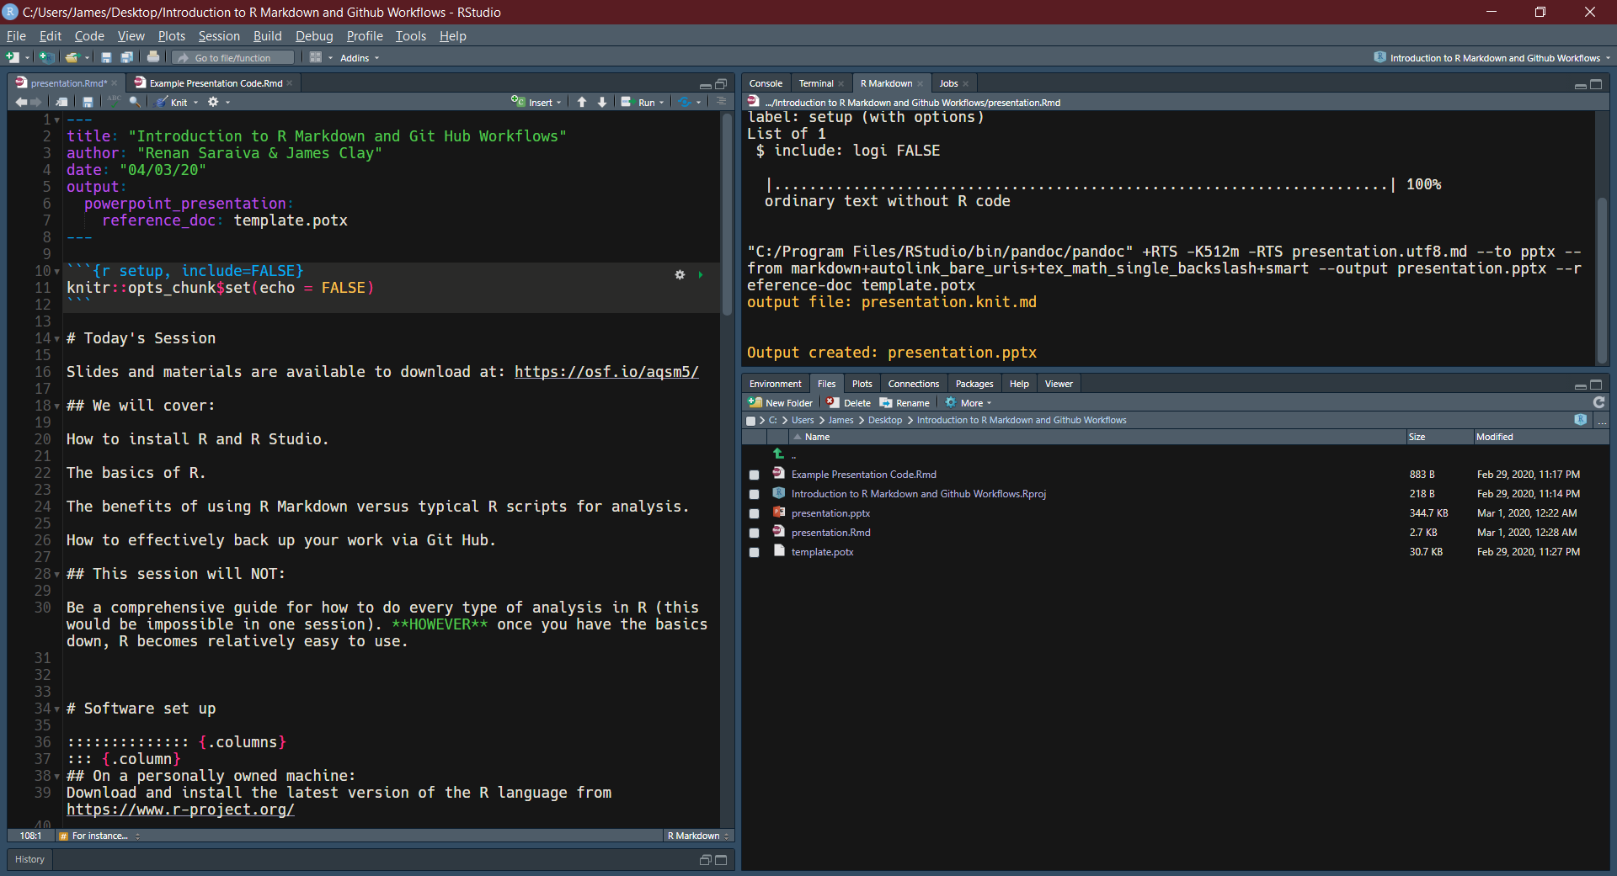
For instance…

Slide 10
CRAN
As anyone can create an R package (more on this later), some people (rightly) worry that any analysis carried out in R could contain errors, and therefore opt to stick to “their tried and trusted” proprietary software.
Thankfully, The Comprehensive R Archive Network (CRAN) exists as a regulatory body for R packages (similar to the academic peer review system).
Nevertheless, like the peer review system, some unrelable work can “slip through the net”. Therefore, we recommend using popular and highly trusted packages wherever possible.

Slide 11
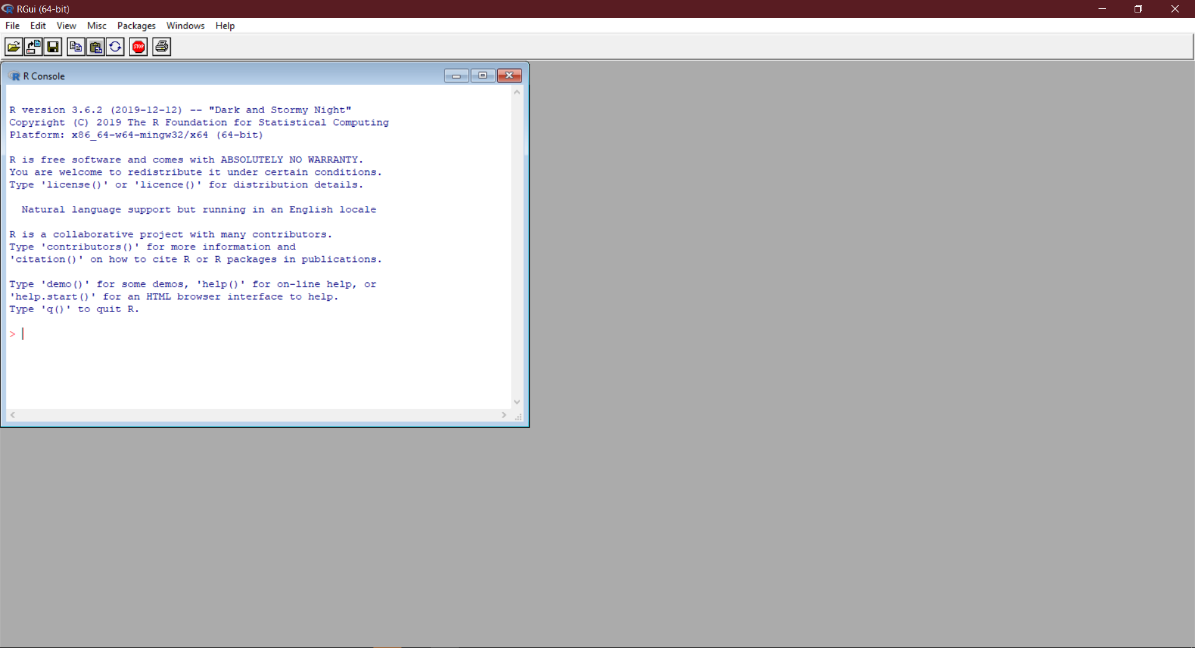
Base R

Slide 12
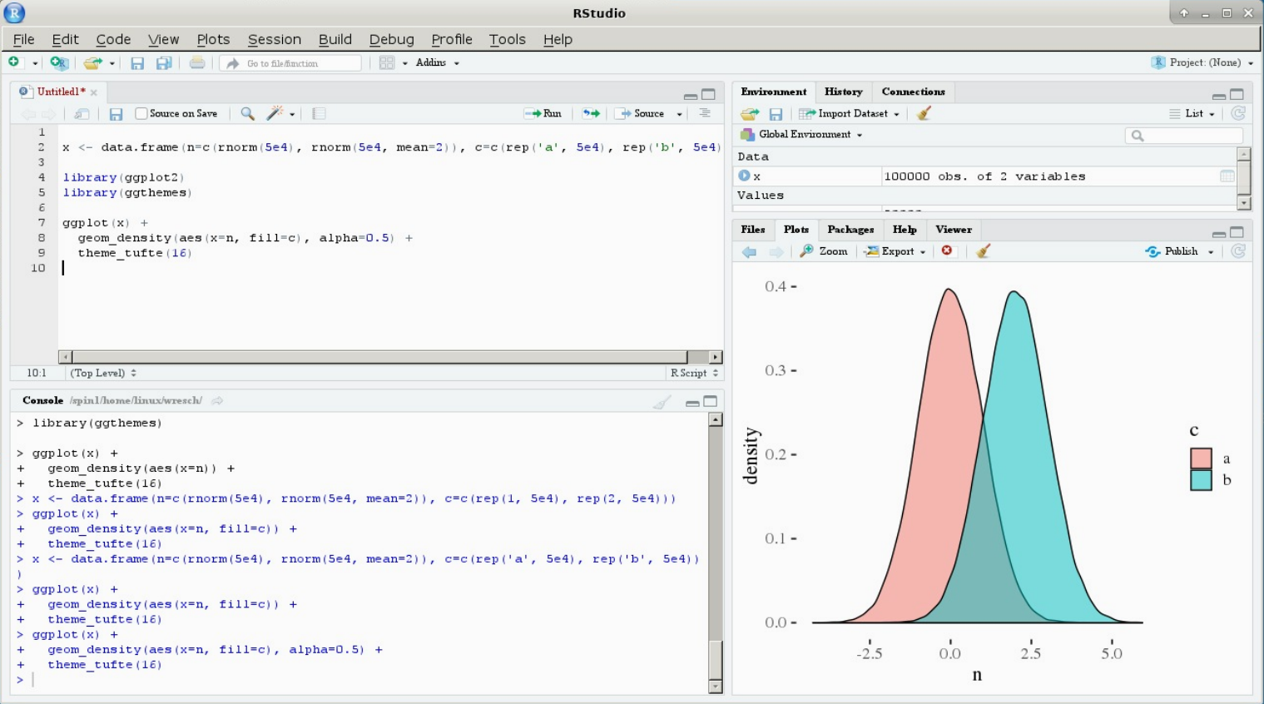
R Studio

Slide 13
How to use R
The following slides about the basics of R are based upon the tutorial provided by Dr Sam Robson (Pharmacy and Biomedical Sciences, University of Portsmouth).
Sam’s original work can be found here: https://uopbioinformatics.github.io/resource/rtutorial/

Slide 14
The R Console
The command line is shown by the > character. Simply type your command here and press return to see the results. If your command is not complete, then the command line character will change to a + to indicate that more input is required, for instance a missing parenthesis:
print ("Hello World!"
## Error: <text>:2:0: unexpected end of input ## 1: print ("Hello World!" ## ^

Slide 15
Variables
R stores “variables” using names made up of characters and numbers. A variable, as the name suggests, is a data “object” that can take any value that you want, and can be changed.
The variable name can be anything that you like, although it must begin with a character.
Whilst it is perfectly acceptable to use simple variable names such as x, y, i, we recommend using a more descriptive name (e.g. participant_height instead of x).

Slide 16
Variables
To assign a value to the variable, use the <- command (less-than symbol followed by minus symbol). You can also use the = symbol, but this has other uses (for instance using == to test for equality) so it is better to use the <- command:
x <- 3 x # Returns the value stored in 'x' - currently 3
## [1] 3
x <- 5 x # Returns the value stored in 'x' - now 5
## [1] 5

Slide 17
Simple Arithmetic
Simple arithmetic can be performed using the standard arithmetic operators (+, -, *, /), as well as the exponent operator (^). There is a level of precedence to these functions – the exponent will be calculated first, followed by multiplication and division, followed by plus and minus. For this reason, you must be careful that your arithmetic is doing what you expect it to do. You can get around this by encapsulating subsets of the sum in parentheses, which will be calculated from the inside out:
1+2*3
## [1] 7
(1 + 2) * 3
## [1] 9
1 + (2 * 3)
## [1] 7

Slide 18
Simple Arithmetic
You can also use other variables in these assignments:
x <- 1 y <- x y
## [1] 1
z <- x + y z
## [1] 2

Slide 19
Data Classes
Variables can take many forms, or “classes”. The most common are “numeric” (which you can do numerical calculations on), character (can contain letters, numbers, symbols etc., but cannot run numerical calculations), and logical (TRUE or FALSE). The speech marks character " is used to show that the class of y is “character”. You can also use the apostrophe '. There is a difference between these, but for now this is not important. You can check the class of a variable by using the class() function:
x <- 12345 class(x)
## [1] "numeric"
y <- "12345" class(y)
## [1] "character"

Slide 20
Data Classes
Addition is a well-defined operation on numerical objects, but is not defined on character class objects. Attempting to use a function which has not been defined for the object in question will throw an error:
x <- "12345" x+1 ## Error in x + 1: non-numeric argument to binary operator
You can also change the class of a variable by assigning to the class() function:
class(x) <- "numeric" class(x)
## [1] "numeric"
x+1
## [1] 12346

Slide 21
Data Classes
The other important data class is “logical”, which is simply a binary TRUE or FALSE value. There are certain operators that are used to compare two variables. The obvious ones are “is less than” (<), “is greater than” (>), “is equal to”" (==). You can also combine these to see “is less than or equal to” (<=) or “is greater than or equal to” (>=). If the statement is true, then it will return the output “TRUE”. Otherwise it will return “FALSE”:
x <- 2 y <- 3 x <= y
## [1] TRUE
x >= y
## [1] FALSE

Slide 22
Data Classes
You can also combine these logical tests to ask complex questions by using the “AND” (&&) or the “OR” (||) operators. You can also negate the output of a logical test by using the “NOT” (!) operator. This lets you test for very specific events in your data. Again, we recommend using parentheses to break up your tests to ensure that the tests occur in the order which you expect:
x <- 3 y <- 7 z <- 6 (x <= 3 && y >= 8) && z == 6
## [1] FALSE
(x <= 3 && y >= 8) || z == 6
## [1] TRUE

Slide 23
Vectors
Single values are all well and good, but R has a number of ways to store multiple values in a single data structure. The simplest one of these is as a “vector” – simply a list of values of the same class. You create a vector by using the c() (concatenate) function:
my_vector <- c(1,2,3,4,5) my_vector
## [1] 1 2 3 4 5

Slide 24
Vectors
This is a very useful way of storing linked data together. You can access the individual elements of the vector by using square brackets ([]) to take a subset of the data. The elements in the vector are numbered from 1 upwards, so to take the first and last values we do the following:
my_vector[5]
## [1] 5
my_vector[6]
## [1] NA
As you can see, a value NA (Not Applicable) is returned if you try to take an element that does not exist.

Slide 25
Vectors
The subset can be as long as you like, as long as it’s not longer than the full set:
my_vector[1:4]
## [1] 1 2 3 4
Here, the : in the brackets simply means to take all of the numbers from 1 through to 4, so this returns the first 4 elements of the vector. For instance, this is a simple way to take the numbers from 1 to 20:
1:20
## [1] 1 2 3 4 5 6 7 8 9 10 11 12 13 14 15 16 17 18 19 20

Slide 26
Vectors
To drop elements from an array, you use the minus symbol:
my_vector
## [1] 1 2 3 4 5
my_vector[-1]
## [1] 2 3 4 5
my_vector[-c(1,3,5)]
## [1] 2 4

Slide 27
Vectors
You can give names to the values in a vector or in a list by using the names() function to make it easier to follow what the values are:
my_vector <- c(1:5) names(my_vector) <- c("length", "width", "height", "weight", "age")
You can use these names instead of the reference number to subset lists and vectors:
my_vector["age"]
## age ## 5

Slide 28
Vectors
The number of values in a vector or list can be found by using the length() function:
my_vector <- 1:5 length(my_vector)
## [1] 5

Slide 29
Vectors
We can also sort the data simply using the sort() function. If we want to get the indeces of the sorted vector (for instance to order a second vector based on the values in the first), we can use the order() function:
## Some values and their corresponding names my_vals <- c( 0.2, 1.7, 0.5, 3.4, 2.7 ) my_names <- c("val1", "val2", "val3", "val4", "val5")
my_sorted <- sort(my_vals) ## Returns the values in sorted order my_sorted
## [1] 0.2 0.5 1.7 2.7 3.4
my_order <- order(my_vals) ## Returns the indeces of the sorted values my_order
## [1] 1 3 2 5 4

Slide 30
Lists
Another data structure that is very useful is the “list”. A list contains a number of things in a similar way to the vector, but the things that it contains can all be completely different classes. They can even be vectors and other lists (a list of lists).

Slide 31
Lists
For example:
my_list <- list(12345, "12345", c(1,2,3,4,5)) my_list
## [[1]] ## [1] 12345 ## ## [[2]] ## [1] "12345" ## ## [[3]] ## [1] 1 2 3 4 5

Slide 32
Lists
To subset a list, the syntax is slightly different and you use double square brackets:
my_list[[3]]
## [1] 1 2 3 4 5

Slide 33
Lists
If your list contains lists or vectors, you can subset these as well by using multiple sets of square brackets:
my_list <- list(12345, "12345", c(1,2,3,4,5)) my_list[[3]][5]
## [1] 5

Slide 34
Functions
R also uses functions (also known as methods, subroutines, and procedures) which simply take in one or more values, do something to them, and return a result.

Slide 35
Functions
A simple example is the sum() function, which takes in two or more values in the form of a vector, and returns the sum of all of the values:
my_vector <- 1:5 my_vector
## [1] 1 2 3 4 5
sum(my_vector)
## [1] 15

Slide 36
Functions
Sometimes functions take more than one variable (also known as “arguments”). These are named values that must be specified for the function to run. For example, the cor() function returns the correlation between two vectors. This requires several variables to be supplied – two vectors, xand y, of equal length – and you can also supply a number of additional arguments to control how the function works, including the method argument, which lets you specify which method to use to calculate the correlation:
sample1 <- c(0.9, 1.2, 8.9, -0.3, 6.4) sample2 <- c(0.6, 1.3, 9.0, -0.5, 6.2) cor(sample1, sample2 , method = "pearson")
## [1] 0.9991263
cor(sample1, sample2 , method = "spearman")
## [1] 1

Slide 37
Functions
Note that we gave a name to the third argument (“method”), but not the first two. If you do not name arguments, they will be taken and assigned to the arguments in the order in which they are input. The first two arguments required by the function are x and y – the two vectors to compare. So there is no problem with not naming these (although you could, if you wanted to, say x=sample1, y=sample2). Any arguments not submitted will use their default value. For instance, the Pearson correlation is the default for method, so you could get this by simply typing:
cor(sample1, sample2)
## [1] 0.9991263

Slide 38
Functions
However, there is another argument for cor(), use, for which we are happy to use the default value before we get to method. We therefore need to name method to make sure that “pearson”" is not assigned to the use argument in the function. It is always safer to name the arguments if you are unsure of the order. You can check the arguments using the args() function:
args(cor)
## function (x, y = NULL, use = "everything", method = c("pearson", ## "kendall", "spearman")) ## NULL

Slide 39
Functions
If you want to find out what a function does, there is a lot of very helpful documentation available in R. To see the documentation for a specific function, use the help() function. If you want to try and find a function, you can search using a keyword by using the help.search() function:
help(cor) ?cor # Alternative for help() help.search("correlation") ??correlation # Alternative for help.search()

Slide 40
Installing Packages
Base R contains a large number of commonly used functions. There are also additional functions available in other “packages” that you can get hold of from the Comprehensive R Archive Network. To install a package, use the install.packages(). Note that the name of the package must be contained with speech marks (").
# example install.packages("tidyverse")
Once a package is downloaded, you need to make it avalible to your current R session by using the library() function:
library(tidyverse)
Note how the libary function does not require speech marks (yes, R can be strange).

Slide 41
Data Frames
Data frames are the most powerful data types in R. They look similar to matrices, but the data structure is actually more similar to a list of vectors (all of the same length). The simplest way to think of them is as being similar to spreadsheets in Excel.
You can create data frames either in a similar way to how you create a list, or also by converting a matrix object:
data.frame(c(1:3), c(4:6), c(7:9), c(10:12))
## c.1.3. c.4.6. c.7.9. c.10.12. ## 1 1 4 7 10 ## 2 2 5 8 11 ## 3 3 6 9 12

Slide 42
Data Frames
Notice how, in the second data frame, no column names are specified so R sets the defaults as V1, V2, V3, etc. Whilst data frames do have row names, it is the column names that are the most important. As with lists, these can be changed by using the names() command:
my_df <- as.data.frame(matrix(1:12, nrow = 3, ncol = 4)) names(my_df) <- c("val1", "val2", "val3", "val4") my_df
## val1 val2 val3 val4 ## 1 1 4 7 10 ## 2 2 5 8 11 ## 3 3 6 9 12

Slide 43
Data Frames
You access the elements of a data frame either using single square bracket notation in the same way as for a matrix, or you can access the individual columns using double square bracket notation in the same way as for lists. You can also access the individual columns by using the special $ operator which is specifically used for data frames.

Slide 44
Data Frames
Example 1
sub_df <- my_df[1:2, 3:4] sub_df
## val3 val4 ## 1 7 10 ## 2 8 11

Slide 45
Data Frames
Example 2
val1 <- my_df[[1]] val1
## [1] 1 2 3

Slide 46
Data Frames
Example 3
val2 <- my_df[["val2"]] val2
## [1] 4 5 6

Slide 47
Data Frames
Example 4
val3 <- my_df$val3 val3
## [1] 7 8 9

Slide 48
Data Frames
The beauty of data frames is that the data frame columns can be dealt with as if they were individual variables. For this reason, the column names must be suitable variable names (i.e. alphanumeric and not starting with a number) and must be unique. If you attach a data frame, you can access the columns as if they were variables:
my_df
## val1 val2 val3 val4 ## 1 1 4 7 10 ## 2 2 5 8 11 ## 3 3 6 9 12
my_df$val1 + 1000
## [1] 1001 1002 1003

Slide 49
Reading and Writing Data
R can handle many file types including CSV, Excel, SPSS, JASON etc. The easiest way to read data into R is to use the “Import Dataset” button in R studio.

Slide 50
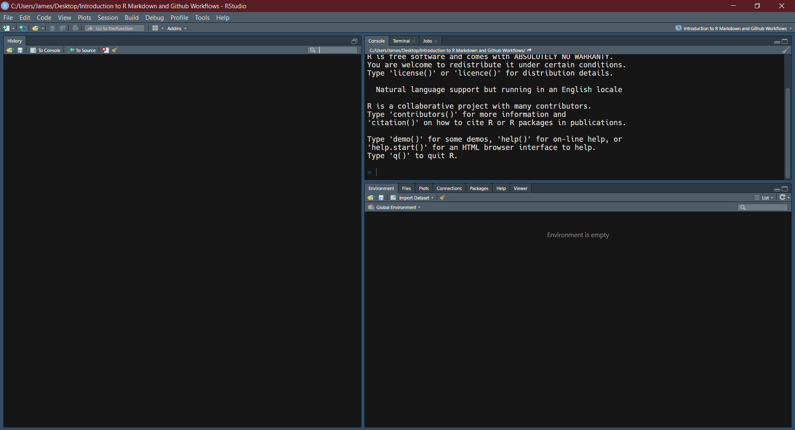
Reading and Writing Data

Slide 51
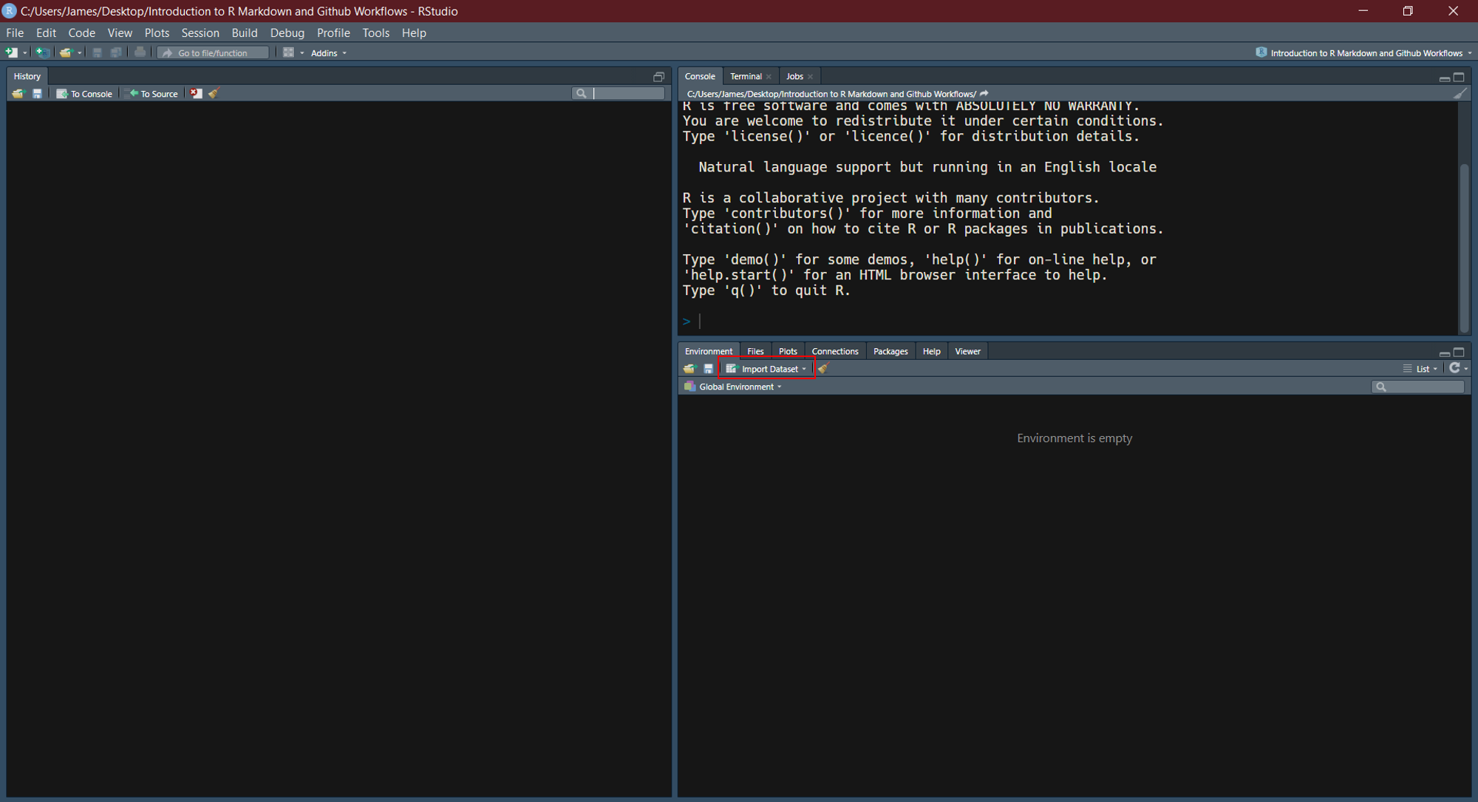
Reading and Writing Data

Slide 52
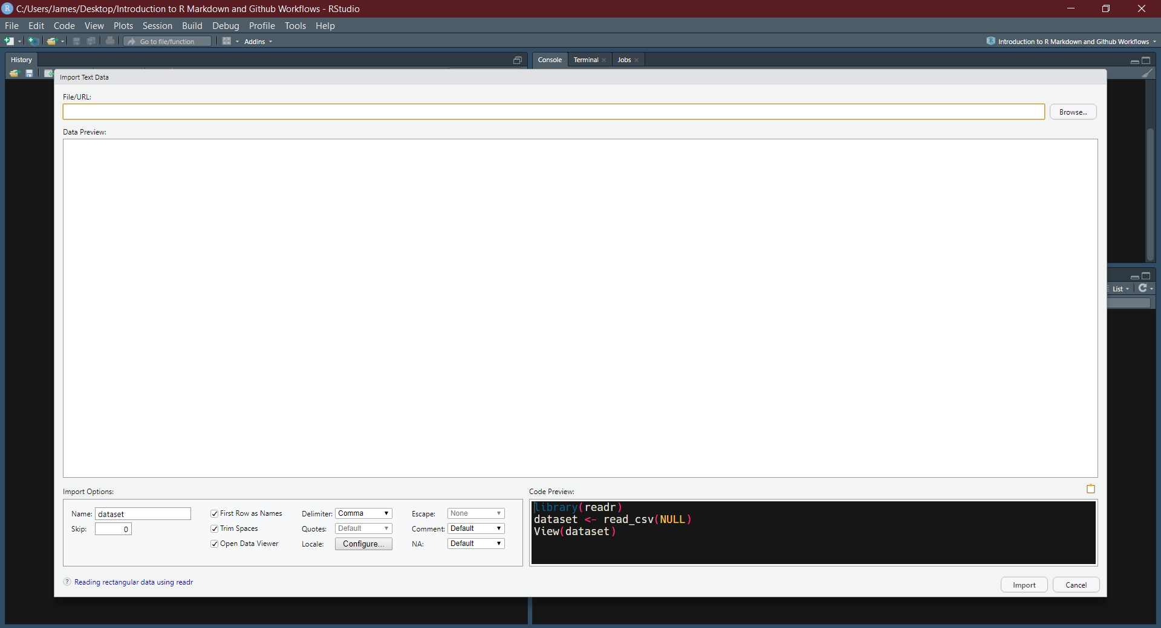
Reading and Writing Data

Slide 53
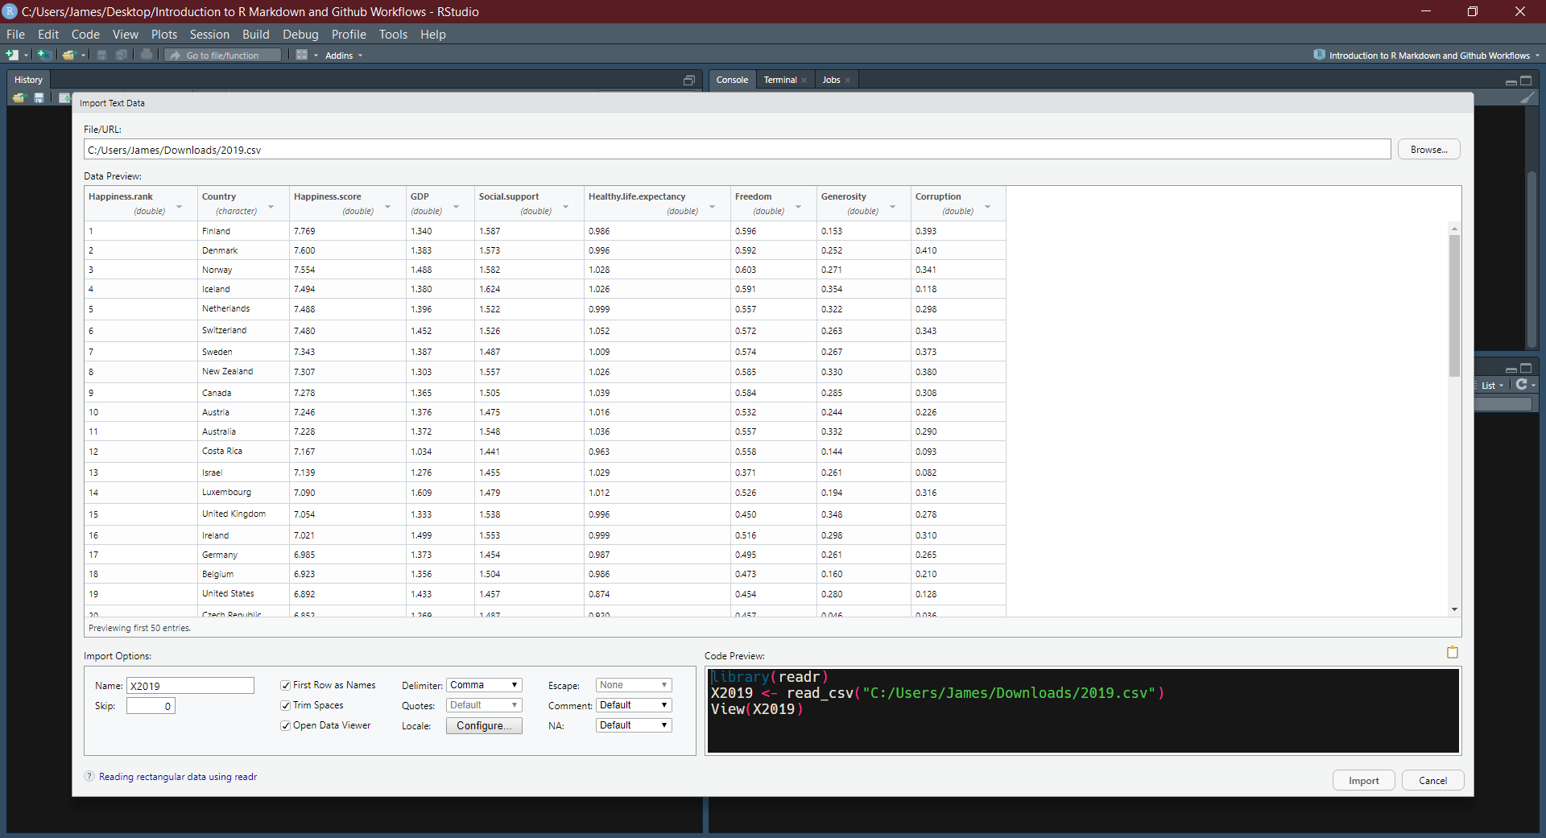
Reading and Writing Data

Slide 54
Reading and Writing Data
The easiest way to write data from R is to use the write.csv() function. The first argument of this function is the object you would like to write to a .csv, followed by what you would like to name the file surrounded by speech marks:
write.csv(mydata, "mydata.csv")

Slide 55
Some Simple Statistics
R is mainly designed for easy computation of statistics and there are many in-built functions and additional libraries that allow you to carry out most tasks. Most simple statistics can be easily calculated using in-built functions.
The following example creates a vector of 100 random values sampled from a normal distribution with mean 0 and standard deviation 1, basic summary statistics are calculated on subsequent slides:
x <- sort(rnorm(100, mean = 0, sd = 1))

Slide 56
Some Simple Statistics
min(x) # Find the minimum value
## [1] -2.736866
max(x) # find the maximum value
## [1] 2.34057
mean(x) # find the mean value
## [1] 0.03762201
median(x) # find the median value
## [1] 0.04633932
sd(x) # find the standard deviation
## [1] 1.091563

Slide 57
Some Simple Statistics
The summary() function will calculate many of these basic statistics for you:
summary(x)
## Min. 1st Qu. Median Mean 3rd Qu. Max. ## -2.73687 -0.68270 0.04634 0.03762 0.83667 2.34057

Slide 58
Some Simple Statistics
Similarly, the describe() function from the psych package give you a detailed overview of the data including values for the skewness and kurtosis:
library(psych) describe(x)
## vars n mean sd median trimmed mad min max range skew kurtosis se ## X1 1 100 0.04 1.09 0.05 0.06 1.12 -2.74 2.34 5.08 -0.2 -0.59 0.11

Slide 59
Some Simple Statistics
A histogram of the values stored in x can be created using the hist() function.
hist(x)

Slide 60
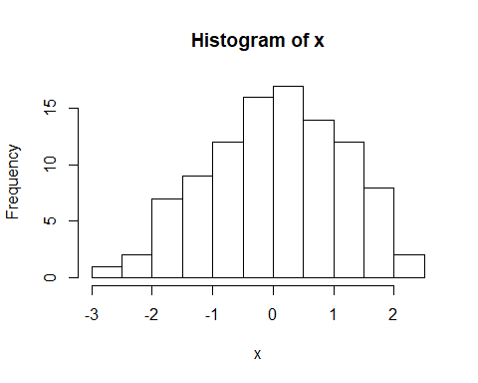

Slide 61
Some Simple Statistics
A boxplot of the values stored in x can be created using the hist() function.
boxplot(x)

Slide 62
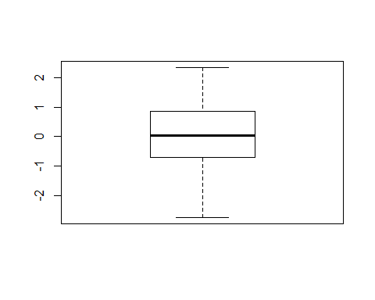

Slide 63
R Scripts Vs R Markdown
R Scripts
Can only contain code.
Organised into sections (CTRL + R).
Canot be compiled.
R Markdown
Can contain code alongside text.
Organised into chunks (CRTL + ALT + I)
Can be compiled into PDF documents, Word documents, Presentations etc.

Slide 64
Over to you…
Go to https://osf.io/mhwqz/ and download the worksheet.
Get into groups containing complete beginners and more experienced R users.
Help each other out.
Ask us.
DON’T BE AFRAID TO USE GOOGLE

Slide 65
Introduction Git
https://git-scm.com/about
Git is an open source command line version control system, primarily used by software creators manage their projects.
You can use it to back up and share your work via tools such as Git Hub, Git Lab, and Bitbucket.
We have chosed to use Git Hub due to the easy to use (and available on AppsAnywhere) Git Hub Desktop.

Slide 66
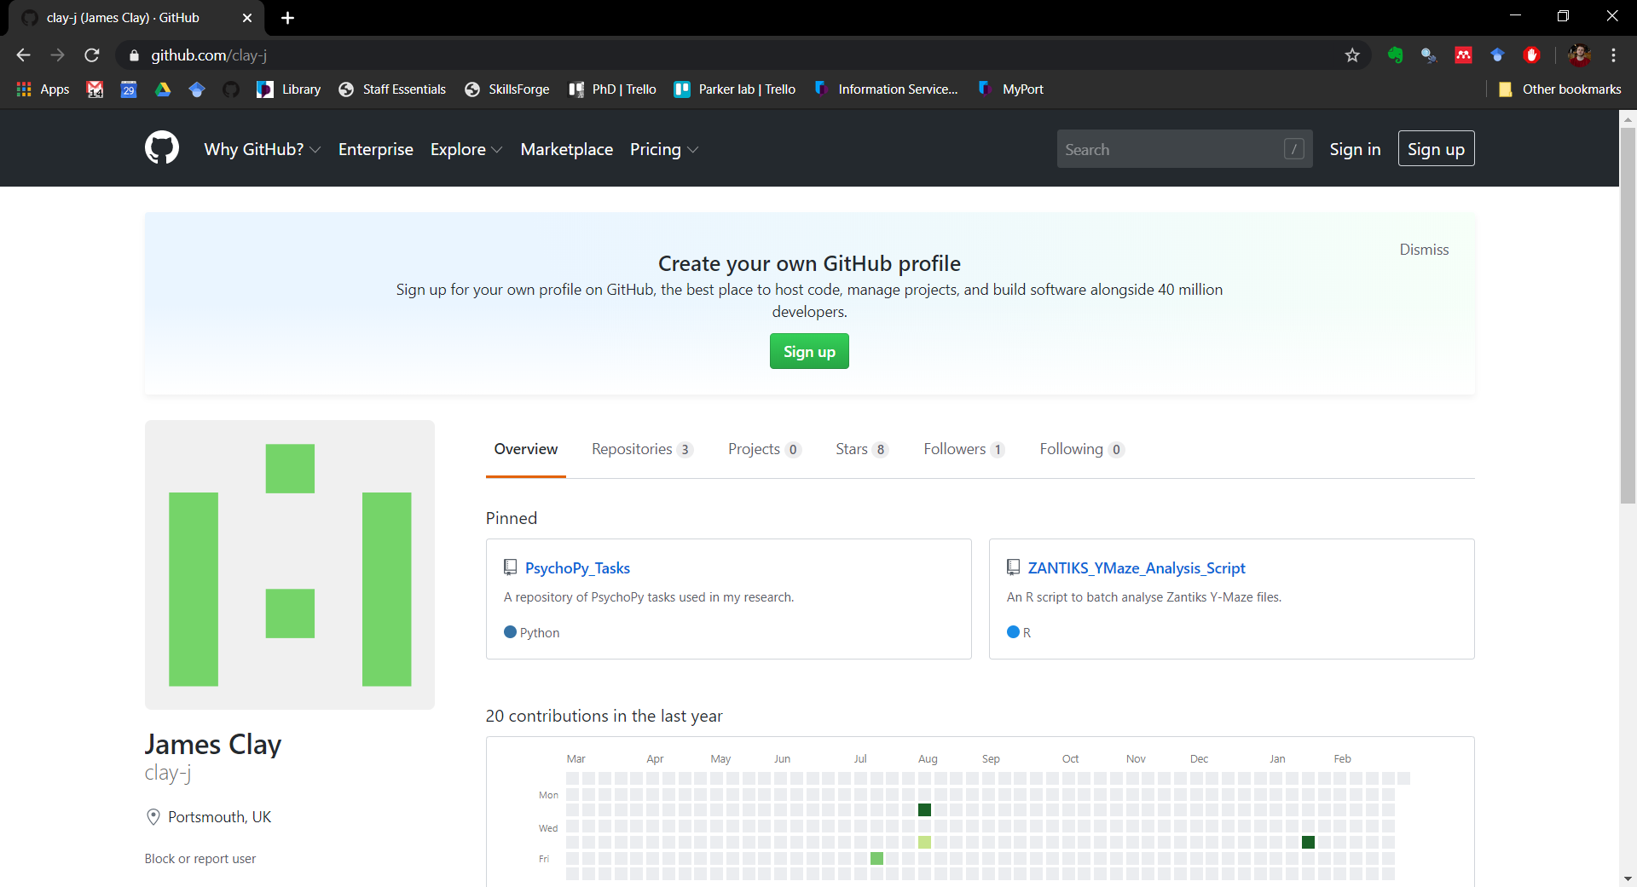
Introduction to Git Hub

Slide 67
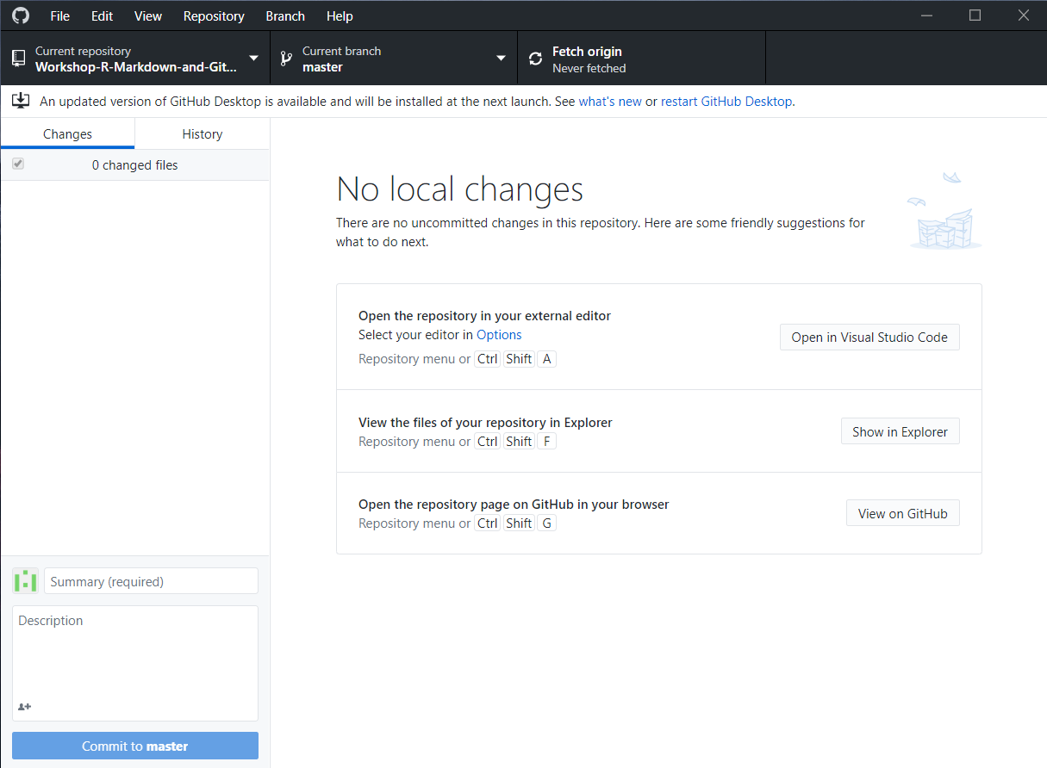
Git Hub Desktop

Slide 68
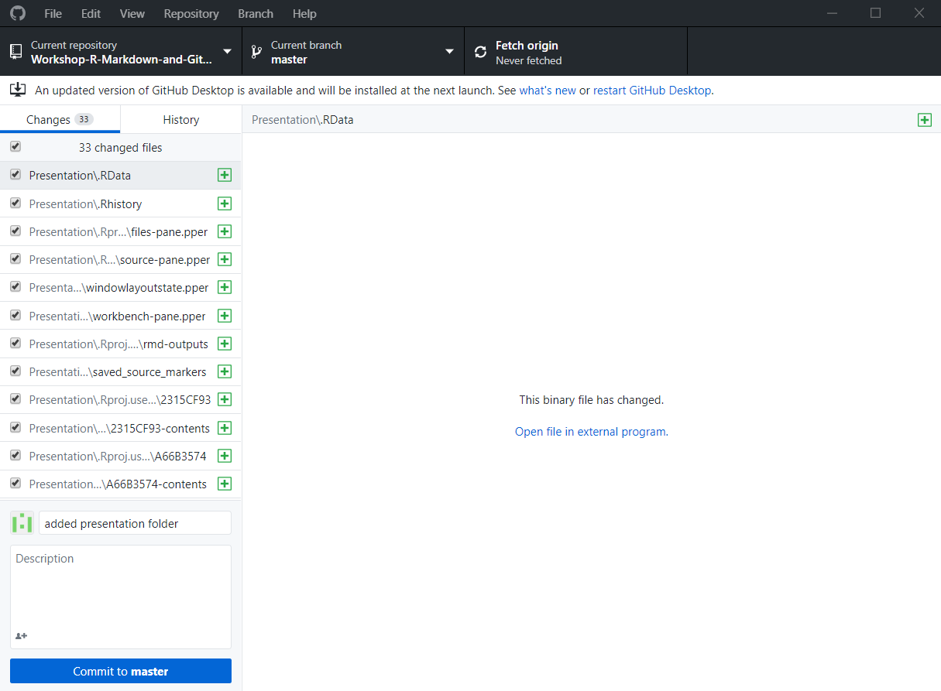
Git Hub Desktop

Slide 69
Thanks
Renan Saraiva (renan.saraiva@port.ac.uk)
James Clay (james.clay@port.ac.uk)

