Slide 1
A Random Walk on the Red Carpet:
Rating Movies with User Reviews and PageRank
Derry Tanti Wijaya
Stéphane Bressan

Slide 2

Semantic Orientation
Reviews contain adjectives that express opinions about items [1,2,3]
An adjective expresses a positive or negative opinion we refer to as its semantic orientation
expensive
fancy
useless
infer
cool
flashy
Semantic orientation of adjectives
Semantic orientation of item

Slide 3
Semantic Orientation
Some adjectives have universal semantic orientation: e.g. good, excellent, poor, etc
Other adjectives have semantic orientation that is dependent on context:
  On genre:
  “The movie is so funny I had a good laugh”
  “The villain looks a bit funny it was weird”
  On collocation and pivot words:
  “The camera is small it is convenient for traveling”
  “The camera is small it is difficult to operate”
  “The camera is small but it is smart”

Slide 4
Collocations
Collocations in sentences reinforce or amend the semantic orientations expressed
Semantic orientations of known adjectives can be used to infer semantic orientations of unknown adjectives
collocations
Known adjectives
Unknown adjectives

Slide 5
Random Walk
good
weird
poor
surprising
boring
Random walk on graphs can be used
to propagate semantic orientations
funny

Slide 6
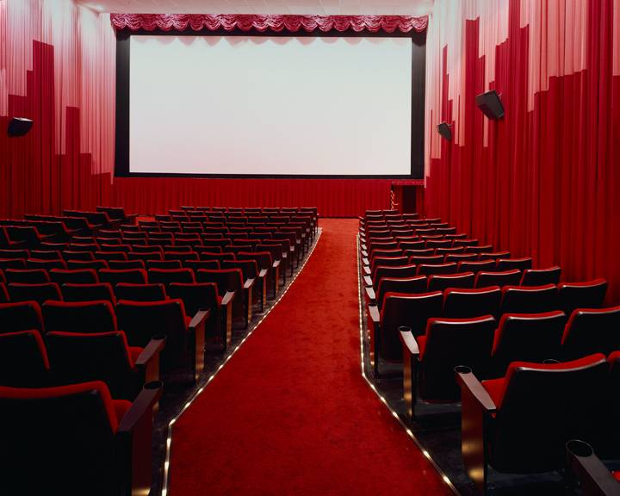
Proposed Method
boring
weird
fake
sad
moving
good
funny
1
amazing
lovely
moving
3
2
Semantic orientations
of adjectives in reviews
Semantic orientation
score of item
Ranking of item
Scores of adjectives
Positive opinion
Ranking
We use PageRank [4] for the random walk

Slide 7
Proposed Method
We define Positive Collocation:
If two adjectives occur in a sentence without words like “but”, “although”, etc. between them in the sentence
We define Negative Collocation:
If two adjectives occur in a sentence with words like “but”, “although”, etc. between them in the sentence
If two adjectives are negatively collocated to the same adjective, we consider them to be positively collocated

Slide 8
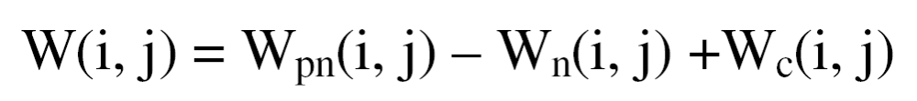
Proposed Method
We construct a sentiment graph
  Extract adjectives in reviews
  Add an edge between two vertices if they are positively collocated
  The weight of edges commensurate to the number of positive collocations
  We normalize the adjacency matrix of the sentiment graph

Slide 9
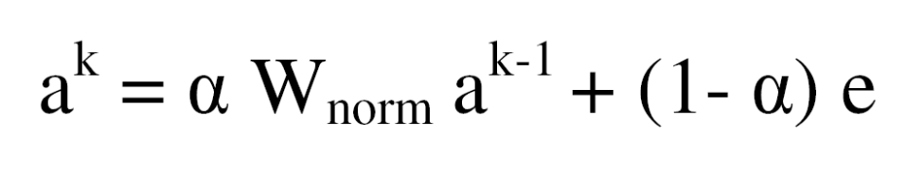
Proposed Method
We apply PageRank to the sentiment graph
  Known adjectives are given non-zero initial semantic orientations
  Semantic orientations are propagated to other adjectives
  Semantic orientations of unknown adjectives can be computed
Vectors containing semantic orientation scores of adjectives

Slide 10
Proposed Method
Depending on how we construct the sentiment graph:
  individual_
  byGenre_
  all_
Depending on which adjectives we assign initial semantic orientation scores:
  _Positive
  _Negative
  _PositiveNegative

Slide 11
Experimental Setup
We evaluate our approach for ranking movies
We compare our ranking with the box office ranking and with the ranking induced from user ratings
We measure rank performance using:
  Percentage of Overlap [5]
  Average Rank Error
  Percentage of Rank Overlap
We evaluate rank performance in:
  Top – k
  Granularity – g
We introduce information loss as a metric for measuring ranking at different granularity

Slide 12
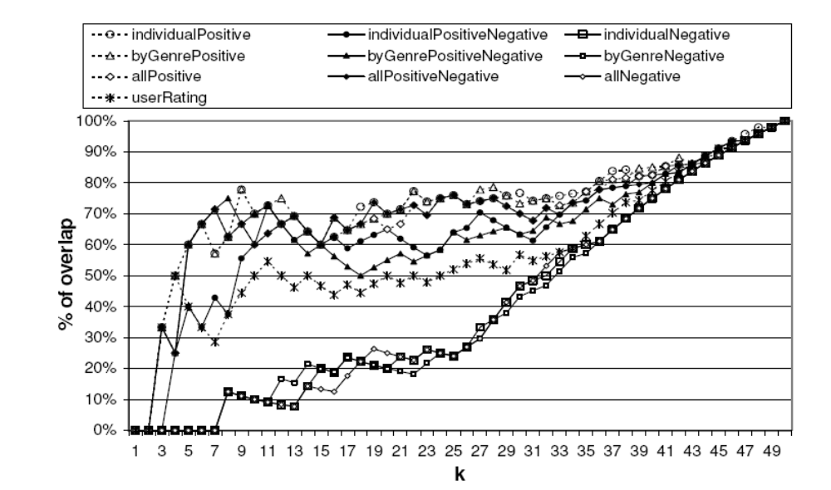
Experimental Results
Percentage of Overlap in Top-k Movies

Slide 13
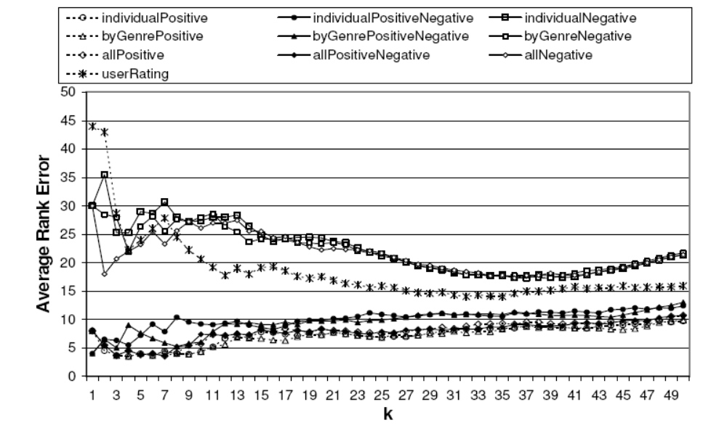
Experimental Results
Average Rank Error in Top-k Movies

Slide 14
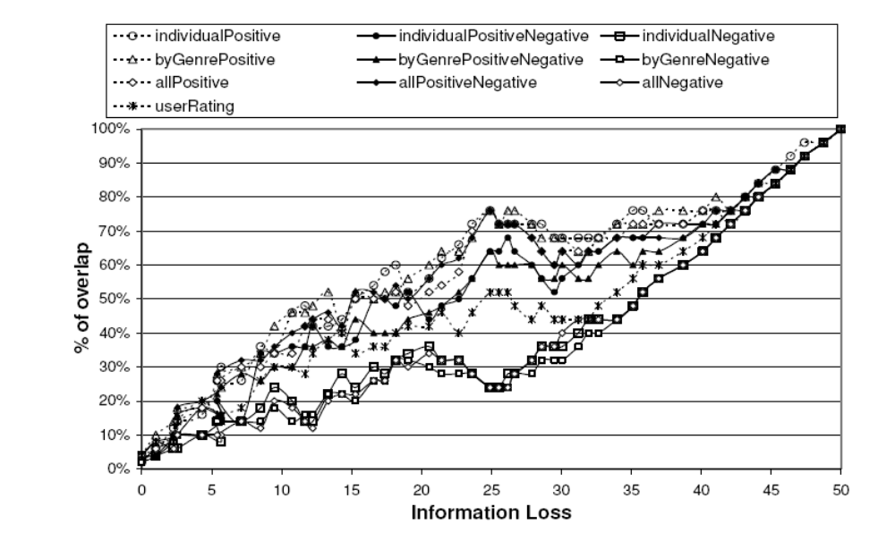
Experimental Results
Percentage of Rank Overlap vs. Information Loss

Slide 15
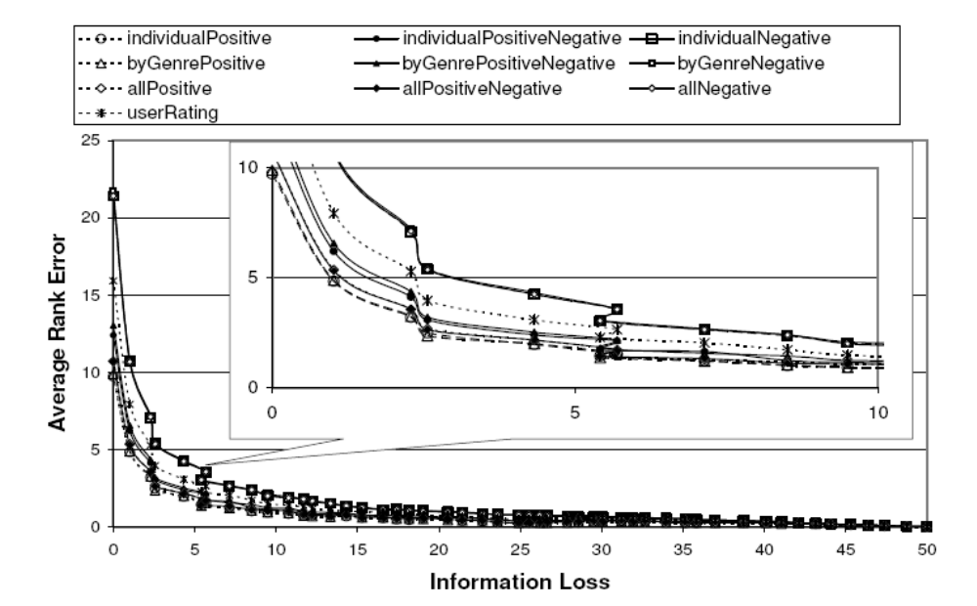
Experimental Results
Average Rank Error vs. Information Loss

Slide 16
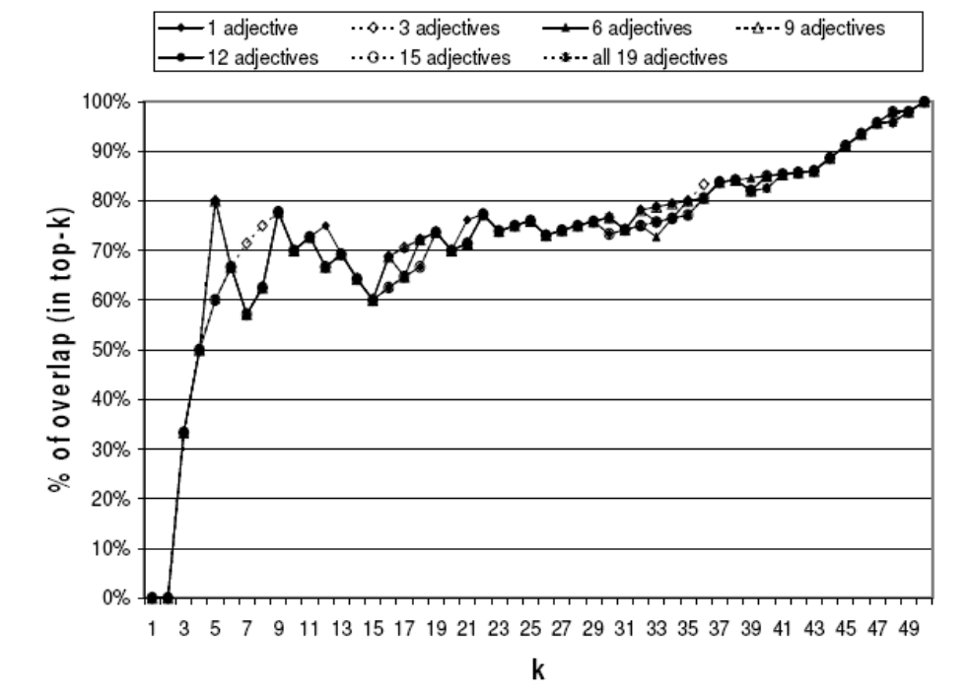
Experimental Results
Percentage of Overlap in Top-k Movies
at Different Numbers of Starting Adjectives

Slide 17
Experimental Results
In ranking the adjectives, using only the adjective ‘good’ as a starting adjective:
  ‘great’ in all genres
  ‘funny’ in comedy, animation, and children genres
  ‘stupid’ in comedy genre
  ‘animated’ in animation and children genres
  ‘political’ and ‘flawed’ in political genre
  ‘original’ in horror genre
  ‘enchanted’ and ‘fairy’ in children genre
  ‘young’ and ‘British’ in romantic genre
Found to have high positive semantic orientations

Slide 18
Experimental Results
Interesting excerpts from experimental results:
  Usage of ‘flawed’ in political genre:
  “… a rather affectionate look at a flawed man who felt compelled to right what was wrong”,
  “Wilson Hanks, a flawed and fun loving Congressman from the piney woods of East Texas…”
  Usage of ‘stupid’ in comedy genre:
  “I like a stupid movie where I do not have to think in and just sit back”

Slide 19
Conclusion
We propose a novel and practical context-dependent ranking of items from their textual reviews
We use simple contextual relationships such as collocation and pivot words to construct a sentiment graph
Semantic orientations are propagated from known adjectives to unknown adjectives using random walk on the sentiment graph
We illustrate and evaluate our approach in ranking movies

Slide 20
Conclusion
We show that our method is effective and produces ranking comparable to that of the box office
We show that our method is not sensitive to the choice of starting adjectives
We show the limitation of ranking induced from user ratings
Our best performing method uses positive starting adjectives and a sentiment graph constructed for individual items

Slide 21
Future Works
Applicability to more domains
Automated ranking of items based on textual reviews
Potential to predict general demands for items. For example, could the rank of adjectives reflect audience demands for movies?
  ‘animated’ in Children genre : Toys Story, Shrek
  ‘original’ in Horror genre : Sixth Sense, The Others
  ‘British’ in Romantic genre : Bridget Jones’ Diary

Slide 22
References
Turney P.D., Thumbs Up or Thumbs Down? Semantic Orientation Applied to Unsupervised Classification of Reviews, Proceedings of the 40th ACL, 2002.
Hu M. and Liu B., Mining Opinion Features in Customer Reviews, AAAI-2004, 2004.
Whitelaw C., Garg N., and Argamon S., Using appraisal taxonomies for sentiment analysis, in Proc. Second Midwest Computational Linguistic Colloquium (MCLC), 2005.
Brin S. and Page L., The anatomy of a large-scale hypertextual Web search engine, Computer Networks and ISDN Systems, 30(1-7):107–117, 1998.
Bar-Ilan J., Mat-Hassan M., Levene M., Methods for Comparing Rankings of Search Engine Results, Computer Networks 50 (1448-1463), 2006.

Slide 23
Credits
This work
was funded
by the
National University of Singapore
ARG project R-252-000-285-112,
"Mind Your Language:
Corpora and Algorithms
for Fundamental
Natural Language Processing Tasks
in Information Retrieval
and Extraction
for the Indonesian
and Malay languages"

