Slide 1
HTML
HyperText Markup Language

Slide 2
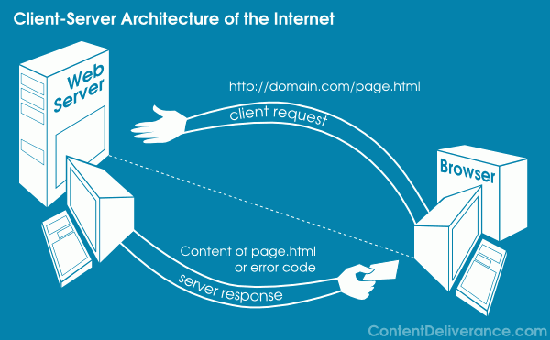
Internet
Client browser (Chrome, IE) sends request to server
Server returns response to client
Browser displays the response in IE or Chrome
HTML is the language that define on how the response will be displayed on browser

Slide 3
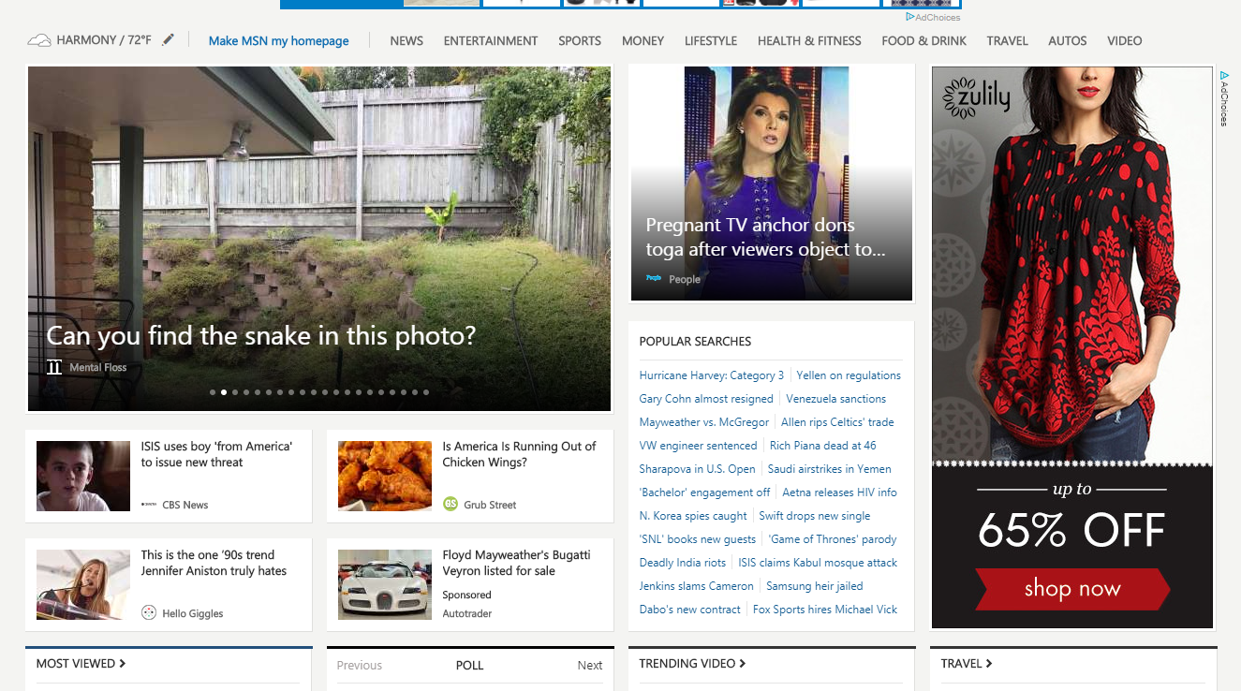

How responses look on browser

Slide 4
What is HTML
HTML documents are simply text documents with a specific form
Documents comprised of content and markup tags
Content: actual information being conveyed
The markup tags tell the Web browser how to display the page
An HTML file must have an htm or html file extension
An HTML file can be created using a simple text editor

Slide 5
Our first HTML
If you are running Windows, start Notepad
If you are on a Mac, start SimpleText
Type in the following:
<!DOCTYPE html> <html> <head> <title>Page Title</title> </head> <body> <h1>This is a Heading</h1> <p>This is a paragraph.</p> </body> </html>

Slide 6
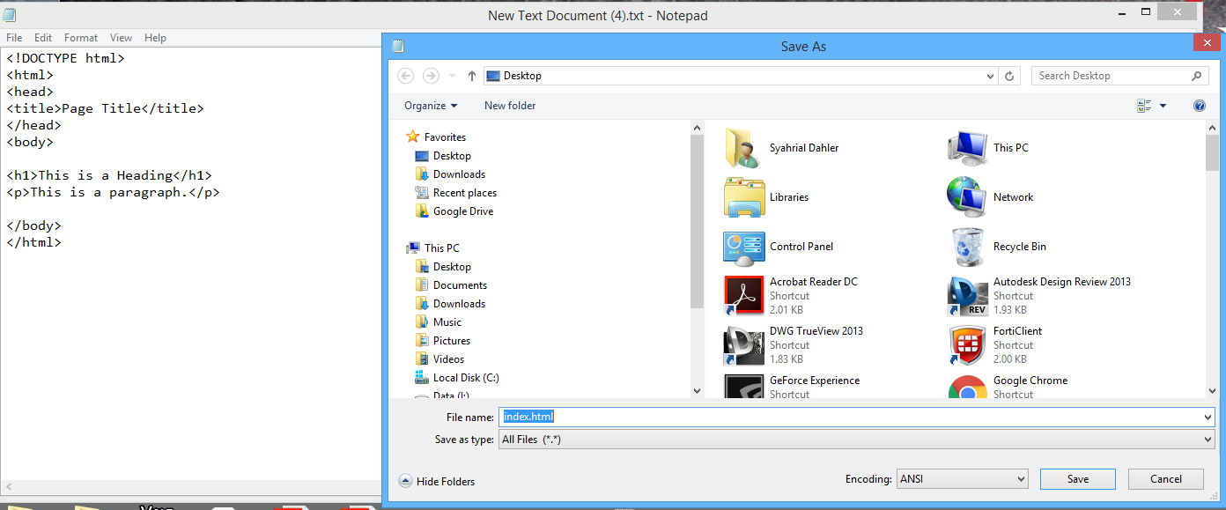
Our first HTML
Save as index.html

Slide 7
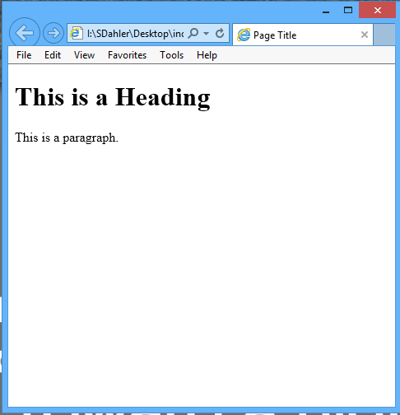
Our first HTML
Open in browser (double click)

Slide 8
Our first HTML
Tag
<!DOCTYPE html> <html> <head> <title>Page Title</title> </head> <body> <h1>This is a Heading</h1> <p>This is a paragraph.</p> </body> </html>
Tag

Slide 9
Our first HTML
Tag
HTML tags are used to mark-up HTML elements
Surrounded by angle brackets < and >
HTML tags normally come in pairs, like <tagname> (start tag) and </tagname> (end tag)
The text between the start and end tags is the element content
Not case-sensitive
Follow the latest web standards: Use lowercase tags
<!DOCTYPE html> <html> <head> <title>Page Title</title> </head> <body> <h1>This is a Heading</h1> <p>This is a paragraph.</p> </body> </html>
Tag

Slide 10
Our first HTML
The <!DOCTYPE html> declaration defines this document to be HTML5
The <html> element is the root element of an HTML page
The <head> element contains meta information about the document
The <title> element specifies a title for the document
The <body> element contains the visible page content
The <h1> element defines a large heading
The <p> element defines a paragraph
Tag
<!DOCTYPE html> <html> <head> <title>Page Title</title> </head> <body> <h1>This is a Heading</h1> <p>This is a paragraph.</p> </body> </html>
Tag

Slide 11
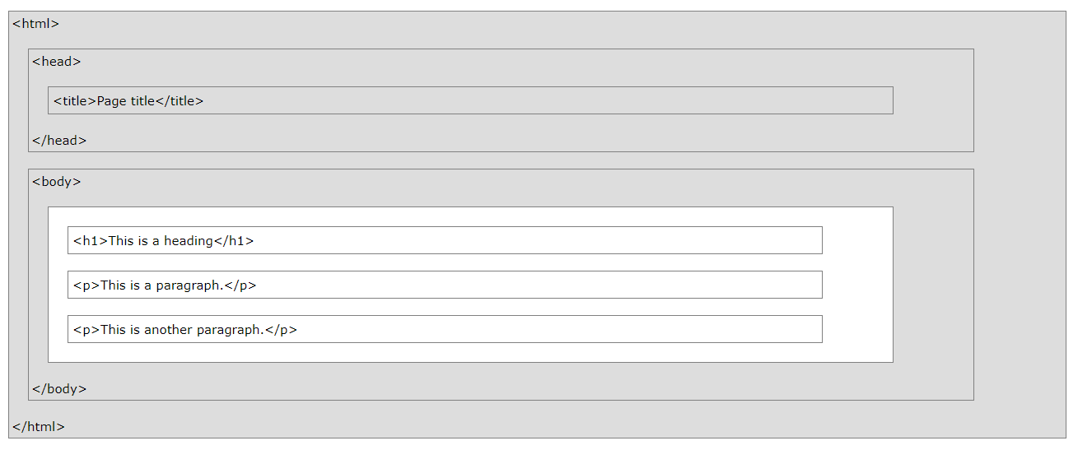
HTML Page Structure

Slide 12
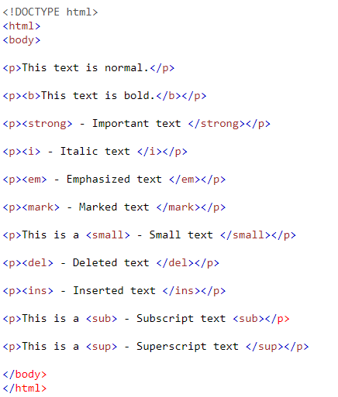
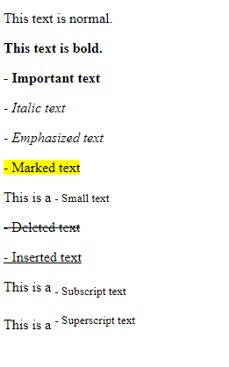
HTML Text Format

Slide 13
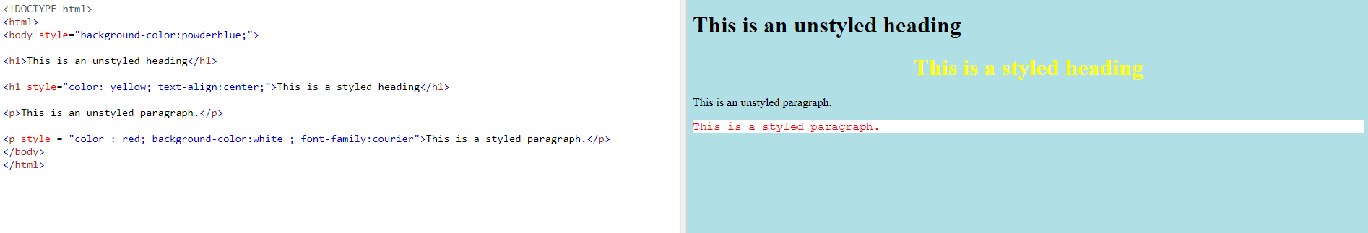
HTML Style
Use the style attribute for styling HTML elements
Use background-color for background color
Use color for text colors
Use font-family for text fonts
Use font-size for text sizes
Use text-align for text alignment

Slide 14
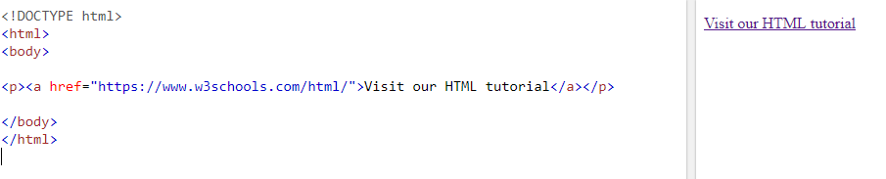
HTML Link
<a href="url">link text</a>

Slide 15
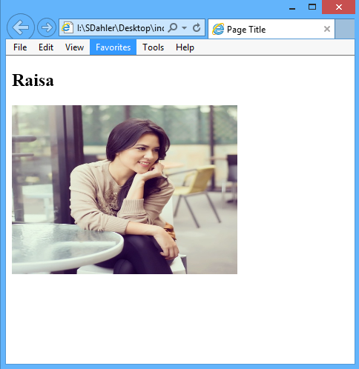

Images
<img src="url" alt="some_text" style="width:width;height:height;">
The alt attribute provides an alternate text for an image, if the user for some reason cannot view it (because of slow connection, an error in the src attribute, or if the user uses a screen reader).

Slide 16

Table
<table style="width:100%"> <tr> <th>Firstname</th> <th>Lastname</th> <th>Age</th> </tr> <tr> <td>Jill</td> <td>Smith</td> <td>50</td> </tr> <tr> <td>Eve</td> <td>Jackson</td> <td>94</td> </tr> </table>

Slide 17
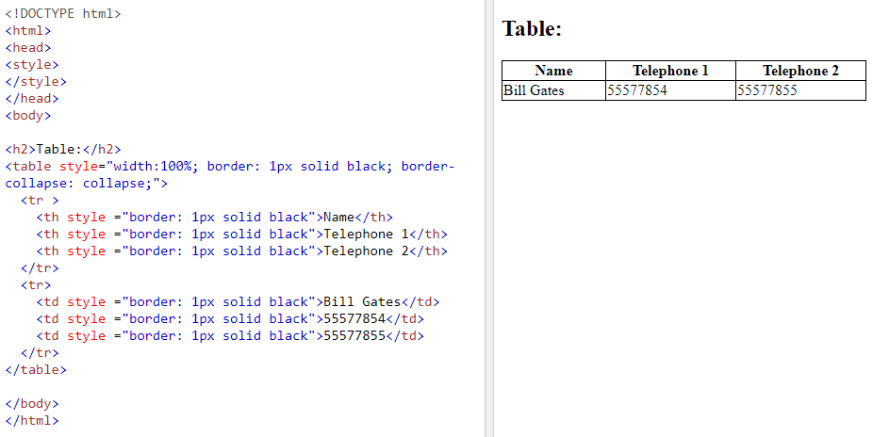
Table with style

Slide 18
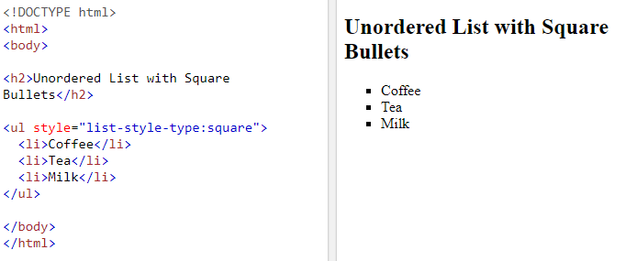
List

Slide 19
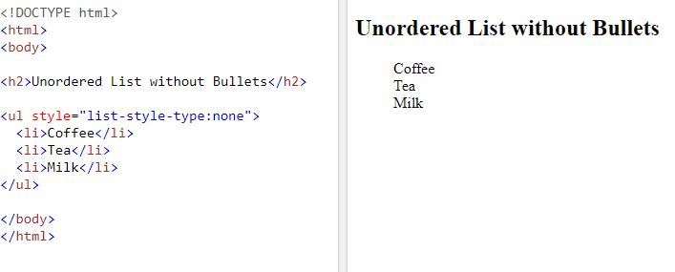
List

Slide 20
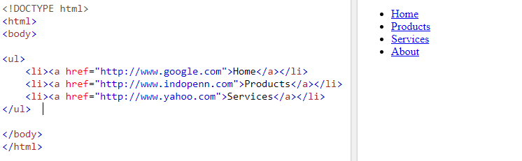
Other html elements can be place inside <li><li>
Links inside <li>

Slide 21
Block
<div></div> is block tag
We can define the style of a block. Everything inside the block will follow the style of the block
<div style="background-color:black;color:white;padding:20px;"> <h2>London</h2> <p>London is the capital city of England. It is the most populous city in the United Kingdom, with a metropolitan area of over 13 million inhabitants.</p> </div>

Slide 22
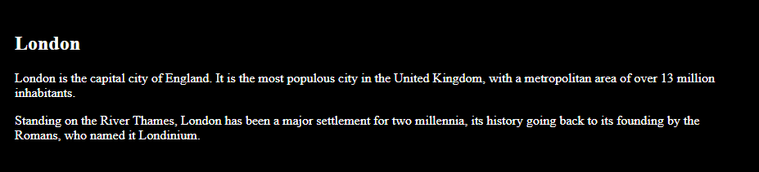
Block

Slide 23
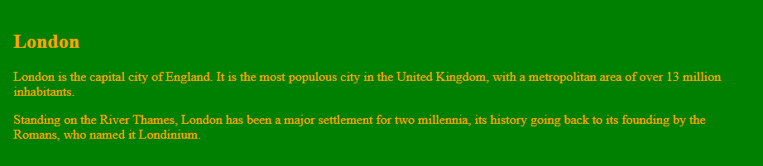
Block
If we change the block background color to green and the color to orange it becomes

Slide 24
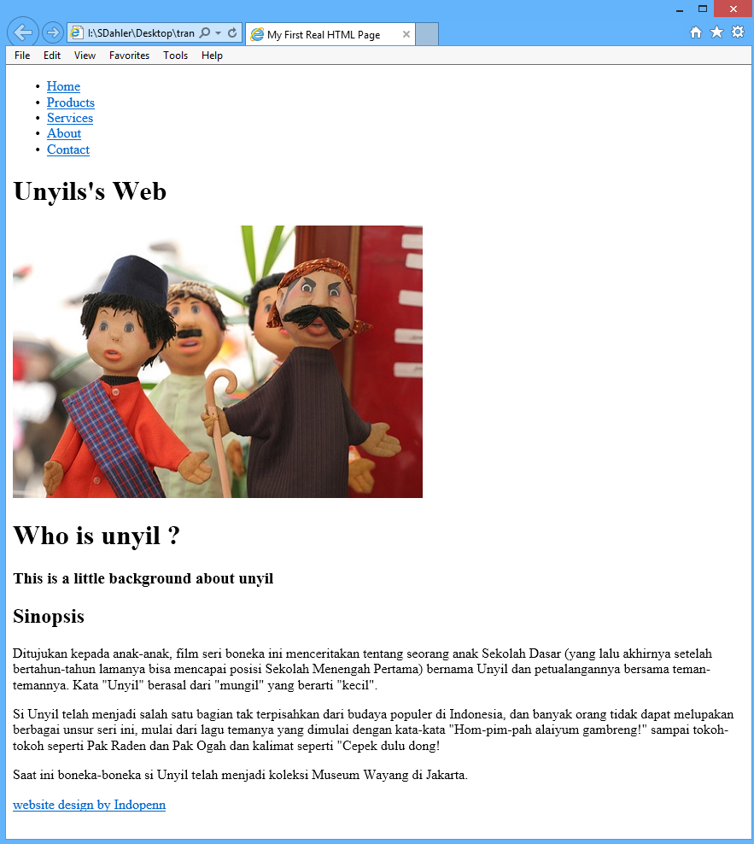
Assignment
Create this page from scratch

Slide 25
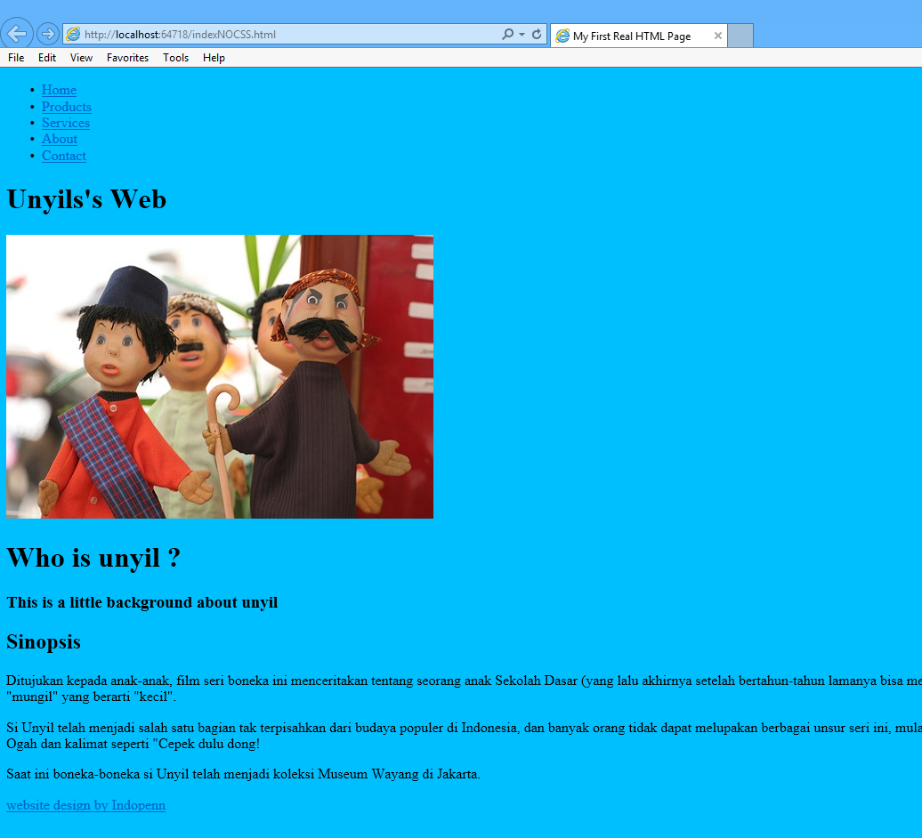
CSS
Make the background blue (deepsky)blue

Slide 26
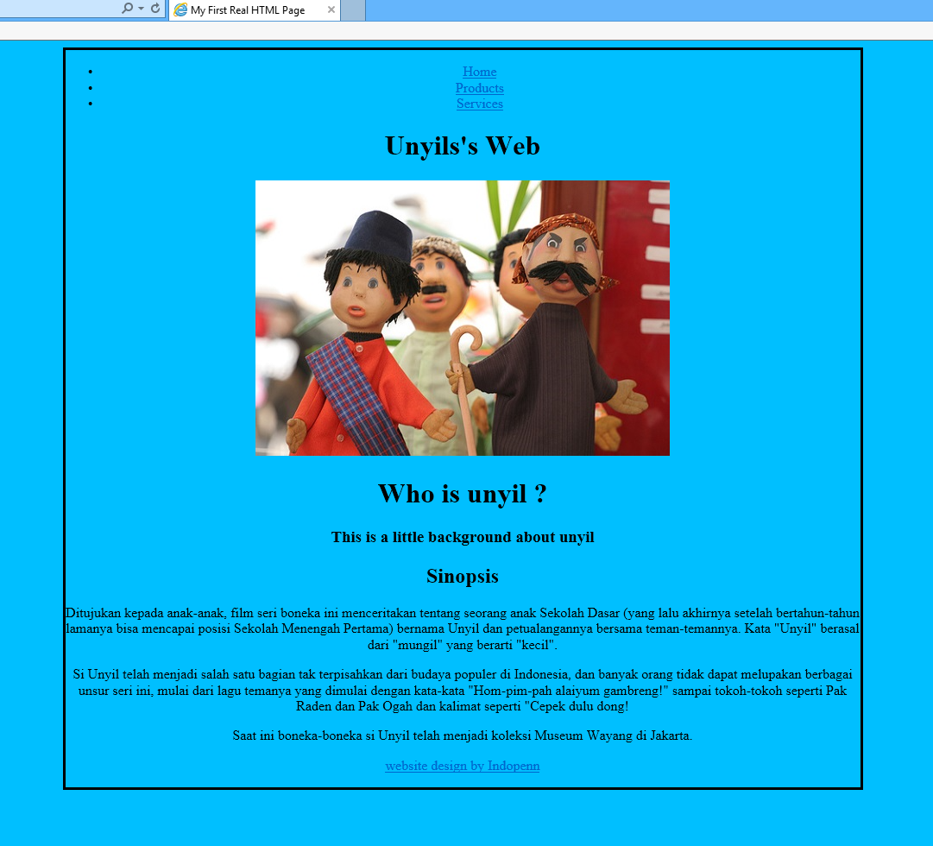
CSS
Make the page center

Slide 27
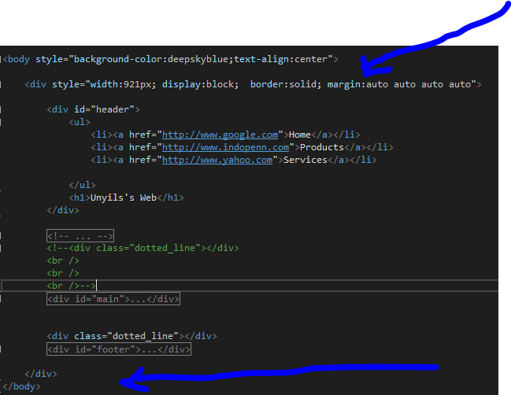
Making the page center
Set the text alignment of the body to be centered (text-align:center)
Add a new block (div) that is the main div that cover all other divs
Set the width of the div

Slide 28
CSS (work on the header)
Combine the links and the header into one block
<div>
<ul>
<li><a href="http://www.google.com">Home</a></li>
<li><a href="http://www.indopenn.com">Products</a></li>
<li><a href="http://www.yahoo.com">Services</a></li>
</ul>
<h1>Unyils's Web</h1>
</div>

Slide 29
CSS (work on the header)
Combine the links and the header into one block
<div>
<ul>
<li><a href="http://www.google.com">Home</a></li>
<li><a href="http://www.indopenn.com">Products</a></li>
<li><a href="http://www.yahoo.com">Services</a></li>
</ul>
<h1>Unyils's Web</h1>
</div>

Slide 30
CSS (work on the header)
<div style="width:921px; display: inline">
<p>
<ul style="list-style-type: none;float:left">
<li style="display:inline"><a href="http://www.google.com">Home</a></li>
<li style="display:inline"><a href="http://www.indopenn.com">Products</a></li>
<li style="display:inline"><a href="http://www.yahoo.com">Services</a></li>
</ul>
<h1 style="float:right">Unyils's Web</h1>
</p>
</div>

Slide 31
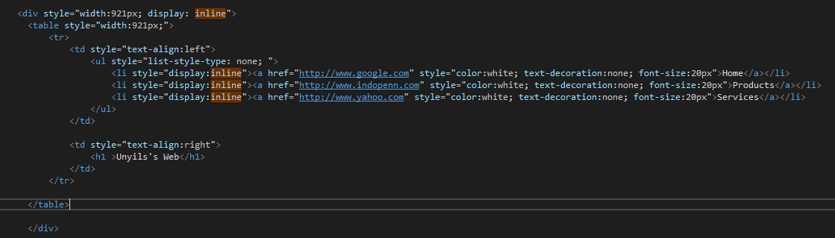
CSS (work on the header). Put them inside a table

Slide 32
Add Line below header
<hr style="border-top: dotted 5px;" />

Slide 33
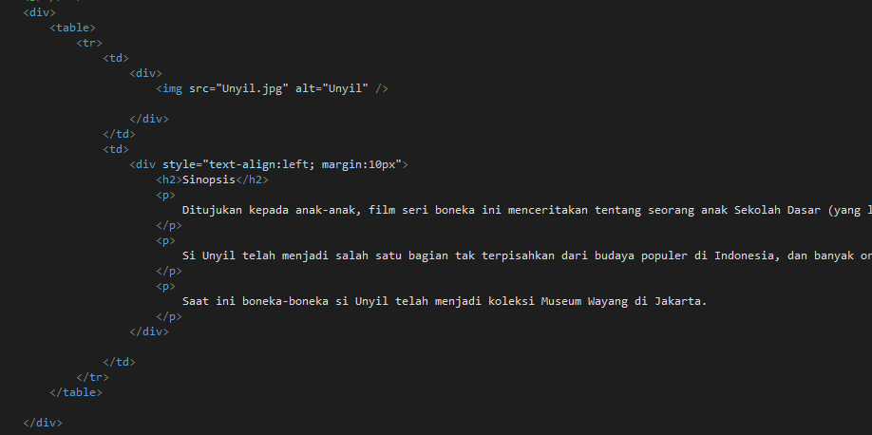
Main content in a table

Slide 34
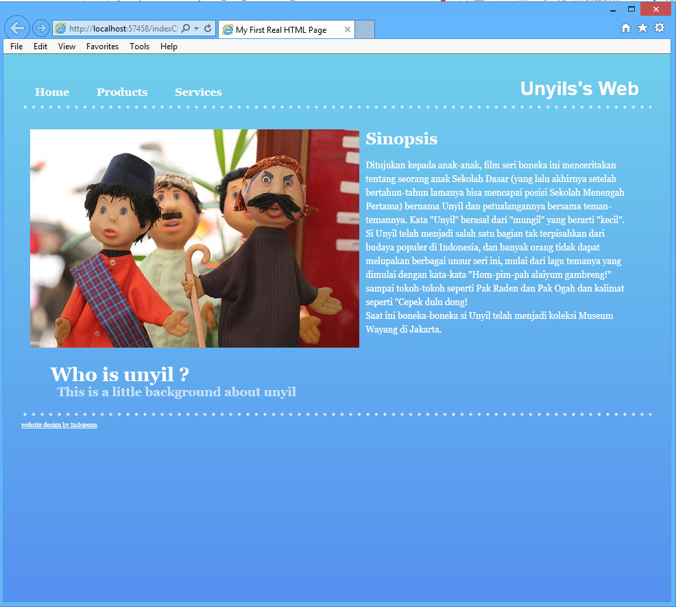
After applying CSS

Slide 35
Resources
https://www.w3schools.com/html/default.asp

Slide 36
Terima Kasih

