Slide 1
Coding Class
with codeacademy

Slide 2
Goal
To facilitate your learning of coding on codeacademy
Why?
It’s more motivating to learn together with other people
If you are stuck, you can get an answer right away
You can use the knowledge for applying to code bootcamp such as ZipCode Wilmington
Some code bootcamps guarantee job placement after you finish training with them

Slide 3
Sign up to codeacademy
Open browser
Go to codeacademy.com
Sign up
You can sign up using Facebook, Google account etc – you won’t have to make and remember an extra password

Slide 4
Ready?
Now we’re ready to begin our coding journey together!
Why Java Script?
It’s the best programming language to start learning how to code
It’s useful for many things especially web development
It’s not enough to learn HTML to create a website, sometimes you want your website to not just display information, but also do things! Interact with people …
Develop websites like Netflix, Airbnb…
Want to start your own online web application?

Slide 5
Intro to Java Script
with codeacademy

Slide 6
Data Types in Java Script
String 'Hello World!' "Hello World!"
Number 200 5 3.32
Boolean true false

Slide 7
Print to screen
If you want to know what your code is doing, print the output to the screen: console.log('what to print here'); console.log(200); console.log('Andy has', 50, 'dollars in his wallet'); console.log(2 + 5); console.log(2 - 5); console.log(2 / 3); console.log(2 * 3);

Slide 8
Print to screen
What if I want to print out ' ? console.log('hello my name\' s Anne');
Use \ to "escape" a character: make it print out to screen as is

Slide 9
Modulus
The remainder after division 10 / 2 = 5 10 % 2 = 0 10 / 3 = 3.33333333333 10 % 3 = 1

Slide 10
Generate random number
Math.random(); Generate a number between 0 and 1 randomly Math.random() * 10; Generate a number between 0 and 10 randomly Math.random() * 50; Generate a number between 0 and 50 randomly

Slide 11
Round a number to nearest integer
Round down: Math.floor(number) Math.floor(10/3) = 3
Round up Math.ceil(number) Math.ceil(10/3) = 4

Slide 12
Comments
You can make comments in the code, to remember what you’re doing // The first 5 decimals of pi console.log('Pi is equal to ' + 3.14159);
You can also comment out part of the code that you don’t want to run: // console.log('I don’t want to run this code');
And you can comment out multiple lines: using /* … */ /* console.log('All of this code'); console.log('Is commented out'); console.log('And will not be executed); */

Slide 13
Exercise Time
on codeacademy

Slide 14
Variables
Variables are storage, to store data. It can store number, boolean, or String var myFavoriteNumber = 29; var likesChocolate = false; var myName = 'Derry'; console.log(likesChocolate); console.log('My favorite number is', myFavoriteNumber); console.log('My name is', myName);

Slide 15
Change variable value
var myFavoriteNumber = 29; var likesChocolate = false; var myName = 'Derry';
myFavoriteNumber = myFavoriteNumber + 3; likesChocolate = true;
myName = myName + ' Wijaya'; // String interpolation console.log(likesChocolate); console.log('My favorite number is ' + myFavoriteNumber); // String interpolation console.log('My name is', myName);

Slide 16
Exercise Time
on codeacademy
Variables

Slide 17
Control Flow
Making decision which part of your code will run: If/else statements We make this kind of decision every day! If you clean up your room, I will let you watch TV If the weather is good today, we’ll go to the beach …

Slide 18
If/else
Instruct computers which part of your code to run: var kidCleanUp= true; if (kidCleanUp) { console.log('Sure, you can watch TV'); } else { console.log('No watching TV until you clean up!'); }

Slide 19
Comparison Operators
=== check if two things equal each other
!== check if two things do not equal each other
var kidBehavior = 'nice'; if (kidBehavior === 'nice') {
console.log('good job!');
}
if (kidBehavior !== 'nice') {
console.log('Be nice!');
}
if (kidBehavior === 'nice') {
console.log('good job!');
} else {
console.log('Be nice!');
}

Slide 20
Comparison Operators
> check if the first value is bigger than the second
>= check if the first value is bigger than or equal to the second
< check if the first value is smaller than the second
<= check if the first value is smaller than or equal to the second
var yourAge = '105';
if (yourAge > 100) {
console.log('Wow! It\'s a miracle you\'re still alive!');
} else {
console.log('Be nice to old people!');
}

Slide 21
Adding more conditions (using else if)
var kidBehavior = 'rolling on the floor';
if (kidBehavior === 'good') {
console.log('good job!');
} else if (kidBehavior === 'bad') {
console.log('Be nice!');
} else if (kidBehavior === 'really nice') {
console.log('You are being suspiciously nice!');
} else {
console.log('I\'m not sure how to respond to this…');
}

Slide 22
Adding more conditions (using switch)
var kidBehavior = 'rolling on the floor';
switch (kidBehavior) {
case 'good': console.log('good job!');
break;
case 'bad': console.log('Be nice!'); break;
case 'really nice': console.log('You are being suspiciously nice!');
break;
default: console.log('I\'m not sure how to respond to this…');
break;
}

Slide 23
Logical Operators
What if you want to say either this condition must be true or that must be true? Use ||
What if you want to say both this condition must be true? Use && var kidBehavior = 'stomping feet'; var embarrassing = true; if (kidBehavior === 'bad' || embarrassing) { console.log('Stop this behavior at once!'); }

Slide 24
Logical Operators
What if you want to say either this condition must be true or that must be true? Use ||
What if you want to say both this condition must be true? Use && var kidBehavior = 'rolling on the floor'; var atHome = true; if (kidBehavior === 'rolling on the floor' && atHome) { console.log('Are you sleepy?'); } else { console.log('I\'m not sure how to respond to this…'); }

Slide 25
Logical Operators
! is to say the opposite of the value var kidBehavior = 'stomping feet'; var embarrassing = true; var kidBehavior = 'rolling on the floor'; var atHome = false; if (kidBehavior === 'rolling on the floor' && !atHome) {
console.log('I\'m not sure how to respond to this…'); }

Slide 26
Exercise Time
on codeacademy
Control Flow

Slide 27
Functions
Like variables, functions is a piece of code that you can call over and over again
They take data/variables as input (we call them parameters) and perform a set of operations on them, and then return the result
When you call a function, you give it arguments as input. The arguments will set the value of the function’s parameters
Let’s go through an example of a function, see if we can figure out how the code works

Slide 28
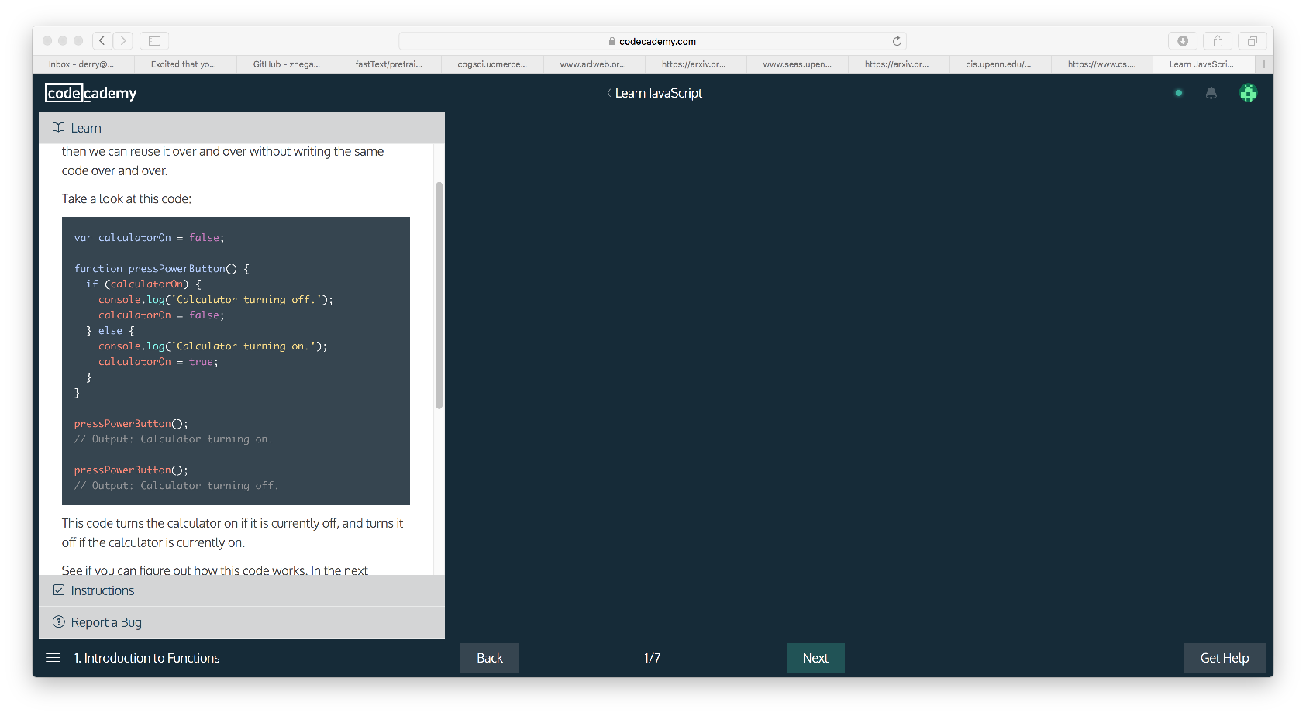
Functions -- example
Make a variable, set it to false
Make a function called pressPowerButton
If the current value of the variable
calculatorOn === true, set it to false
Else, if the current value of the variable
calculatorOn === false, set it to true
What is the output here?
What will be printed to the console?
What will be the value of calculatorOn?
What is the output here?
What will be printed to the console?
What will be the value of calculatorOn?

Slide 29
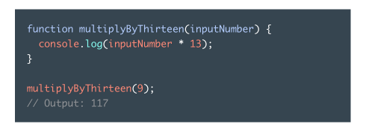
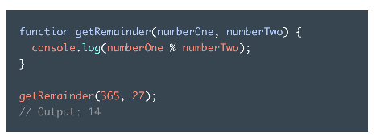
Functions can take as input data/variable
A function that has a parameter called inputNumber
It multiplies the value of the inputNumber variable by 13, and print out the result
When you call the function and give it a number 9 as argument, what will be the output?
A function that has two parameters named numberOne and numberTwo
It computes the remainder of numberOne divided with numberTwo
When you call the function and give it as arguments, two numbers: 365 and 27, what will be the output?

Slide 30
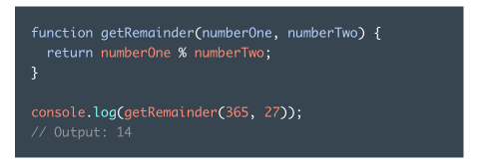
Function can return a result instead of printing to screen
A function that has two parameters named numberOne and numberTwo and returns the remainder of the values of the two variables as result
console.log is printing the result of calling the function with two numbers as arguments: 365 and 27

Slide 31
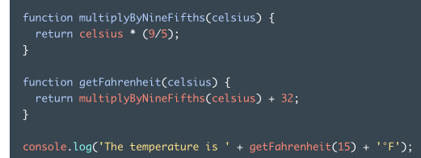
Functions can call each other
A function that multiplies its parameter with 9/5 and returns the result
This function calls the multiplyByNineFifths function and passes its parameter as argument to the function and returns the result of the function plus 32
What will be the output here?
If you type console.log(celcius) outside the function call, will it return anything?
Or will it return error?
This is the next topic → Scope : Scope informs us which variables are accessible
from within our programs

Slide 32
Exercise Time
on codeacademy
Functions

Slide 33
Global scope
This is a global variable. They are declared outside functions and can be called from anywhere in your code

Slide 34
Function scope
‘celcius’ is a function variable. They are declared inside a function and can only be called inside the function
This ‘celcius’ is different from the celcius we declare in multiplyByNineFifths function. They have the same names but they are different parameters that belong to different functions

Slide 35
Function scope
function multiplyByNineFifths(inputNumber) {
return inputNumber* (9/5);
}
function getFahrenheit(celcius) {
return multiplyByNineFifths(celcius) + 32;
}
console.log('The temperature is ' + getFahrenheit(15) + '°F');
Will this work? What will be the output?

Slide 36
Function scope
function multiplyByNineFifths(inputNumber) {
return inputNumber* (9/5);
}
function getFahrenheit(celcius) {
return multiplyByNineFifths(celcius) + 32;
}
var celcius = 15;
console.log('The temperature is ' + getFahrenheit(celcius) + '°F');
celcius = celcius + 20;
console.log('The temperature now is ' + celcius + '°C');
Will this work? What will be the output?

Slide 37
Exercise Time
on codeacademy
Scope

Slide 38
Arrays
A list to store data var bucketList = ['Rappel into a cave', 'Take a falconry class', 'Learn to juggle'];

Slide 39
Arrays
Select element from an array
Each item in the array has a numbered position, starting from 0 var bucketList = ['Rappel into a cave', 'Take a falconry class', 'Learn to juggle']; var listItem = bucketList[0]; console.log(listItem); listItem = bucketList[1]; console.log(listItem); var hello = 'Hello World'; console.log(hello[6]);

Slide 40
Arrays
Length of array (i.e., how many items are inside the array) var bucketList = ['Rappel into a cave', 'Take a falconry class']; console.log(bucketList.length); console.log('Hello World'.length);

Slide 41
Arrays
Adding items to the list: (added to the end)
var bucketList = ['item 0', 'item 1', 'item 2'];
bucketList.push('item 3', 'item 4');
console.log(bucketList);
Removing item from the list: (removed from the end)
bucketList.pop();
console.log(bucketList);

Slide 42
Exercise Time
on codeacademy
Scope

Slide 43
Loops
To repeat a task over and over, so we don’t have to write the same code over and over
for loops : loop a block of code a known amount of times
while loops: loop a block of code an unknown amount of times – the looping stops after a condition is reached

Slide 44
Loops
var animals = ["Grizzly Bear", "Sloth", "Sea Lion"]; for (var i = 0; i < animals.length; i++) { // start counting at 0 and // continue looping as long as i // is less than animals.length // at each loop, add 1 to i console.log(animals[i]); // the code that is being run until // the loop stops }

Slide 45
Loop
Backward loops
for (var i = animals.length-1; i>=0; i--) { // start counting at the last item // in the array, continue looping // as long as i >= 0 // at each loop, subtract 1 from i console.log(animals[i]); // the code that is being run until // the loop stops }

Slide 46
Loops
What if you don’t know how many times you want the loop to run?
Set a stopping condition and use while loop while (condition) { // as long as the condition is true // run this code block }

Slide 47
Loops
Flip cards in a deck until we get a Spade: var cards = ['Diamond', 'Spade', 'Heart', 'Club']; var currentCard = 'Heart'; while (currentCard !== 'Spade') { console.log(currentCard); var randomNumber = Math.floor(Math.random() * 4); currentCard = cards[randomNumber]; }

Slide 48
Exercise Time
on codeacademy
Scope

Slide 49
Putting it all together
You now know JavaScript, how do we use it on a website?
JavaScript can make your website much more interactive and dynamic

Slide 50
JavaScript, HTML, and CSS
Link JavaScript to HTML
On your HTML page, you can ask the browser to run the JavaScript code every time your HTML page loads: Add this code before the closing </body> tag on your HTML page <script src='js/main.js'></script>

Slide 51
JavaScript, HTML, and CSS
Select an HTML element within your JavaScript code to interact with: var header = document.getElementsByClassName('example-class-name');
This will find an element like this in your HMTL code: <div class='example-class-name'> ... </div>

Slide 52
JQuery
An easier way to interact with HTML elements from your JavaScript
JQuery is a library consisting of JavaScript codes, we can link it from our HTML page like we link any piece of JavaScript code from our HTML page <script src='https://code.jquery.com/jquery-3.1.0.min.js'></script>
Library is so nice! We don’t have to code a lot of things by ourselves!

Slide 53
JQuery
Make sure your HTML page is ready (loaded) before you call any function in your JavaScript code: $(document).ready(main);

Slide 54
JQuery
Instead of calling HTML element from JavaScript code like this: document.getElementsByClassName('skillset'); We can call it simpler using JQuery: $('.skillset');

Slide 55
JQuery
Once you call an HTML element, you can do many things to the element:
hide them: $('.my-selector').hide();
show them: $('.my-selector').show();
reveal hidden element them slowly: $('.my-selector').fadeIn(400); the fade in will last 400 miliseconds (or 0.4 seconds)
toggle the element: hide/show the element depending on whether the element is shown/hidden: $('.my-selector').toggle();
run a function when the element is clicked: $('.my-selector').on('click', function() { // execute the code here when .example-class is clicked. });

Slide 56
JQuery
Once you call an HTML element, you can do many things to the element:
toggle a particular style for the element: $('.my-selector').toggleClass('active') 'active' is the style that we will toggle on and off. This style class may look like this on the CSS: (applied to a button, it will make the button color darker and the text on the button light) .active { background-color: #333333; color: whitesmoke; }

Slide 57
JQuery
Instead of by name, we can refer to a specific element that we click with $this – if there are other elements with the same name as our clicked element, $this will only refer to the element we clicked, not the other elements $('.my-selector').on('click', function() { $(this).toggleClass('active'); });

Slide 58
JQuery
We can use next() to select elements that are next to another element: e.g., in our HTML: <div class='item-one'> ... </div> <div class='item-two'> ... </div> If we want to hide item-two, we can write: $('.item-two').hide(); OR $('.item-one').next().hide();

Slide 59
JQuery
We can also modify the text of an element: $('.my-selector').text('Hello world!'); the text of the element my-selector will be changed to 'Hello World!'

Slide 60
JQuery
Instead of toggle an element in and out, we can make the toggling smoother by sliding the element into the page $('.example-class').slideToggle(400); Here, 400 means that the sliding will last for 400 miliseconds (0.4 seconds)

Slide 61
Exercise Time
on codeacademy
Scope

