Slide 1
PIDGIN: Aligning KB Ontologies using Web Texts as Interlingua
Derry Wijaya, Partha Pratim Talukdar, Tom Mitchell

Slide 2
Motivation
There are many knowledge sources independently developed in the semantic web
They can act as background knowledge to improve natural language understanding:
e.g., Wikipedia, Freebase, IMDB, NELL, Yago, WordNet, VerbNet etc.
But they are often incomplete

Slide 3
Goal
One way to improve KB coverage is to automatically align categories and relations across these knowledge bases
e.g., Yago:wasBornIn == NELL:personbornincity
e.g., NELL:actorStarredInMovie == WordNet: star, act, play, cast, feature, …

Slide 4
Goal
Ontology Alignment
connect predicates from ontologies from different KBs (e.g., KB1:bornIn == KB2:personBornIn)
Lots of prior work: PARIS (2011), ...
exploits predicate instance overlap

Slide 5
Going beyond Overlap

Slide 6
Going beyond Overlap

Slide 7
Going beyond Overlap

Slide 8
Going beyond Overlap
Extract 600m Subject-Verb-Object (SVO) triples from a parsed web corpus (ClueWeb) of about 230 billion tokens

Slide 9
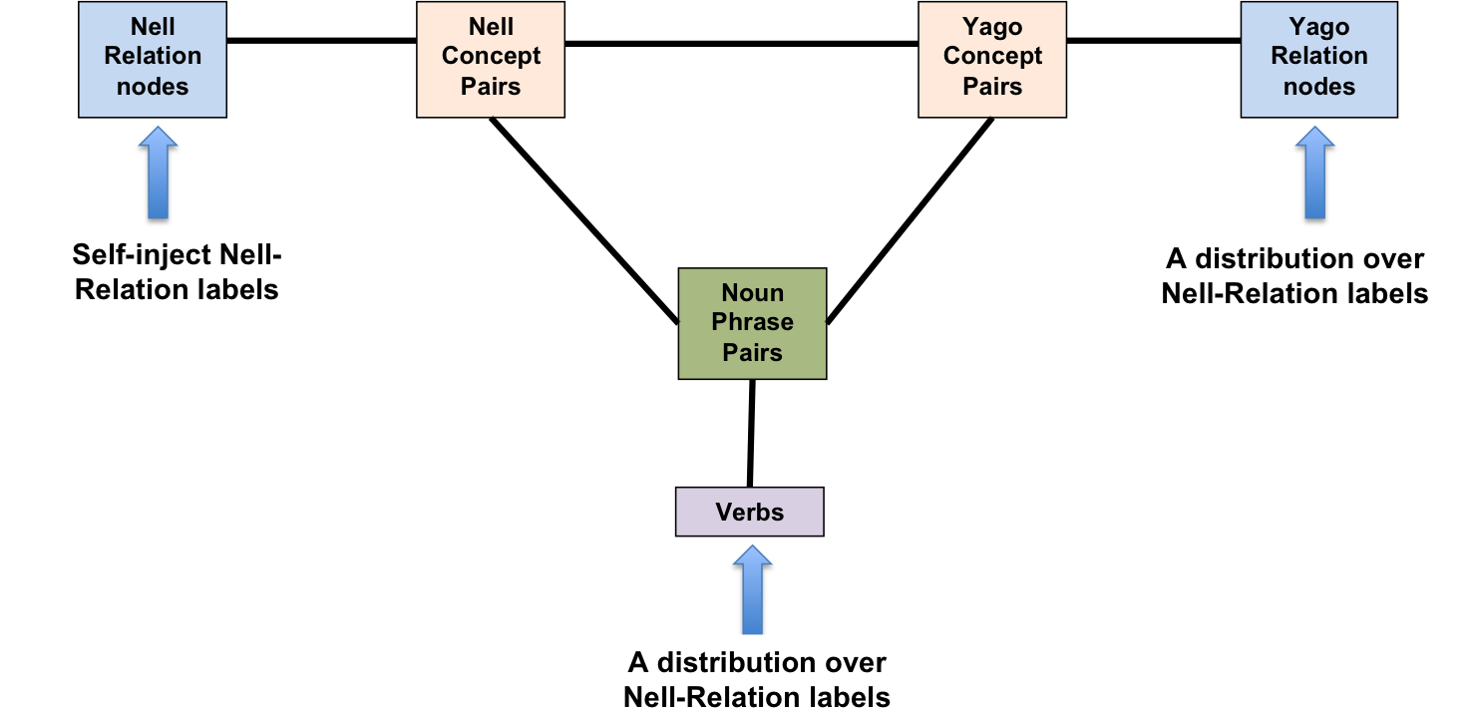
Putting it all Together
Treats alignment as classification over graph:
assigns (self) label to the node in KB₁
starting with this initial label information, PIDGIN uses label propagation to classify the rest of the nodes

Slide 10
PIDGIN
So far we have mapped:
NELL and Freebase
NELL and Yago
NELL and KBP

Slide 11
By-product: Category Alignment from Relation Alignment

Slide 12
By-product: Category Alignment from Relation Alignment

Slide 13
Relation and Category Alignment
Examples of relation alignments:
Freebase: /medicine/medical_treatment/side_effects == NELL:drughassideeffect,
Freebase:/sports/league/arena_stadium == NELL:leaguestadiums
Examples of category alignments:
Yago2:wordnet_actor_109765278 == NELL:actor
Yago2:yagoURL == NELL:website
Yago2:yagoLegalActor == NELL:agent

Slide 14
By-product: Learned Relation-Verb Mappings

Slide 15
Current Work
We can also learn Relation-Verb Mappings by aligning NELL and WordNet
Adding hypernym and hyponym structure in WordNet improves mappings
Nell Relation
Nodes
Nell Concept Pairs
Noun Phrase Pairs
WordNet Verbs
Verb1
Verb2
Verb3
Verbs
Verb4
Verb5

Slide 16
Current Work
We can also learn Relation-Verb Mappings by aligning NELL and VerbNet
Adding WordNet verbs improves NELL and VerbNet alignments
Nell Relation
Nodes
Nell Concept Pairs
Noun Phrase Pairs
Verbs
VerbNet classes
WordNet Verbs

Slide 17
Summary
PIDGIN uses large web-text as interlingua overcomes limitations of previous approaches
Relation-Verb Mappings can be used to read and understand sentences better
Current work
Building a verb resource for improving natural language understanding

