Slide 1
Computer programming
II. Algorithms

Slide 2
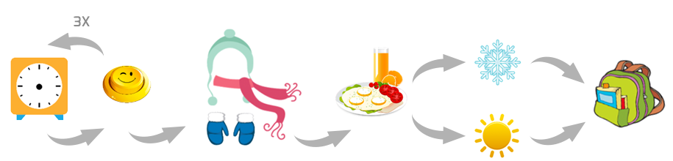
Recap: What is computer programming?
Telling computers to solve a problem
Think about the problem and generate a solution (algorithm)
Break down the problem into step by step solution
Write the solution in a language that computer can understand (coding)
Algorithm for going to school in the morning

Slide 3
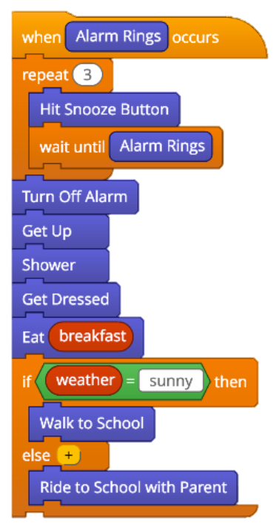
Coding
repetition
Write the step by step instruction in a programming language
Scratch (https://scratch.mit.edu)
sequencing
conditional
logic
https://www.tynker.com/blog/articles/ideas-and-tips/how-to-explain-algorithms-to-kids/

Slide 4
Algorithm: Decision Trees
Twenty questions
A number between 1 and 100
A number between 1 and 1000
How many guesses do you need?

Slide 5
Algorithm: Decision Trees
Guess a number between 0 and 7 (3 questions)
X > 3 ?
X > 1 ?
X > 5 ?
X > 0 ?
X > 2 ?
X > 4 ?
X > 6 ?
http://csunplugged.org/wp-content/uploads/2014/12/unplugged-05-information_theory.pdf

Slide 6
Algorithm: Decision Trees
Number 0
X > 3 ?
X > 1 ?
X > 5 ?
X > 0 ?
X > 2 ?
X > 4 ?
X > 6 ?
0 | 1 | 2 | 3 | 4 | 5 | 6 | 7

Slide 7
Algorithm: Decision Trees
Number 5
X > 3 ?
X > 1 ?
X > 5 ?
X > 0 ?
X > 2 ?
X > 4 ?
X > 6 ?
0 | 1 | 2 | 3 | 4 | 5 | 6 | 7

Slide 8
Coding: Decision Trees
Guess a number between 0 and 3:
If the number is bigger than 1 then:
If the number is bigger than 2 then:
The number is 3
Else:
The number is 2
Else:
If the number is bigger than 0 then:
The number is 1
Else:
The number is 0
X > 1?
no
yes
X > 0?
X > 2?
no
yes
no
yes
X = 0
X = 1
X = 2
X = 3

Slide 9
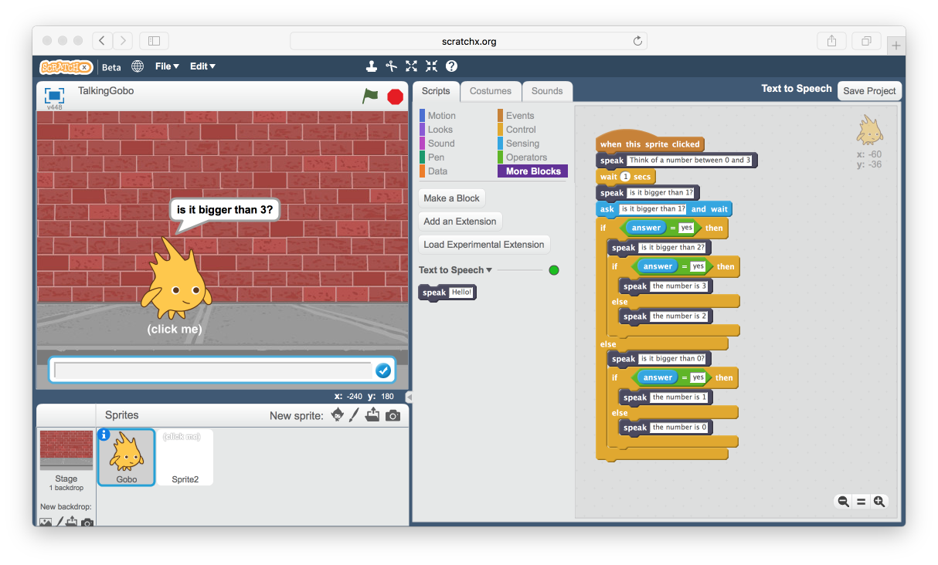
Coding: Decision Trees
Code the previous decision tree using ScratchX (http://scratchx.org)
If the number is bigger than 1 then:
If the number is bigger than 2 then:
The number is 3
Else:
The number is 2
Else:
If the number is bigger than 0 then:
The number is 1
Else:
The number is 0

Slide 10
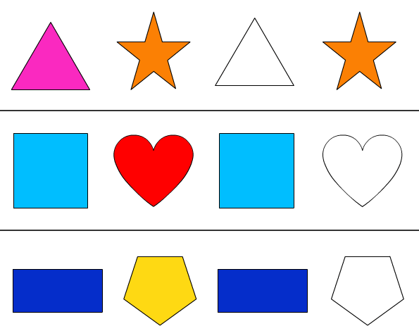
ALGORITHM: PATTERN RECOGNITION

Slide 11
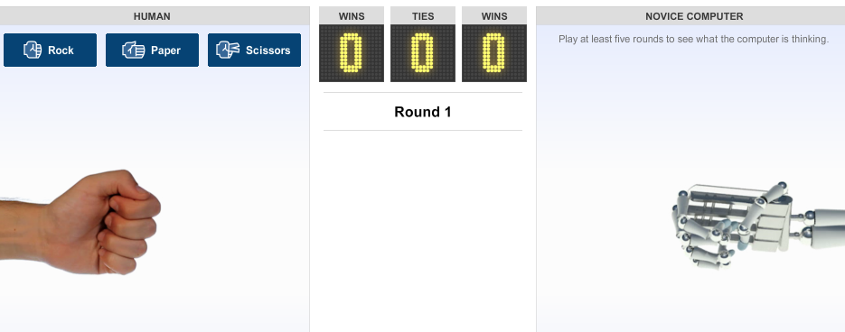
Algorithm: Pattern Recognition
Rock-Paper-Scissors: Human VS Computer
The computer guesses
what we are going to do
next based on the patterns of
our previous throws
http://www.nytimes.com/interactive/science/rock-paper-scissors.html

Slide 12
Algorithm: Pattern Recognition
Fun exercise: Translate a language you don’t know
Tshiluba: one of the official languages of the Democratic Republic of the Congo
You are given some example sentences in Tshiluba with their English translations
You will be asked to:
translate English sentences into Tshiluba
Translate Tshiluba sentences into English

Slide 13
Algorithm: Pattern Recognition
bakaji bavwa bamona bana
The women saw the children

Slide 14
Algorithm: Pattern Recognition
Translate to Tshiluba:
Given that the Tshiluba word for ”fruit” is cimuma and “fruits” is bimuma ; translate these to English:

Slide 15
Algorithm: Pattern Recognition
The child: muana
The children: bana
The woman: mukaji
The women: bakaji
The man: muluma
The men: baluma
The lion: ntambwe
The lions: bantambwe
The small lions: tubantambwe
The small lion: kantambwe
Saw: mumona/bamona/tumona/kamona

Slide 16
Algorithm: Pattern Recognition
Translate to Tshiluba:
mbwa
muluma uvwa mumona muana
nzolu uvwa mumona bambwa
kulu uvwa mupeta mbuji
tubambuji tuvwa tupeta kana
Given that the Tshiluba word for ”fruit” is cimuma and “fruits” is bimuma ; translate these to English:
The fruit saw the lion
The lion saw the small fruits

Slide 17
Next week:
Algorithm: Divide and Conquer
Sorting
Tower of Hanoi (https://www.mathsisfun.com/games/towerofhanoi.html)

Slide 18
Questions?

