Slide 1
Computer programming
III. Algorithms

Slide 2
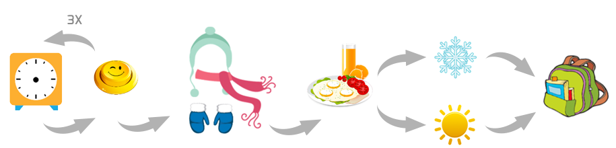
Recap: What is computer programming?
Telling computers to solve a problem
Think about the problem and generate a solution (algorithm)
Break down the problem into step by step solution
Write the solution in a language that computer can understand (coding)
Algorithm for going to school in the morning

Slide 3
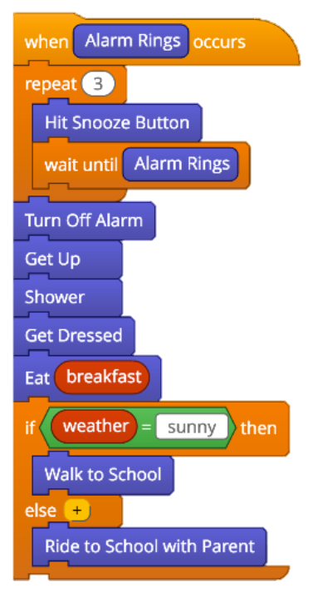
Coding
repetition
Write the step by step instruction in a programming language
Scratch (https://scratch.mit.edu)
sequencing
conditional
logic
https://www.tynker.com/blog/articles/ideas-and-tips/how-to-explain-algorithms-to-kids/

Slide 4
Coding: Decision Trees
Guess a number between 0 and 3:
If the number is bigger than 1 then:
If the number is bigger than 2 then:
The number is 3
Else:
The number is 2
Else:
If the number is bigger than 0 then:
The number is 1
Else:
The number is 0
X > 1?
no
yes
X > 0?
X > 2?
no
yes
no
yes
X = 0
X = 1
X = 2
X = 3

Slide 5
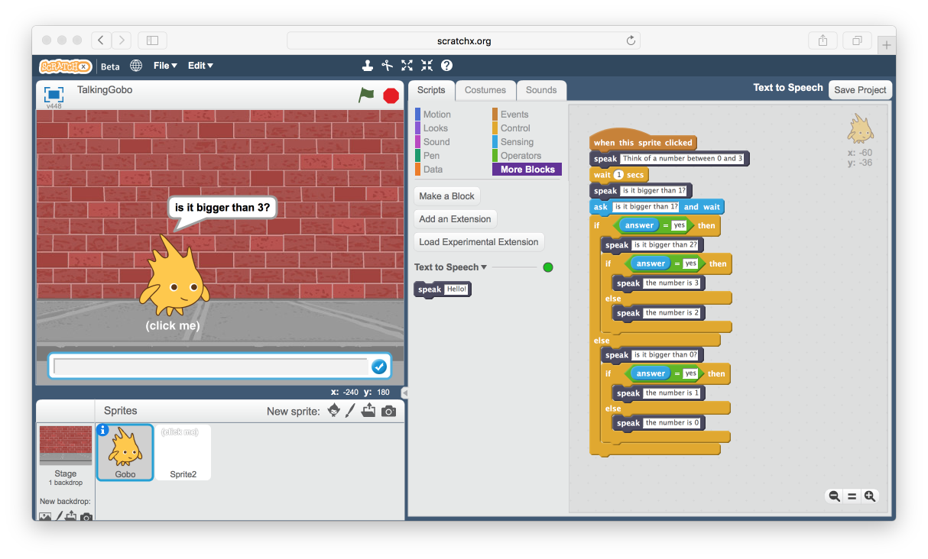
Coding: Decision Trees

Slide 6
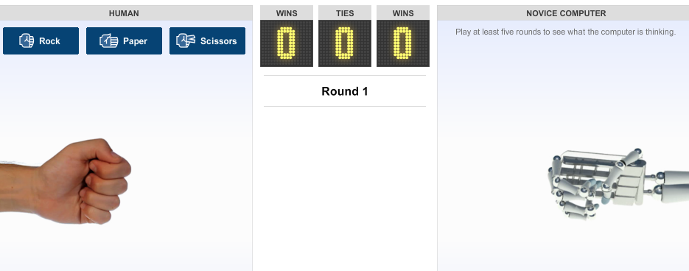
Algorithm: Pattern Recognition
Rock-Paper-Scissors: Human VS Computer
The computer guesses
what we are going to do
next based on the patterns of
our previous throws
http://www.nytimes.com/interactive/science/rock-paper-scissors.html

Slide 7
Algorithm: Pattern Recognition
bakaji bavwa bamona bana
The women saw the children

Slide 8
Algorithm: Pattern Recognition
The child: muana
The children: bana
The woman: mukaji
The women: bakaji
The man: muluma
The men: baluma
The lion: ntambwe
The lions: bantambwe
The small lions: tubantambwe
The small lion: kantambwe
Saw: mumona/bamona/tumona/kamona

Slide 9
More Programming Exercise
Create a story using scratch
Choose Your Own Adventure story

Slide 10
ALGORITHM: Divide and conquer

Slide 11
Algorithm: Divide et Impera
Divide and Conquer
Break the problem to similar but smaller pieces
Solve the smaller problems
Iteratively merge the solutions of smaller problems to get the solution of the bigger problems

Slide 12
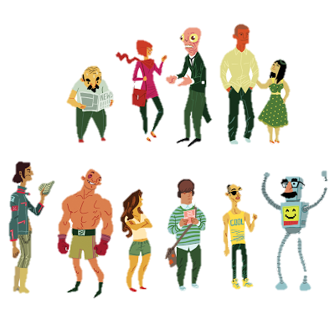
Algorithm: Sorting
We sort things all the time!
Packing, moving, ...
How can we teach computers how to sort things?
http://sambosma.blogspot.com/2009/07/

Slide 13
Algorithm: Selection sort
While there is still some heights to be sorted:
Select the shortest from the set and put it to one side
45

Slide 14
Algorithm: Bubble sort
While there is still some change:
Go through the list and swap side-by-side objects that are in the wrong order of heights
1

Slide 15
Algorithm: Bubble sort
While there is still some change:
Go through the list and swap side-by-side objects that are in the wrong order of heights
2

Slide 16
Algorithm: Bubble sort
While there is still some change:
Go through the list and swap side-by-side objects that are in the wrong order of heights
2

Slide 17
Algorithm: Bubble sort
While there is still some change:
Go through the list and swap side-by-side objects that are in the wrong order of heights
3

Slide 18
Algorithm: Bubble sort
While there is still some change:
Go through the list and swap side-by-side objects that are in the wrong order of heights
3

Slide 19
Algorithm: Bubble sort
While there is still some change:
Go through the list and swap side-by-side objects that are in the wrong order of heights
4

Slide 20
Algorithm: Bubble sort
While there is still some change:
Go through the list and swap side-by-side objects that are in the wrong order of heights
4

Slide 21
Algorithm: Bubble sort
While there is still some change:
Go through the list and swap side-by-side objects that are in the wrong order of heights
5

Slide 22
Algorithm: Bubble sort
While there is still some change:
Go through the list and swap side-by-side objects that are in the wrong order of heights
5

Slide 23
Algorithm: Bubble sort
While there is still some change:
Go through the list and swap side-by-side objects that are in the wrong order of heights
6

Slide 24
Algorithm: Bubble sort
While there is still some change:
Go through the list and swap side-by-side objects that are in the wrong order of heights
6

Slide 25
Algorithm: Bubble sort
While there is still some change:
Go through the list and swap side-by-side objects that are in the wrong order of heights
7

Slide 26
Algorithm: Bubble sort
While there is still some change:
Go through the list and swap side-by-side objects that are in the wrong order of heights
8

Slide 27
Algorithm: Bubble sort
While there is still some change:
Go through the list and swap side-by-side objects that are in the wrong order of heights
8

Slide 28
Algorithm: Bubble sort
While there is still some change:
Go through the list and swap side-by-side objects that are in the wrong order of heights
9

Slide 29
Algorithm: Bubble sort
While there is still some change:
Go through the list and swap side-by-side objects that are in the wrong order of heights
9

Slide 30
Algorithm: Bubble sort
While there is still some change:
Go through the list and swap side-by-side objects that are in the wrong order of heights
10

Slide 31
Algorithm: Bubble sort
While there is still some change:
Go through the list and swap side-by-side objects that are in the wrong order of heights
10

Slide 32
Algorithm: Bubble sort
While there is still some change:
Go through the list and swap side-by-side objects that are in the wrong order of heights
11

Slide 33
Algorithm: Bubble sort
While there is still some change:
Go through the list and swap side-by-side objects that are in the wrong order of heights
11

Slide 34
Algorithm: Bubble sort
While there is still some change:
Go through the list and swap side-by-side objects that are in the wrong order of heights
12

Slide 35
Algorithm: Bubble sort
While there is still some change:
Go through the list and swap side-by-side objects that are in the wrong order of heights
12

Slide 36
Algorithm: Bubble sort
While there is still some change:
Go through the list and swap side-by-side objects that are in the wrong order of heights
13

Slide 37
Algorithm: Bubble sort
While there is still some change:
Go through the list and swap side-by-side objects that are in the wrong order of heights
13

Slide 38
Algorithm: Bubble sort
While there is still some change:
Go through the list and swap side-by-side objects that are in the wrong order of heights
14

Slide 39
Algorithm: Bubble sort
While there is still some change:
Go through the list and swap side-by-side objects that are in the wrong order of heights
14

Slide 40
Algorithm: Bubble sort
While there is still some change:
Go through the list and swap side-by-side objects that are in the wrong order of heights
15

Slide 41
Algorithm: Bubble sort
While there is still some change:
Go through the list and swap side-by-side objects that are in the wrong order of heights
16

Slide 42
Algorithm: Bubble sort
While there is still some change:
Go through the list and swap side-by-side objects that are in the wrong order of heights
16

Slide 43
Algorithm: Bubble sort
While there is still some change:
Go through the list and swap side-by-side objects that are in the wrong order of heights
17

Slide 44
Algorithm: Bubble sort
While there is still some change:
Go through the list and swap side-by-side objects that are in the wrong order of heights
17

Slide 45
Algorithm: Bubble sort
While there is still some change:
Go through the list and swap side-by-side objects that are in the wrong order of heights
18

Slide 46
Algorithm: Bubble sort
While there is still some change:
Go through the list and swap side-by-side objects that are in the wrong order of heights
19

Slide 47
Algorithm: Bubble sort
While there is still some change:
Go through the list and swap side-by-side objects that are in the wrong order of heights
20

Slide 48
Algorithm: Bubble sort
While there is still some change:
Go through the list and swap side-by-side objects that are in the wrong order of heights
20

Slide 49
Algorithm: Bubble sort
While there is still some change:
Go through the list and swap side-by-side objects that are in the wrong order of heights
21

Slide 50
Algorithm: Bubble sort
While there is still some change:
Go through the list and swap side-by-side objects that are in the wrong order of heights
21

Slide 51
Algorithm: Bubble sort
While there is still some change:
Go through the list and swap side-by-side objects that are in the wrong order of heights
22

Slide 52
Algorithm: Bubble sort
While there is still some change:
Go through the list and swap side-by-side objects that are in the wrong order of heights
22

Slide 53
Algorithm: Bubble sort
While there is still some change:
Go through the list and swap side-by-side objects that are in the wrong order of heights
23

Slide 54
Algorithm: Bubble sort
While there is still some change:
Go through the list and swap side-by-side objects that are in the wrong order of heights
24

Slide 55
Algorithm: Bubble sort
While there is still some change:
Go through the list and swap side-by-side objects that are in the wrong order of heights
24

Slide 56
Algorithm: Bubble sort
While there is still some change:
Go through the list and swap side-by-side objects that are in the wrong order of heights
25

Slide 57
Algorithm: Bubble sort
While there is still some change:
Go through the list and swap side-by-side objects that are in the wrong order of heights
25

Slide 58
Algorithm: Bubble sort
While there is still some change:
Go through the list and swap side-by-side objects that are in the wrong order of heights
26

Slide 59
Algorithm: Bubble sort
While there is still some change:
Go through the list and swap side-by-side objects that are in the wrong order of heights
27

Slide 60
Algorithm: Bubble sort
While there is still some change:
Go through the list and swap side-by-side objects that are in the wrong order of heights
28

Slide 61
Algorithm: Bubble sort
While there is still some change:
Go through the list and swap side-by-side objects that are in the wrong order of heights
29

Slide 62
Algorithm: Bubble sort
While there is still some change:
Go through the list and swap side-by-side objects that are in the wrong order of heights
29

Slide 63
Algorithm: Bubble sort
While there is still some change:
Go through the list and swap side-by-side objects that are in the wrong order of heights
30

Slide 64
Algorithm: Bubble sort
While there is still some change:
Go through the list and swap side-by-side objects that are in the wrong order of heights
30

Slide 65
Algorithm: Bubble sort
While there is still some change:
Go through the list and swap side-by-side objects that are in the wrong order of heights
31

Slide 66
Algorithm: Bubble sort
While there is still some change:
Go through the list and swap side-by-side objects that are in the wrong order of heights
32

Slide 67
Algorithm: Bubble sort
While there is still some change:
Go through the list and swap side-by-side objects that are in the wrong order of heights
32

Slide 68
Algorithm: Bubble sort
While there is still some change:
Go through the list and swap side-by-side objects that are in the wrong order of heights
33

Slide 69
Algorithm: Bubble sort
While there is still some change:
Go through the list and swap side-by-side objects that are in the wrong order of heights
33

Slide 70
Algorithm: Bubble sort
While there is still some change:
Go through the list and swap side-by-side objects that are in the wrong order of heights
34

Slide 71
Algorithm: Bubble sort
While there is still some change:
Go through the list and swap side-by-side objects that are in the wrong order of heights
35

Slide 72
Algorithm: Bubble sort
While there is still some change:
Go through the list and swap side-by-side objects that are in the wrong order of heights
36

Slide 73
Algorithm: Bubble sort
While there is still some change:
Go through the list and swap side-by-side objects that are in the wrong order of heights
37

Slide 74
Algorithm: Bubble sort
While there is still some change:
Go through the list and swap side-by-side objects that are in the wrong order of heights
37

Slide 75
Algorithm: Bubble sort
While there is still some change:
Go through the list and swap side-by-side objects that are in the wrong order of heights
38

Slide 76
Algorithm: Bubble sort
While there is still some change:
Go through the list and swap side-by-side objects that are in the wrong order of heights
38

Slide 77
Algorithm: Bubble sort
While there is still some change:
Go through the list and swap side-by-side objects that are in the wrong order of heights
39

Slide 78
Algorithm: Bubble sort
While there is still some change:
Go through the list and swap side-by-side objects that are in the wrong order of heights
40

Slide 79
Algorithm: Bubble sort
While there is still some change:
Go through the list and swap side-by-side objects that are in the wrong order of heights
40

Slide 80
Algorithm: Bubble sort
While there is still some change:
Go through the list and swap side-by-side objects that are in the wrong order of heights
41

Slide 81
Algorithm: Bubble sort
While there is still some change:
Go through the list and swap side-by-side objects that are in the wrong order of heights
41

Slide 82
Algorithm: Bubble sort
While there is still some change:
Go through the list and swap side-by-side objects that are in the wrong order of heights
42

Slide 83
Algorithm: Bubble sort
While there is still some change:
Go through the list and swap side-by-side objects that are in the wrong order of heights
43

Slide 84
Algorithm: Bubble sort
While there is still some change:
Go through the list and swap side-by-side objects that are in the wrong order of heights
44

Slide 85
Algorithm: Bubble sort
While there is still some change:
Go through the list and swap side-by-side objects that are in the wrong order of heights
45

Slide 86
Algorithm: Bubble sort
While there is still some change:
Go through the list and swap side-by-side objects that are in the wrong order of heights
46

Slide 87
Algorithm: Bubble sort
While there is still some change:
Go through the list and swap side-by-side objects that are in the wrong order of heights
46

Slide 88
Algorithm: Bubble sort
While there is still some change:
Go through the list and swap side-by-side objects that are in the wrong order of heights
47

Slide 89
Algorithm: Bubble sort
While there is still some change:
Go through the list and swap side-by-side objects that are in the wrong order of heights
48

Slide 90
Algorithm: Bubble sort
While there is still some change:
Go through the list and swap side-by-side objects that are in the wrong order of heights
48

Slide 91
Algorithm: Bubble sort
While there is still some change:
Go through the list and swap side-by-side objects that are in the wrong order of heights
49

Slide 92
Algorithm: Bubble sort
While there is still some change:
Go through the list and swap side-by-side objects that are in the wrong order of heights
49

Slide 93
Algorithm: Bubble sort
While there is still some change:
Go through the list and swap side-by-side objects that are in the wrong order of heights
50

Slide 94
Algorithm: Bubble sort
While there is still some change:
Go through the list and swap side-by-side objects that are in the wrong order of heights
51

Slide 95
Algorithm: Bubble sort
While there is still some change:
Go through the list and swap side-by-side objects that are in the wrong order of heights
52

Slide 96
Algorithm: Bubble sort
While there is still some change:
Go through the list and swap side-by-side objects that are in the wrong order of heights
53

Slide 97
Algorithm: Bubble sort
While there is still some change:
Go through the list and swap side-by-side objects that are in the wrong order of heights
54

Slide 98
Algorithm: Bubble sort
While there is still some change:
Go through the list and swap side-by-side objects that are in the wrong order of heights
55

Slide 99
Algorithm: Bubble sort
While there is still some change:
Go through the list and swap side-by-side objects that are in the wrong order of heights
56

Slide 100
Algorithm: Bubble sort
While there is still some change:
Go through the list and swap side-by-side objects that are in the wrong order of heights
56

Slide 101
Algorithm: Bubble sort
While there is still some change:
Go through the list and swap side-by-side objects that are in the wrong order of heights
57

Slide 102
Algorithm: Bubble sort
While there is still some change:
Go through the list and swap side-by-side objects that are in the wrong order of heights
57

Slide 103
Algorithm: Bubble sort
While there is still some change:
Go through the list and swap side-by-side objects that are in the wrong order of heights
58

Slide 104
Algorithm: Bubble sort
While there is still some change:
Go through the list and swap side-by-side objects that are in the wrong order of heights
59

Slide 105
Algorithm: Bubble sort
While there is still some change:
Go through the list and swap side-by-side objects that are in the wrong order of heights
60

Slide 106
Algorithm: Bubble sort
While there is still some change:
Go through the list and swap side-by-side objects that are in the wrong order of heights
61

Slide 107
Algorithm: Bubble sort
While there is still some change:
Go through the list and swap side-by-side objects that are in the wrong order of heights
62

Slide 108
Algorithm: Bubble sort
While there is still some change:
Go through the list and swap side-by-side objects that are in the wrong order of heights
63

Slide 109
Algorithm: Bubble sort
While there is still some change:
Go through the list and swap side-by-side objects that are in the wrong order of heights
64

Slide 110
Algorithm: Bubble sort
While there is still some change:
Go through the list and swap side-by-side objects that are in the wrong order of heights
64

Slide 111
Algorithm: Bubble sort
While there is still some change:
Go through the list and swap side-by-side objects that are in the wrong order of heights
65

Slide 112
Algorithm: Bubble sort
While there is still some change:
Go through the list and swap side-by-side objects that are in the wrong order of heights
65

Slide 113
Algorithm: Bubble sort
While there is still some change:
Go through the list and swap side-by-side objects that are in the wrong order of heights
66

Slide 114
Algorithm: Bubble sort
While there is still some change:
Go through the list and swap side-by-side objects that are in the wrong order of heights
67

Slide 115
Algorithm: Bubble sort
While there is still some change:
Go through the list and swap side-by-side objects that are in the wrong order of heights
68

Slide 116
Algorithm: Bubble sort
While there is still some change:
Go through the list and swap side-by-side objects that are in the wrong order of heights
69

Slide 117
Algorithm: Bubble sort
While there is still some change:
Go through the list and swap side-by-side objects that are in the wrong order of heights
70

Slide 118
Algorithm: Bubble sort
While there is still some change:
Go through the list and swap side-by-side objects that are in the wrong order of heights
71

Slide 119
Algorithm: Bubble sort
While there is still some change:
Go through the list and swap side-by-side objects that are in the wrong order of heights
72

Slide 120
Algorithm: Bubble sort
While there is still some change:
Go through the list and swap side-by-side objects that are in the wrong order of heights
73

Slide 121
Algorithm: Bubble sort
While there is still some change:
Go through the list and swap side-by-side objects that are in the wrong order of heights
73

Slide 122
Algorithm: Bubble sort
While there is still some change:
Go through the list and swap side-by-side objects that are in the wrong order of heights
74

Slide 123
Algorithm: Bubble sort
While there is still some change:
Go through the list and swap side-by-side objects that are in the wrong order of heights
75

Slide 124
Algorithm: Bubble sort
While there is still some change:
Go through the list and swap side-by-side objects that are in the wrong order of heights
76

Slide 125
Algorithm: Bubble sort
While there is still some change:
Go through the list and swap side-by-side objects that are in the wrong order of heights
77

Slide 126
Algorithm: Bubble sort
While there is still some change:
Go through the list and swap side-by-side objects that are in the wrong order of heights
78

Slide 127
Algorithm: Bubble sort
While there is still some change:
Go through the list and swap side-by-side objects that are in the wrong order of heights
79

Slide 128
Algorithm: Bubble sort
While there is still some change:
Go through the list and swap side-by-side objects that are in the wrong order of heights
80

Slide 129
Algorithm: Bubble sort
While there is still some change:
Go through the list and swap side-by-side objects that are in the wrong order of heights
81

Slide 130
Algorithm: Bubble sort
While there is still some change:
Go through the list and swap side-by-side objects that are in the wrong order of heights
82

Slide 131
Algorithm: Bubble sort
While there is still some change:
Go through the list and swap side-by-side objects that are in the wrong order of heights
83

Slide 132
Algorithm: Bubble sort
While there is still some change:
Go through the list and swap side-by-side objects that are in the wrong order of heights
84

Slide 133
Algorithm: Bubble sort
While there is still some change:
Go through the list and swap side-by-side objects that are in the wrong order of heights
85

Slide 134
Algorithm: Bubble sort
While there is still some change:
Go through the list and swap side-by-side objects that are in the wrong order of heights
86

Slide 135
Algorithm: Bubble sort
While there is still some change:
Go through the list and swap side-by-side objects that are in the wrong order of heights
87

Slide 136
Algorithm: Bubble sort
While there is still some change:
Go through the list and swap side-by-side objects that are in the wrong order of heights
88

Slide 137
Algorithm: Bubble sort
While there is still some change:
Go through the list and swap side-by-side objects that are in the wrong order of heights
89

Slide 138
Algorithm: Bubble sort
While there is still some change:
Go through the list and swap side-by-side objects that are in the wrong order of heights
90

Slide 139
Algorithm: Quick Sort
While the group has more than 1 object
Pick one object at random, put objects shorter than it on its left and objects taller than it on its right
Repeat this same procedure on the left and right groups

Slide 140
Algorithm: Quick Sort
While the group has more than 1 object
Pick one object at random, put objects shorter than it on its left and objects taller than it on its right
Repeat this same procedure on the left and right groups
9

Slide 141
Algorithm: Quick Sort
While the group has more than 1 object
Pick one object at random, put objects shorter than it on its left and objects taller than it on its right
Repeat this same procedure on the left and right groups
9

Slide 142

Algorithm: Quick Sort
While the group has more than 1 object
Pick one object at random, put objects shorter than it on its left and objects taller than it on its right
Repeat this same procedure on the left and right groups
16

Slide 143
Algorithm: Quick Sort
While the group has more than 1 object
Pick one object at random, put objects shorter than it on its left and objects taller than it on its right
Repeat this same procedure on the left and right groups
16

Slide 144
Algorithm: Quick Sort
While the group has more than 1 object
Pick one object at random, put objects shorter than it on its left and objects taller than it on its right
Repeat this same procedure on the left and right groups
19

Slide 145
Algorithm: Quick Sort
While the group has more than 1 object
Pick one object at random, put objects shorter than it on its left and objects taller than it on its right
Repeat this same procedure on the left and right groups
19

Slide 146
Algorithm: Quick Sort
While the group has more than 1 object
Pick one object at random, put objects shorter than it on its left and objects taller than it on its right
Repeat this same procedure on the left and right groups
19

Slide 147
Algorithm: Quick Sort
While the group has more than 1 object
Pick one object at random, put objects shorter than it on its left and objects taller than it on its right
Repeat this same procedure on the left and right groups
19

Slide 148
Next week:
Algorithm: Divide and Conquer
Tower of Hanoi (https://www.mathsisfun.com/games/towerofhanoi.html)

Slide 149
Questions?

