Slide 1
Ricochet
A Family of Unconstrained Algorithms for Graph Clustering

Slide 2
Background
Clustering is an unsupervised process of discovering natural clusters:
  Objects within the same cluster are “similar”
  Objects from different clusters are “dissimilar”
When we have similarity metrics, we can represent objects in a similarity graph:
  Vertices represent objects
  Edges represent similarity between objects
Clustering translates to graph clustering for dense graph

Slide 3
Background
Motivation: clustering algorithm often necessitates a priori decisions on parameters
Based on our study on:
  Star clustering [1] to select significant vertices
    Using Star clustering’s method for selecting cluster seeds, without the need for number of clusters
  Single-link hierarchical clustering [2] to select significant edges
    Using single-link hierarchical clustering’s method for selecting edges, without the need for threshold
  K-means [3] for termination condition
    Using re-assignment of vertices, clusters’ quality can be updated and improved. Reach a terminating condition without the need for number of clusters or threshold

Slide 4

Contribution
Ricochet does not require any parameter to be set a priori
Alternate two phases:
  Choice of vertices to be seeds using average metric [1]:
  ave(v) = Σ_{∀vi ∈ v.adj} sim(v_{i},v) / degree(v)
  Assignment of vertices into clusters using single-link hierarchical clustering and K-means method
Pictorially, resembling the rippling of stones thrown in a pond, thus the name: Ricochet

Slide 5
Ricochet family
Sequential rippling
  Stones are thrown one after another
  Hard clustering
  Straightforward extension to K-means
Concurrent rippling
  Stones are thrown at the same time
  Soft clustering

Slide 6
Sequential Rippling
Sequential Rippling (SR)
  Choose the heaviest vertex (vertex with the biggest ave(v)) as the first seed
  One cluster is formed containing all vertices
  Subsequent seeds are chosen from the list of ordered vertices from heaviest to lightest
    When new seed is added, re-assign vertices to nearest seeds
    Clusters reduced to singletons are assigned to other nearest seeds
  Stop when all vertices have been considered
Balanced Sequential Rippling (BSR)
  Balances the distribution of seeds
  Subsequent seed is chosen as one that maximizes the ratio of its weight (ave(v)) to the sum of its similarities to existing seeds
  Stop when there is no more re-assignment
O (N³)

Slide 7
Balanced Sequential Rippling

Slide 8
Concurrent Rippling
Concurrent Rippling (CR)
  Each vertex is initially a seed
  At each iteration, find all edges connecting vertices to their next most similar neighbors
    Find the minimum of these edges, e_{min}
    Collect all unprocessed edges whose weight are ≥ e_{min}
    Process these edges from heaviest to lightest:
      If an edge connects a seed to a non-seed, add the non-seed to the seed’s cluster
      If an edge connects two seeds, the cluster of one is absorbed by the other if its weight (ave(v)) is smaller than the weight of the other seed
  Stop when the seeds no longer change
Ordered Concurrent Rippling (OCR)
  At each iteration, process edges connecting vertices to their next most similar neighbors from heaviest edge to lightest edge
O (N²logN)

Slide 9
Ordered Concurrent Rippling
2nd iteration
1st iteration
_{S}
_{S}
_{S}
_{S}
_{S}

Slide 10
Ordered Concurrent Rippling
At each step, OCR tries to maximize the average similarity between vertices and their seeds:
  OCR processes adjacent vertices of each vertex in order of their similarity from highest to lowest, ensuring best possible merger for the vertex at each iteration
  OCR chooses the bigger weight (ave(v)) vertex as seed whenever two seeds are adjacent to one another. As in [1, 4] this is an approximation to maximizing the average similarity between the seed and its vertices

Slide 11
Experiments
Compare performance with constrained clustering algorithms (K-medoids [5], Star clustering [4]) and unconstrained clustering algorithms (Markov Clustering [6])
Use data from Reuters-21578, Tipster-AP, and our original collection: Google
Measure effectiveness: recall, precision, F1
Measure efficiency: running time

Slide 12
Experimental Results
Comparison with constrained algorithms
Effectiveness:
  BSR and OCR are most effective
  BSR achieves higher precision than K-medoids, Star and Star-Ave
  OCR achieves higher or comparable F1 than K-medoids, Star and Star-Ave
Efficiency:
  OCR is faster than Star and Star-Ave, but is slower than K-medoids due to the pre-processing time required to build the graph

Slide 13
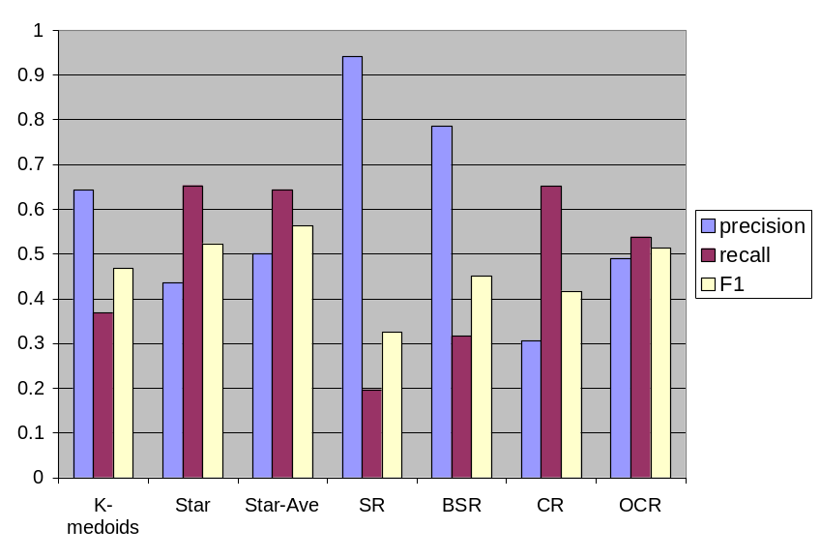
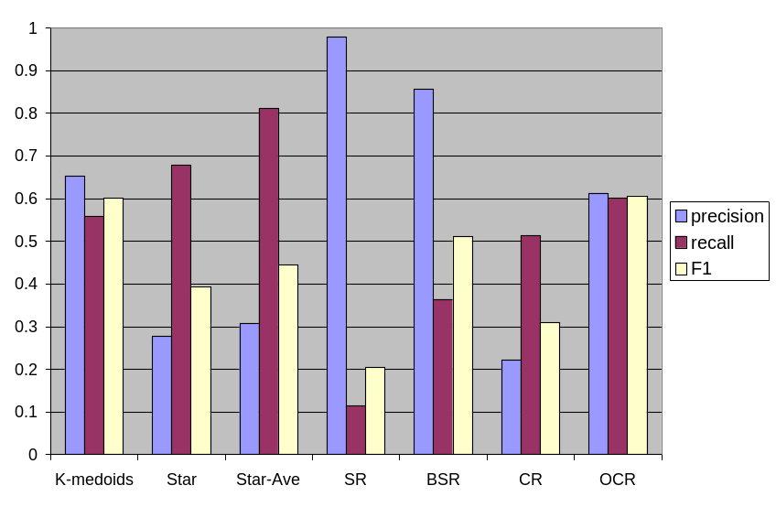
Experimental Results
Effectiveness comparison
Reuters
Tipster-AP

Slide 14
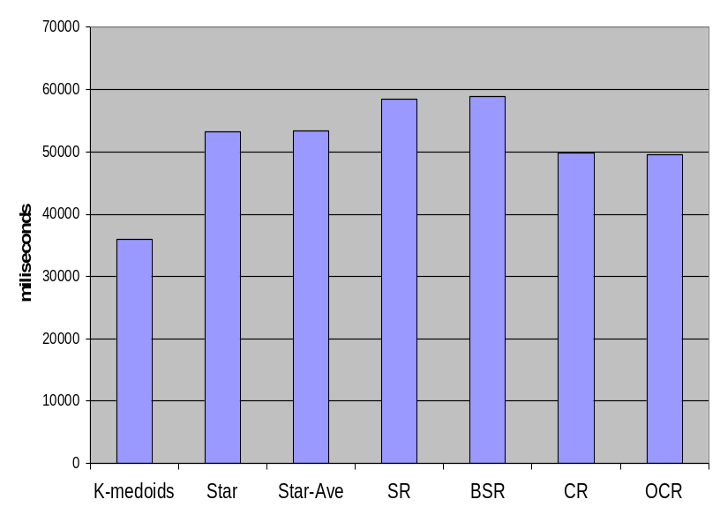
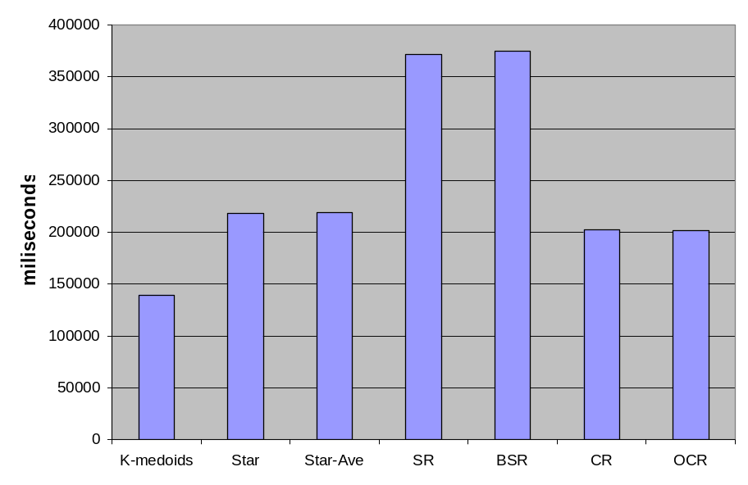
Experimental Results
Efficiency comparison
Reuters
Tipster-AP

Slide 15
Experimental Results
Comparison with unconstrained algorithms
Compare with Markov Clustering (MCL) that has an intrinsic inflation parameter (MCL is sensitive to this choice of inflation parameter)
Effectiveness
  BSR and OCR are competitive to MCL set at its best inflation value
  BSR and OCR are much more effective than MCL at its minimum and maximum inflation values
Efficiency
  BSR and OCR are significantly faster than MCL at all inflation values

Slide 16
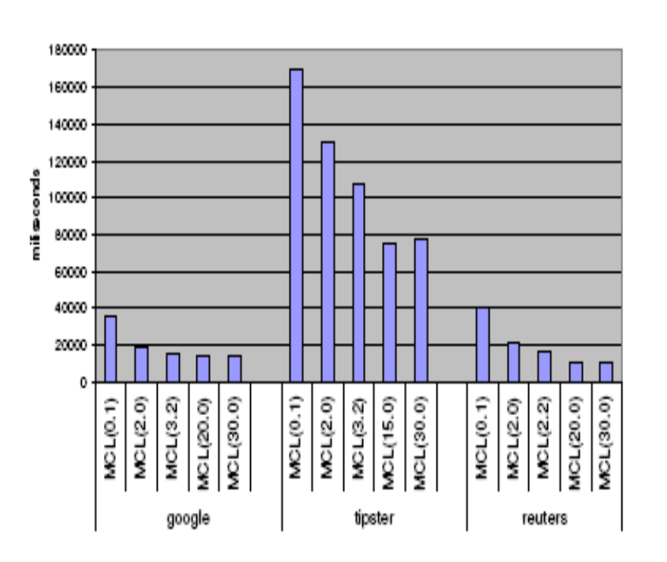
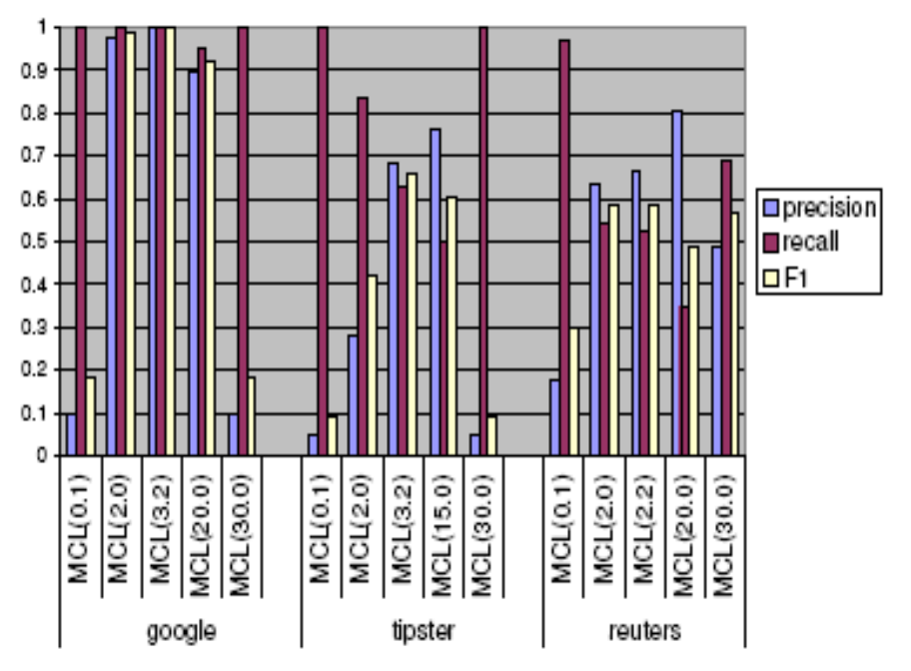
Experimental Results
Effectiveness and efficiency of MCL at different inflation parameters

Slide 17
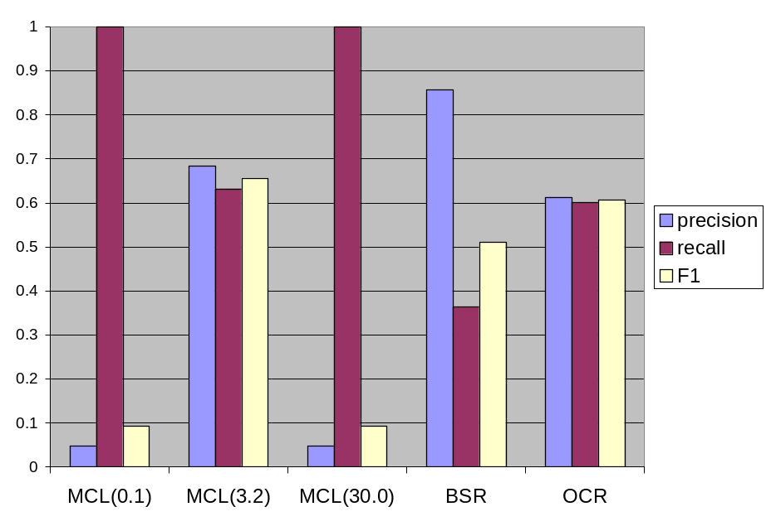
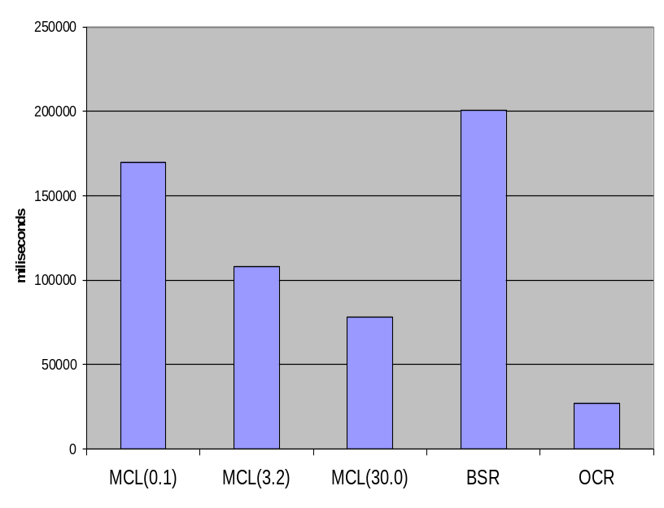
Experimental Results
Effectiveness and efficiency comparison (on Tipster-AP)

Slide 18
Summary
We propose Ricochet, a family of algorithms for clustering weighted graphs
Our proposed algorithms are unconstrained, they do not require a priori setting of extrinsic or intrinsic parameters
OCR yields a very respectable effectiveness while being efficient
Pre-processing time is still a bottleneck when compared to non-graph clustering algorithms like K-medoids

Slide 19
References
Wijaya D., Bressan S.: Journey to the Centre of the Star: Various Ways of Finding Star Centers in Star Clustering. In: 18th International Conference on Database and Expert Systems Applications DEXA (2007)
Croft, W. B.: Clustering Large Files of Documents using the Single-link Method. In: Journal of the American Society for Information Science, 189--195 (1977)
MacQueen, J. B.: Some Methods for Classification and Analysis of Multivariate Observations. In: 5th Berkeley Symposium on Mathematical Statistics and Probability. Berkeley, 1:281--297. University of California Press (1967)
Aslam, J., Pelekhov, K., Rus, D.: The Star Clustering Algorithm. In: Journal of Graph Algorithms and Applications, 8(1) 95--129 (2004)
Kaufman L., Rousseeuw P.: Finding Groups in Data: An Introduction to Cluster Analysis. John Wiley and Sons, New York (1990)
Van Dongen, S. M.: Graph Clustering by Flow Simulation. In: Tekst. Proefschrift Universiteit Utrecht (2000)

