Slide 1
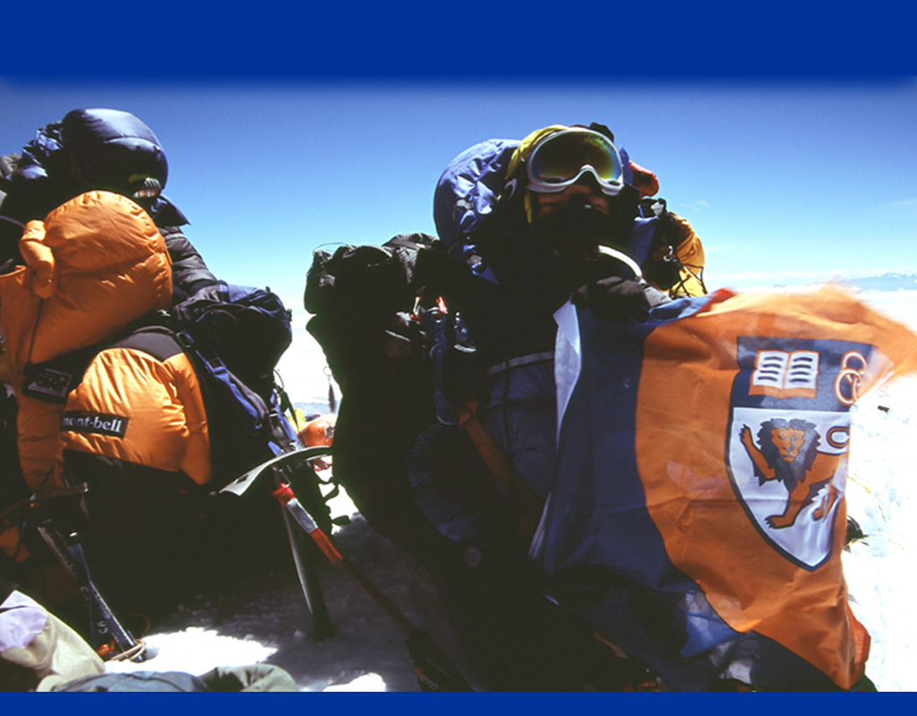





18th International Conference on Database and Expert Systems Applications
Journey to the Centre of the Star:
Various Ways of Finding Star Centers in Star Clustering
Tok Wee Hyong
Derry Tanti Wijaya
Stéphane Bressan

Slide 2

Vector Space Clustering
Naturally translates into a graph clustering problem for a dense graph
Weight is cosine of corresponding vectors
_{Vectors}

Slide 3
Star Clustering for Graph [1]
Computes vertex cover by a simple computation of star-shaped dense sub-graphs
Lower weight edges are pruned
Vertices with higher degree (that are not satellites) are chosen in turn as Star centers
Vertices connected to a center become satellites
Algorithm terminates when every vertex is either a center or a satellite
Each center and its satellites form a cluster

Slide 4
Star Clustering
Does not require the indication of an a priori number of clusters
Allows clusters to overlap
Analytically guarantees a lower bound on the similarity between objects in each cluster
Computes more accurate clusters than either the single or average link hierarchical clustering

Slide 5
Star Clustering
Two critical elements:
  Threshold for pruning edges (σ)
  Metrics for selecting Star centers
Aslam et al. [1] derived the theoretical lower bound on the expected similarity between two satellites in a cluster
Empirically shown to be a good estimate of the actual similarity
Current metrics for selecting Star centers does not leverage this finding
Our focus is on the metrics for selecting Star centers

Slide 6
Extended Star Clustering
Choose Star centers using complement degree of vertices
Allow Star centers to be adjacent to one another
Has two versions: unrestricted and restricted

Slide 7
Our proposal
Degree may not be the best metrics
We propose metrics that considers weights of edges in order to maximize intra-cluster similarity:
  Markov Stationary Distribution
  Lower Bound
  Average
  Sum

Slide 8
Markov Stationary Distribution
Similar to the idea of Google’s Page Rank algorithm [2]
Method:
Similarity graph is normalized into a symmetric Markov matrix
Compute the stationary distribution of the matrix
A* = (I – A) ⁻¹
Vertices are sorted by their stationary values and chosen in turn as Star centers

Slide 9
Lower Bound
Theoretical lower bound on expected similarity between satellite vertices:
cos(γi,j) ≥ cos(αi) cos(αj)+ (σ / σ + 1) sin(αi) sin(αj)
Can be used to estimate the average intra-cluster similarity
Lower bound metric is the estimated average intra-cluster similarity when v is a Star center and v.adj are its satellites
lb (v) = ((Σ_{vi ∈ v.adj} cos(αi)) ² + (σ / σ + 1) (Σ_{vi ∈ v.adj} sin(αi)) ²) / n²
Computed on the pruned graph

Slide 10
Average and Sum
Approximations of the lower bound metric
Computed on the pruned graph
For each vertex v,
ave (v) = Σ_{∀vi ∈ v.adj} cos(αi) / degree(v)
sum (v) = Σ_{∀vi ∈ v.adj} cos(αi)
Average metric is the square root of the first term in the lower bound metric

Slide 11
Markov, Lower Bound, Average, Sum Metrics
We integrate our proposed metrics in the Star algorithm and its variants to produce:
  Star-lb
  Star-sum
  Star-ave
  Star-markov
  Star-extended-sum-(r)
  Star-extended-ave-(r)
  Star-extended-sum-(u)
  Star-extended-ave-(u)
  Star-online-sum
  Star-online-ave

Slide 12
Experiments
Compare performance with off-line and on-line Star clustering and restricted and unrestricted Extended Star clustering
Use data from Reuters-21578, Tipster-AP, and our original collection: Google
Measure effectiveness: recall, precision, F1
Measure efficiency: running time
Measure sensitivity to σ

Slide 13
Off-line Algorithms
Star-lb and Star-ave are most effective but Star-ave is much more efficient
Star-random performs comparably to original Star when threshold σ is the average similarity

Slide 14
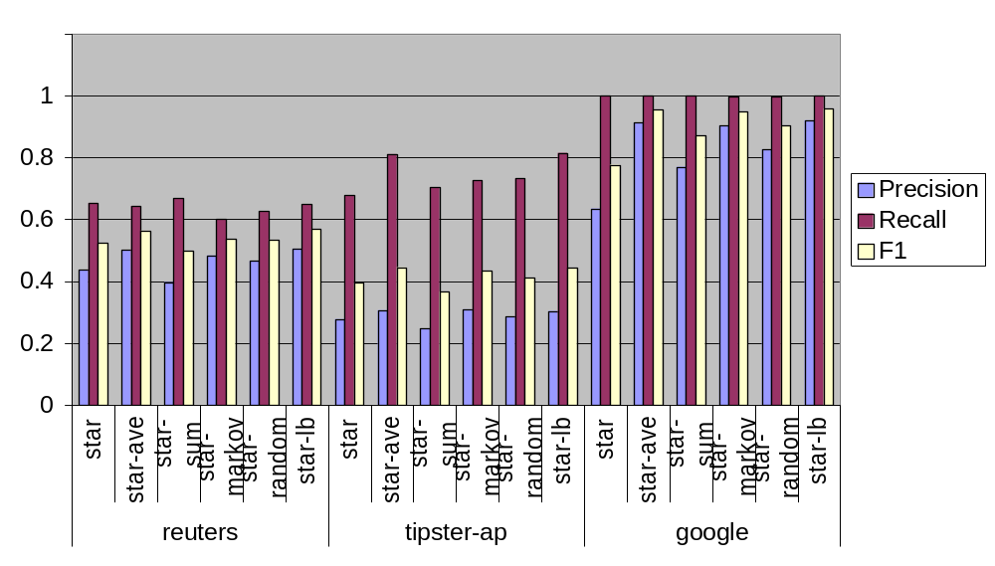
Off-line Algorithms
Effectiveness comparison

Slide 15
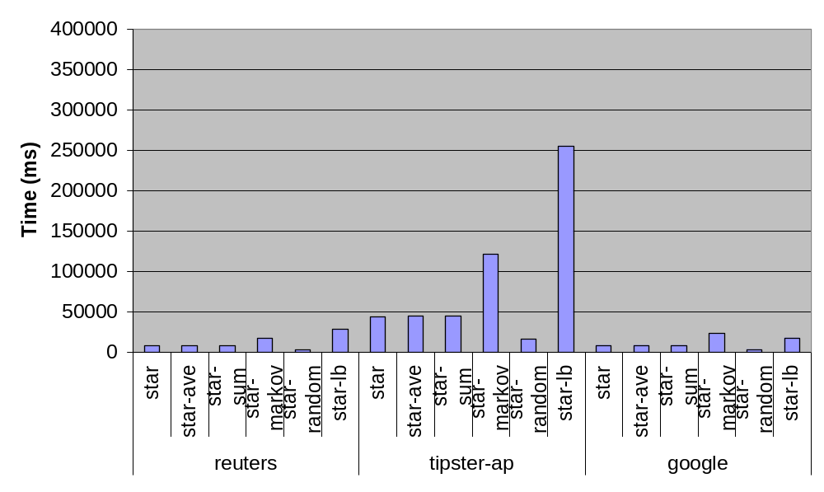
Off-line Algorithms
Efficiency comparison

Slide 16
Order of Stars
We empirically demonstrate that Star-ave indeed approximates Star-lb better than other algorithms by a similar choice of Star centers

Slide 17
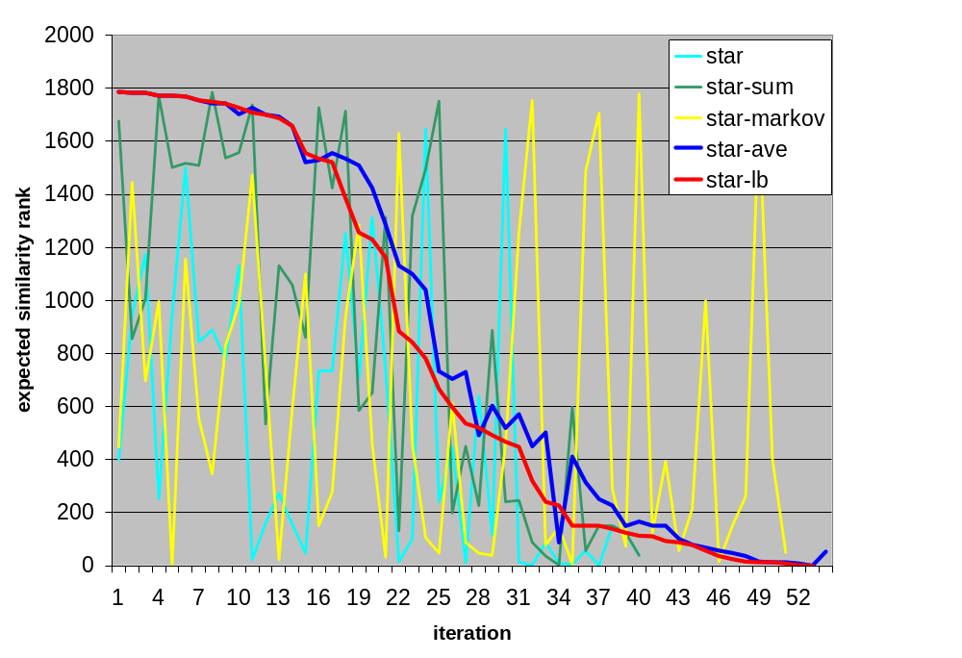
Order of Stars (on Tipster-AP)

Slide 18
Sensitivity to σ
As compared to the original Star:
Star-ave and Star-markov converge to a maximum F1 at a lower threshold
The maximum F1 of Star-ave is higher
F1 gradient of Star-ave and Star-markov is smaller

Slide 19
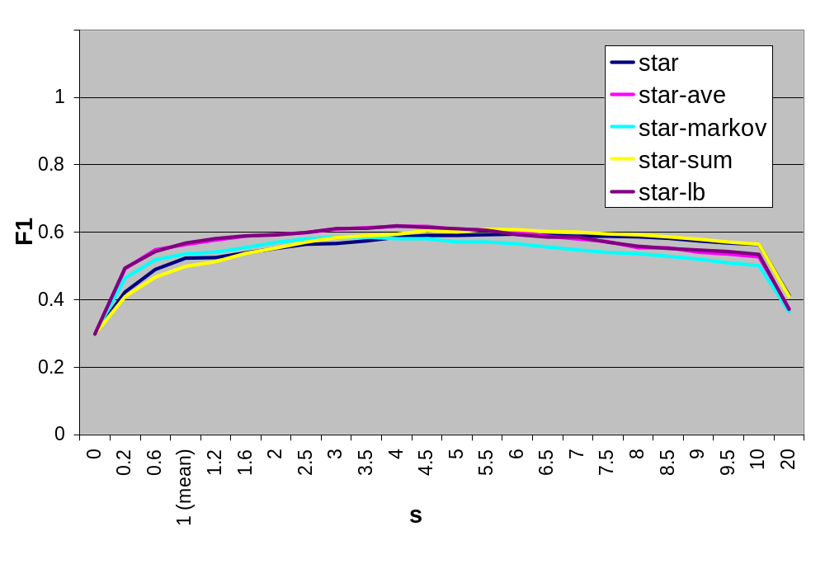
Sensitivity to σ (F1 on Reuters)
_{σ}

Slide 20
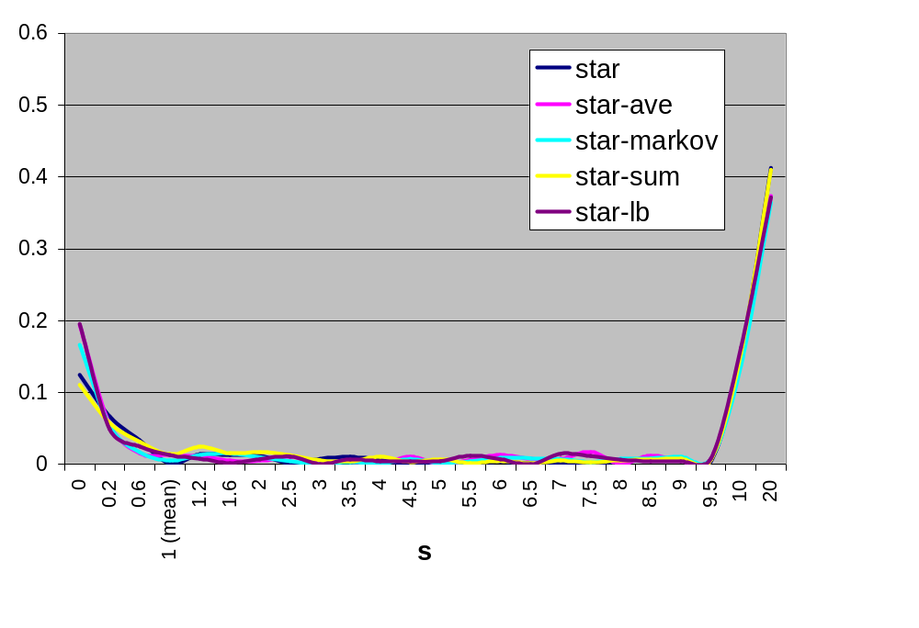
Sensitivity to σ (F1 gradient on Reuters)
_{σ}

Slide 21
Extended Star
Star-ave is more effective and efficient than Star-extended-(r)
Star-extended-ave-(r) improves the effectiveness of Star-extended-(r)
Similar findings are observed with Star-extended-(u)

Slide 22
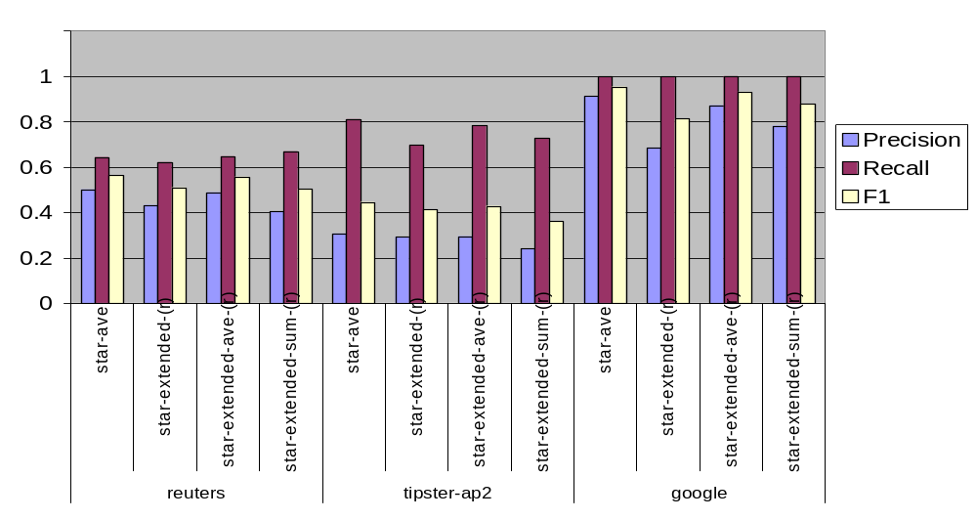
Extended Star
Effectiveness comparison

Slide 23
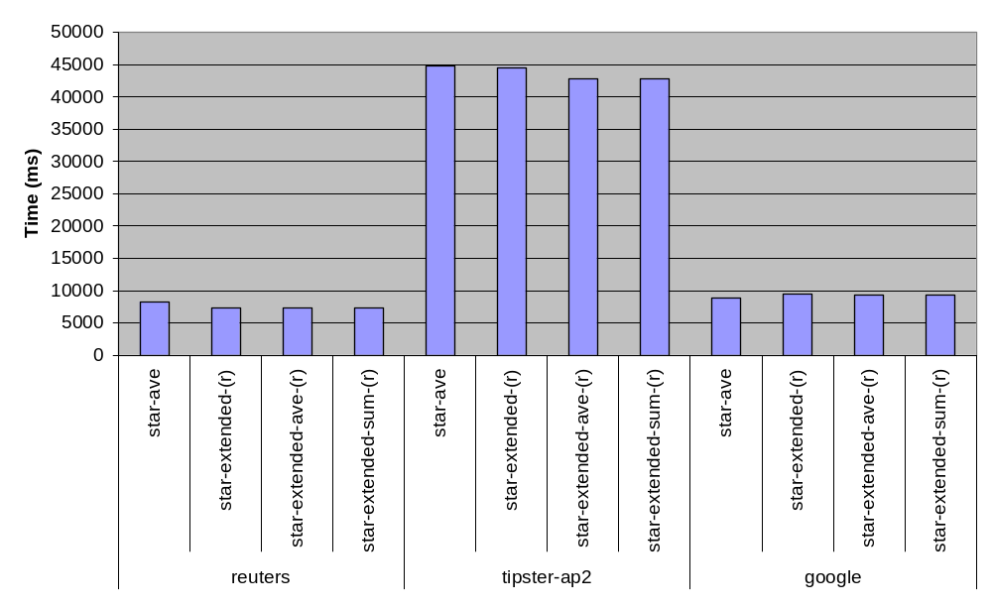
Extended Star
Efficiency comparison

Slide 24
On-line Algorithms
Star-online-ave is more effective and efficient than the original Star on-line algorithm

Slide 25
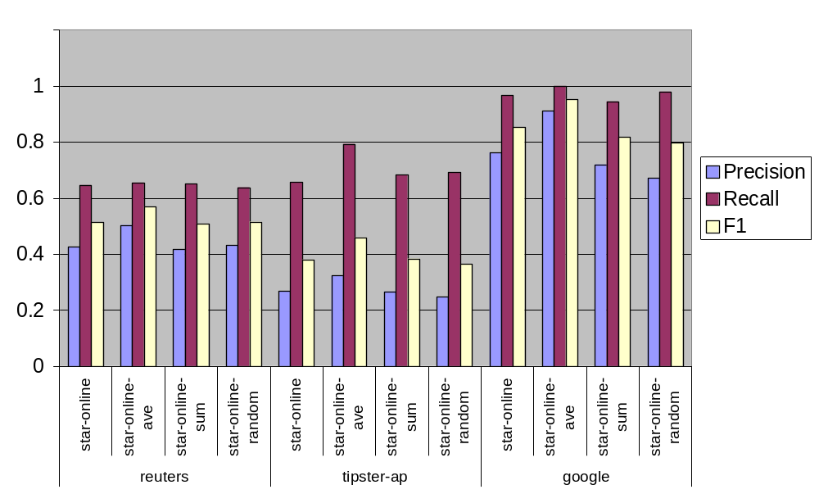
On-line Algorithms
Effectiveness comparison

Slide 26
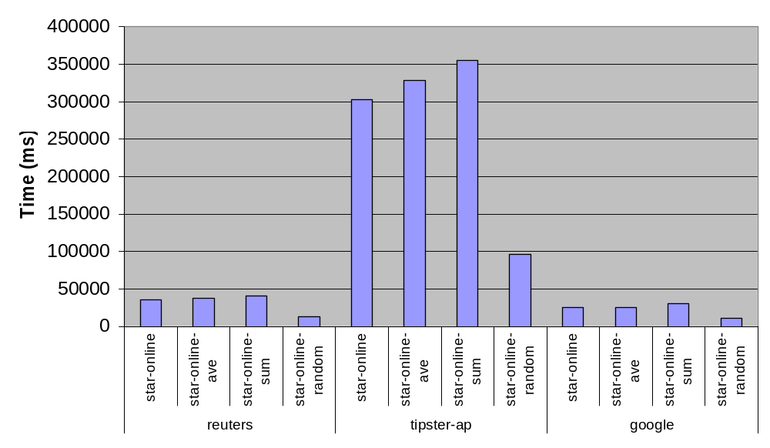
On-line Algorithms
Efficiency comparison

Slide 27
Conclusion
Current metrics for selecting Star centers is not optimal
We propose various new metrics for selecting Star centers that maximize intra-cluster similarity
Average metrics is a fast and good approximation of lower bound metrics
Since intra-cluster similarity is maximized, it is precision that is mostly improved
Our proposed average metrics yield up to 19.1% improvement on precision for off-line algorithms, 20.9% improvement on precision for on-line algorithms, and 102% improvement on precision for extended star algorithm

Slide 28
References
Aslam, J., Pelekhov, K., Rus, D.: The Star Clustering Algorithm. In Journal of Graph Algorithms and Applications, 8(1) 95–129 (2004)
Brin Sergey, Page Lawrence: The anatomy of a large-scale hypertextual Web search engine. Proceedings of the seventh international conference on World Wide Web 7, 107-117 (1998)

Slide 29

Credits
This work
was funded
by the
National University of Singapore
ARG project R-252-000-285-112,
"Mind Your Language:
Corpora and Algorithms
for Fundamental
Natural Language Processing Tasks
in Information Retrieval
and Extraction
for the Indonesian
and Malay languages"
Copyright © 2007 by Stéphane Bressan

