Slide 1
Hierarchical Clustering for POS Tagging of the Indonesian Language
Derry Tanti Wijaya and Stéphane Bressan

Slide 2
Motivation
Lack of annotated training data for Bahasa Indonesia
Contextual information gives clues to the part-of-speech of words
User knowledge of the language helps in determining the part-of-speech of words

Slide 3
Idea
Clustering of words based on their contextual similarities
The clustering must be interactive to allow the inclusion of user knowledge
Choose incremental hierarchical clustering because its hierarchical construction of clusters allows for interactivity in-between the hierarchy levels

Slide 4
Related Works:
Schutze’s Approach
Schutze (1999) proposes the first algorithm for tagging words whose POS are unknown
Similarity between words are determined using contextual information:
  The left and right neighbors of a word is its feature
  Similarity between words is the cosine of their feature vectors
Buckshot algorithm is used to cluster the words

Slide 5
Related Works:
Extended Schutze’s Approach
Bressan et. al. (2004) extends Schutze’s approach by considering a broader context for feature vectors: two left and two right neighbors
Shown to be superior on the Brown corpus

Slide 6
Proposed Method: Overview
Cluster words into their POS classes based on the cosine similarity of their feature vectors
Evaluate two incremental hierarchical clustering:
  Single-link incremental hierarchical clustering
  Our own Borůvka hierarchical clustering
Can be extended to other hierarchical clustering (average-, complete-link)

Slide 7
Proposed Method: Clustering
Single-Link
  Treat each vertex as a separate cluster initially
  Scan through the list of edges from heaviest to lightest similarity
  Iteratively merge pairs of clusters connected by the heaviest edge until there is only one cluster left
Borůvka
  Treat each vertex as a separate cluster initially
  Scan through the list of clusters
  Iteratively merge each cluster to another cluster to which it is connected with its heaviest edge until there is only one cluster left
Single-Link scans through the list of edges while Borůvka scans through the list of vertices (clusters)

Slide 8
Proposed Method: Tools
Feature Vectors
Measure the similarity of words by the degree to which they share the same two neighbors on the left and right (extended Schutze’s approach)
Interactive Clustering
Allow user to decide which clusters to merge/break in between levels
Constrained Clustering
Allow user to input constraints (words/morphological) in between levels

Slide 9
Performance Evaluation:
Experimental Setup
Evaluate proposed method using the Indonesian Language Corpus (Jelita Asian et. al., 2004)
Obtain 3000 most frequent words in the corpus to compose the feature vectors
Select 198 words whose POS tags are not ambiguous to be clustered
Manually tag these 198 words using Penn Treebank tag set
Study recall, precision and F1 measure

Slide 10
Performance Evaluation:
Experimental Results
Present at each hierarchy level the average precision, recall and F1 measure
Borůvka always gives higher F1 and recall than Single-Link
Borůvka builds clusters level-by-level, therefore allows user interactivity in-between levels

Slide 11
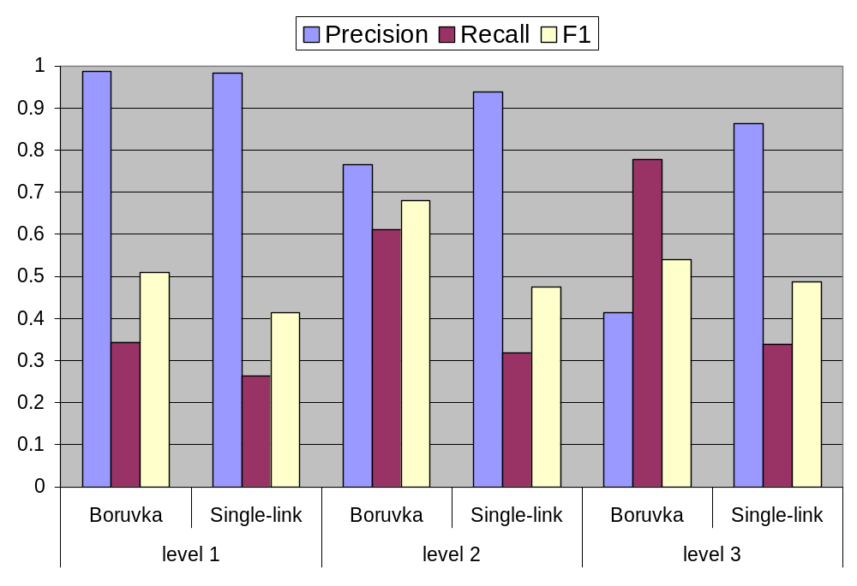
Performance Evaluation:
Experimental Results
Borůvka and Single-Link comparison

Slide 12
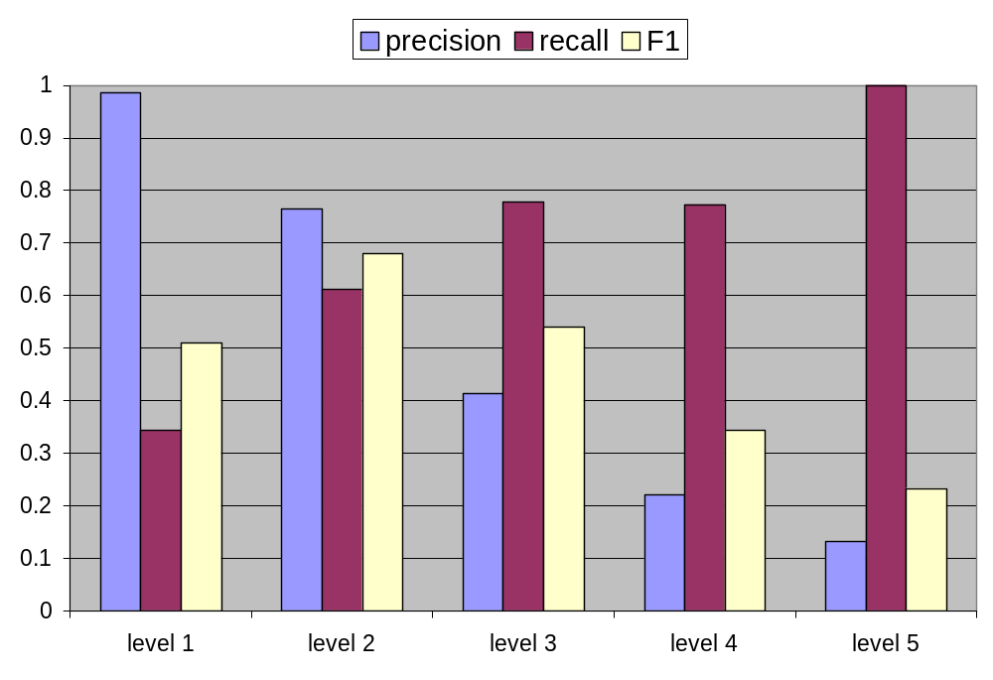
Performance Evaluation:
Experimental Results
Borůvka at different levels
Best clustering is found at level 2

Slide 13
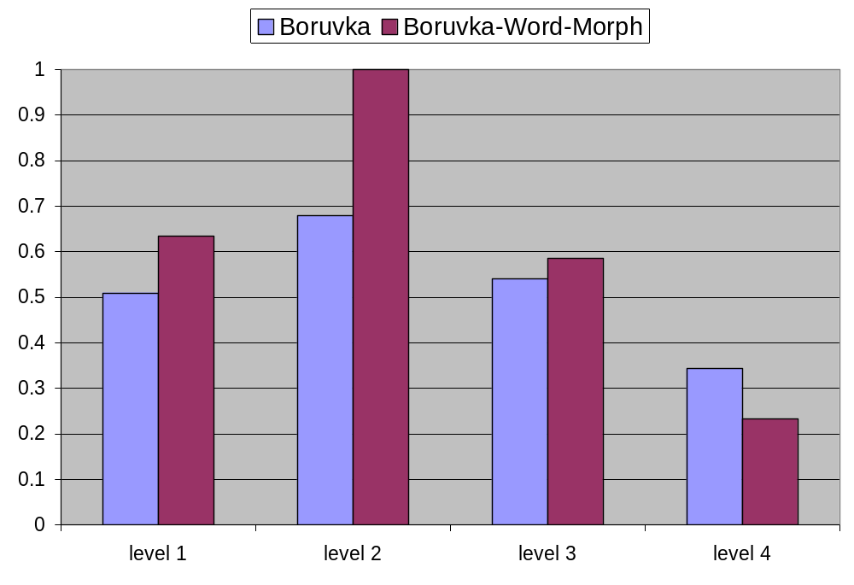
Performance Evaluation:
Experimental Results
Adding words and morphological constraints to Borůvka gives the highest improvement of F1 values
Best clustering is found at level 2

Slide 14
Performance Evaluation:
Experimental Results
Clustering at fine granularity displays semantic significance beyond part-of-speech tagging
Clustering is able to group words by their named-entity and senses

Slide 15
Performance Evaluation:
Experimental Results
Example of named-entity grouping:
At level 1 and level 2 of clusters, names of days, months, years, places, and people are grouped in separate clusters
Example of word-sense grouping:
Indonesian repeat words (e.g. orang-orang: people) are most often used as nouns. However, some repeat words (e.g. pelan-pelan: slowly) are adjectives. Our proposed clustering is able to cluster them correctly in different groups (one of nouns and one of adjectives)

Slide 16
Conclusion
We apply clustering to the problem of POS tagging for Bahasa Indonesia
We present a tool for interactive and constrained exploration of POS classes
Performance of Borůvka is better than Single-Link and is satisfactory even for a small set of words
Clustering at fine granularity displays semantic results beyond parts-of-speech tagging (named-entity tagging, word senses identification)

Slide 17
References
Hinrich Schutze. 1999. Distributional Part-of-speech Tagging. In EACL7: 141-148.
Stéphane Bressan and Lily Indrajaja. 2004. Part-of-speech Tagging without Training. In Proceedings of IFIP International Conference, INTELLCOMM 2004, Bangkok, Thailand.
Jelita Asian, Hugh Williams, and Seyed Tahaghoghi. 2004. A Testbed for Indonesian Text Retrieval. In Proceedings of the 9th Australasian Document Computing Symposium, Melbourne, Australia : 55-58.

