Slide 1
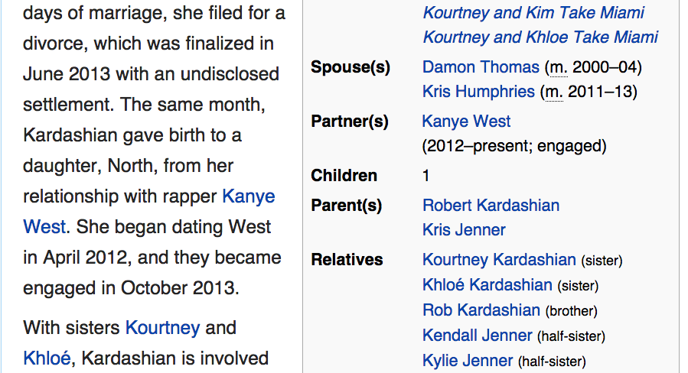
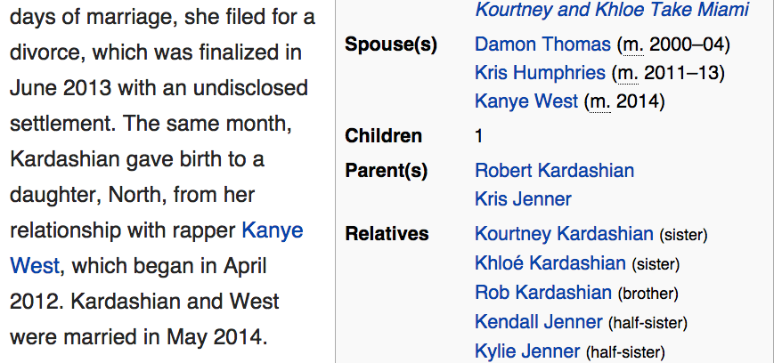
marriage
time
05/23/2014
05/24/2014
05/25/2014

