Slide 1
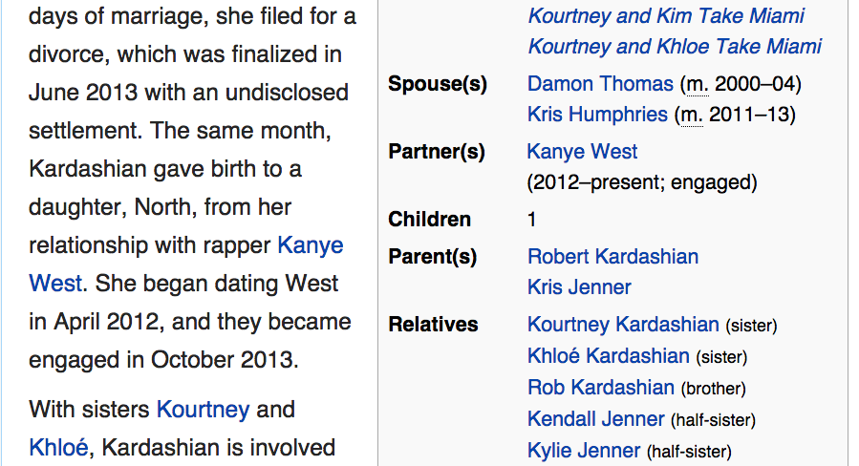
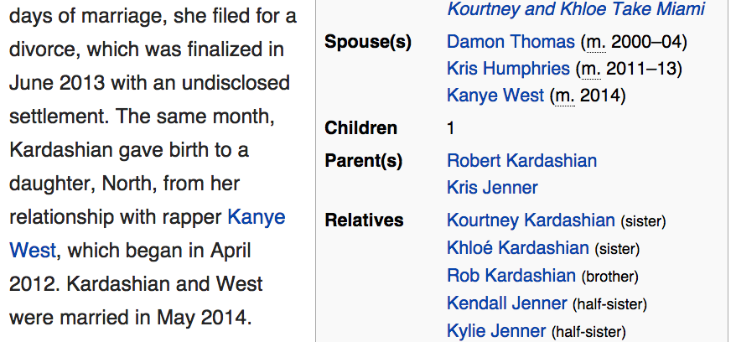
marriage
time
May 23, 2014
May 24, 2014
May 25, 2014

