Slide 1
Xamarin
Cross-Platform App Development

Slide 2
Xamarin
Based on Mono (open source .NET implementation)
Xamanrin Studio (Mac), Visual Studio (Windows)
Apps for Adroid, iOS, MacOS, UWA 10, UWA 8.1 (Windows native WPF/WinFroms)
Supports: C# and F#
Up to 80% shared code (with Xamarin.Froms up to 95% possible)
Big community
Free Webinars

Slide 3
Shared code
Project architecture must fit to reach 80% shared code
MVVM Frameworks help (MVVMCross, MVVMLight, Prism, etc.)
Some limitations (some introduced by bugs, so maybe fixed in future)
PCL, Shared-Projects, .NetStandardLibrary

Slide 4
Android Development
using Windows
Virtualization support for Android Emulator
Android tool-chain running native on Windows
Android SDK tools avl. through Visual Studio (logcat, AVD, SDK Manager, adb, DDMS)
AndroidManifest GUI editor in Visual Studio
using Mac
Virtualization support Android Emulator running on Mac
Visual Studio on Windows in Parallels,VmWare
using SSH to communicate with Android Emulator on Mac

Slide 5
iOs Development
using Windows
Mac in network needed / Xcode neede
iOS Emulator shown on Windows incl. full-functions and debugger
Build runs on Mac
GUI-tool for iOS app configuration in Visual Studio
iOS Simulator
using Mac
Xamarin Studio for iOS development
Xcode needed (just installation)
Visual Studio on Windows in Parallels,VmWare

Slide 6
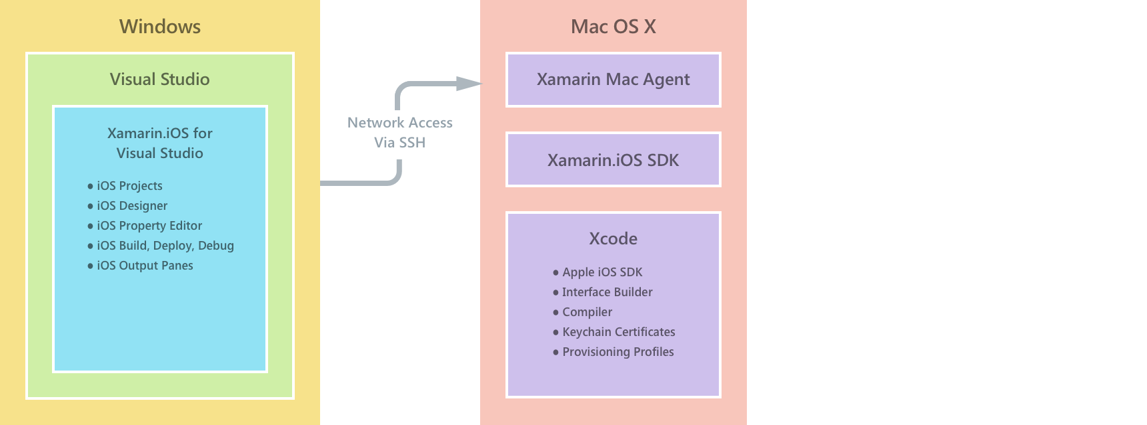
iOs Development

Slide 7
Windows Development
using Windows
Native support of Windows Store App development
Supports UWP, Win8.1 and WinPhone 8.1 development
Mobile Emulator running inside Hyper-V
Great tooling using Visual Studio
UWP apps run without Emulator directly on host OS
using Mac
Installing Windows on Parallels, VmWare, etc.

Slide 8
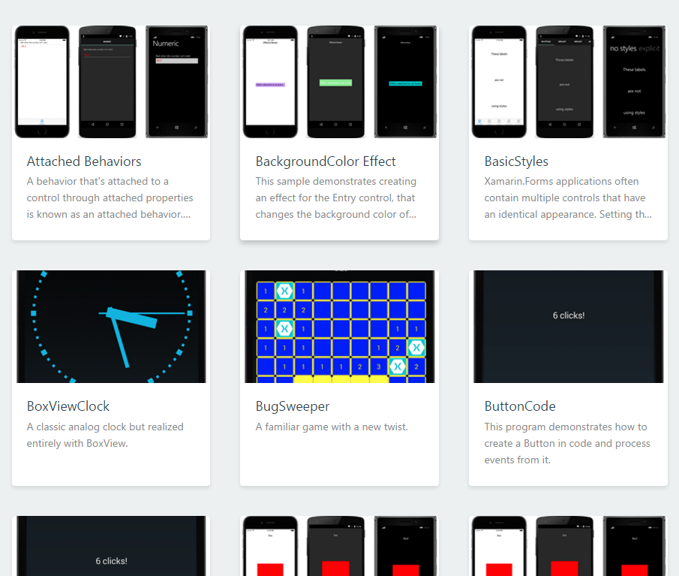
Xamarin Forms
Great for basic Apps
Improved in new Cycle
Big examples Gallery
Good support Forums
XAML not really XAML
Greate for PoC, Prototyping

Slide 9
Xamarin Forms
Xaml Compilation
Xaml Previewer
Support for OS specific Xaml
Layout Dictionaries
Only a few lines of code in OS specific projects
Use plattform specific custom controls and 3rd party components from within XF
Deep-Linking-Support thanks to PrismLibrary

Slide 10
Prism Library
Originally created in MS Enterprise Lib Blocks
MVVM-Pattern for WPF / Silverlight / Windows 8(.1) / WinPhone / UWP / XF
Supports different DI-Containers (Unity/Ninject/Autofac/etc)
Commanding / Messaging / Navigation / Logging / Page Dialog Service
Deep-Linking with Parameters
Async Support

Slide 11
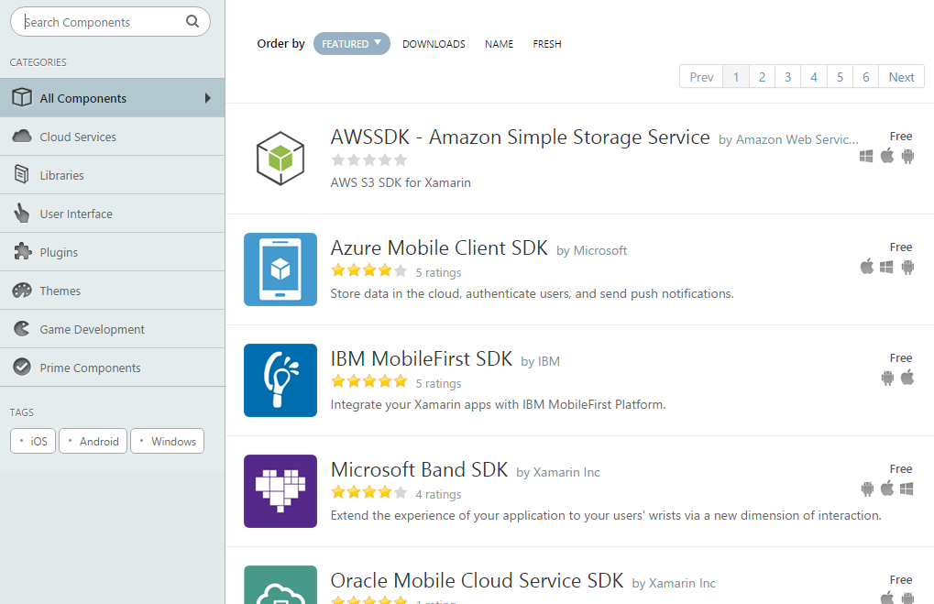
Xamarin Components
Ready to use cross-platform-components
SDKs, Themes, Plugins and UI Components
ComponentStore, submit your own Component

Slide 12
Visual studio online
Headless builds
Continuos Integration/Deployment
Run tests
For iOS builds Mac with build agent needed, reachable from the internet

Slide 13
Xamarin Test Cloud
UI Tests on over 2000 devices
Xamarin Test Recorder
Write tests in C# or Ruby with Cucumber
See full-frame screenshots for every step of every test
Receive performance data (memory, CPU, duration, etc.)
Integrates with TFS, Jenkins, TeamCity, or any CI systems with custom post-build commands
Subscription starts at 99/month

Slide 14
Xamarin insights / hockeyapp
Distribution
Crash Reports
Test Coverage
Feedback
App Management
Tester Management

Slide 15
Xamarin University
Unlimited live, online training from mobile experts
1-on-1 office hours with Xamarin experts
Unlimited annual access to recorded class videos, class labs and materials
Dedicated community for Xamarin University students
Certification exam eligibility to become a Xamarin Certified Mobile Developer
Xamarin University Annual Subscription starts at $1995.00

Slide 16
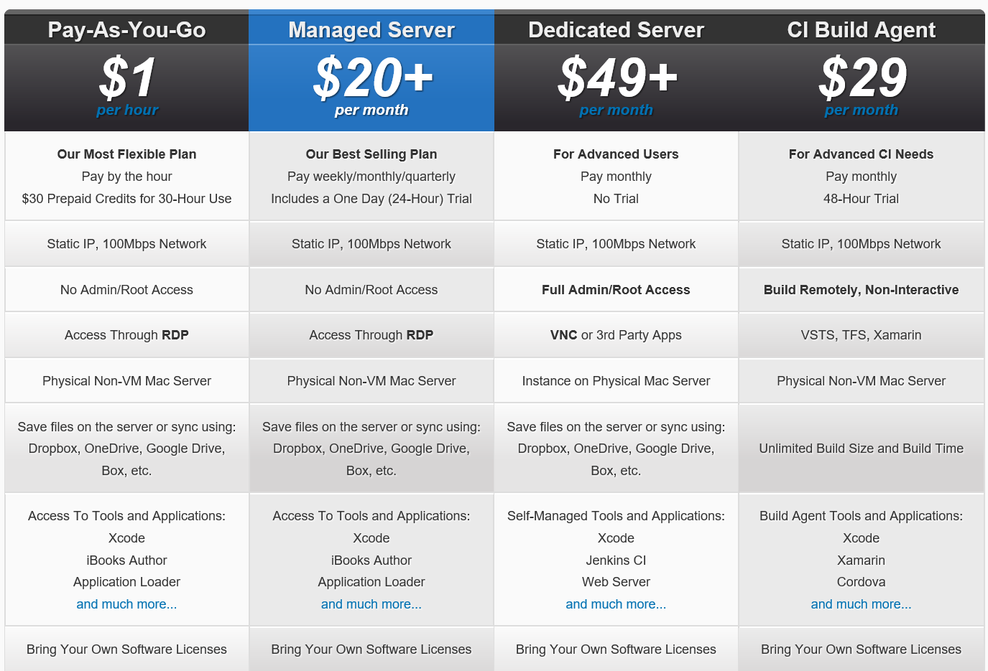
Mac-in-cloud
Pay-as-you-go / Managed Server for development
CI Build Agent for VSO
Avl in US / Asia / Europe and Australia
Pay-as-you-go is prepaid ($30, $60, $90)
Addon: Enable Remote Build Port ($2.50 one-time)

Slide 17
Trade Off
Limitations (Mac needed in network for iOS and Mac development, etc.)
Lerning curve can be bigger than native development
Afterwards lot of time saving due to shared code

Slide 18
Demo
Let see some demo

Slide 19

Questions

Slide 20
Thank you
Twitter: @DerSia_
Github: https://www.github.com/dersia
Xamarin: https://www.xamarin.com
MvvmCross: https://github.com/MvvmCross/MvvmCross
PrismLibrary: https://github.com/PrismLibrary/Prism
Slack: xamarinchat.slack.com

