Slide 1
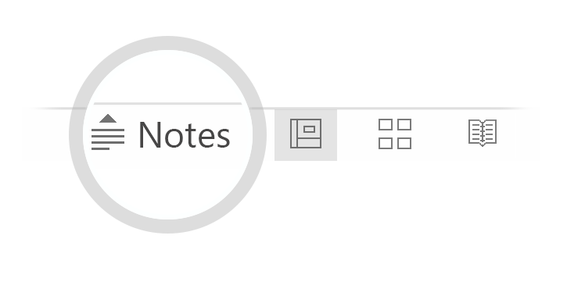

Here's your outline to get started
Key facts about your topic
In software engineering, a software development process is the process of dividing software development work into distinct phases to improve design, product management, and project management. It is also known as a software development life cycle. The methodology may include the pre-definition of specific deliverables and artifacts that are created and completed by a project team to develop or maintain an application.
See more: Open the Notes below for more information.
Notes:
QuickStarter has created an outline to help you get started on your presentation. Some slides include information here in the notes to provide additional topics for you to research.

Slide 2
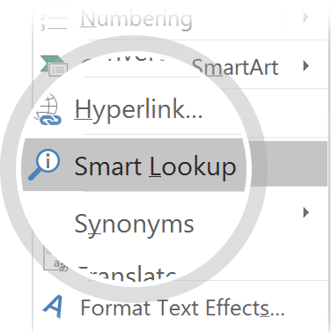
Related topics to research
Software testing
Software Engineering
Application software
Software Engineer
History of software engineering
Disciplined agile delivery
Infrastructure as Code
Outline of software engineering
Scrumban
Deployment environment
Use Smart Lookup to learn more
1
Highlight one of the related topics
Right-click on the topic
Choose "Smart Lookup"
2
3

Slide 3

What’s new in Xamarin.Forms 4.0
Overview and demos on new features for Xamarin.Forms

Slide 4
Agenda
Xamarin.Forms BindableLayout
Xamarin.Forms Flexbox
Xamarin.Forms Shells
Xamarin.Forms CollectionView
Xamarin.Forms CSS
Xamarin.Forms Visuals

Slide 5
Xamarin.Forms BindableLayout
Attached property on Layout<T>
MVVM binding of properties to i.e.
StackLayout
RelativeLayout
Grid
FlexLayout
Supports ItemTemplte and ItemTemplateSelector

Slide 6
Xamarin.Forms FlexLayout
Derived from CSS FlexBox
Replacement of RelativeLayout
No absolute positioning
More flexible layouting options
Children are stacked

Slide 7
Xamarin.Forms Shells
Single Page Applications for Apps
Uri-based navigation
Supports
Master-Detail-Page
Tabs
Navbar
Searchbox
Customizable

Slide 8
Xamarin.Forms CollectionView
New virtualized list of items (views)
Replaces ListView
Supports DataTemplate, EmptyViews
Scrolling to
item
index
Scroll positions
Start
Center
End
Scroll SnapPoints
Scroll animations

Slide 9
Xamarin.Forms CSS
Cascading Style Sheets in XAML
Can be applied together with XAML-Styles
It’s easier to find CSS-Designers than XAML-Designers
Regular CSS + extensions for base-class-styling (^)

Slide 10
Xamarin.Forms Visuals
Xamarin.Forms Themes is dead
Long live Visuals
Styling, animations and behaviors in a package
So far only support for Material Design

Slide 11
Xamarin.Forms bindable Layouts
Xamarin.Forms FlexLayout
Xamarin.Forms Shells
Xamarin.Forms CollectionView
Xamarin.Forms Cascading Style Sheet
Xamarin.Forms Visuals
DEMO

Slide 12
Xamarin.Forms bindable Layouts
DEMO

Slide 13
Xamarin.Forms FlexLayout
DEMO

Slide 14
Xamarin.Forms Shells
DEMO

Slide 15
Xamarin.Forms CollectionView
DEMO

Slide 16
Xamarin.Forms Cascading Style Sheet
DEMO

Slide 17
Xamarin.Forms Visuals
DEMO

Slide 18




Thanks!

Slide 19
Resources
ReleaseNotes:
https://developer.xamarin.com/releases/xamarin-forms/xamarin-forms-3.0/
https://developer.xamarin.com/releases/xamarin-forms/xamarin-forms-3.1/
https://developer.xamarin.com/releases/xamarin-forms/xamarin-forms-3.2/
https://developer.xamarin.com/releases/xamarin-forms/xamarin-forms-3.3/
https://github.com/PrismLibrary/Prism/releases
https://github.com/davidortinau/TheLittleThingsPlayground
https://prismlibrary.github.io/
https://github.com/xamarin/Essentials
Sehlls Spec: https://github.com/xamarin/Xamarin.Forms/issues/2415
Shells Playground: https://github.com/davidortinau/Gastropods
My presentations: https://github.com/dersia/presentations
This Code: https://github.com/dersia/Xamarin.Prism.Forms.3371

