Slide 1


Here's your outline to get started
Key facts about your topic
In software engineering, a software development process is the process of dividing software development work into distinct phases to improve design, product management, and project management. It is also known as a software development life cycle. The methodology may include the pre-definition of specific deliverables and artifacts that are created and completed by a project team to develop or maintain an application.
See more: Open the Notes below for more information.
Notes:
QuickStarter has created an outline to help you get started on your presentation. Some slides include information here in the notes to provide additional topics for you to research.

Slide 2
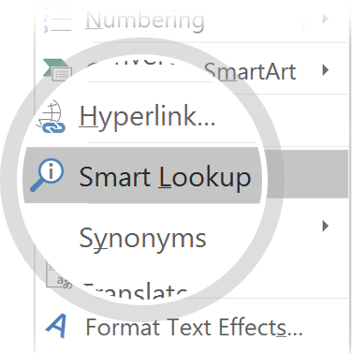
Related topics to research
Software testing
Software Engineering
Application software
Software Engineer
History of software engineering
Disciplined agile delivery
Infrastructure as Code
Outline of software engineering
Scrumban
Deployment environment
Use Smart Lookup to learn more
1
Highlight one of the related topics
Right-click on the topic
Choose "Smart Lookup"
2
3

Slide 3

What’s new in Xamarin.Forms 4.0
Overview and demos on new features for Xamarin.Forms

Slide 4
Agenda
Xamarin.Forms BindableLayout
Xamarin.Forms Flexbox
Xamarin.Forms Shells
Xamarin.Forms CollectionView
Xamarin.Forms CSS

Slide 5
Xamarin.Forms BindableLayout
Attached property on Layout<T>
MVVM binding of properties to i.e.
StackLayout
RelativeLayout
Grid
FlexLayout

Slide 6
Xamarin.Forms BindableLayout
Attached property on Layout<T>
MVVM binding of properties to i.e.
StackLayout
RelativeLayout
FlexLayout
Grid

Slide 7
Xamarin Forms
Xamarin Forms Flexbox
Xamarin Forms CSS
Xamarin Forms BindableLayout
Xamarin Forms Styles
Xamarin Forms Shells
Xamarin Forms CollectionView

Slide 8
3.0 Demo
Visual State Manager, Flexbox, Css

Slide 9
Xamarin.Forms 3.1
F100 Features
Incl. Editor enhancements
Incl. Entry enhancements

Slide 10
3.1 Demo
Editor Enhancements, Entry Enhancements

Slide 11
Xamarin.Forms 3.2
More F100 Features
Custom Titlebar
Editor Placeholder Color
OnPlatform Extension

Slide 12
3.2 Demo
Custom Titlebar, Editor Placeholder Color, OnPlatform Extension

Slide 13
Xamarin.Forms 3.3
More F100 Features
Label MaxLines
FormattedText

Slide 14
3.3 Demo
MaxLines, FormattedText

Slide 15
Prism.Forms 7.0/7.1
Breaking Changes in Module API
Breaking Changes in Navigation
Breaking Changes in Commanding
ObserveCanExecute((vm) => Prop) ➔ ObserveCanExecute(() => Prop)
Breaking Changes in Bootstraper/PrismApplication
Breaking Change: Deprecated Autofac & MEF
Breaking Change: New Unity Version (Netstandard)

Slide 16
Prism.Forms 7.0/7.1 Module API
Way too many Changes for Presentation
Check release notes: https://github.com/PrismLibrary/Prism/releases

Slide 17
Prism.Forms 7.0/7.1 Navigation
Breaking Change: Added INavigationParameter interface
Breaking Change: TabbedPage Navigation changed fully
/TabbedPage?selectedTab=TabA/ViewB/ViewC
/TabbedPage?createTab=NavigationPage|ViewA
Breaking Change: Navigation API
Task NavigateAsync() ➔ Task<INavigationResult> NavigateAsync()
Task GoBack() ➔ Task<INavigationResult> GoBack()

Slide 18
Prism.Forms 7.0/7.1 BootStrap / PrismApplication
RegisterTypes() ➔ RegisterTypes(IContainerRegistry cr)
CreateContainer()
CreateNavigationService()
CreateLogger()
Container == IContainerProvider
Ren: ConfigureContainer ➔ RegisterRequiredTypes(IContainerRegistry cr)
Ren: RegisterTypeForNavigation ➔ RegisterForNavigation

Slide 19
PRISM 7.0/7.1
Better Navigation
Partial Views
ContentProdiver
XAML Navigation

Slide 20
PRISM 7.0/7.1 Demo
Better Navigation, Partial Views, ContentProdiver, XAML Navigation

Slide 21
Xamarin Essentials
Abstraction of Hardware/System functions for CrossPlatform
Replacement for Plugins
App Information
Clipboard
Connectivity
Launcher
MainThread
Maps
PhoneDailer
Sms
Text-To-Speech

Slide 22
Xamari.Forms Shells
Like Google Flutter
Rapid Application Development
Material Shells

Slide 23
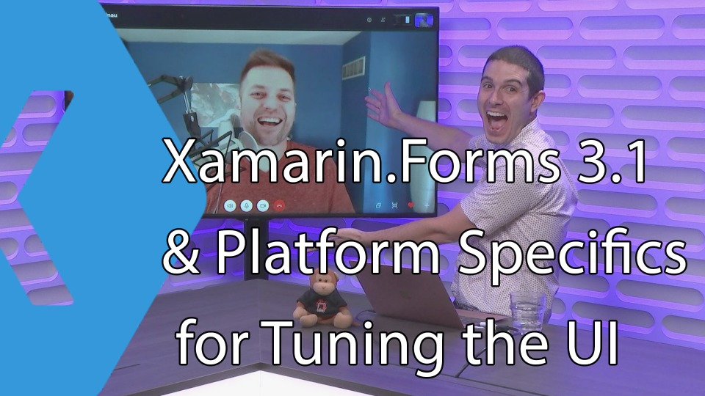
Thanks!

Slide 24
Resources
ReleaseNotes:
https://developer.xamarin.com/releases/xamarin-forms/xamarin-forms-3.0/
https://developer.xamarin.com/releases/xamarin-forms/xamarin-forms-3.1/
https://developer.xamarin.com/releases/xamarin-forms/xamarin-forms-3.2/
https://developer.xamarin.com/releases/xamarin-forms/xamarin-forms-3.3/
https://github.com/PrismLibrary/Prism/releases
https://github.com/davidortinau/TheLittleThingsPlayground
https://prismlibrary.github.io/
https://github.com/xamarin/Essentials
Sehlls Spec: https://github.com/xamarin/Xamarin.Forms/issues/2415
Shells Playground: https://github.com/davidortinau/Gastropods
My presentations: https://github.com/dersia/presentations
This Code: https://github.com/dersia/Xamarin.Prism.Forms.3371

