Slide 1
Blazor
ASP.NET MVC on dope

Slide 2
Agenda
History of SPA
Blazor
WASM
C# -> WASM, Razor Pages -> WASM
Alternatives to Blazor

Slide 3
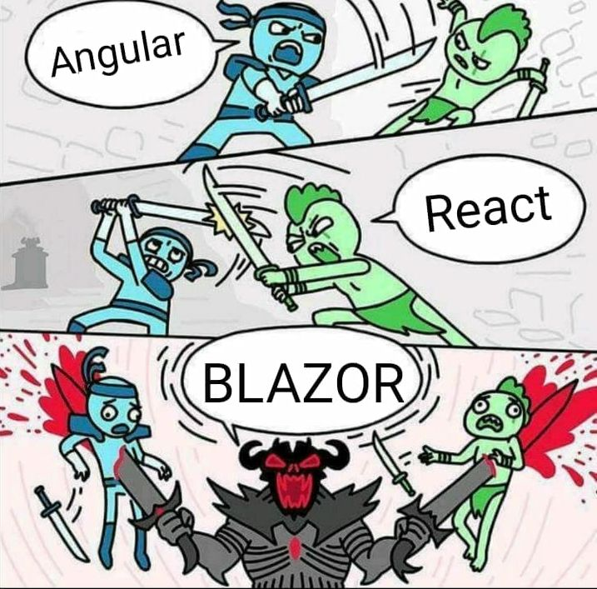
History of SPA

Slide 4
Blazor
Blazor announced at NDC 2017
C# for the Web
Blazor = Browser + Razor
Runs on Mono WASM
AngularJS / ReactJS for .NET developers
NOT yet another fancy product for shiny new things by Microsoft (Silverlight)

Slide 5
WASM
WASM = WebASM = WebAssembly
Announced June 2015
Supported by major Browsers
Developed by W3C
Safe, portable, low-level code for efficient execution and compact representation
No GC
Only 4 primitive types
No access to DOM and WEB API
Interop with JS

Slide 6
C# -> WASM, Razor Pages -> WASM
C# -> WASM
Mono WebAssembly
Mono interpreter
Netstandard
Shared code
Razor Pages -> WASM
Blazor Framework
Support for Components, Routing, Binding, DI, Http, JS interop
Cshtml
Blazor-Redux
Blazor-EF core

Slide 7
DEMO
DEMO

Slide 8
Alternatives
Ooui – Xamarin.Forms -> Web
Platform.Uno WASM – XAML -> Web
NeosisGUI – XAML/Unity -> Web

Slide 9
Thank you!

