Slide 1
Broadcasting

Slide 2
Agenda
OBS Studio
NDI
Teams/Skype/Zoom
Hardware
Azure

Slide 3
OBS Studio
Open Broadcaster Studio (github.com/obsproject/obs-studio)
SceneCollection
Transitions
Virtual Camera (V26+)
NDI Support
Plugin System
WS-Plugin

Slide 4

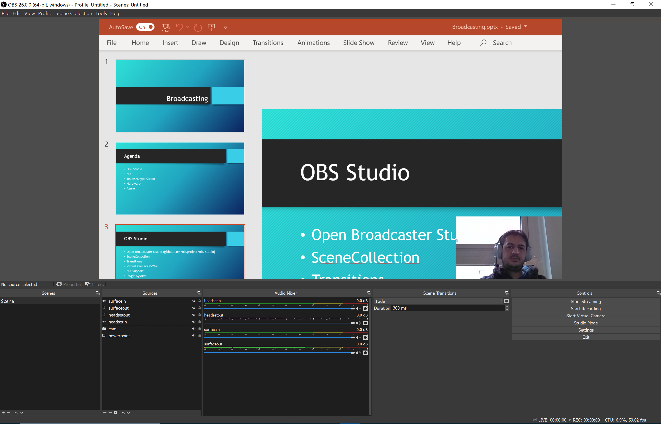
OBS Studio
Create Scenes
Add Sources to Scene
Audio Capture
Video Capture
NDI
Color Source
Browser
Display Capture
Window Capture
Game Capture
Image/Slideshow
Media
Text
Scenes
Choose Transition between Scenes
Simple
Luma Wipe
Stinger
Start Streaming/Recording/Cam

Slide 5
OBS Studio
Demo

Slide 6
NDI
Network Device Interface (by NewTek)
Broadcast Audio/Video Sources over the Network (TCP/UPD)
Supported by many devices
Appliances for non NDI Devices
Software for non NDI Devices
Supported by Teams and Skype (audio still a mess)
Available as Source in OBS

Slide 7
Teams/Skype/Zoom
Bring your Skype/Teams Guests into OBS using NDI
Use OBS Virtual Cam to make your own Transitions und Layout for presentations
No Screenshare needed, add your Cams Video to the feed

Slide 8
Hardware
Streaming Hardware
Streamdeck
Lights
Capture Cards for external sources
Pro Microphone
NDI Hardware
Cameras
HDMI to NDI converters
NDI Studio Hardware

Slide 9
Azure
Use Azure VMs for Streaming
One VM for Teams/Skype
One VM (GPU Support) for OBS
Both on same VNET for NDI
Azure Files Share for Recordings
Use OBS WS-Plugin for control
Use Web App for WS-Frontend with access to the OBS VNET

