Slide 1
Extension Everything!
C# proposal champion

Slide 2

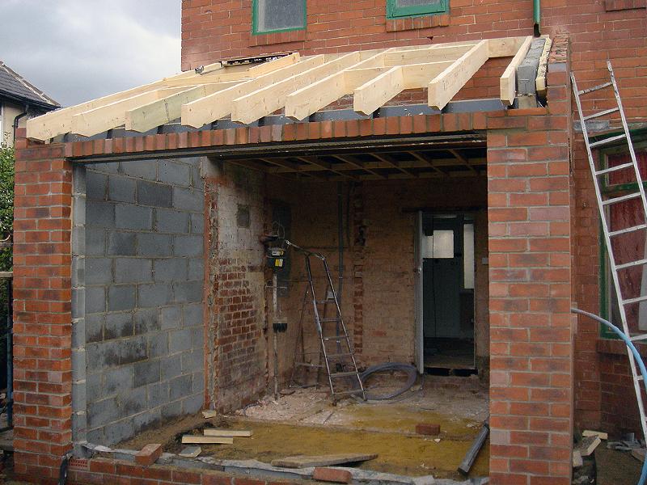


Extension Everything

Slide 3
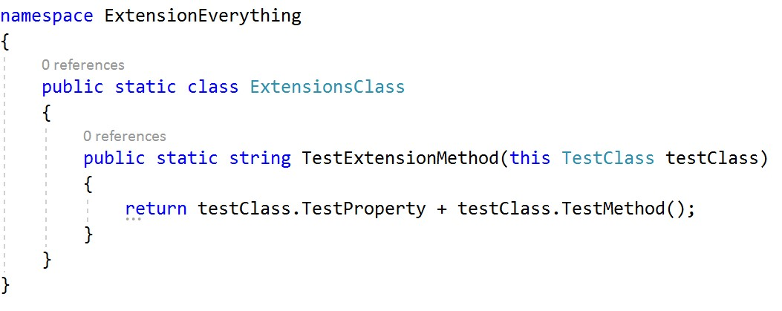
C# Extension Methods

Slide 4


Slide 5
ICH WILL MEHR

Slide 6

Was Entwickler Wollen!

Slide 7

Extension everything!

Slide 8

(not included at first)
Instance members
Events
Constructors
Constraints on operators

Slide 9
Demo

Slide 10
warning
Still a proposal!
But a champion!
Planned for C# x.0
What about generics?

Slide 11
Thank you!

Slide 12
Resources
CSharpLang-GitHub: https://github.com/dotnet/csharplang/issues/192
Roslyn-GitHub: https://github.com/dotnet/roslyn/issues/11159

