Slide 1
Building Microservices using Azure Functions

Slide 2
Agenda
Microservice Pattern
Serverless Architecture
Implementation Details
Road to Microservices

Slide 3
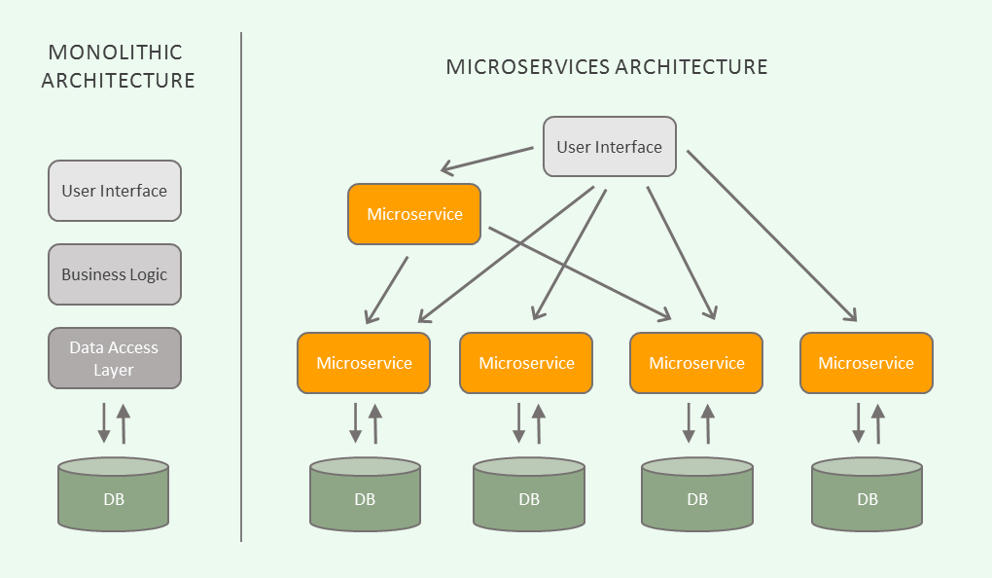
Microservices

Slide 4
Microservice Pattern
Design Pattern like IoC, Signleton, Factory, Observer, etc
Solves problem: reliability, scalability and maintainability
Separation of concerns, every service only ONE purpose
Communication through communication channels like queues (loosely coupled)
Services are agnostic
Independently deployable

Slide 5
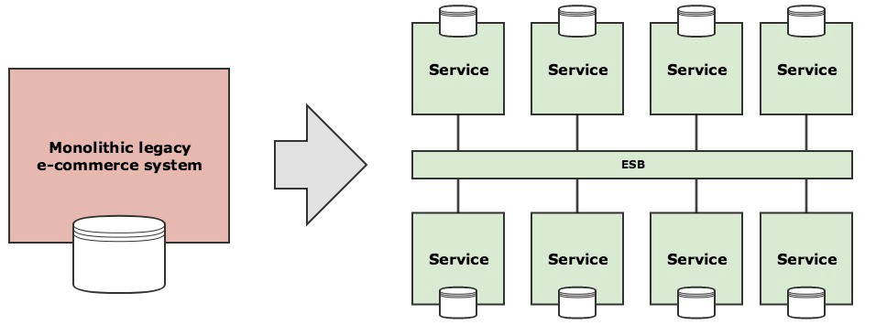
Microservice pattern
Agnostic services using a communication channel

Slide 6
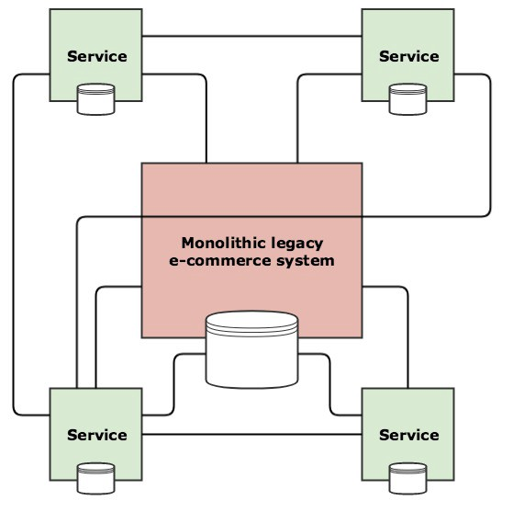
Do not build a distributed monolith
Services strongly coupled, directly communicating

Slide 7
Distributed monolith
Strongly coupled
Direct communication → Services MUST know each other, Services are NOT agnostic
Not independently deployable
Scalability not easy

Slide 8

Serverless Architecture
Event driven
Perfectly scalable
Reliable
Maintainable
Independent
Stateless
Cheap

Slide 9
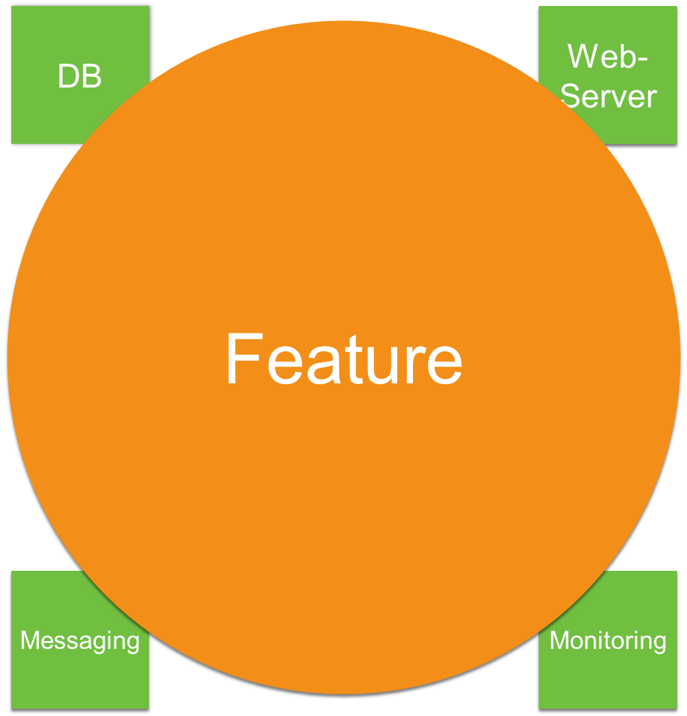
Serverless Architecture
Next big feature to implement
a little bit of DB
a little bit of WebServer
a little bit of Messaging
a little bit of Monitoring

Slide 10
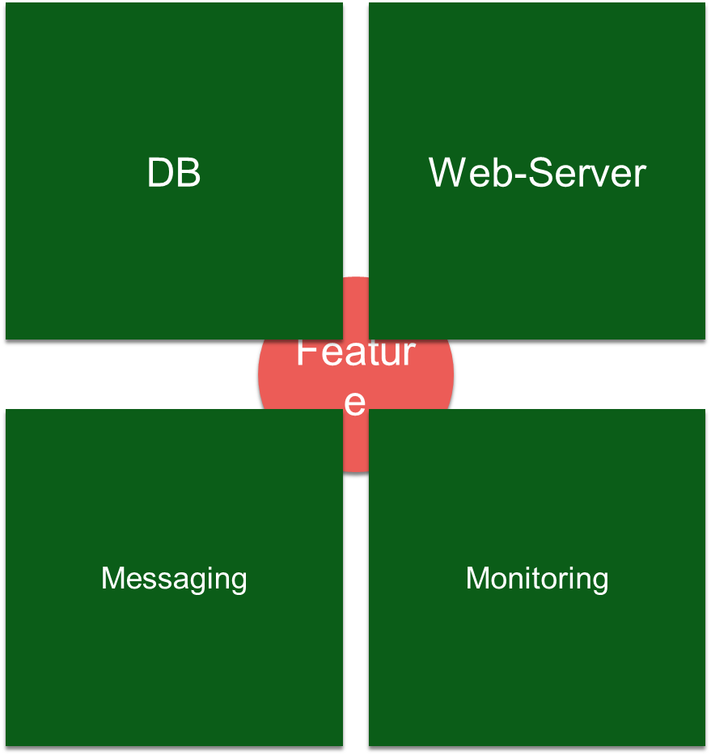
Serverless Architecture
What this actually means
a lot of DB
a lot of WebServer
a lot of Messaging
a lot of Monitoring

Slide 11
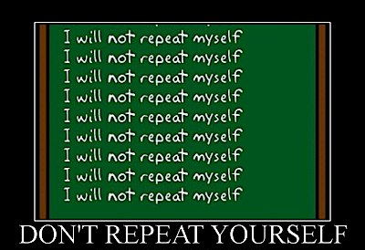
Serverless Architecture
Repeating is annoying and NOT maintainable

Slide 12
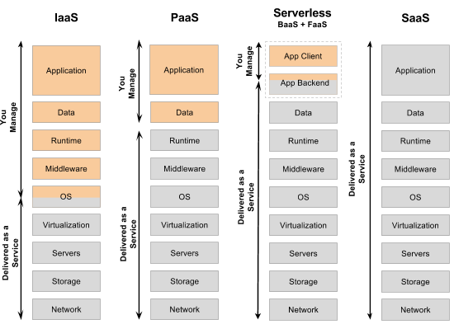
Serverless Architecture

Slide 13
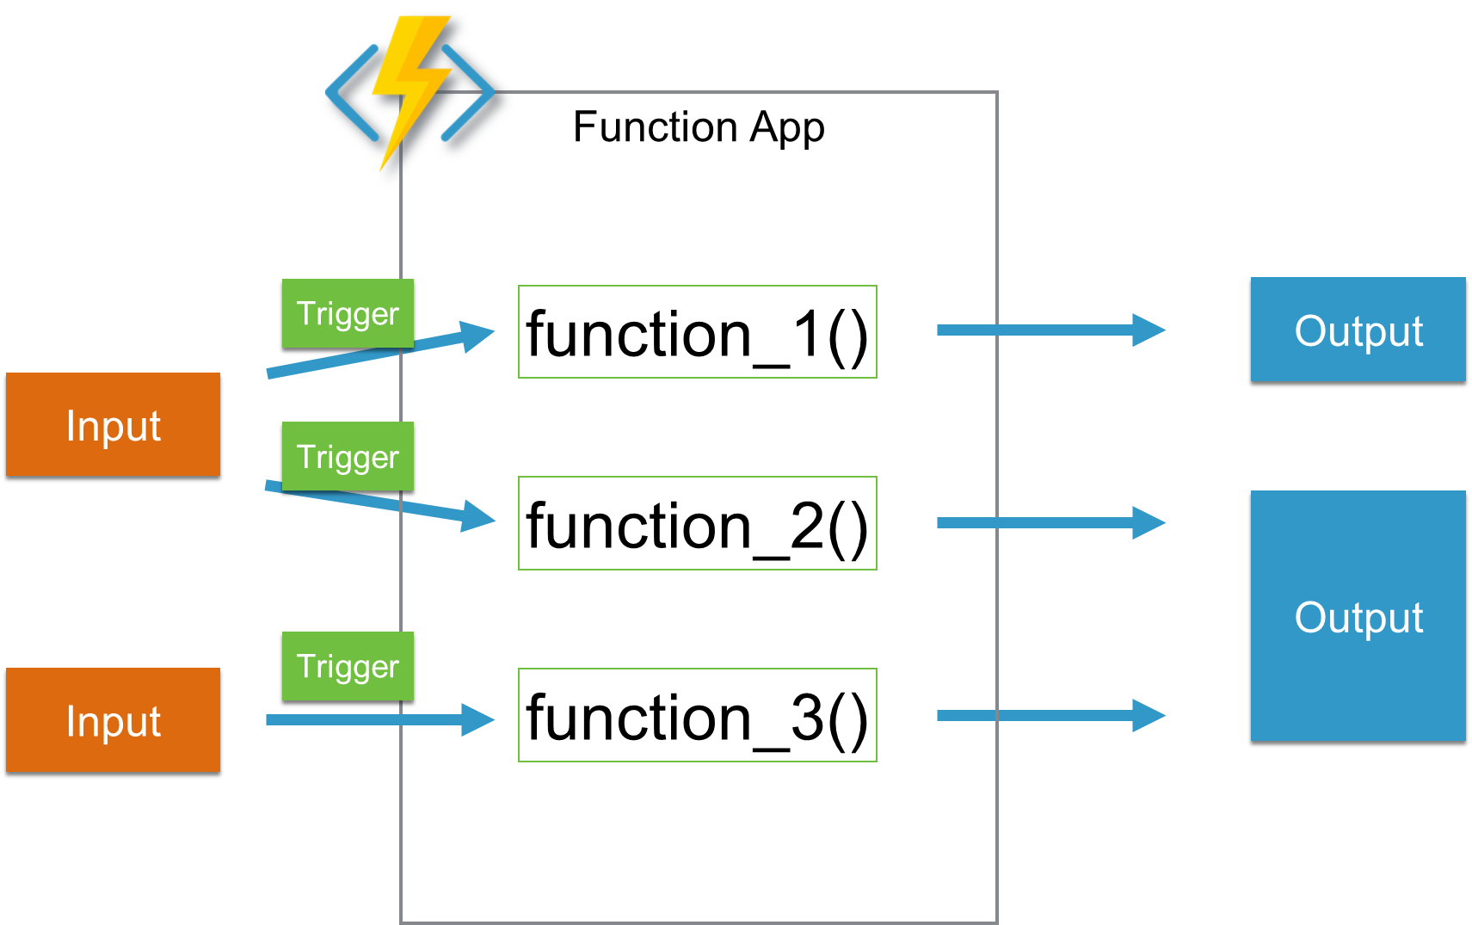
Serverless Architecture

Slide 14
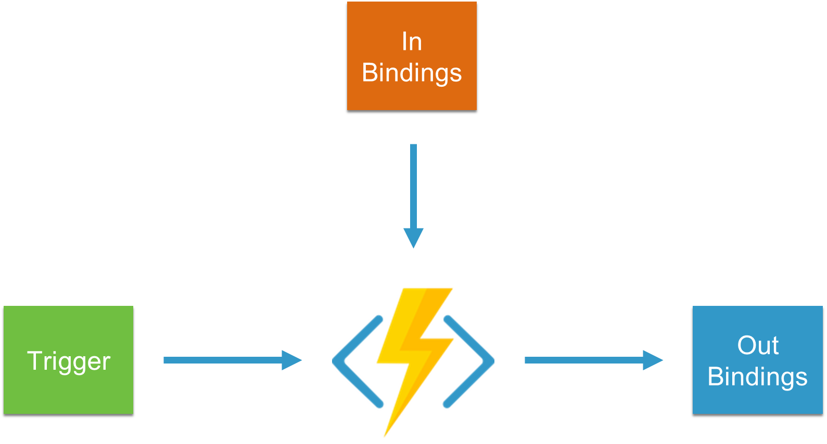
Serverless Architecture

Slide 15
Recap
Microservice Pattern
Solves problem: reliability, scalability and maintainability
Separation of concerns, every service only ONE purpose
Communication through communication channels like queues (loosely coupled)
Services are agnostic
Independently deployable
Serverless Architecture
Event drive
Scalable
Reliable
Maintainable
Independent

Slide 16
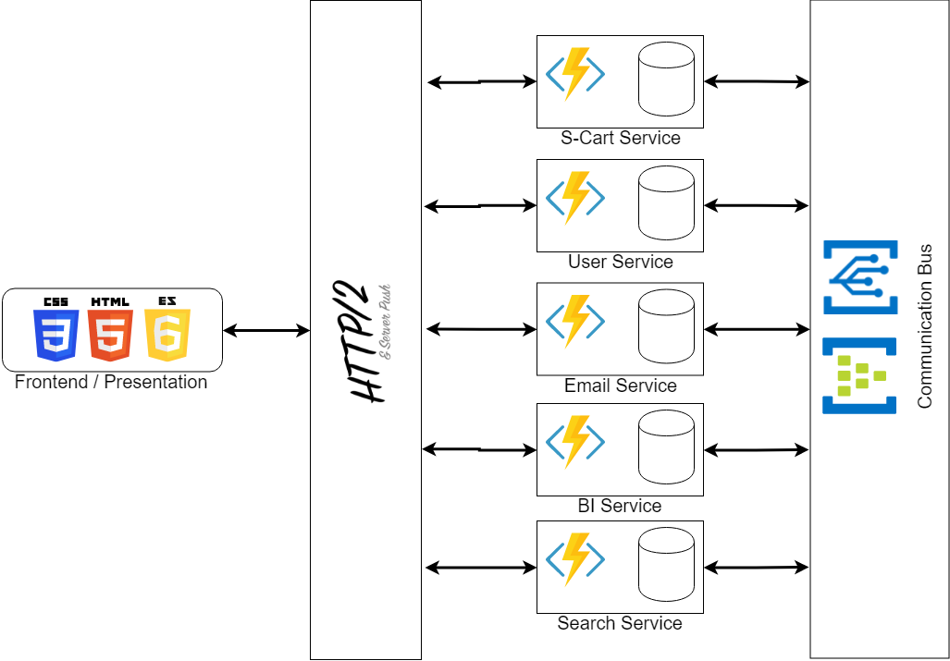
Bringing both together

Slide 17
Road to Microservice
Do not start at your monolithic application
01
Pick one feature and develop from scratch as Microservice
02
Loosely couple to your monolithic application
03
Remove converted feature
04

Slide 18
Road to Microservices
Use patterns and practices for better maintainability
Command and Query Responsibility Segregation
Domain Driven Design
Event Sourcing
Event Storming
Pure functions
Immutable types
Detach from monolithic Database
Each service ONLY ONE purpose

Slide 19
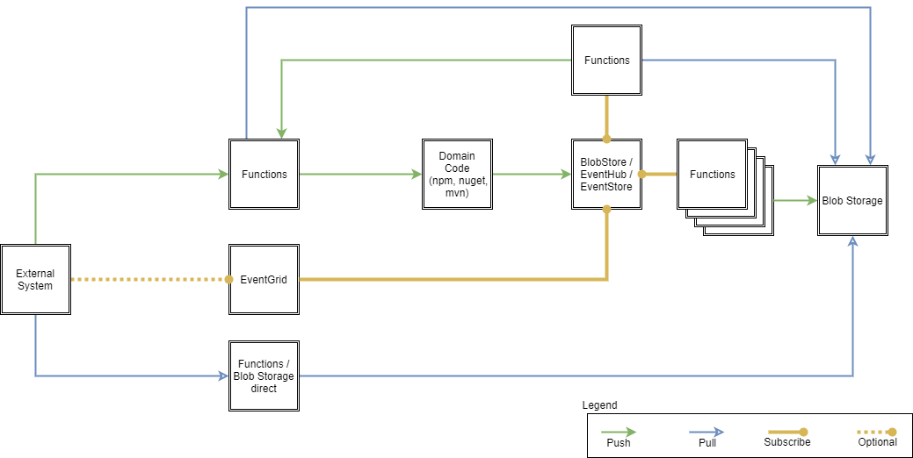
Serverless CQRS

Slide 20
Microservice Pattern with Serverless Architecture

