Slide 1
Serverless CQRS

Slide 2
Agenda
Command and Query Responsibility Segregation (CQRS)
Event Sourcing (ES) / Event Store
Pure functions
Serverless CQRS
CQRS as a Service

Slide 3
CQRS
First described 1988 by Bertrand Meyer as CQS
Picked up by Martin Fowler 2005
Picked up by Greg Young 2008 -> CQRS 2009
Facebook Flux 2014, Redux 2015, Mobx 2015, Vuex 2015*
* first commit on github

Slide 4
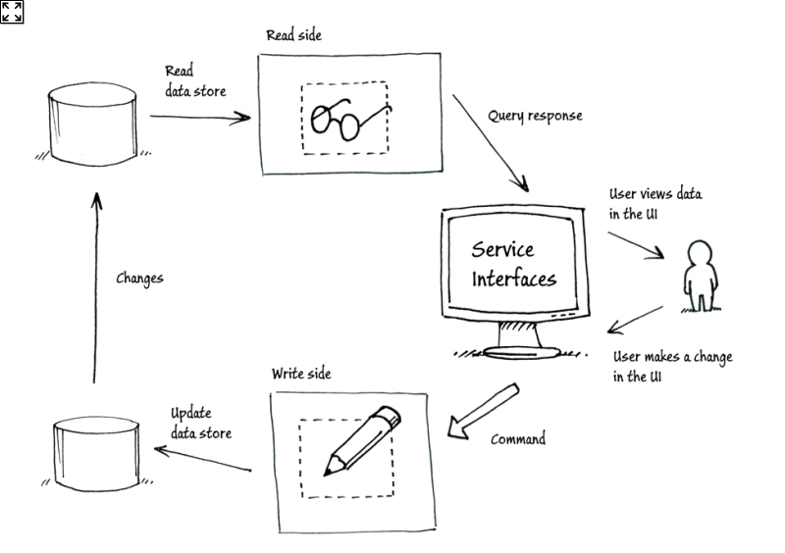
CQRS
Asking a question should not change the answer – Bertrand Meyer 1988

Slide 5
Event Sourcing
First work chain of blocks described 1991 by Stuart Haber and W. Scott Stornetta
Described as EventSourcing 2005 by Martin Fowler
Blockchain – 2008 by Satoshi Nakamoto

Slide 6
Event Sourcing
Append only ledger
Immutable Events
No Locking¹
Complete history of Entity²
Perfect for Reports (BI)
Meaningful for a domain expert³
¹ ordering is vital
² Entity in this case has a different meaning than in a relational-data-structure
³ further read Domain Driven Design
Limitations and concerns
Only eventually consistent
Event ordering is vital
No SQL queries
Rethinking Data

Slide 7
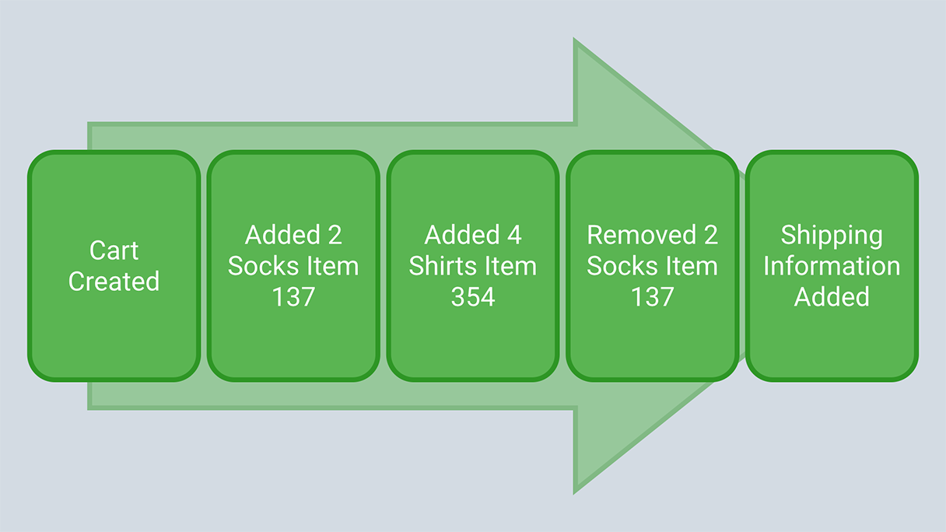
Event Sourcing
Capture all changes to an application state as a sequence of events. – Martin Fowler 2005

Slide 8
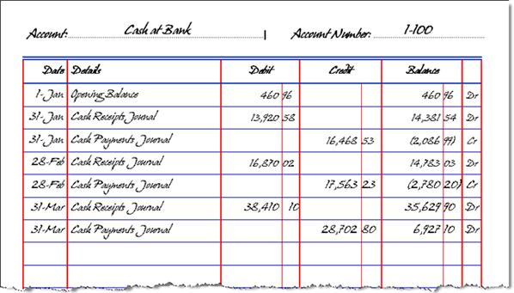
Event Sourcing
Append only ledger

Slide 9
Event Sourcing or Blockchain
Common
storing facts in order
append-only
cryptographic verfication¹
¹ optional for Eventsourcing
Blockchain
publicly verified ledger
reward mechanism for verifying blocks
Event Sourcing
centralized

Slide 10
Event Store
Append only data store for Events
Handling od concurrency and versioning
Pub/Sub
Multi-Event-Stream support
Optional projections
Implemtation: https://eventstore.org

Slide 11
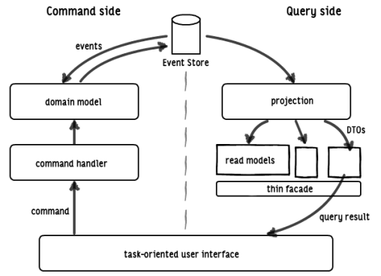
CQRS + ES

Slide 12
Pure Function
Side-effect free
Always same output on same input
Easy to maintain
Easy to understand
Easy to test

Slide 13
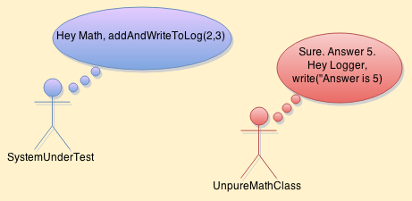
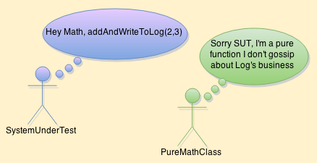
Pure Function
Not Pure!
Pure!

Slide 14
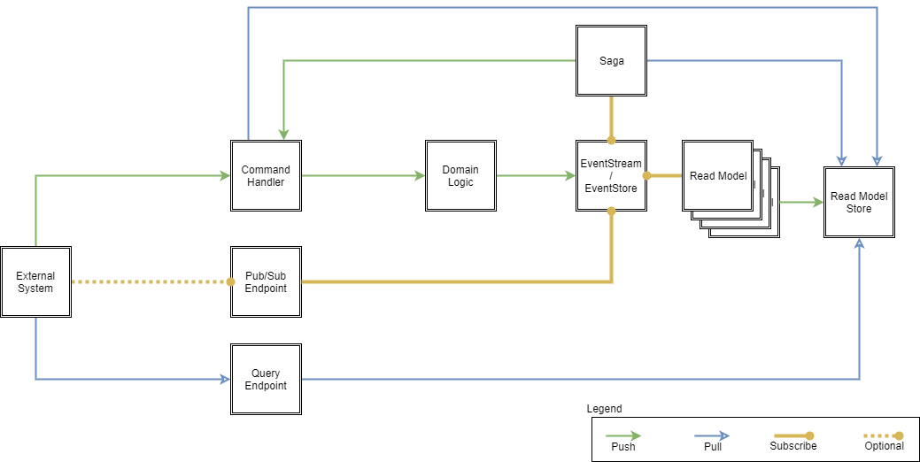
Serverless CQRS

Slide 15
Serverless CQRS
Command Handler => Serverless Functions
Projections => Serverless Functions
Sagas => Serverless Functions
EventStore => BlobStorage or EventHubs
ProjectionStore => BlobStorage
Query Handler => BlobDirect or Serverless Functions
Pub/Sub => EventGrid

Slide 16
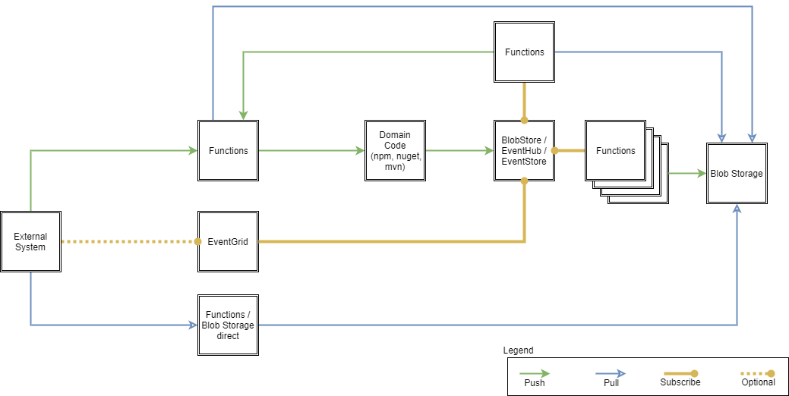
Serverless CQRS

Slide 17
Serverless CQRS Limitations
EventStore
No catch-up of events with Blob Storage
No catch-up of events with Event Hubs
No way to enforce ordering
EventStore.org only running on VMs
No bindings/trigger for EventStore.org
Projections
No real singleton support for Projections
No Pub/Sub using WebSockets

Slide 18
Serverless CQRS Limitations -> Solutions
EventStore
BYOB: Blob binding with catch-up support
BYOB: EventHubs binding with catch-up support
BYOB: Binding for EventStore.org
BYOB: Out binding with enforced ordering

Slide 19
CQRS as a Service
Cloud Framework for Microservice Pattern
UI for
Bring your Command Handler
Bring your Domain
Bring your Projections
Automated resources provisioning
Automated wiring
Pub/Sub

Slide 20
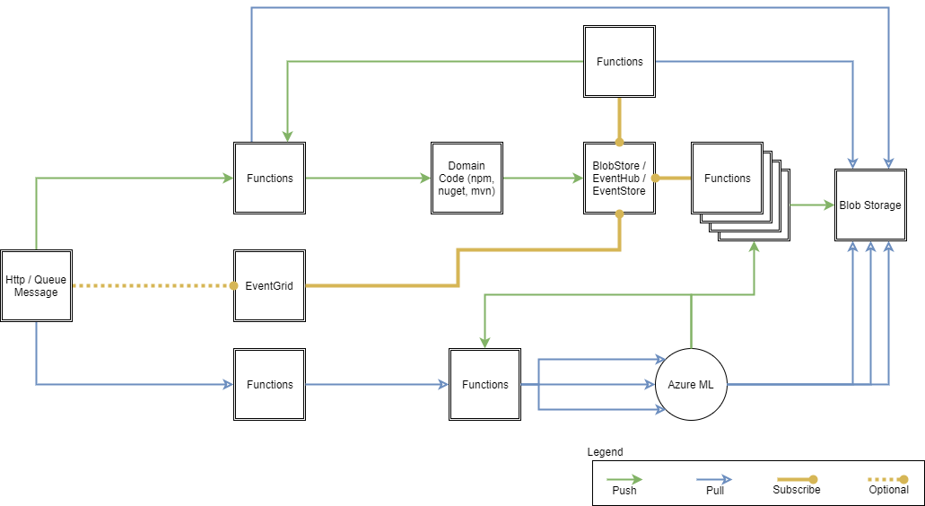
Serverless CQRS Future

Slide 21
Sources Serverless CQRS / CQRS as a Service
https://github.com/CQRSaaS/
https://github.com/dersia/timey-SCQRS/tree/blobOnly

Slide 22
Sources CQRS
Martin Fowler “CommandQuerySeparation” 2005 https://martinfowler.com/bliki/CommandQuerySeparation.html
Greg Young “DDDD 10 [CQS]” 2008 http://codebetter.com/gregyoung/2008/04/28/dddd-10-cqs/
Greg Young “Command Query Separation?” 2009 http://codebetter.com/gregyoung/2009/08/13/command-query-separation/
Martin Fowler “CQRS” 2011 https://martinfowler.com/bliki/CQRS.html

Slide 23
Further Read CQRS
https://ordina-jworks.github.io/domain-driven%20design/2016/02/02/A-Decade-Of-DDD-CQRS-And-Event-Sourcing.html
https://docs.microsoft.com/en-us/azure/architecture/guide/architecture-styles/
https://docs.microsoft.com/en-us/azure/architecture/patterns/cqrs
https://msdn.microsoft.com/en-us/library/jj591577.aspx
http://codebetter.com/gregyoung/2010/02/16/cqrs-task-based-uis-event-sourcing-agh/
https://martinfowler.com/bliki/CQRS.html
http://codebetter.com/gregyoung/2010/02/16/cqrs-task-based-uis-event-sourcing-agh/

Slide 24
Sources Event Sourcing
Martin Fowler “Event Sourcing” 2005 https://martinfowler.com/eaaDev/EventSourcing.html
History of Blockchain https://en.wikipedia.org/wiki/Blockchain#History

Slide 25
Further Read Event Sourcing
https://martinfowler.com/eaaDev/EventSourcing.html
http://eventuate.io/whyeventsourcing.html
https://docs.microsoft.com/en-us/azure/architecture/patterns/event-sourcing
https://www.linkedin.com/pulse/blockchain-event-sourcing-lee-hambley/
https://adaptechsolutions.net/blockchain-hype-or-necessity/

