Slide 1
Xamarin.Forms ist viel schöner mit Prism.Forms

Slide 2
What is Prism?
XAML Application Framework
Guidance
Patterns & Practices
Testable & Maintainable
Open Source: http://github.com/PrismLibrary
.NET Foundation

Slide 3
What do you get?
MVVM Support
Commanding
Messaging
Navigation
Page Dialog Service
IPlatformInitializer
Modularity
Logging
Dependency Injection
Visual Studio Project and Item Templates

Slide 4

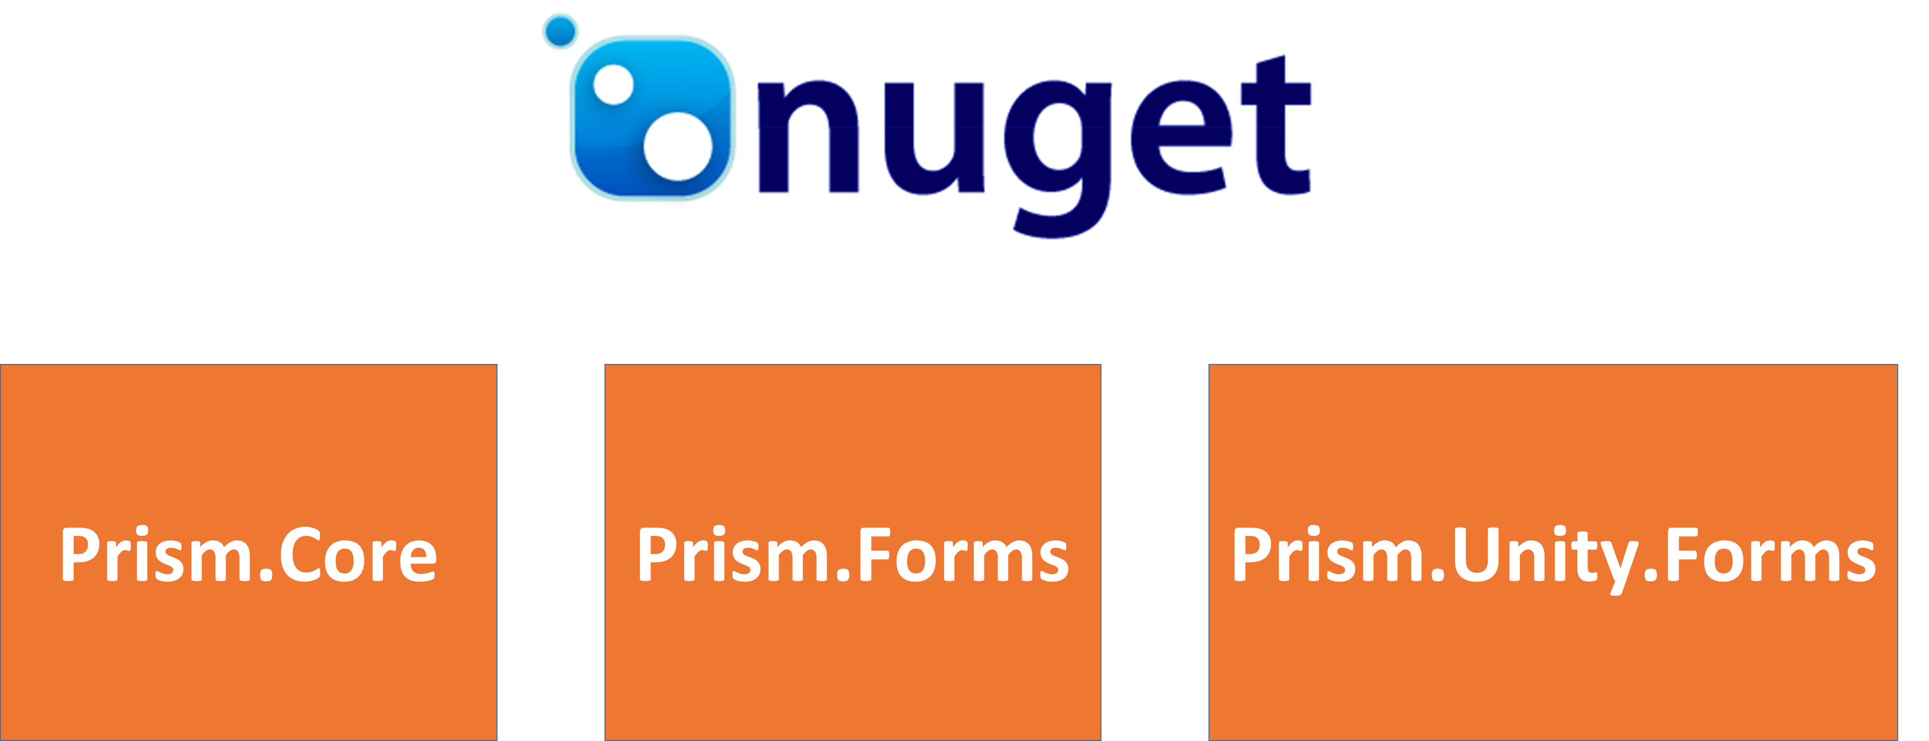
Where do you get Prism?

Slide 5
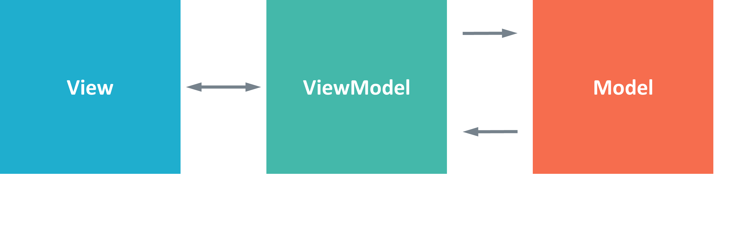
What is MVVM?
Design pattern
Question: how to connect Binding context and ViewModel?

Slide 6
Making the connection
ViewModelLocator
Automatic ViewModel Construction and Wire-up
AutowireViewModel Attached Property
Convention Based
“Views” namespace
“ViewModels” namespace
View Name + “ViewModel” = ViewModel Name
MainPage + “ViewModel” = MainPageViewModel

Slide 7
Commanding
DelegateCommand / DelegateCommand<T>
CanExecute
RaiseCanExecuteChanged();
ObservesProperty
ObservesCanExecute

Slide 8
Better navigation
Decoupled Navigation
No Page references
No ViewModel references
URI like ( = strings )
Relative (default) – navigation occurs relative to calling VM
Absolute – replaces entire navigation stack
Pages must be registered for navigation
INavigationService
Navigate
GoBack
Navigation Aware
NavigatingTo
NavigatedTo
NavigatedFrom
Mutli-Page-Navigation
IPageLifecycleAware
selectedTab / createTab

Slide 9
Navigation: passing parameters
Use NavigationParameters
Dictionary of objects (Key/Value)
Use querystring
Pass parameters via INavigationService
Navigate
GoBack

Slide 10
Navigation: Stack Manipulation
Remove Page from Navigation
ViewA/ViewB/ViewC/../ViewD
Go Back to root
INavigationService.GoBackToRoot
Retrive current navigation URI
INavigationService.GetNavigationUriPath

Slide 11

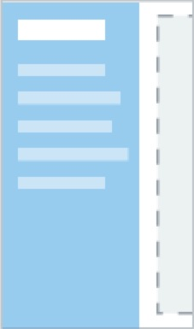
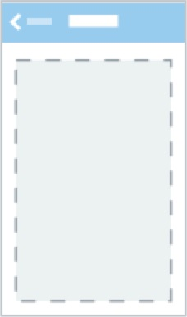
Deep linking
Navigate(“MasterDetail/NavigationPage/ViewA/ViewB”);
View A
View B

Slide 12
Deep linking with parameters
Navigate(“MasterDetail?id=6/NavigationPage/ViewA?user=Sia/ViewB?sort=asc”);
id=6 user=Sia sort=asc
View A
View B

Slide 13
IEventAggregator
Loosely coupled, event based communication
Multiple publishers & subscribers
Pass parameters/payloads

Slide 14
CODE/Demo

Slide 15
Thank you!

