Slide 1
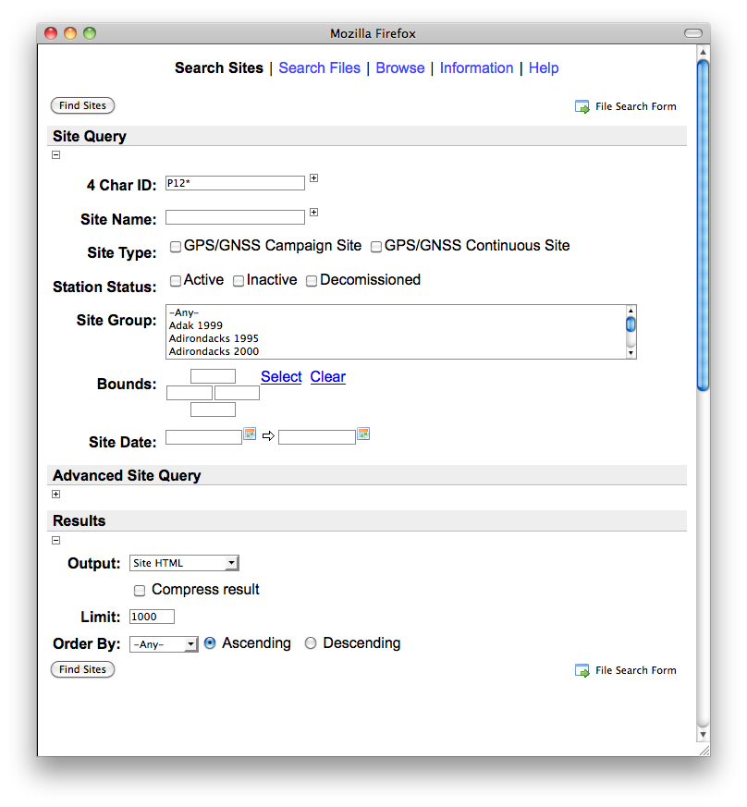
Look for files instead
Use “*” for wildcard
Select spatial bounds
Open for more options
Choose result format

Slide 2
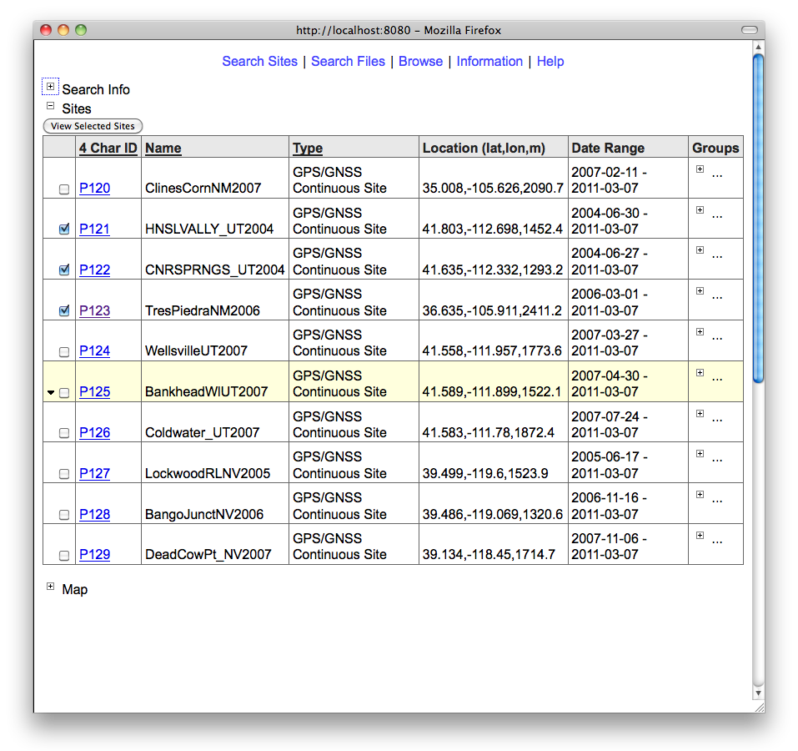
Open to see search info
Select to view individual sites
Click on row to see site details
Open to view results in a map

Slide 3
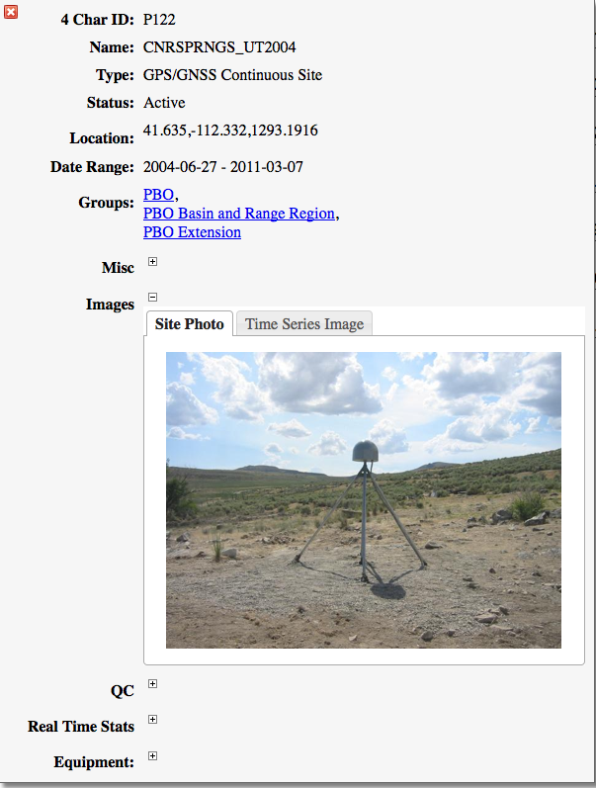

Slide 4
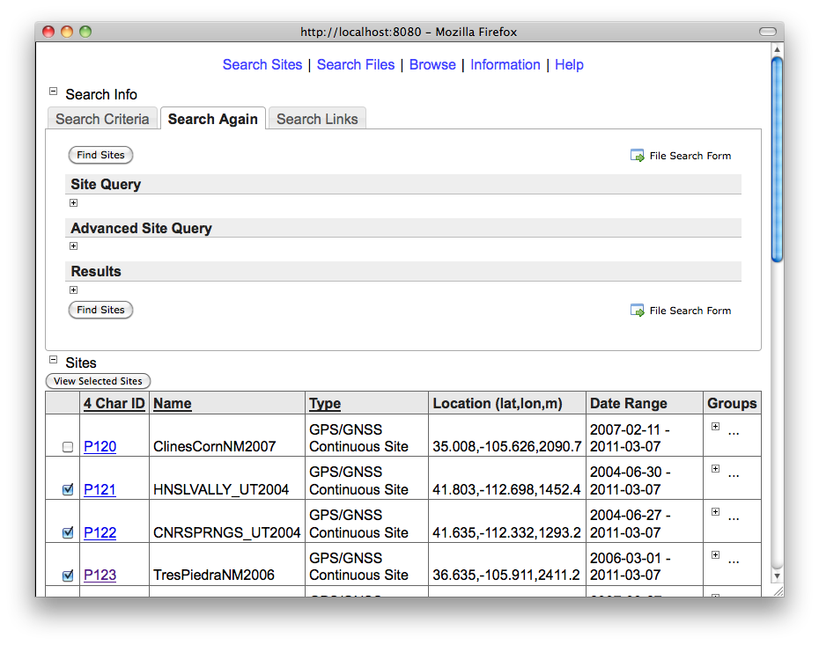
Refine your search
Search for files

Slide 5
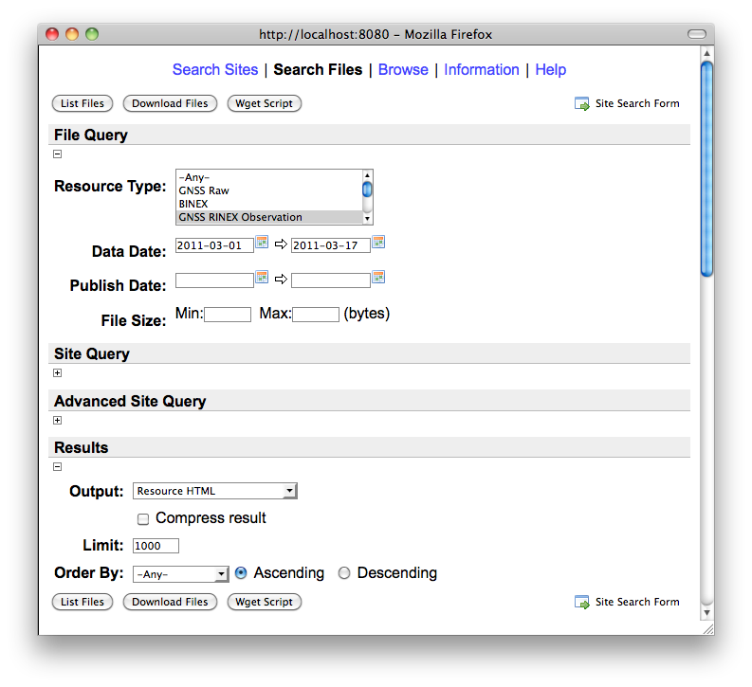
Search for files or download them
Choose file type and date
Site search criteria carried over
Choose result format

Slide 6
