Slide 1
Recap 19.03.18
Jan Vonmoos
Daniel Schumacher

Slide 2
Schedule
Clock and Timer
Keys
Questions

Slide 3
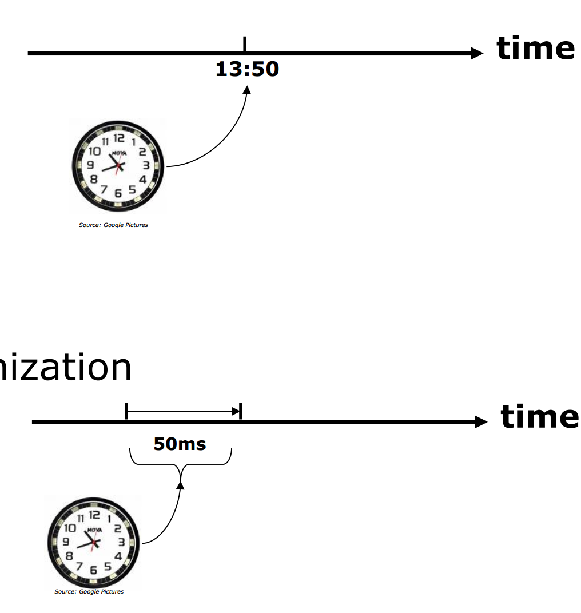
Absolut and Relative Timer
Absolute
Relative

Slide 4
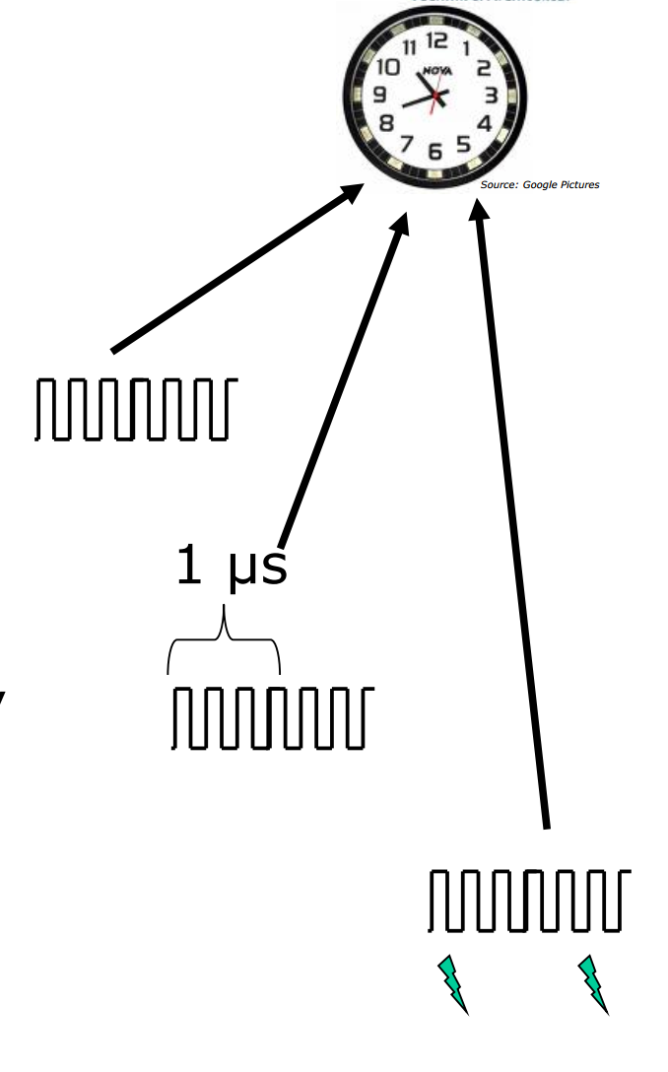
Counting Possibilitys
Counting Ticks
Counting Time for x Ticks
Interrupts

Slide 5
USB Clock
USB runs on 24Mhz
Remote CPU Clock has to be on 48Mhz
On 50Mhz the Divider can’t be set to reach 24Mhz

Slide 6
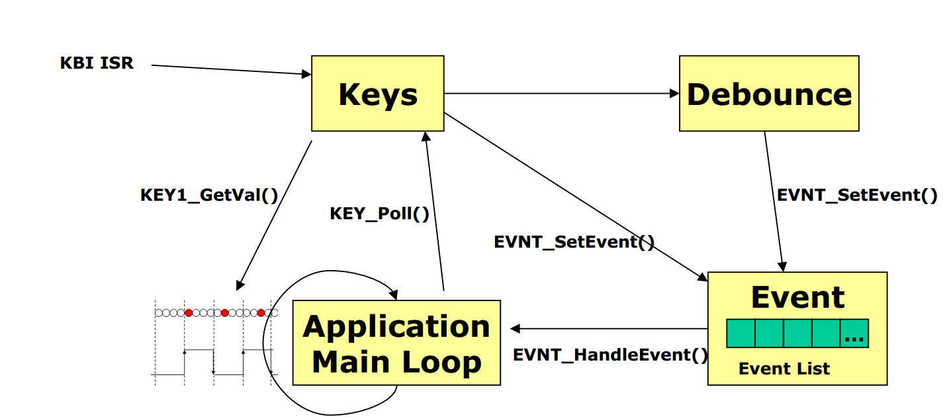
Keys

Slide 7

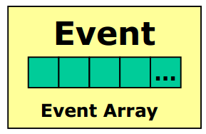
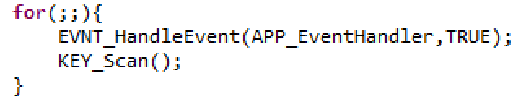
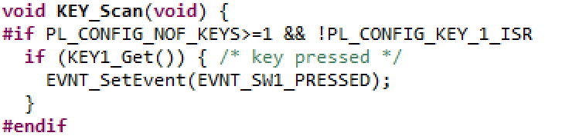
Code
Calls Callback
Handle Event
Adds Event
Polls Keys

Slide 8
Questions
What’s a Low Power Timer (LPTR)?
A timer who only works, when the MC is in low Power Mode

Slide 9
Question 2
Why is reading Variables from the Flash a bad Idea?
The Flash runs on a Lower Clock Rate so reading takes much longer

Slide 10
Question 3
What are the possibilitys to detect Key Inputs
Interrupts and Polling

Slide 11
Question 4
What’s the Advantage/Disadvantge of Polling and Interrupts
No Bussy waiting for Interrupts (+)
Pin must be able to generate Interrupts (-)
Interrupt Synchronization (-)

