Slide 1

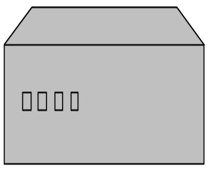
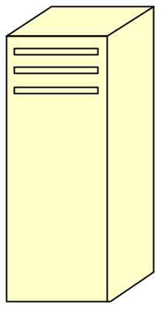


Register and Begin Call
Load Balancer
Mobicents Cluster
(shared CMP state)
IP Address:
Public_Server:5060
SLEE Server1
polling
SLEE Server2
IP Address:
anonymous

Slide 2

Continue Call after Server1 Failure
Load Balancer
Mobicents Cluster
(shared CMP state)
IP Address:
Public_Server:5060
SLEE Server1
polling
SLEE Server2
IP Address:
anonymous

Slide 3
Continue Call after LB1 Failure
Load Balancer
Mobicents Cluster
(shared CMP state)
IP Address:
offline
SLEE Server1
LB1
IP Address:
Public_Server:5060
SLEE Server2
LB2

