Slide 1
Mobicents
The First Certified Open Source Implementation of JAIN-SLEE 1.0
Ivelin Ivanov
JBoss, Inc.

Slide 2
Speaker Intro – Ivelin Ivanov
Director of Product Development, JBoss
Member of JBoss Core Team since 2003
Java.net Communications Community co-lead
Member of JSR 240 E.G.
Member of Eclipse WTP Requirements Committee
Contributor to GNU QeXO, Apache Cocoon, jXPath, XMLForm, FreeBuilder

Slide 3
Talk Overview
IP Telephony: more than telephony over IP
  Services – the key differentiator.
  Concrete Example: SIP, commodity infrastructure, open standards.
  Converged Services: separating carrier from operator, e.g. online gaming, location - movie theater, meet-up

Slide 4
Talk Overview
The requirements of IP telephony services motivate a new container architecture:
  What are the requirements of such services?
  Why does EJB + Signaling Stack not adequately address these requirements?
  What motivates the need for a new service architecture?

Slide 5
Talk Overview
Implementing the JAIN-SLEE spec on JBoss:
  Quick SLEE Demonstration : A SIP Proxy Server
  Key JBoss AS components used in the implementation.

Slide 6
IP Telephony In the Large
There’s two parts to IP Telephony:
  Call setup (signaling) and media.
  Signaling is where the Network Intelligence (services) reside.
This talk will focus on Signaling and Services

Slide 7
Signaling and Services
In order to set up a call the two end-points (IP Phones) exchange messages.
SIGNALING refers to the messages that are required to set up the call.
SIP is the dominant standard for call setup.
We will motivate the requirements using SIP as an example.
  SLEE is SIGNALING PROTOCOL AGNOSTIC.

Slide 8
Motivating the Requirements
Example Simple SIP Call Flow
UAC
UAS
INVITE
UAS – User Agent Server
UAC – User Agent Client
100 Trying
180 Ringing
200 OK
ACK
RTP Media Stream
There can be intermediate
Signaling nodes (Proxy Servers
that keep call state and network
services).
BYE
OK

Slide 9



Motivating the Requirements
A Typical SIP Enabled Network
SIP Proxy +
Registrar for domain A
SIP Proxy +
Registrar for domain B
B
A

Slide 10

An Architecture for Building Services
Components are good.
  But I am preaching to the choir!
  We need a component oriented event driven service platform
Need high performance and reliability
  No downtime – 99.999%
  50ms response time
  Example: mobile operator with 1 million customers serves over 300 SIP read/write requests / sec.
Transactions are good
  Simplifies the task of building resilient applications.
  But I am preaching again!
So we need a component oriented transaction supporting, event driven platform.

Slide 11
A Possible architecture for
Building Signaling Services
JAIN-SIP Listener
EJB
EJB
EJB
JAIN-SIP Stack
EJB Container
Signaling message
Tightly Coupled Listener
Constrains distribution.
      Object management is under application control
Application Complexity
High Latency
  Persistent state is stored in an EJB.

Slide 12
Lets Replace the EJB
EJB offers a nice component model.
Lets keep the cool stuff about the EJB model
and toss the rest out.
JAIN-SIP Listener
EJB
SBB
Event Mapping Layer
JAIN-SIP Stack
Signaling message
Replace EJB with a lighter weight component - “SBB”
Event driven ( one way messages )
What about execution order of the SBBs?

Slide 13
Services and SBBs
Services are compositional
Each compositional block is an SBB.
  SBB: Event Driven Service Building Block
SBBs fire in response to events
SBBs send each other events.
Order of SBB execution is important
  Otherwise outcome of composition is non-deterministic.

Slide 14
Lets group and order the SBBs
Lets group SBBs and define a means for specifying execution order
SIP Messages
SBB
JAIN-SIP Listener
SBB
Event Mapping Layer
SBB
JAIN-SIP Stack
Signaling message
A Service is a group of related SBBs.
Deployment descriptor allows us to specify execution order of SBBs.

Slide 15
Summing it up: What is the SLEE ?
JSR 22 ( spec leads Open Cloud and Sun ).
Crafted for the needs of Communications service platforms
  Highly Available
  Scalable
  Distributed
Supports standard JMX Management Interfaces
Supports standard facilities (timer, trace, usage, alarm)
Point of integration for multiple protocols and components:
  Events and components are strongly typed using java interfaces.
  A single container can support multiple protocols

Slide 16
Summing it up: Why Invent the SLEE?
Need to support Asynchronous invocations.
  EJBs are typically synchronous
SLEE is designed for fine grained short lived objects that are typically replicated in memory.
  SLEE objects are replicated in memory.
  SLEE transactions are light weight.
  SLEE manages transaction boundaries.

Slide 17
Simplified JAIN-SLEE Architecture
Svc A
Svc B
Timer
Trace
Sbbs
Sbbs
Alarm
Ac. Context Naming
Management (JMX)
Profile
Event Routing
Usage
SIP
H.323
Custom Protocol
Resource Adaptors,
RA APIs

Slide 18
JMS vs. SLEE
SLEE uses publish-subscribe model like JMS so why not just use it?
  Impedance mismatch.
  SLEE messages are supposed to be processed in 10-100 ms. JMS messages could take anywhere from seconds to days. Results in different implementation strategies.
  The “Topics” are not known a-priori here.
  JMS Connection is an expensive resource
  JMS is designed for remote messaging
  JMS drags in baggage that we don’t want.

Slide 19
The Mobicents Project
Purpose – to build an open source SLEE implementation.
Project is housed at http://www.mobicents.org
Development Lead: M. Ranganathan (NIST)
Founder: Ivelin Ivanov
Core Contributors : Francesco Moggia, Tim Fox, Jean Deruelle, Buddy Bright, Ralf Siedow, Marco Montiero, Sancho Cesar Rego
Significant contributions to date: Vodafone R&D, Lucent Technologies, PT Innovaco, TI Labs, Open Cloud, University of Genoe, Luis Pasteur University.
An active project with a growing list of contributors!

Slide 20
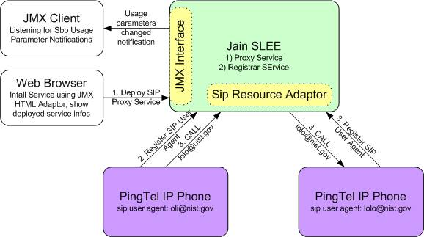
Demo 1

Slide 21

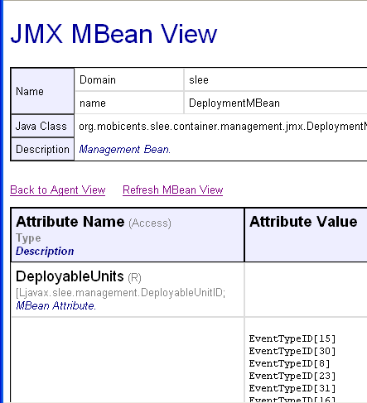
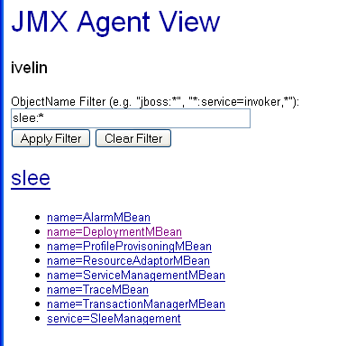
JMX and Management (cont’)
Deployment MBean
All SLEE Services

Slide 22

Q&A

