Slide 1

Mobicents
Open Source
VoIP Platform
http://www.mobicents.org
JavaPolis, Antwerp, 2005
  Ivelin Ivanov, JBoss, Inc.

Slide 2
What are we going to talk about?
VoIP Background
JSLEE in the industry
Mobicents Architecture
Demo
Roadmap

Slide 3
VoIP Background

Slide 4
A quick poll
Do you know what VoIP is?
Are you developing VoIP apps?
Why not?

Slide 5
You are not developing yet because
Internet is ubiquitous and bandwidth is abundant, but
There is no equivalent of a public Web layer
There are many proprietary islands:
  Skype, Google Talk, FWD, Yahoo Messenger, MSN Messenger, etc.
Ironically …bridged by the Plain old Telephone Network
What is needed is a public IP communications network that you can write apps for
  See Mobicents Google Talk Bot example
Java…is behind in standardization and OSS implementations
  VoIP is top level category at SourceForge
  At java.net it is a subset of the communications community
  JAIN is unfinished business

Slide 6
So what are we going to do about it?
We will do the unthinkable
Build Open Source, Open Standards Java VoIP platform
With buy-in from telco vendors and operators
Why will this work?...
  let’s look at the telco landscape today

Slide 7
Java VoIP Industry Realization and Trends

Slide 8

Telecom Industry Challenges
Single Service
Orientation
Voice
Internet
Wireless
Wi-Fi
Cable
VoIP
Media
Duplicative
Network
Infra
For
Each
New
Service
Decreasing
ARPU
High
Costs
Convergence
Service Provider
Consolidation
&
Competition
Consolidation of Networks, Bandwidth, Subscriber Base

Slide 9

Next-Generation Service Delivery Platform
CONVERGED
APPLICATIONS
Presence
IP Telephony
Messaging
INTEGRATED
SESSION CONTROL
Next-Generation
Service Delivery Platform
NETWORK
AGNOSTIC
Wireline
Wireless
IP
Evolution to an all-IP network
Well-defined, standardized interfaces through 3GPP, OMA and IETF
Based on standard communication protocols – SIP, XMPP
Common abstracted network service interfaces

Slide 10
Example value add applications
Meet people with similar interest in the same area, German Retailer
Baby tracker, Canadian telco
Airfare deal notifier, Southwest Airlines
Corporate conferencing
Wake up caller with hunting
Personalized ring profile
Business process integration, decision making over the phone
…no one knows what’s possible…think TCP/IP…

Slide 11

J2EE and JSLEE
Client
Web tier
Business tier
Data tier
Enterprise
Network
EJB
EIS
Web
Browser
Servlet
Telecommunication
Network
SBB
HLR HSS
Comms
Device

Slide 12
J2EE vs. JSLEE principles
Criteria | J2EE | JSLEE
Average Transaction Span | < 2 seconds | < 100ms
Transaction Volume | 1’000s/sec | 10’000s/sec
Persistence | Wide range | Read mostly
Uptime | 99.9% (9 hours/year) | 99.999% (5min/year)

Slide 13
Benefits
Traditional of-the-shelf software
  Leverage IDE’s for Service creation
Co-location of services
  Reduce latency and resource consumption
Open programming environment
  Tools can be leveraged by developers
  Leverage the best of the enterprise patterns
  Event driven design base
  Profile interface to subscriber/service data

Slide 14
Barriers
No backing by large software providers yet
NEP’s resisting adoption
  Spoils business model
New technology
  Will developers pick up programming model
  Requires investment
Bad press
  ISV’s competing for business – trashing technologies
  Competing architectures from different standards bodies

Slide 15
What changing in the industry?
Operators reluctant to upgrade capacity from older black box solutions to new black-box solutions
  NEP’s are losing business they typically secured
NEP’s have in-house development of technology
  Near tipping point
Key operators are still applying pressure
  Willingness to invest in standard based middleware
Open source environment gaining traction
  Communities speak volumes

Slide 16
Keep it real
July 5, 2005
Vodafone Spain Proves Software Portability for Programmable Network Services
MADRID, Spain (July 05, 2005)-While the telecommunications industry readies for the deployment of truly programmable network services that provides service portability in both IN and 3G/IMS, Vodafone Spain has already successfully used JAIN SLEE (Java) technology to deploy and run a real life commercial IN service on two different vendors platforms.
17 March, 2005
Rogelio Martinez, head of the Centre of Competence for JSLEE technologies of Vodafone Spain, said:
"Ensuring the success of our MMS network is a business-critical priority for us. The NetSpira ECS-MMR provides a way to eliminate bottlenecks in our MMS network. NetSpira has proved once again that it is ahead of the game - anticipating the needs of mobile and cellular operators and developing must-have products." The trial used several value-added services running on the top of Open Cloud Rhino's 1.2, a JAIN™ SLEE standards compliant service logic execution environment for carrier grade implementations.

Slide 17
Mobicents Architecture,
Implementation and Examples

Slide 18
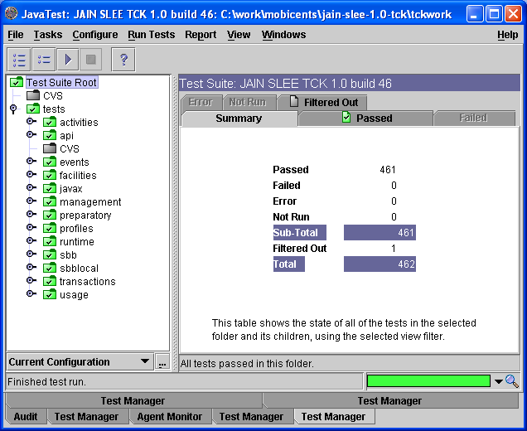
First and Only Certified OSS JSLEE
JAIN SLEE 1.0 Certified since v1.0a
Rigorous and thorough spec helps a lot
Great TCK coverage
Leverage solid JBoss microkernel and plug-ins

Slide 19
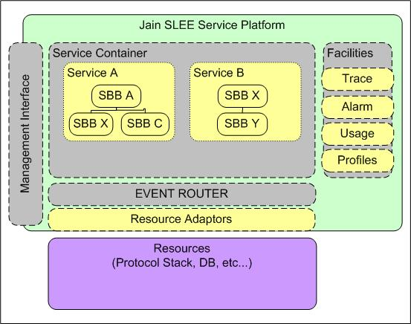
Simplified JAIN-SLEE Architecture
H.323
Network

Slide 20
Some Details
The SLEE abstracts the notion of an Event bus and event triggered pieces of code ( Called SBBs).
The event bus is called an Activity Context (AC).
  An Activity is a stream of related events.
  One-to-one mapping between Activities (Resource Adaptor domain) and Activity Contexts (SLEE domain).
  Activity Context is an Event Channel.
Sbb Ent
Sbb Ent
SLEE
AC
AC
AC
R.A. (SIP Stack)
Activity
Activity
Activity

Slide 21
SLEE Building Blocks
Event Type
SBB
Service
Profile Specification
Usage parameters interfaces
JMX management clients

Slide 22
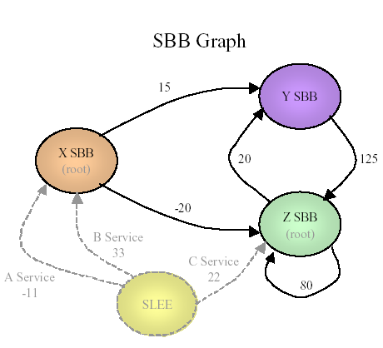
Service instantiation
(graphic re-used from JAIN-SLEE Tutorial with permission)
These are the SBBs known to
the SLEE
This picture is known at
Deployment time (through
the deployment descriptors).
At run time, the service
Instantiates a traversal of a
Sub-graph of this sbb graph.
B Service Instance
x
y
z

Slide 23
SLEE (JSR 22) as a JBoss Service
JBoss Microkernel architecture is a natural fit for building the SLEE
JTA
TreeCache
Profile
MBean
Trace
MBean
Alarm
MBean
Service
Mgt. MBean
Resource
Adaptor
MBean
Deployment
MBean
SLEE
Management
MBean
JMX Microkernel

Slide 24
jboss-service.xml for Mobicents
<mbean code="org.mobicents.slee.container.management.jmx.SleeManagementMBeanImpl" name="slee:service=SleeManagement">
<depends optional-attribute-name="AlarmMBean">slee:name=AlarmMBean</depends>
<depends optional-attribute-name="DeploymentMBean">
slee:name=DeploymentMBean</depends>
<depends optional-attribute-name=
"ServiceManagementMBean">slee:name=ServiceManagementMBean</depends>
<depends optional-attribute-name="TraceMBean">slee:name=TraceMBean</depends>
<depends optional-attribute-name=
"ProfileProvisioningMBean">slee:name=ProfileProvisoningMBean</depends>
<depends optional-attribute-name=
"ResourceAdaptorMBean">slee:name=ResourceAdaptorMBean</depends>
<depends>slee:name=TransactionManagerMBean</depends>
<depends>jboss.cache:service=TreeCache</depends>
<depends>jboss.cache:service=DeploymentTreeCache</depends>
<depends>jboss.cache:service=ProfileTreeCache</depends>
<depends>slee:service=SleeProfileManager</depends>
<depends>jboss.cache:service=RuntimeTreeCache</depends>
</mbean>

Slide 25
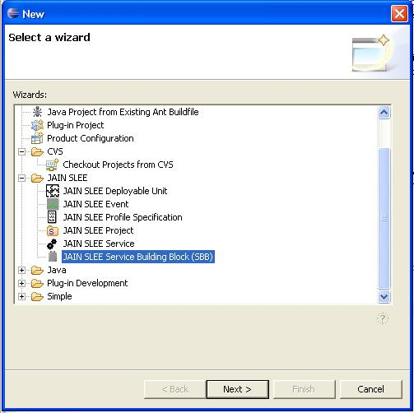
EclipSLEE plug-in project
EclipSLEE project on java.net
Subproject of Mobicents
OpenClouod Contribution
The plug-in provides a user friendly service creation environment for JAIN SLEE.

Slide 26
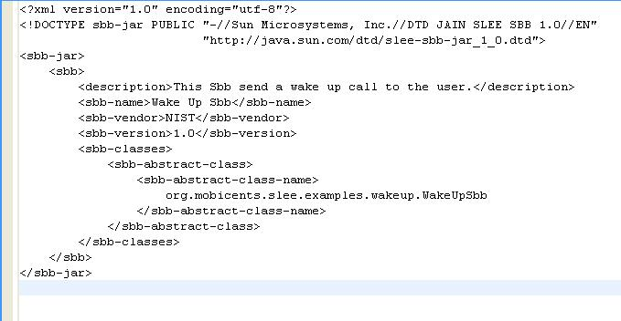
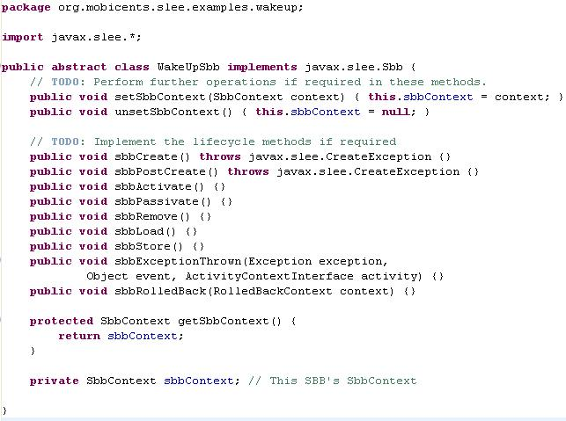
Minimal SBB xml & code

Slide 27
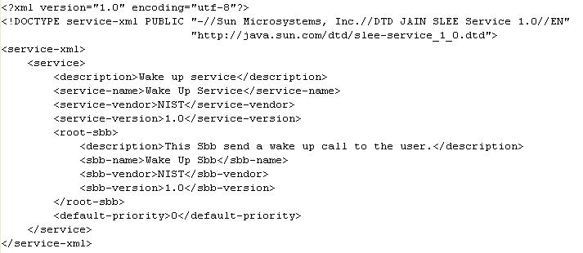
Service descriptor

Slide 28

Wake Up Service
SIP 200 OK
SIP Resource
Adaptor
Event Router
<MESSAGE, JAIN SIP, 1.1>
SIP MESSAGE
SIP MESSAGE
create
sendRequest(…)
Activity Context (Event Bus)
sendResponse(…)
<MESSAGE, JAIN SIP, 1.1>
<TIMER, JAIN SLEE, 1.0>
create
After 10 seconds
<TIMER, JAIN SLEE, 1.0>
Wake Up Sbb
Timer
Sip Message Body:
“10 COFFEE BREAK !!!!”
Sip Message:
“COFFEE BREAK !!!!”
Activity Context (Event Bus)

Slide 29
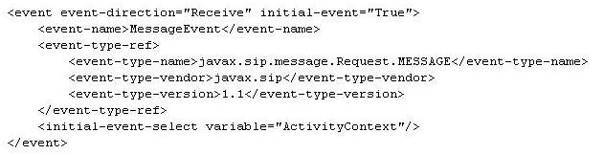
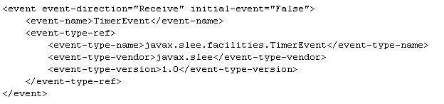
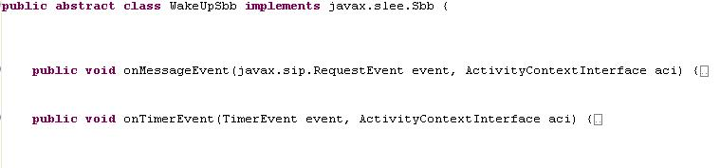
Event handlers

Slide 30
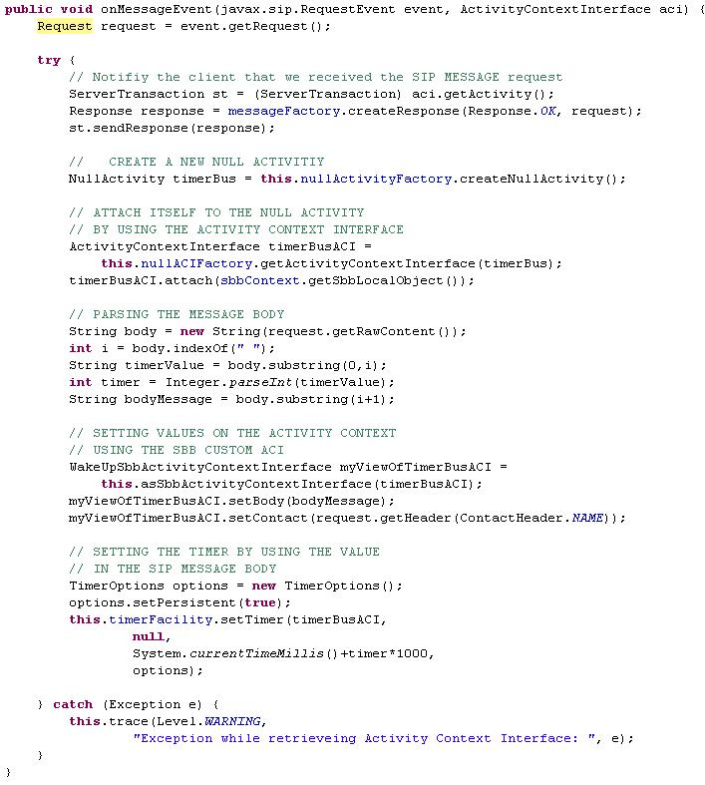
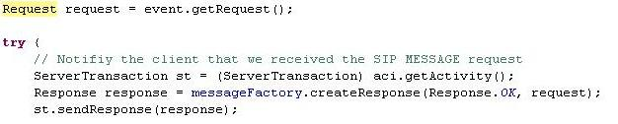
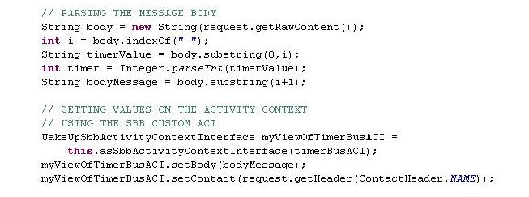
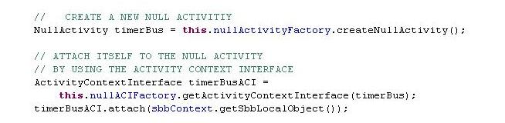
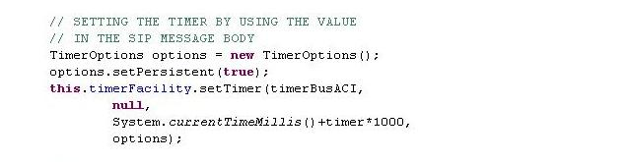
SIP MESSAGE event handler

Slide 31
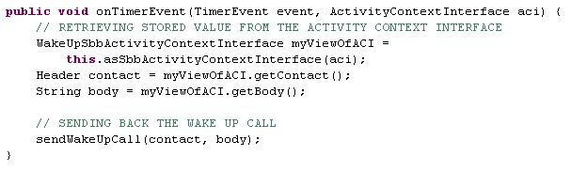
Timer Event Handler

Slide 32
Some Implementation Details

Slide 33
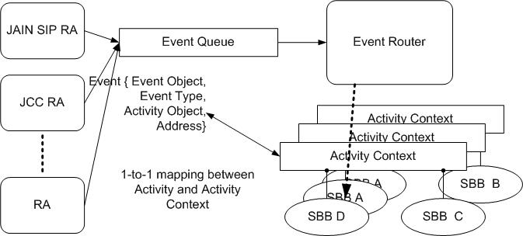
Event Delivery
“Heart” of the SLEE is the Event Router. Each AC is an event queue.

Slide 34
Concurrency And Consistency
SLEE spec is defined using a SERIALIZABLE consistency model.
This implies that for concurrent event delivery the final state of the SLEE after consumption of these events should be achievable through some serial ordering of event delivery.
Can be achieved using either optimistic or pessimistic concurrency control.
Current version of Mobicents uses pessimistic concurrency control.
Concurrency is at a per activity level.

Slide 35
Cached and Replicated Structures
ACs and Sbb Entities need to be replicated on Tx boundaries
  ACs are visible to applications and represent a transitory event bus.
  SBB Entities are the in memory representation of an SBB in use
  JBoss Cache is very handy for this –provides transactional replication.
JBoss Cache
Parent Sbb Entity ID
Activity ID
Activity Context ID
Sbb Entity ID
Service ID
Cmp fields
Child rel
SIP Transaction ID
CMP Field
Sbb Entity ID

Slide 36
Deployment
A deployable unit may contain Services, SBB jar files, Event jar files, Profile Specification jar files.
Each sbb has abstract methods for various operations: onXXX, CMP fields accessors. Profile CMP accessors, usage parameters.
These are generated at deployment time to access container facilities for actually performing the operations.
Abstract Sbb Class
service-jar.xml
event-jar-xml
event classes
Deployment Verification
Class Generation using JavaAssist
Deployment (registration in the SLEE)

Slide 37
A More Sophisticated Example:
SIP Proxy Server With Failover Support.

Slide 38
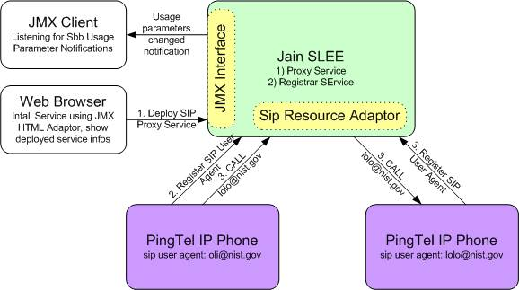
SIP Proxy as a SLEE Service

Slide 39
Replication and Persistence
Billing/ accounting Services
Proxy Server Replica
2
Call ID
BYE
OK
OK
1
INVITE
RINGING
Phone 1
Phone 2
Call Setup messages
Convergence name = CallID
Server 1 fails after call setup
Server 2 takes over for Server 1
Server 2 needs to replicate the same service structure
Server 2 needs to know about the call (Call ID)
  that server 1 was handling and map it to the same Service
HA is still a work in progress

Slide 40
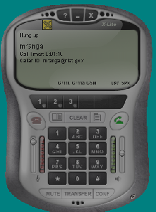
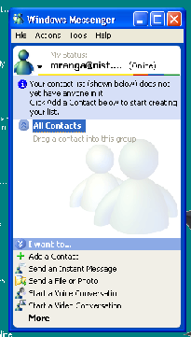
Demo Outline
A
B
INVITE
OK
FWD
ACK
FWD is a stateless forwarder.
Could also use IP Address Takeover
Ping
Proxy
Proxy
SLEE
SLEE

Slide 41
Demo Outline (cont’d)
A
B
BYE
OK
FWD
BYE
Ping
Proxy
Proxy
SLEE
SLEE

Slide 42
Demo Outline (cont’d)
B registers with the proxy server.
A calls B via the proxy.
Proxy crashes replica takes over
Hang up the call
  Show that the Service survives the crash.
  The initiator gets the BYE.
Re initiate the call from A to B
  Illustrates that the registrar survived the crash

Slide 43
Mobicents Community and Roadmap

Slide 44
Project Status
1.0b1 release
Beta quality
More stable SLEE core
Basic failover for SIP
Much better performance ~ 15cps/CPU
Profile persistence
Auto deployment

Slide 45
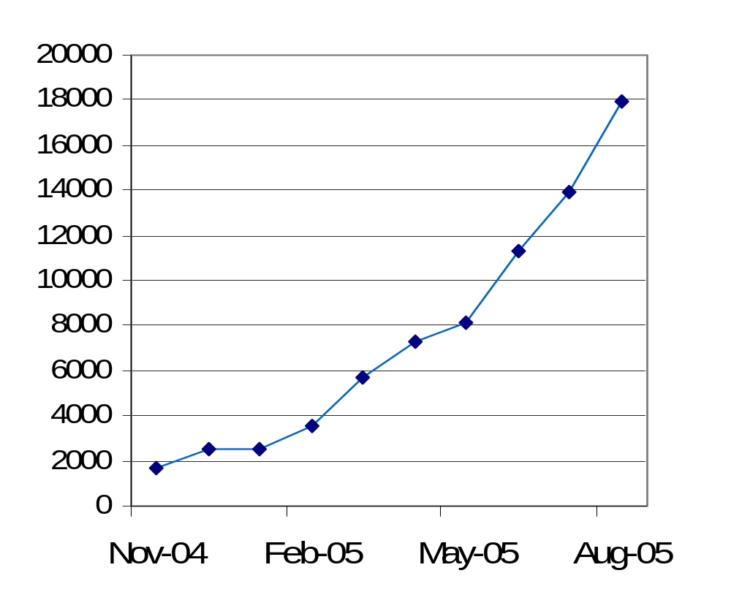
What makes it possible?
Committed Leadership
Vibrant Community
  20+ registered developers
  Daily forum discussions
  Increasing Wiki Views

Slide 46
Mobicents Community
NIST: Contributed SIP Stack, development of core platform
University of Genoa: Core contributor.
Luis Pasteur University: Continuous build and TCK runs
Java.net: project hosting
Portugal Telecom Innovacao: Asterisk RA, XMPP RA, Diameter RA
Lucent: Performance, profiling, HA
Open Cloud: EclipSLEE, SIP RA
Telecom Italia: core SLEE, community support
Vodafone R&D: Examples, XMPP RA
Volgograd Mobifon: JCC RA
Aepona: Parlay/Parlay-X RA
ZyXEL: WiFi SIP Phone Prototype
JBoss, Federation membership, JBoss World session
Several independent VoIP vendors
Major Contributing Individuals: M. Ranganathan, Francesco Moggia,
Ivelin Ivanov, Jean Deruelle, Ralf Siedow, Buddy Bright,
Leon Do, Marco Montiero, Luis Tiexeira, Tim Fox

Slide 47
Community feedback
Roadmap visibility and predictable timelines
  Most popular demand by far!
Carrier grade quality
Higher Availability
Better performance - 100+ cps
More modules – XMPP, JCC, Parlay, Skype, Asterisk, Diameter
Sophisticated Administration GUI
Tools for Rapid Service Development

Slide 48
What’s next?
Continue active development
  HA, performance, new RAs
  Enhance test framework
  Implement JSLEE 1.1 (JSR 240) when spec is final
Scale project coordination
  Add new contributors
  Preserve synergy and productivity
  Ensure ongoing module integration
Consider ideas for formal organization
  Predictable roadmap
  Measurable commitments by members
  Professional support channels

Slide 49

Q&A

