Slide 1

The Mobicents Open Source SLEE Platform
http://www.mobicents.org
VON Fall 2005
  Ivelin Ivanov, JBoss, Inc.
  M. Ranganathan, NIST
  Francesco Moggia, IRIS Srl
  Phelim O’Doherty, BEA Systems, Inc.

Slide 2
What are we going to talk about?
Mobicents Background
JSLEE in the industry
Mobicents Architecture
Demo
Roadmap

Slide 3

Mobicents Background
  Ivelin Ivanov

Slide 4
In the beginning…
First CVS commit in fall 2003
Initial Goals
  IM Portal bridging ICQ, MSN, Y!, Jabber
  Message transformation, routing, broadcasting, command execution
Challenges
  Independent OSS projects for each IM protocol
  Integration headache
  Lack of unifying platform

Slide 5
Priorities revisited
Need for a solid foundation
Standard way to add building blocks
Ability to extend with VoIP services
First option – J2EE + JAIN SIP + Jabber + Y!...
  Easy to demo, hard to extend, hopeless performance outlook
Next option – JSLEE
  Looks like a duck…
  Tough to comprehend, hard to implement
  We’ll byte the bullet anyway

Slide 6
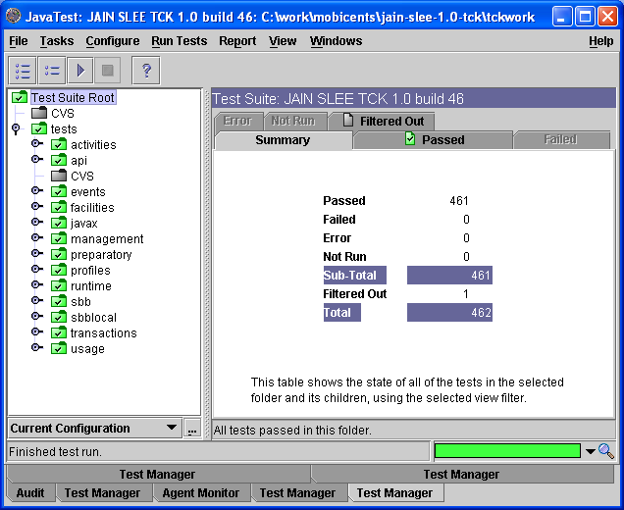
1.0a milestone
JAIN SLEE 1.0 Certification
Rigorous and thorough spec helps a lot
Great TCK coverage
Leverage JBoss 3.2.x

Slide 7

JAIN SLEE Industry Realization and Trends
  Phelim O’Doherty

Slide 8

Telecom Industry Challenges
Single Service
Orientation
Voice
Internet
Wireless
Wi-Fi
Cable
VoIP
Media
Duplicative
Network
Infra
For
Each
New
Service
Decreasing
ARPU
High
Costs
Convergence
Service Provider
Consolidation
&
Competition
Consolidation of Networks, Bandwidth, Subscriber Base

Slide 9

Next-Generation Service Delivery Platform
CONVERGED
APPLICATIONS
Presence
IP Telephony
Messaging
INTEGRATED
SESSION CONTROL
Next-Generation
Service Delivery Platform
NETWORK
AGNOSTIC
Wireline
Wireless
IP
Evolution to an all-IP network
Well-defined, standardized interfaces through 3GPP, OMA and IETF
Based on SIP as standard communication protocol
Common abstracted network service interfaces

Slide 10

J2EE and JSLEE
Client
Web tier
Business tier
Data tier
Enterprise
Network
EJB
EIS
Web
Browser
Servlet
Telecommunication
Network
SBB
HLR HSS
Comms
Device

Slide 11
JSLEE and Parlay
Parlay defines an architecture and set of abstracted interfaces
  No application server defined
JSLEE is a standard event driven application server
  Parlay App servers are typically built on proprietary SLEE’s instead of J2EE in order to achieve performance
  Vendors should build Parlay application servers on a standard JSLEE, enabling portability of services

Slide 12
JSLEE and SIP Servlet
SIP Servlet satisfies the ‘big bang’ approach to Voip
  All application development in SIP
  Tightly integrated with web-tier
JSLEE satisfies the ‘migration’ approach to Voip
  Leverage existing IN investment
  Single environment for IN evolution and IMS adoption
  Enables multiple protocol development
Both servers will co-exist each finding certain application niches
Each will make the other successful
  Same goal – replace proprietary systems with standard application infrastructure

Slide 13
Benefits
Traditional of-the-shelf software
  Leverage IDE’s for Service creation
Co-location of services
  Reduce latency and resource consumption
Open programming environment
  Tools can be leveraged by developers
  Leverage the best of the enterprise patterns
  Event driven design base
  Profile interface to subscriber/service data

Slide 14
Barriers
No large software provider
NEP’s resisting adoption
  Spoils business model
New technology
  Will developers pick up programming model
  Requires investment
Bad press
  ISV’s competing for business – trashing technologies
  Competing architectures from different standards bodies

Slide 15
What changing in the industry?
Operators reluctant to upgrade capacity from older black box solutions to new black-box solutions
  NEP’s are losing business they typically secured
NEP’s have in-house development of technology
  Near tipping point
Key operators are still applying pressure
  Willingness to invest in standard based middleware
Open source environment gaining traction
  Communities speak volumes

Slide 16
Keep it real
July 5, 2005
Vodafone Spain Proves Software Portability for Programmable Network Services
MADRID, Spain (July 05, 2005)-While the telecommunications industry readies for the deployment of truly programmable network services that provides service portability in both IN and 3G/IMS, Vodafone Spain has already successfully used JAIN SLEE (Java) technology to deploy and run a real life commercial IN service on two different vendors platforms.
17 March, 2005
Rogelio Martinez, head of the Centre of Competence for JSLEE technologies of Vodafone Spain, said:
"Ensuring the success of our MMS network is a business-critical priority for us. The NetSpira ECS-MMR provides a way to eliminate bottlenecks in our MMS network. NetSpira has proved once again that it is ahead of the game - anticipating the needs of mobile and cellular operators and developing must-have products." The trial used several value-added services running on the top of Open Cloud Rhino's 1.2, a JAIN™ SLEE standards compliant service logic execution environment for carrier grade implementations.

Slide 17


Mobicents Examples Architecture and
Implementation
  M. Ranganathan and Francesco Moggia

Slide 18
What is JSLEE – A more detailed answer
JAIN SLEE is an event oriented application middleware. Its main job is to field events from external resources and deliver these events to application installed fragments of code.
Is multi-protocol. Each protocol stack is a Resource with a corresponding Resource adaptor.
Has the flavor of EJB but is oriented towards asynchronous low latency event oriented apps.
Manages application objects, lifecycle, isolation, deployment, management, concurrency, persistence and failover needs.
Provides the necessary facilities commonly needed by such applications (i.e. timers, management via JMX, profile, trace).

Slide 19
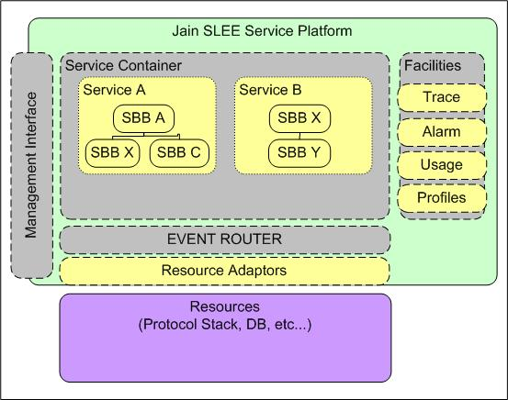
Simplified JAIN-SLEE Architecture
H.323
Network

Slide 20
Some Details
The SLEE abstracts the notion of an Event bus and event triggered pieces of code ( Called SBBs).
The event bus is called an Activity Context (AC).
  An Activity is a stream of related events.
  One-to-one mapping between Activities (Resource Adaptor domain) and Activity Contexts (SLEE domain).
  Activity Context is an Event Channel.
Sbb Ent
Sbb Ent
SLEE
AC
AC
AC
R.A. (SIP Stack)
Activity
Activity
Activity

Slide 21
SLEE Building Blocks
Event Type
  Typed event model.
  Resource adaptors generate events
SBB
  Fundamental building block (like an EJB).
  SBBs can communicate by firing events on ACs
  SBBs receive events over AC’s.
  Event source can be Resource Adaptors, Facilities, Timers, Alarms…
Service
  Management Artifact
  Contains information for initial event processing
  Is instantiated by the SLEE upon receipt of appropriate message matching the Convergence Name of the Service.
Profile Specification
  Provisioned data for management of services.
Usage parameters interfaces
JMX management clients

Slide 22
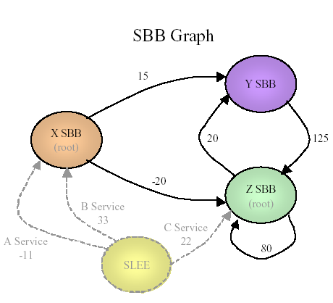
Service instantiation
These are the SBBs known to
the SLEE
This picture is known at
Deployment time (through
the deployment descriptors).
At run time, the service
Instantiates a traversal of a
Sub-graph of this sbb graph.
(graphic re-used from JAIN-SLEE Tutorial with permission)
B Service Instance
x
y
z

Slide 23
SLEE (JSR 22) as a JBoss Service
JBoss Microkernel architecture is a natural fit for building the SLEE
JBoss
Transaction.
Manager
TreeCache
Profile
MBean
Trace
MBean
Alarm
MBean
Service
Mgt. MBean
Resource
Adaptor
MBean
Deployment
MBean
SLEE
Management
MBean
JMX

Slide 24
jboss-service.xml for Mobicents
<mbean code="org.mobicents.slee.container.management.jmx.SleeManagementMBeanImpl" name="slee:service=SleeManagement">
<depends optional-attribute-name="AlarmMBean">slee:name=AlarmMBean</depends>
<depends optional-attribute-name="DeploymentMBean">
slee:name=DeploymentMBean</depends>
<depends optional-attribute-name=
"ServiceManagementMBean">slee:name=ServiceManagementMBean</depends>
<depends optional-attribute-name="TraceMBean">slee:name=TraceMBean</depends>
<depends optional-attribute-name=
"ProfileProvisioningMBean">slee:name=ProfileProvisoningMBean</depends>
<depends optional-attribute-name=
"ResourceAdaptorMBean">slee:name=ResourceAdaptorMBean</depends>
<depends>slee:name=TransactionManagerMBean</depends>
<depends>jboss.cache:service=TreeCache</depends>
<depends>jboss.cache:service=DeploymentTreeCache</depends>
<depends>jboss.cache:service=ProfileTreeCache</depends>
<depends>slee:service=SleeProfileManager</depends>
<depends>jboss.cache:service=RuntimeTreeCache</depends>
</mbean>

Slide 25
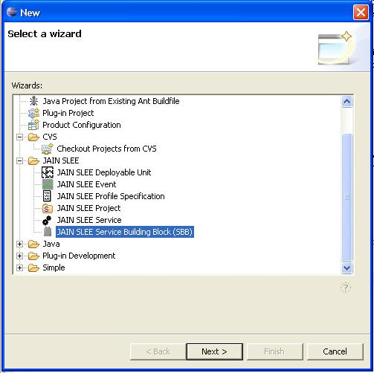
EclipSLEE plug-in project
EclipSLEE project on java.net
Subproject of Mobicents
OpenClouod Contribution
The plug-in provides a user friendly service creation environment for JAIN SLEE.

Slide 26
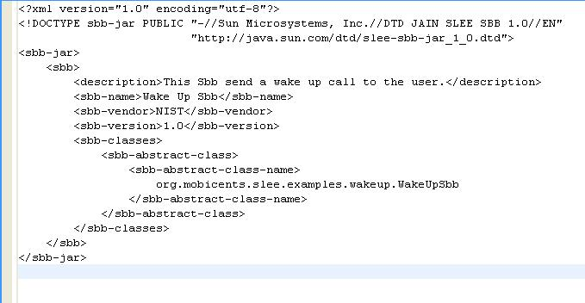
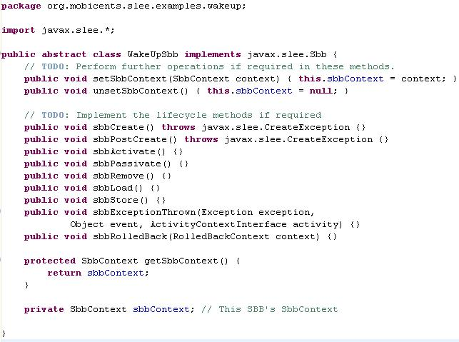
Minimal SBB xml & code

Slide 27
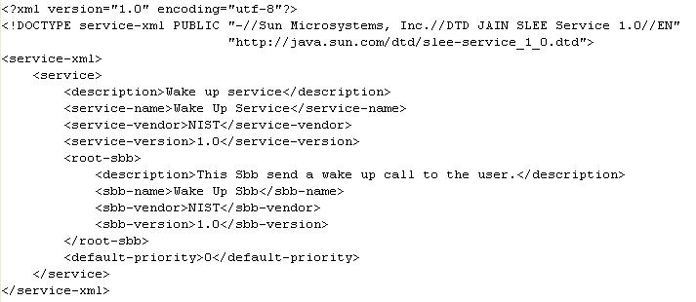
Service descriptor

Slide 28
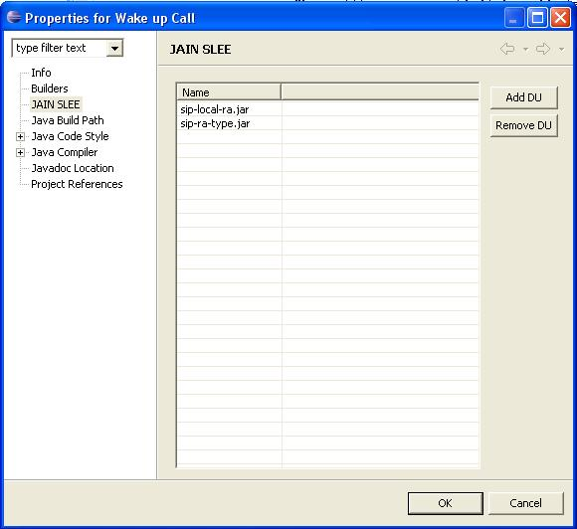
Resource Adaptor inside the Plug-in

Slide 29

Wake Up Service
SIP 200 OK
SIP Resource
Adaptor
Event Router
<MESSAGE, JAIN SIP, 1.1>
SIP MESSAGE
SIP MESSAGE
create
sendRequest(…)
Activity Context (Event Bus)
sendResponse(…)
<MESSAGE, JAIN SIP, 1.1>
<TIMER, JAIN SLEE, 1.0>
create
After 10 seconds
<TIMER, JAIN SLEE, 1.0>
Wake Up Sbb
Timer
Sip Message Body:
“10 COFFEE BREAK !!!!”
Sip Message:
“COFFEE BREAK !!!!”
Activity Context (Event Bus)

Slide 30
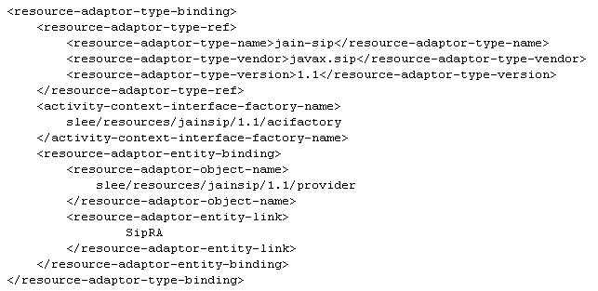
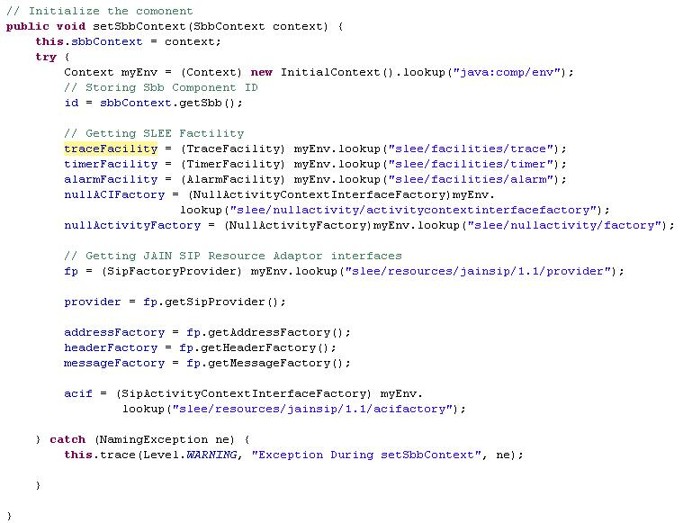
Resource adaptor & SBB

Slide 31
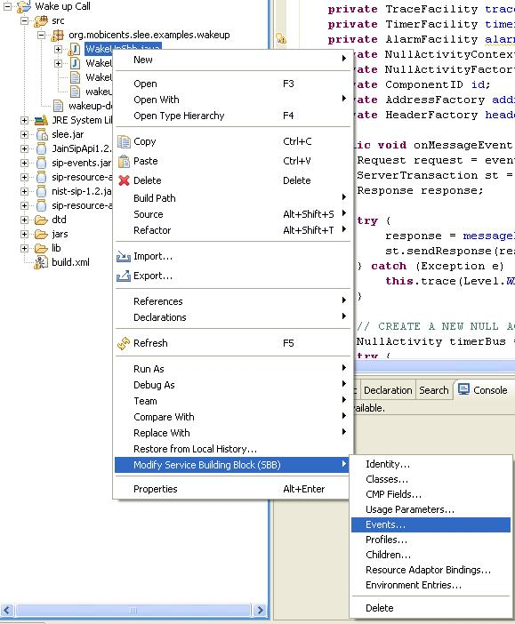
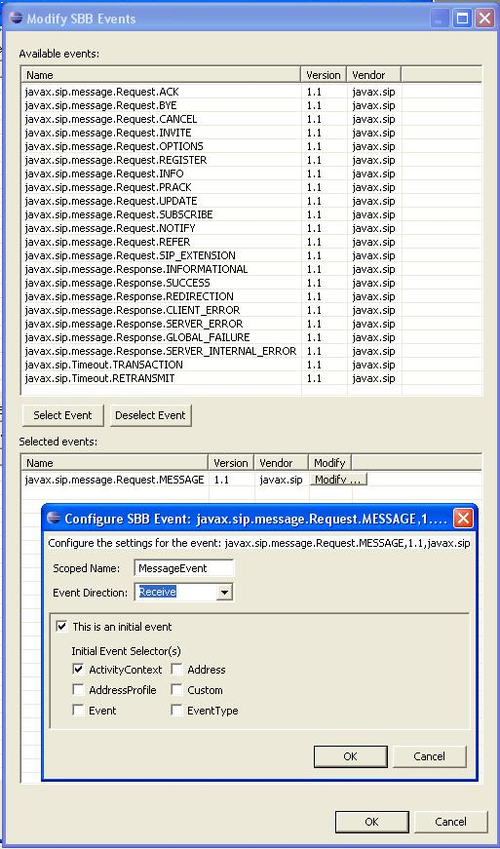
Adding Events with the Plug-in

Slide 32
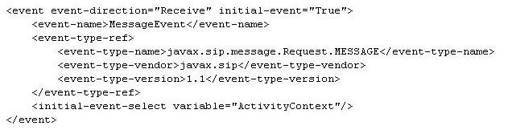
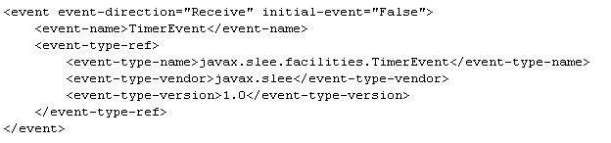
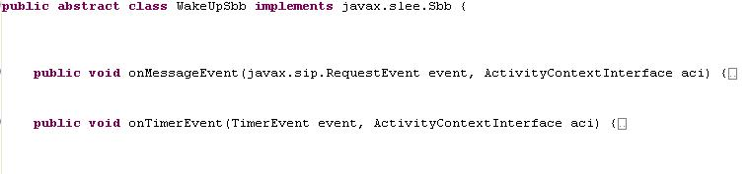
Event handlers

Slide 33
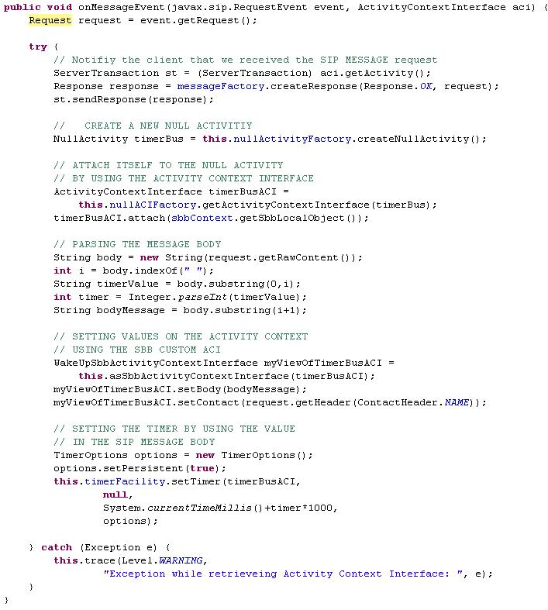
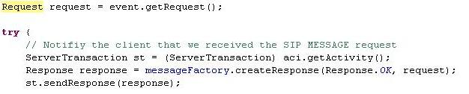
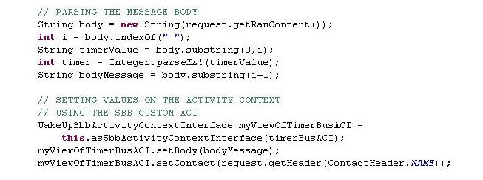
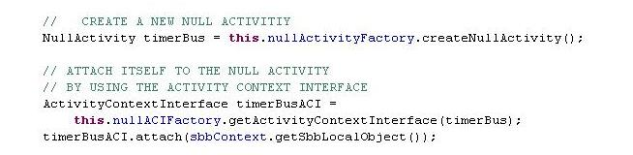
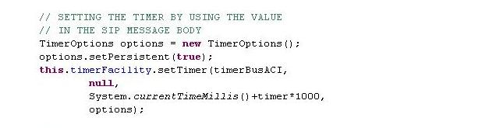
SIP MESSAGE event handler

Slide 34
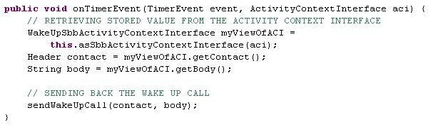
Timer Event Handler

Slide 35
Some Implementation Details

Slide 36
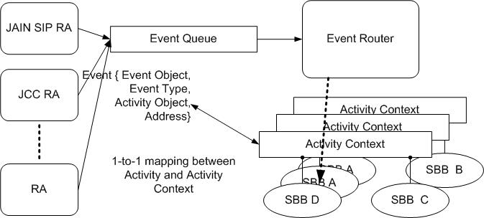
Event Delivery
“Heart” of the SLEE is the Event Router. Each AC is an event queue.

Slide 37
Concurrency And Consistency
SLEE spec is defined using a SERIALIZABLE consistency model.
This implies that for concurrent event delivery the final state of the SLEE after consumption of these events should be achievable through some serial ordering of event delivery.
Can be achieved using either optimistic or pessimistic concurrency control.
Current version of Mobicents uses pessimistic concurrency control.
Concurrency is at a per activity level.

Slide 38
Cached and Replicated Structures
ACs and Sbb Entities need to be replicated on Tx boundaries
  ACs are visible to applications and represent a transitory event bus.
  SBB Entities are the in memory representation of an SBB in use
  JBoss Cache is very handy for this –provides transactional replication.
JBoss Cache
Parent Sbb Entity ID
Activity ID
Activity Context ID
Sbb Entity ID
Service ID
Cmp fields
Child rel
SIP Transaction ID
CMP Field
Sbb Entity ID

Slide 39
Deployment
A deployable unit may contain Services, SBB jar files, Event jar files, Profile Specification jar files.
Each sbb has abstract methods for various operations: onXXX, CMP fields accessors. Profile CMP accessors, usage parameters.
These are generated at deployment time to access container facilities for actually performing the operations.
Abstract Sbb Class
service-jar.xml
event-jar-xml
event classes
Deployment Verification
Class Generation using JavaAssist
Deployment (registration in the SLEE)

Slide 40
A More Sophisticated Example:
SIP Proxy Server With Failover Support.

Slide 41
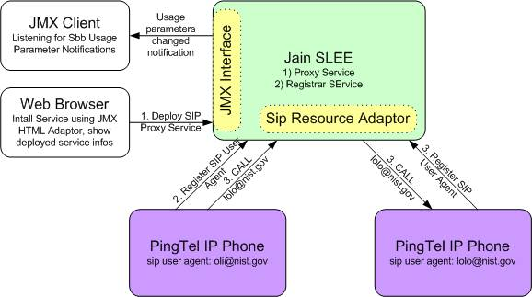
SIP Proxy as a SLEE Service

Slide 42
Replication and Persistence
Billing/ accounting Services
Proxy Server Replica
2
Call ID
BYE
OK
OK
1
INVITE
RINGING
Phone 1
Phone 2
Call Setup messages
Convergence name = CallID
Server 1 fails after call setup
Server 2 takes over for Server 1
Server 2 needs to replicate the same service structure
Server 2 needs to know about the call (Call ID)
  that server 1 was handling and map it to the same Service
HA is still a work in progress

Slide 43
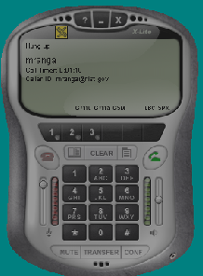
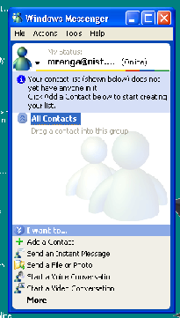
Demo Outline
A
B
INVITE
OK
FWD
ACK
FWD is a stateless forwarder.
Could also use IP Address Takeover
Ping
Proxy
Proxy
SLEE
SLEE

Slide 44
Demo Outline (cont’d)
A
B
BYE
OK
FWD
BYE
Ping
Proxy
Proxy
SLEE
SLEE

Slide 45
Demo Outline (cont’d)
B registers with the proxy server.
A calls B via the proxy.
Proxy crashes replica takes over
Hang up the call
  Show that the Service survives the crash.
  The initiator gets the BYE.
Re initiate the call from A to B
  Illustrates that the registrar survived the crash

Slide 46
Mobicents Community and Roadmap
  Ivelin Ivanov

Slide 47
Project Status
1.0b1 release
Beta quality
More stable SLEE core
Basic failover for SIP
Much better performance ~ 15cps/CPU
Profile persistence
Auto deployment

Slide 48
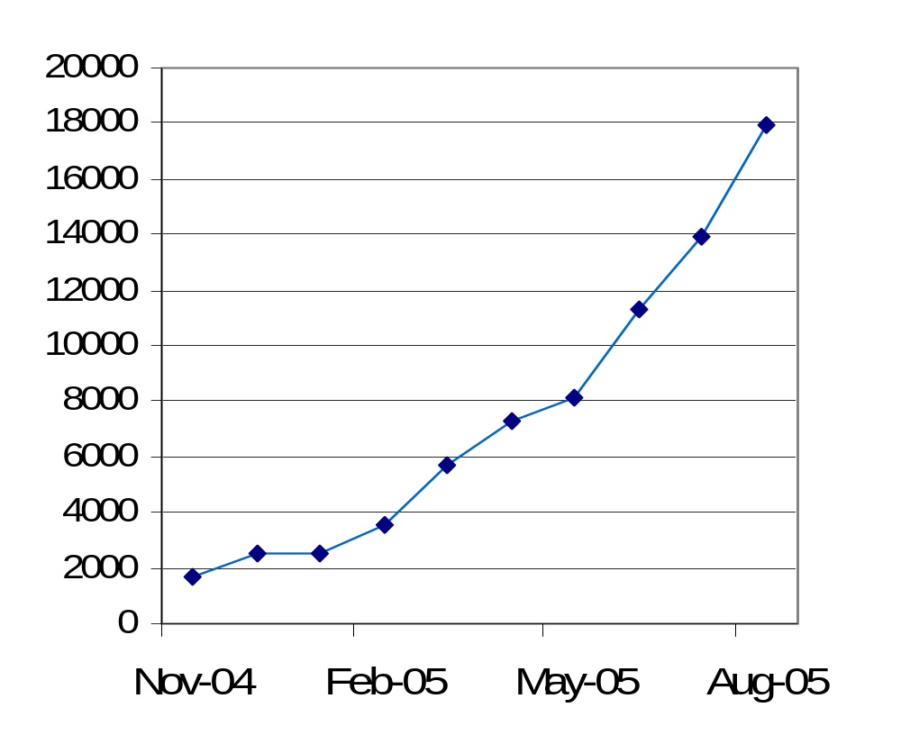
What makes it possible?
Committed Leadership
Vibrant Community
  20+ registered developers
  Daily forum discussions
  Increasing Wiki Views

Slide 49
Mobicents Community
NIST: Contributed SIP Stack, development of core platform
University of Genoa: Core contributor.
Luis Pasteur University: Continuous build and TCK runs
Java.net: project hosting
Portugal Telecom Innovacao: Asterisk RA, XMPP RA
Lucent: Performance, profiling, HA
Open Cloud: EclipSLEE, SIP RA
Vodafone R&D: Examples, XMPP RA,
<Tier 1 Telco>: Diameter RA
<VoIP vendor>: Parlay/Parlay-X RA
ZyXEL: WiFi SIP Phone Prototype
JBoss, Federation membership
Several independent VoIP vendors
Technical Lead: M. Ranganathan
Major Contributing Individuals: Francesco Moggia,
Ivelin Ivanov, Jean Deruelle, Ralf Siedow, Buddy Bright,
Leon Do, Marco Montiero, Luis Tiexeira, Tim Fox

Slide 50
Community feedback
Roadmap visibility and predictable timelines
  Most popular demand by far!
Carrier grade quality
Higher Availability
Better performance - 100+ cps
More modules – XMPP, Parlay, Skype, Asterisk, Diameter
Sophisticated Administration GUI
Tools for Rapid Service Development

Slide 51
What’s next?
Continue active development
  HA, performance, new RAs
  Enhance test framework
Scale project coordination
  Add new contributors
  Preserve synergy and productivity
  Ensure ongoing module integration
Consider ideas for formal organization
  Predictable roadmap
  Measurable commitments by members
  Professional support channels

Slide 52

Q&A

