Slide 1
Rough component breakdown for a single SLEE node
SLEE Management and facilities
Transaction state
Timer
Alarms
Addresses
Naming
Profiles
SLEE Activities
R.A
SBB Runtime
Network
Management
actions
SLEE End point
Transaction mgr
Event Router
Replication (clustering) manager
R.A Deployer
activity
Stats
Transaction state
Activity ctx
queries
R.A. jar
SBB pool
SBB Context Interface
Activity ctx
SBB Factory
Service / SBB Management
component
Persistence mgr
SBB pool
manager
Service Deployer
Runtime structure
Static data
service.jar
sbb.jar
legend

Slide 2
Key Concepts: Event Model
SLEE uses the publish/subscribe model for event distribution
SBBs attach to and detach from activity contexts for event distribution
The SLEE architecture does not allow SBBs to register themselves explicity as listeners of a resource

Slide 3
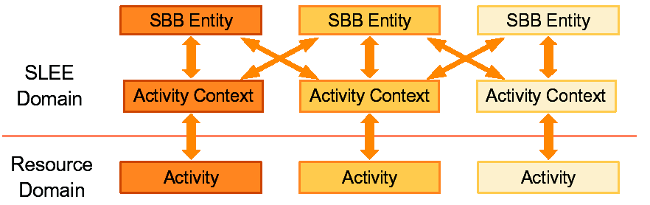
Key Concepts Activity Context
• SLEE domain object to encapsulate Activity defined by resources
An event channel on which events are fired and delivered on
Holds shared state regarding the Activity
Many-to-many attachment relationships
SBBs only receive events from attached Activities

Slide 4
Example: Message delivery inside the SLEE
T
h
e
S
i
p
S
t
a
c
k
r
e
c
e
i
v
e
T
h
e
S
L
E
E
w
r
a
p
s
t
h
e
A
c
t
i
v
i
t
y
a
S
i
p
m
e
s
s
a
g
e
i
n
a
n
A
c
t
i
v
i
t
y
C
o
n
t
e
x
t
a
n
d
e
n
q
u
e
e
v
e
n
t
i
n
t
h
e
r
o
u
t
e
r
q
u
e
u
e
T
h
e
r
e
s
o
u
r
c
e
a
d
a
p
t
o
r
c
r
e
a
t
e
t
h
e
E
v
e
n
t
w
r
a
p
p
e
r
t
o
p
a
s
s
t
o
t
h
e
S
L
E
E
.
G
e
t
t
h
e
A
c
t
i
v
i
t
y
O
b
j
e
c
t
f
r
o
m
t
h
e
S
t
a
c
k
.
S
i
p
S
e
r
v
e
r
T
r
a
n
s
a
c
t
i
o
n
T
h
e
r
o
u
t
e
r
d
e
q
u
e
t
h
e
e
v
e
n
t
e
n
d
r
u
n
t
h
e
r
o
u
t
i
n
g
e
v
e
n
t
p
r
o
c
e
d
u
r
e
T
h
e
R
e
s
o
u
r
c
e
A
d
a
p
t
o
r
p
a
s
s
e
s
t
h
e
e
v
e
n
t
t
o
e
n
q
u
e
t
h
e
S
L
E
E
p
r
o
v
i
d
i
n
g
t
h
e
f
o
l
l
o
w
i
n
g
i
n
f
o
r
m
a
t
i
o
n
:
e
v
e
n
t
-
t
y
p
e
,
e
v
e
n
t
-
o
b
j
e
c
t
,
a
c
t
i
v
i
t
y
o
b
j
e
c
t
,
a
d
d
r
e
s
s
o
b
j
e
c
t
R
e
s
o
u
r
c
e
A
d
p
a
p
t
o
r
S
L
E
E

Slide 5
Example
RegistrarSbb
onRegister(SIPRequest, SBBActivityContextInterface)
ActivityContext
One-to-one relationship
EventRouter
Event (Activity ”SipServerTransaction”,
Event type “javax.sip.request.REGISTER”,
EventObject “SIPRequest”, Address)
Resource Adaptor
Activity:Transaction
Resource: SIP Stack
Transaction
Registrar

Slide 6
Example:
Dynamic service creation
Container
RegistrarSbb
Registrar Service Description
Root Sbb: RegistrarSbb
Initial event: javax.sip.request.REGISTER
Activity Context
(3) onRegister
(2) processInitialEvent()
EventRouter
(1) javax.sip.request.REGISTER

