Slide 1
Trash Material Classification via Deep Learning
Abdulellah Abualshour
Visual Computing Center

Slide 2
Outline
Motivation
Problem Statement
Related Work
Datasets
Methodology
Experiments
Results
Conclusion
Future Work

Slide 3
Motivation
Waste management is a very important task to preserve the environment. Environment and natural materials played an important function in the development of human societies and in history on the whole [1].
Therefore, trash material classification helps a lot with achieving the goal of a better environment by applying deep learning methods to help us build useful applications dedicated for categorizing different types of materials given suitable datasets.

Slide 4
Problem Statement
In this project, I try to find the best and most efficient approaches to image classification suitable for trash material classification. My hope in this project is to implement and develop very accurate and efficient classifiers for the task of material classification.

Slide 5
Related Work
G. Schwartz and K. Nishino. Recognizing material properties from images. IEEE transactions on pattern analysis and machine intelligence, 2018.
C. Liu, L. Sharan, E. H. Adelson, and R. Rosenholtz. Exploring features in a bayesian framework for material recognition. IEEE Computer Society Conference on Computer Vision and Pattern Recognition, pages 239–246, 2010.
M. Yang and G. Thung. Classification of trash for recyclability status. Stanford University, 2016.
C. Bircanoglu, M. Atay, F. Beser, O. Genc, and M. A. Kizrak. RecycleNet: Intelligent waste sorting using deep neural networks. Innovations in Intelligent Systems and Applications, pages 1–7, 2018.

Slide 6
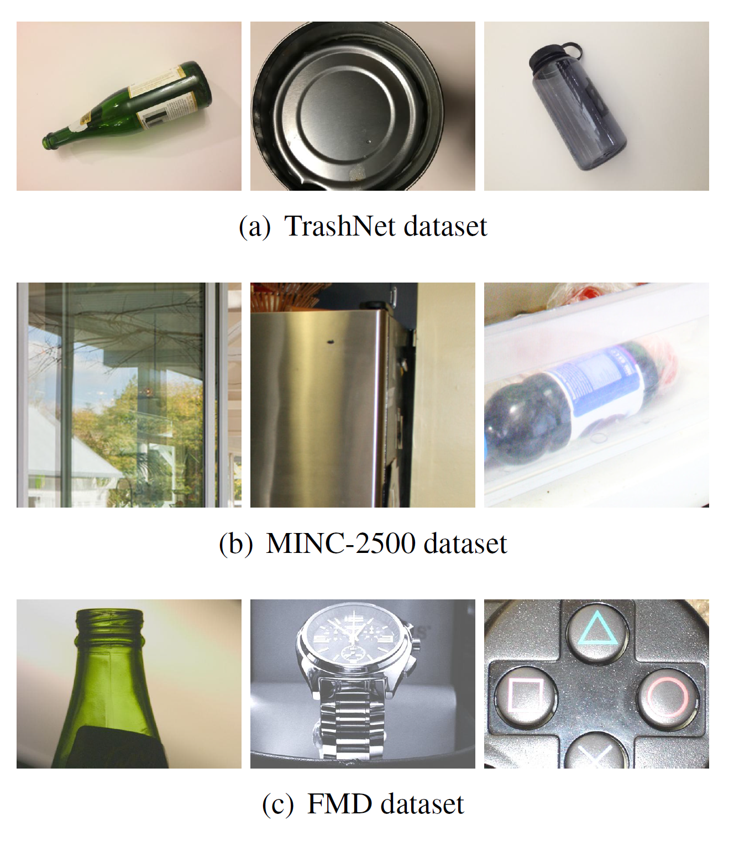
Datasets
State-of-the-art: DenseNet121 (95%)
Reported in RecycleNet
2527 images
State-of-the-art: Deep-TEN (81.3%)
Rutgers University CVPR Paper!
57500 images
State-of-the-art: FV-CNN (82.4%)
1000 images

Slide 7
Methodology
Convolutional Neural Networks
Fine-tuning
Implementing new model! (Future work)
Data Augmentation
Shifting images horizontally and vertically
Rotation by a 45 degree angle
Horizontal flipping
Shearing
Zooming
Optimization
SGD, RMSProp, Adam, Adamax, Nadam

Slide 8
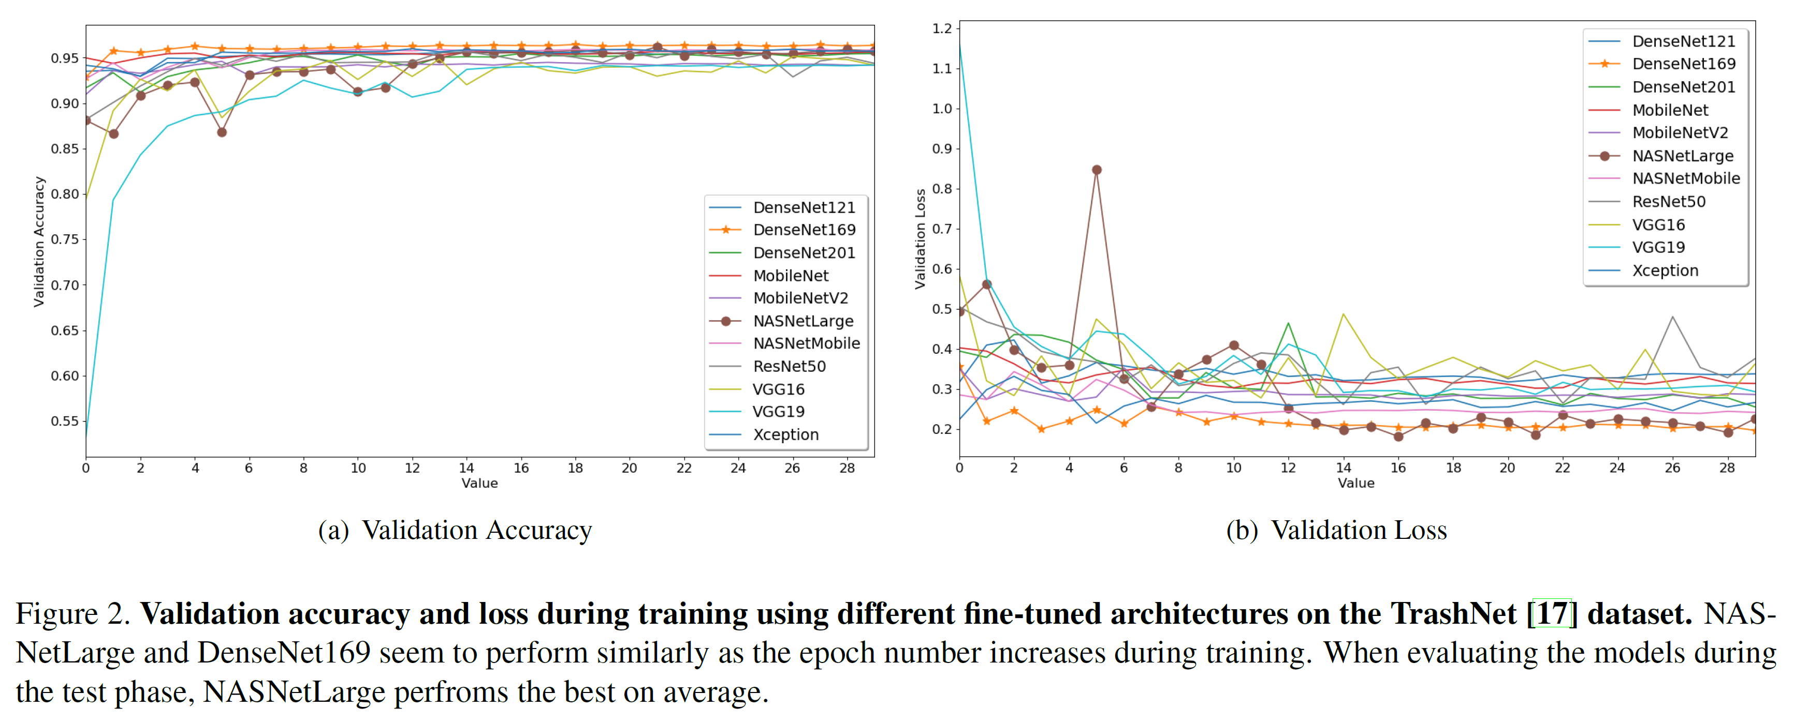
Experiments

Slide 9
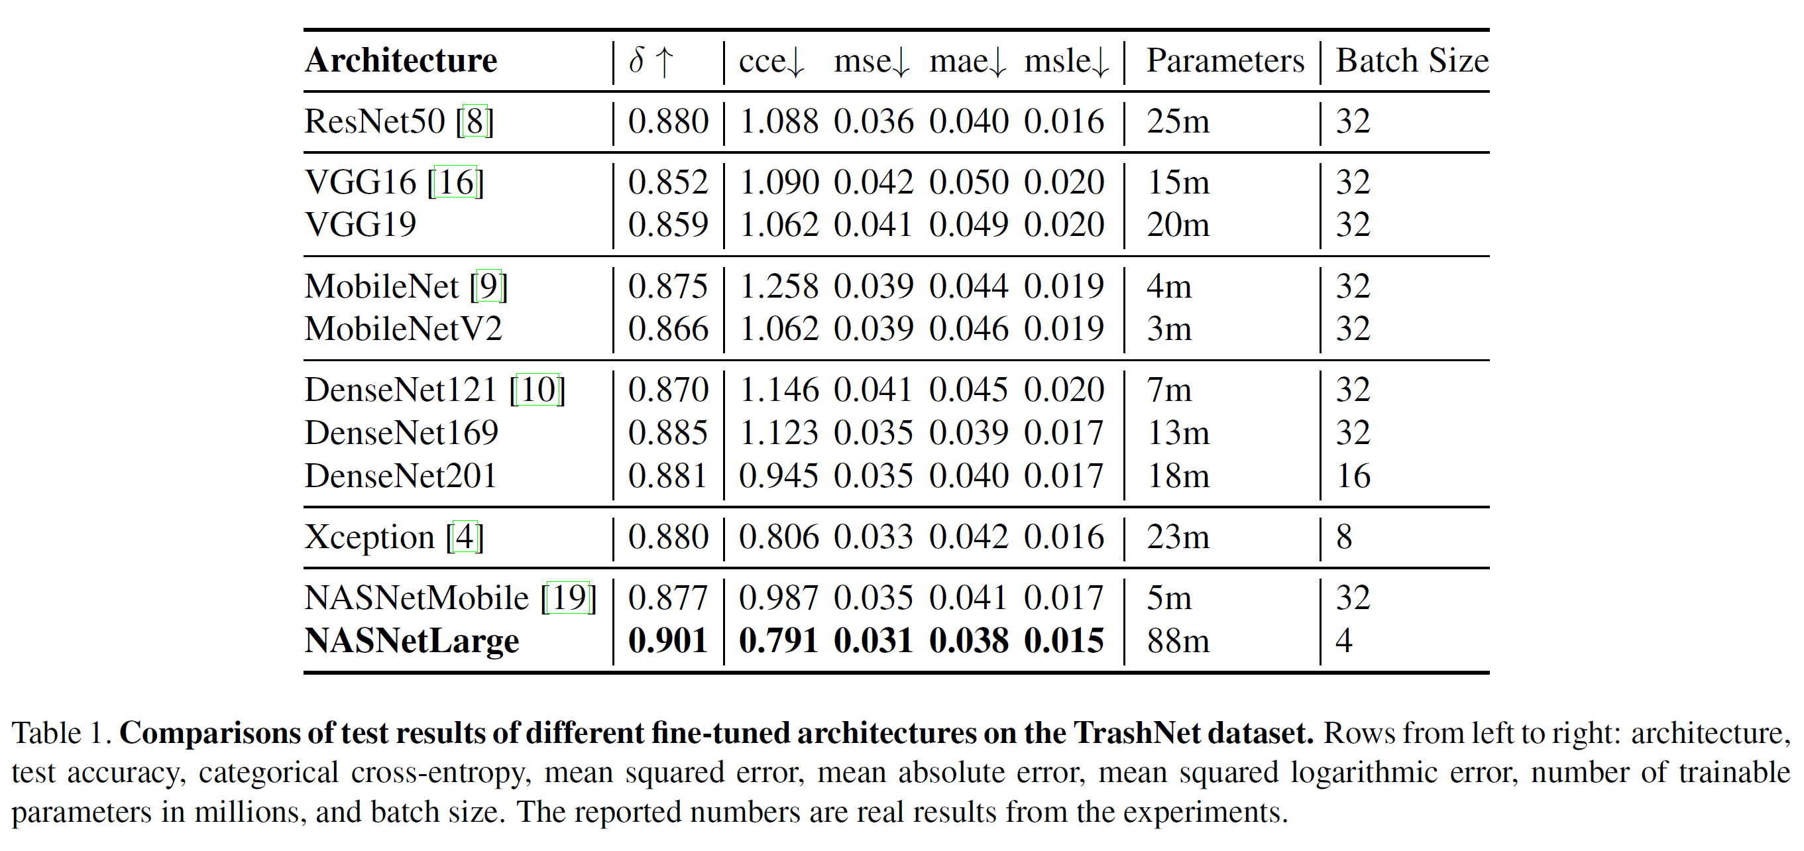
Test Results

Slide 10
Conclusion
So far, NASNetLarge seemed to perform the best among all architectures used. I speculate that I can get even better results given better hardware. A larger batch size would definitely bump up the accuracy.

Slide 11
Future Work
Try to increase accuracy by exploring other methods
Experiment with the other 2 datasets (FMD & MINC2500)
Experiment with different optimizers
Implement my own network
Develop a demo application

Slide 12
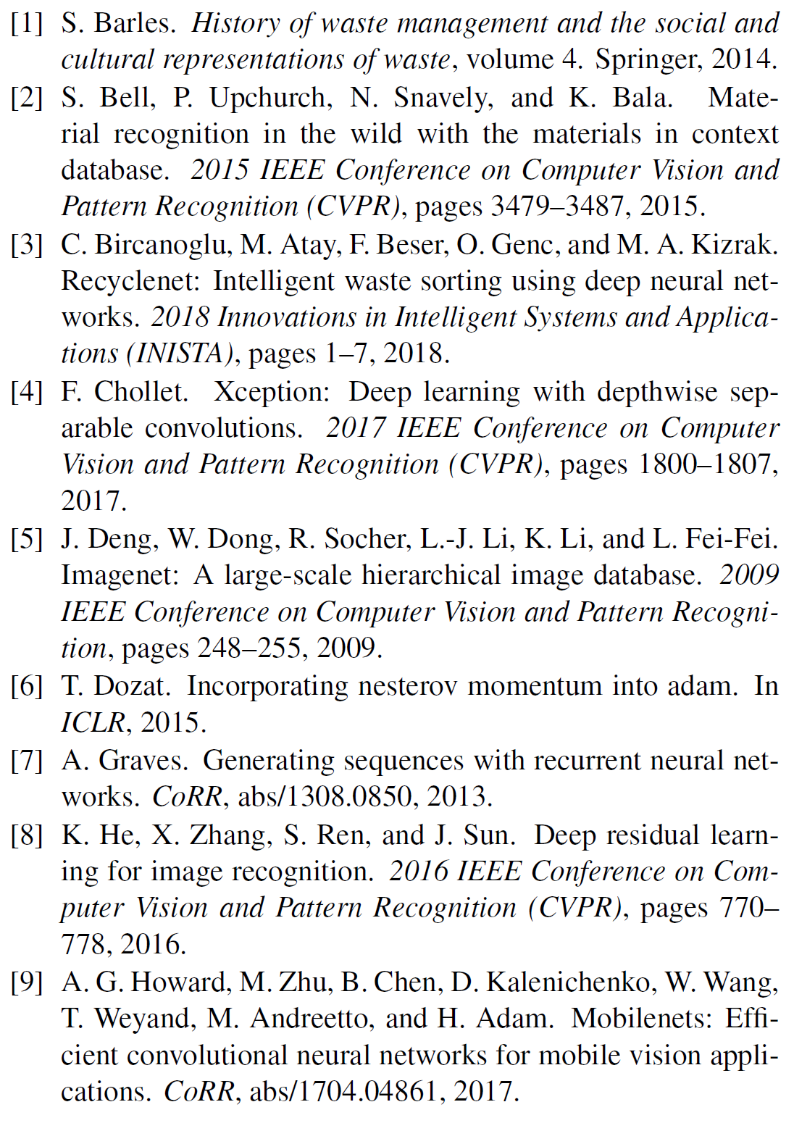
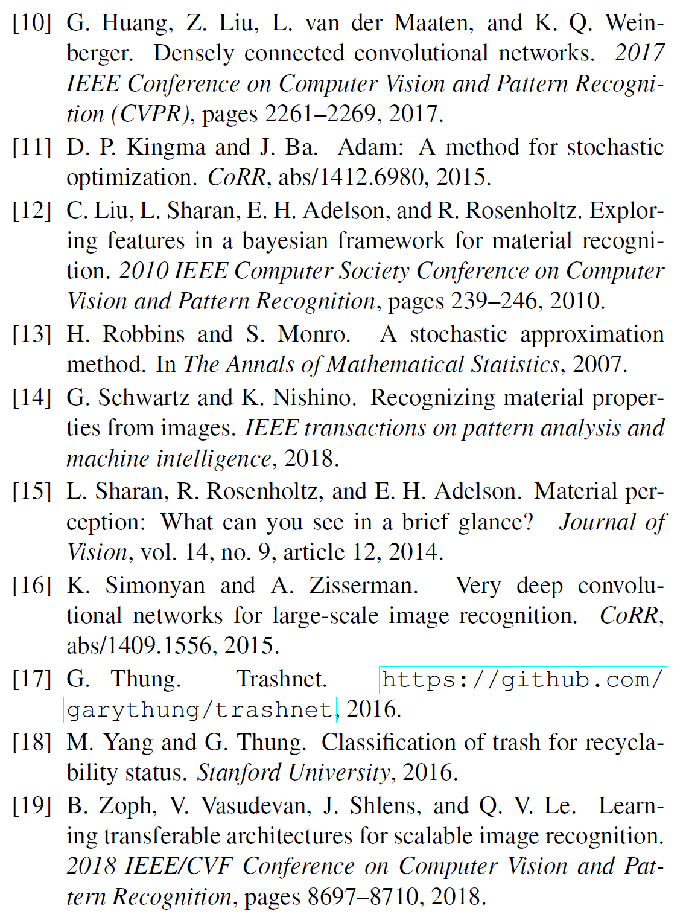
References

