Slide 1
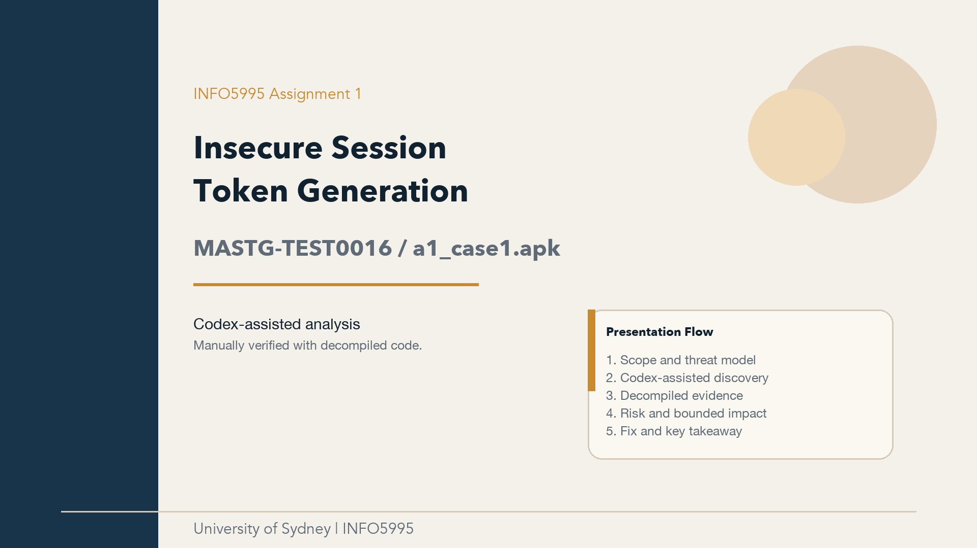


Slide 2
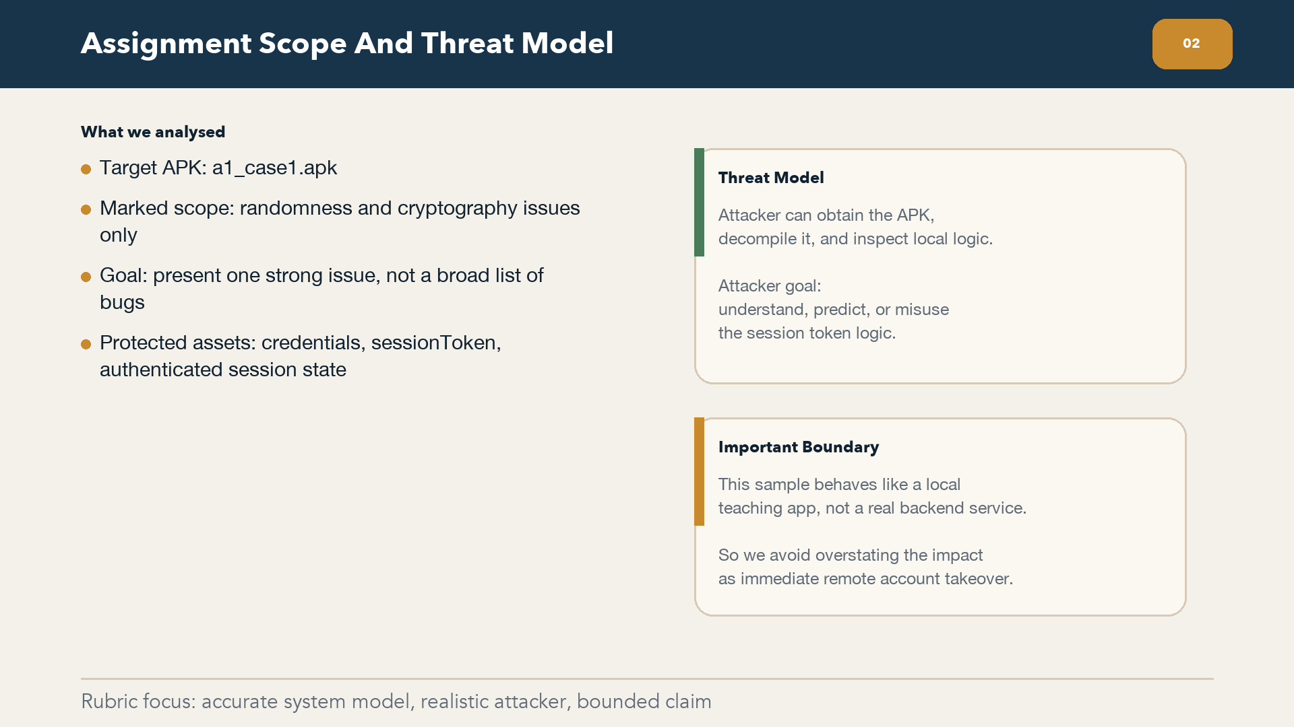

Slide 3
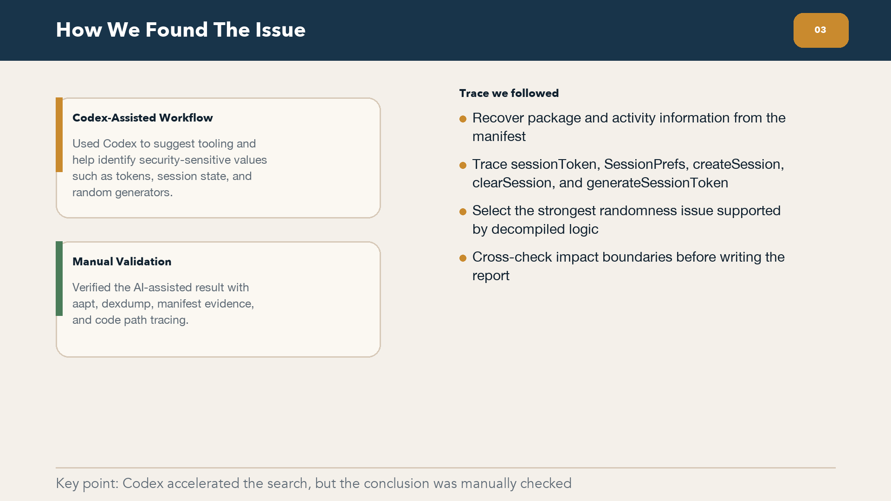

Slide 4
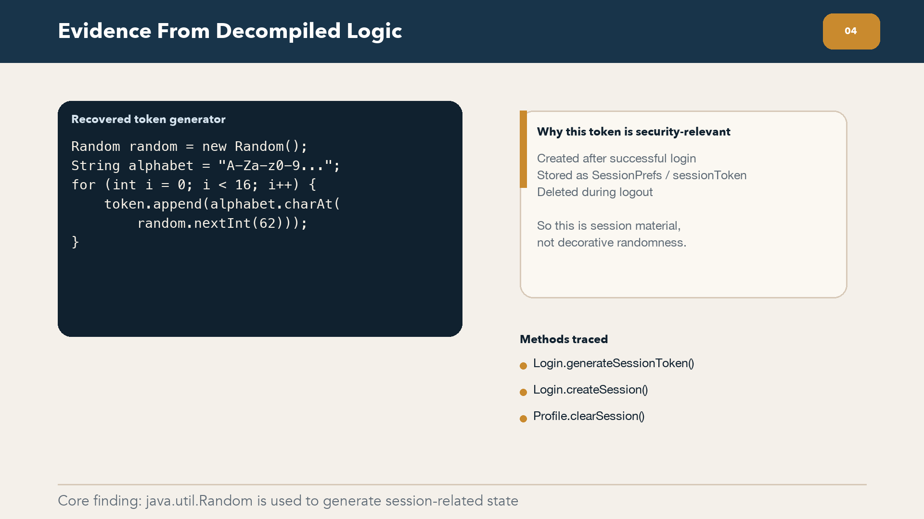


Slide 5
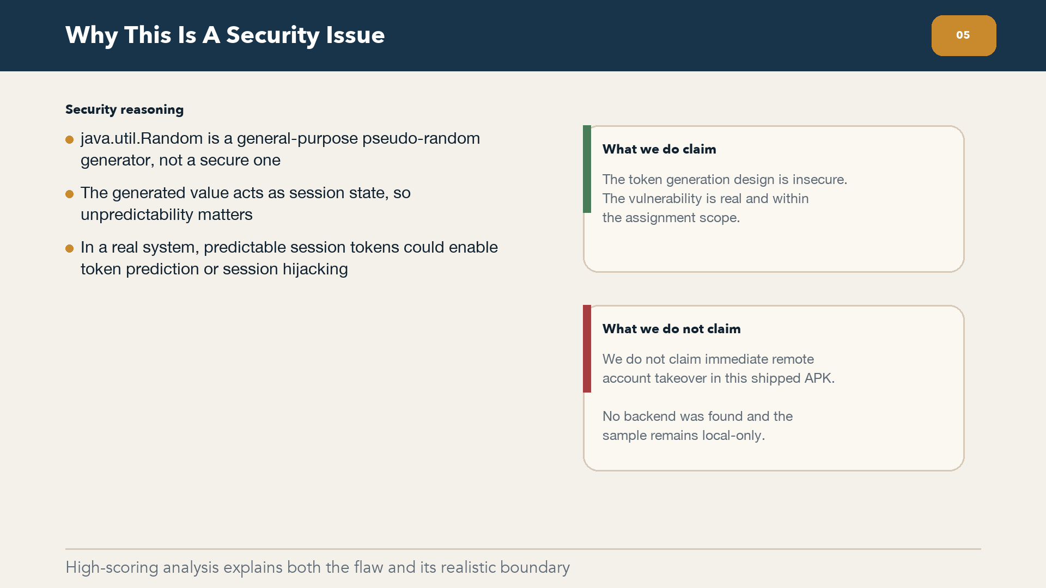


Slide 6
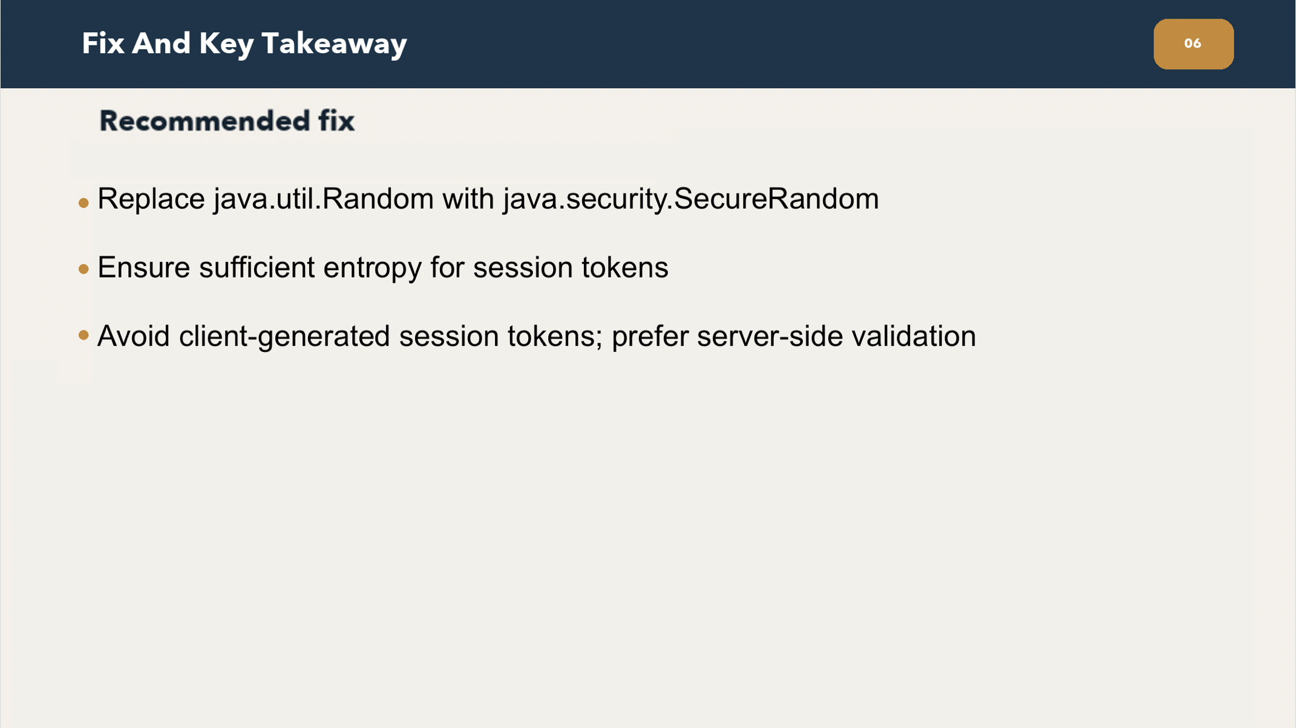
Notes:
The direct fix is to replace java.util.Random with SecureRandom,
because session tokens are security-sensitive and need stronger unpredictability.
A better design is to avoid generating session tokens on the client side.
In real applications, tokens should be created and validated by a trusted server.
So overall, the issue is that the token generation method doesn't match its security role,
and this can be fixed by using a secure random source and better session design.
Thats all for our presentation. Thank you.

