Slide 1
Distributed Virtual Computing
Advisor: Danny Miller
Presented By:
Chris Oelke
Ryan George
Dustin Schaut
Michael Dery

Slide 2
What is DVC?
Distributed Computing:
A computing system comprised of components located on multiple networked computers.
Virtual Computing:
A computing system where comprised of components that are abstracted from the hardware itself

Slide 3
Our Goal
Expand on the concept of Distributed Virtual Computing to include the clustering and virtualization of scavenged resources.
Be able to host one or several virtual machines on a cluster comprised of the unused resources in a typical computer lab setup in such a way that the local user(s) of the lab are unaware of the scavenging process.

Slide 4
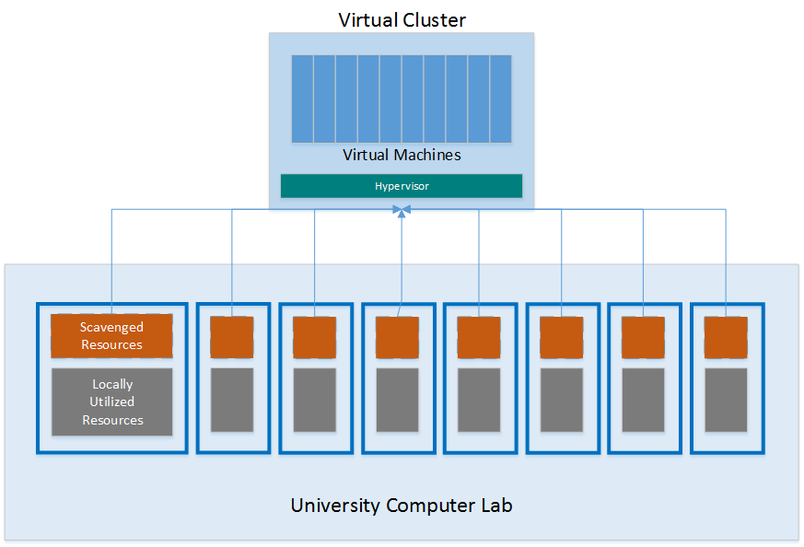
Our Goal

Slide 5
Obstacles
While clusters are able to gracefully “hot” add and remove nodes, they are much less receptive to dynamically adjusting a node’s size.
Resource scavenging programs are more report oriented than action oriented.
Custom solutions are outside the scope of our project time frame.

Slide 6
Past DVC Projects
Due to technical challenges, previous iterations modified their goal to explore similar technologies.
Private grid computing solutions were researched, including BOINC, HTCondor, and some grid-specific Linux distributions.
Focused on job-based computing (calculations and algorithms).
Lately, new technologies have emerged that could get us closer to a general purpose computational grid

Slide 7
Where We Picked Up
We discovered ScaleMP, which added the virtualized aspect and kept SMP capabilities for possible grid computing
We started an info-session with a representative from ScaleMP
ScaleMP requires Infiniband and some specific hardware sets
Flexible with Hypervisor on Hypervisor capabilities
Researched extensively into its capabilities

Slide 8
Acquired Hardware and Setup
After talking to Mellanox we quickly received our required Infiniband hardware
1 Mellanox SX6018 18 port 56 Gb/s IB switch
5 ConnectX 56Gb/s HCA’s
5 ConnectX 56Gb/s Interconnects
All of the hardware installed perfectly and was recognised by our HP and Dell Servers
5 USB Drives with vSMP images are being used to allow for installation of the hypervisor
One acts as a primary node and all other system boards (servers) are secondary node systems
Our IB link speeds are actually much higher than the internal bus structure of our servers

Slide 9
Current Progress
Initially our 5 nodes worked fine and all of them recognised each other
Negotiated link speeds at 15.2 Gb/s (scaled back)
After this we encountered a fatal error with the CPU and vSMP
Thinking it was a node/licensing problem, we tried to isolate it but even with only 2 nodes up, the results remained the same
Log file difficult to find
ScaleMP is actively working with us to try to solve this problem

Slide 10
What Lies Ahead?
If we exhaust our resources with ScaleMP in troubleshooting we may need to acquire certified hardware or newer servers.
Once or if we can get around the problem, we can then boot into RHEL as our system spanning OS
With RHEL we will then make way for installation of KVM and configuring KVM as our VM sandbox

Slide 11
Questions?

