Slide 1
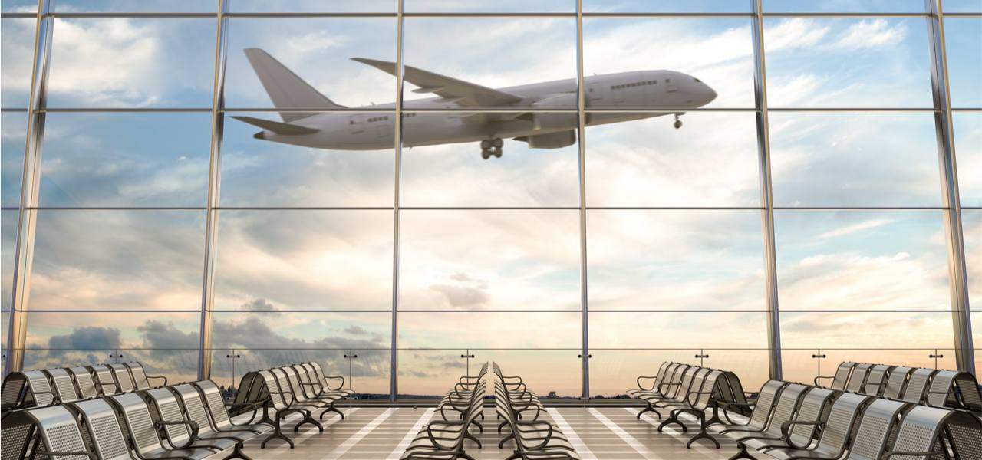
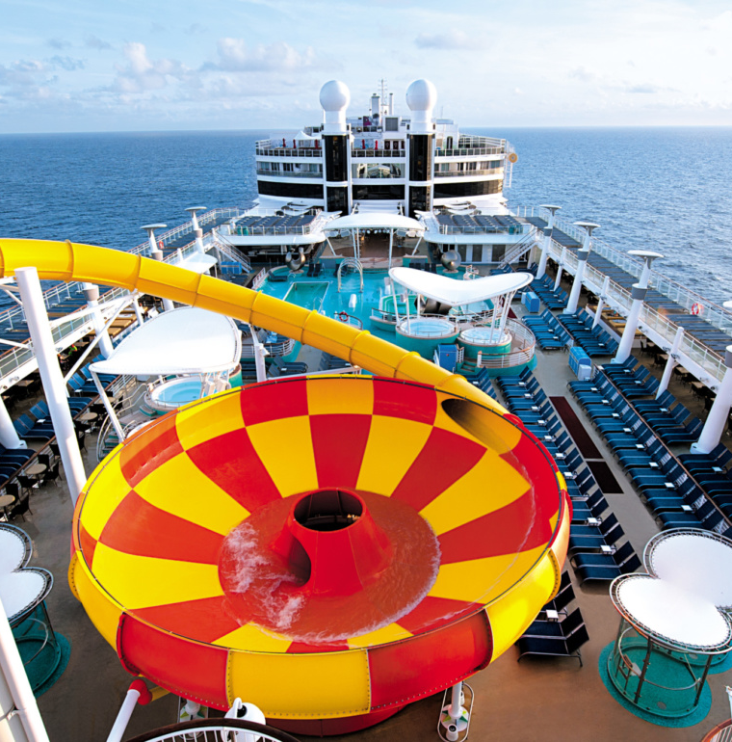


ALL PORTS TOURS CRUISE LINE
(APT)
Security Assessment Briefing
TEAM-IDENTIFIER

Slide 2


Team Introduction
Green Lead Technical Representative
Green Jr. Sr. Consultant
Green Jr. Jr. Sr. Consultant
Green II
Sr. Consultant
Sir Green
Consultant
Green Jr. Jr. I Consultant

Slide 3
Assessment Overview
TEAM-IDENTIFIER conducted a penetration test on the following CLIENT-ABV assets.
These assets were tested in two stages:
Really cool time
Really cooler time
In addition, a social engineering attack was performed upon request from CLIENT-ABV.
Network but higher
High Network
Kinda High Network
Maybe High Network
Low Network

Slide 4
Assessment Results
XX Industry & Legal Compliance Findings
$XX,000/mo in potential non-compliance fines
XX,XXX
Customers at risk of a data breach with PII & CHD
XX
Total Findings
X
Critical Findings
Best Practice:
yeah
Cooler Time
Security Assessment
Results

Slide 5
Findings Distribution

Slide 6
Residual Risk

Slide 7



Security Strengths
Doing that one thing
Doing that other thing
Doing that other other thing

Slide 8
Key Findings
FINDING TITLE
AFFECTED GENERAL AREAS
HOW IT IMPACTS THE COMPANY
HIGH LEVEL MITIGATIONS

Slide 9

PCI DSS Compliance
Payment Card Industry Data Security Standard
XX Related findings in total
Estimated Cost of Monthly Fines
$XX,XXX/month

Slide 10
IMO Maritime Law Compliance
Payment Card Industry Data Security Standard
XX Related findings in total
Estimated Cost of Monthly Fines
$XX,XXX/month

Slide 11


Conclusion
Yeah
Yeah
Yeah 2 cont.
Yeah 2
Yeah 3 cont.
Yeah 3
Yeah 4 cont.
Yeah 4

Slide 12
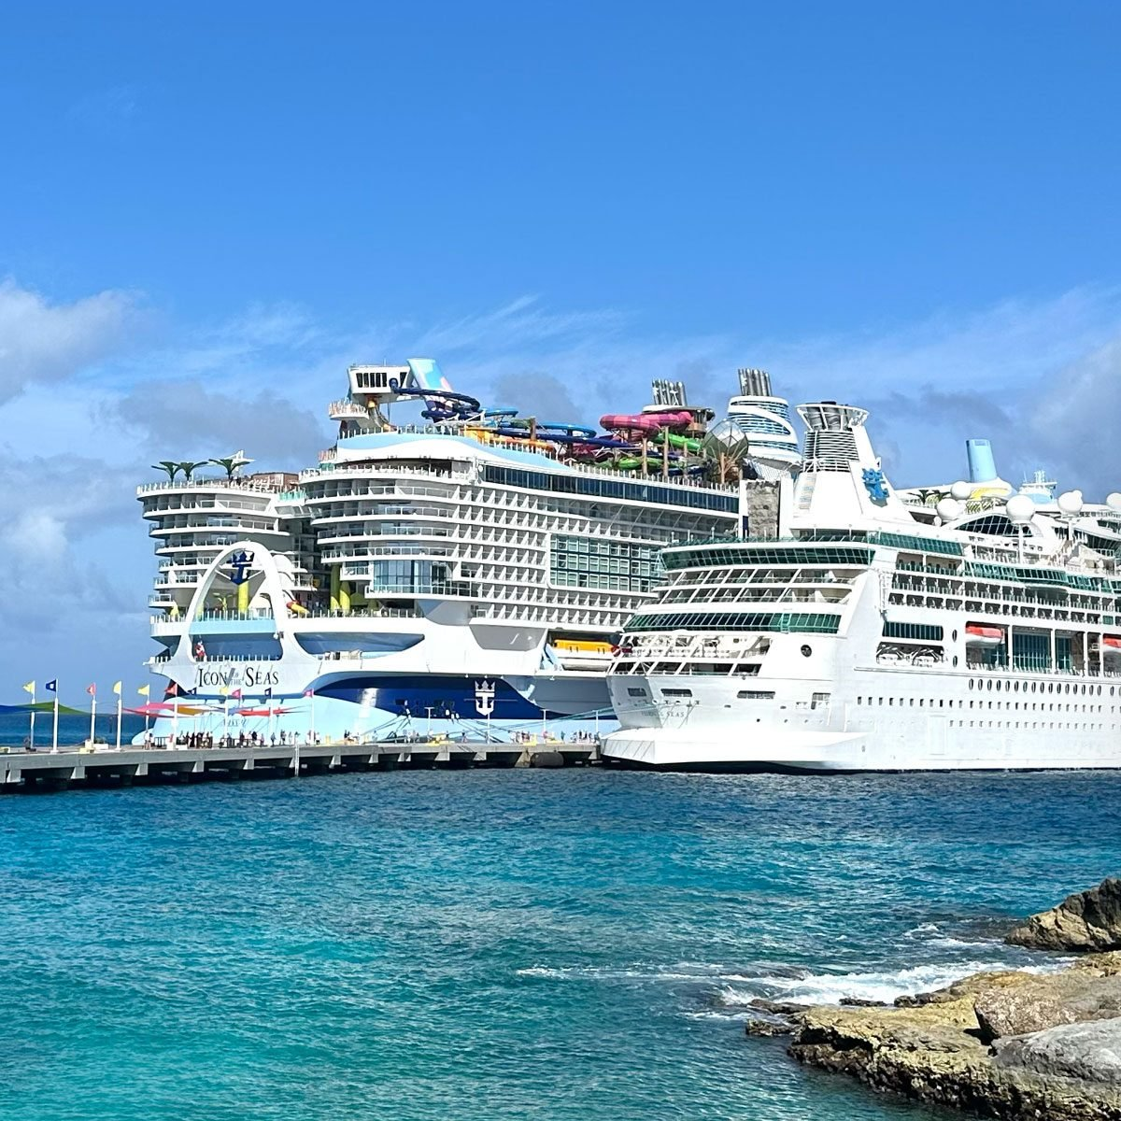
ඞ
Any Questions?
Thank You!

