Slide 1
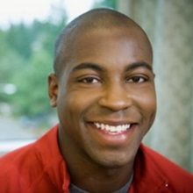

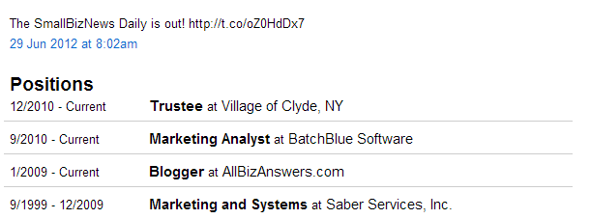




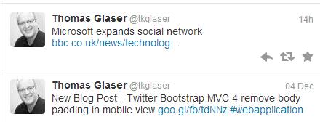

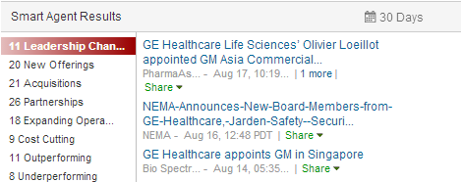
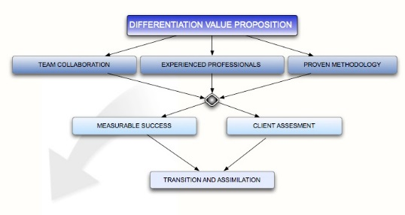
John Doe, Senior Account Manager at Big Enterprise
John Doe
Senior Account Manager
General Electric
Joined company in 2012
Cincinnati, OH
Tailored Pitch
become lean, innovative, and competitive
improve conversion
simple dashboard
70 F
Reports to Barbara Watkins, Director of Enterprise
Colleagues
Derek Watson
Pranav Shah
Nancy Kim
Microsoft
Cabo
Pain Points
MVC
Germany
wall between Dev and IT Ops
no end-to-end visibility
continuous releases versus quality software
Product1 Value Proposition
Your customized card here …

Slide 2
John Doe
Senior Account Manager
General Electric
Joined company in 2012
Cincinnati, OH
Tailored Pitch
become lean, innovative, and competitive
improve conversion
simple dashboard
70 F
Reports to Barbara Watkins, Director of Enterprise
Colleagues
Derek Watson
Pranav Shah
Nancy Kim
Microsoft
Cabo
Pain Points
MVC
Germany
wall between Dev and IT Ops
no end-to-end visibility
continuous releases versus quality software
Product1 Value Proposition
Your customized card here …

