Slide 1
Cost Optimization Solutions For E-Commerce Vendors
Presented by: Sashwat Desai (60001190047)
Guided by: Dr. Ramesh Vulavala Prof. Mayur Parulekar

Slide 2
Introduction
Since the introduction of e-commerce, the retail industry has sky rocketed.
Although this is advantageous for the customer, the vendor also has to look at his/her own costs.
To win over the customer, the delivery process must be sped up by using methods such as Same Day Delivery (SDD), all the while ensuring the vendor doesn’t go over-budget.
An effective way to satisfy the customer as well as balancing the costs is by using customized logistic optimization methods.
One such method is the popular Differential Evolution Algorithm.
The commodity chosen for this project is milk, which being a a perishable product, makes time a major constraint.

Slide 3
Review Of Literature
How Retail can Scale Fast Using Logistics Optimization
With many vendors opting to sell online, the customers have an even wider range to choose from.
Winning over customers becomes essential, by speeding up delivery all the while balancing the accounts.
This requires logistics optimizations, by using methods such as:
Optimization Technology – This involves mapping out the entire supply chain and collecting information such as distribution costs and the size of the orders.
Fulfilling Same Day Delivery – This means that the order should be ready to ship within 3-4 hours of placing the order. Combined with Last Mile Delivery, this speeds up the entire process.

Slide 4
Review Of Literature
Developing Cost Effective SCM – By scanning and automating as many steps as possible, results in massive savings.
Managing live delivery with end-to-end visibility – Optimization involves using AI and ML to select the best path for delivery along with choosing the nearest driver.

Slide 5
Review Of Literature
Supply Chain Management in a Dairy Industry – A Case Study
A supply chain is a model where various business entities come together to address the issue of material and information flow.
By using a reference model, an attempt has been made to develop a co-ordinated supply chain model with procurement, production and distribution systems.
A multi-objective function is then formulated to minimize cost subject to supplies, plant and distribution capacities, production and distribution through put limits and customs demand requirements.
Total cost includes fixed costs of production and distribution, variable costs of production, distribution and transportation. This model consists of four echelons namely Suppliers, Plants, Distribution Centres (DCs), and Customer zones (CZs).

Slide 6
System Model
Mathematical Model
Material Cost = Σ Av,m x Cv,m ∀v,m ; where v = vendor, m = material
Production Cost = Σ Ag,f x Cg,f ∀f,g ; where g = goods, f = facility
Transportation Cost = Σ Am,v,f x Cm,v,f ∀v,f,m + Σ Ag,f,w x Cg,w,f ∀f,w,g + Σ Ag,w,c x Cg,w,c ∀w,c,g where v = vendor, f = facility, m = material, w = warehouse, g = goods, c = customer
Objective Function = Min (Σ Av,m x Cv,m ∀v,m + Σ Ag,f x Cg,f ∀f,g + Σ Am,v,f x Cm,v,f ∀v,f,m + Σ Ag,f,w x Cg,w,f ∀f,w,g + Σ Ag,w,c x Cg,w,c ∀w,c,g + IC)

Slide 7
System Model
Mathematical Model
Limits
0 ≤ Am,v,f ≤ Am,v,f(max)
0 ≤ Ag,f,w ≤ Ag,f,w(max)
0 ≤ Ag,w,c ≤ Ag,w,c(max)
Ag,f(min) ≤ Ag,f ≤ Ag,f(max)
Restrictions
Am,v,f = (Amount sold)v,f ∀v,m,f
Ag,w,c = (Amount sold)g,c ∀w,c,g

Slide 8
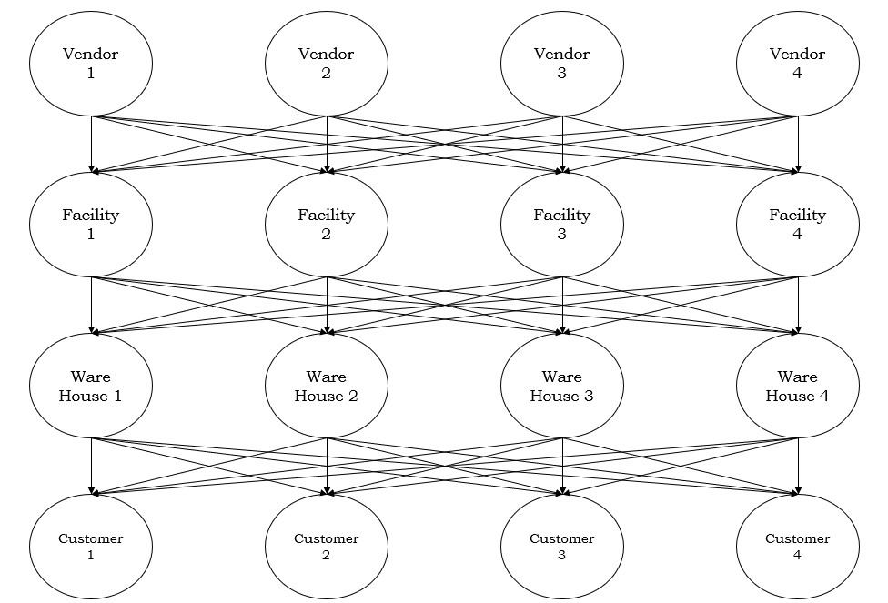
Network Model

Slide 9
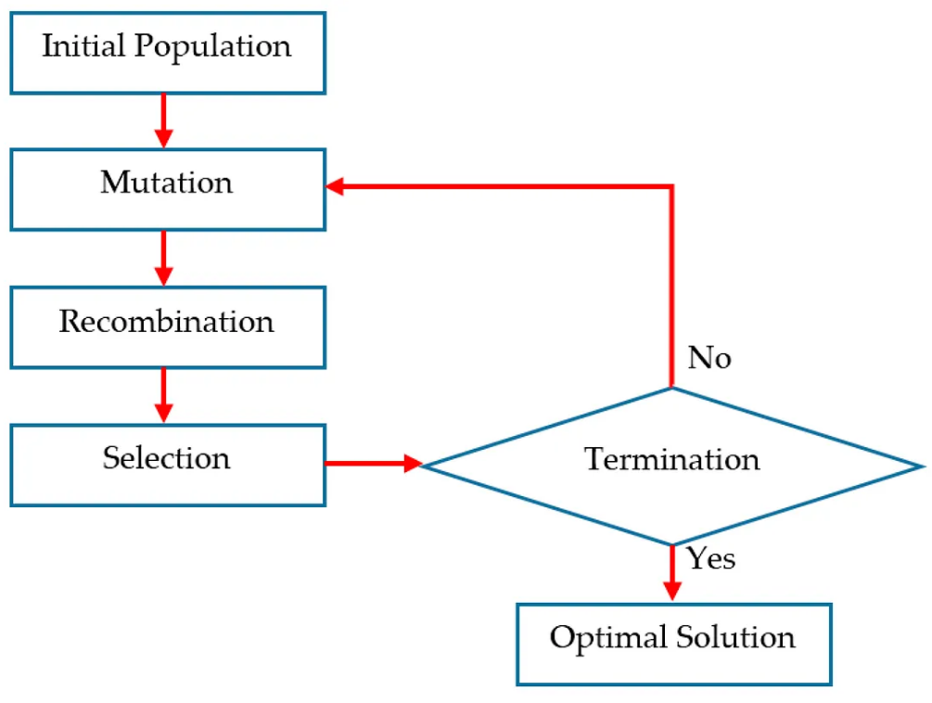
Differential Evolution
Population based meta heuristic search algorithm.
Optimization done on an iterative basis.
DE does not make any assumptions about the underlying data.
Can explore the entire data very speedily.

Slide 10
Differential Evolution Working
Step 1: Initialize the algorithm to G = 0, where G is the total number of iterations.
Step 2: Generate 3 random individuals from the initial population, such that they are distinct and not equal to one another.
Step 3: Next, form the donor vector using these individuals using the mutation function.
Step 4: Perform crossover. This is done by developing a trial vector which is formed such that, if the index of the donor vector is less than or equal to the crossover probability then choose the donor vector. Else choose the original individual.
Step 5: Evaluate if the objective value of the trial vector is less than or equal to the objective value of the individual. If so then replace the individual with the trial vector, else keep it.
Step 6: Check if the stopping criterion has been met. If met then stop, else go to step 2.

Slide 11
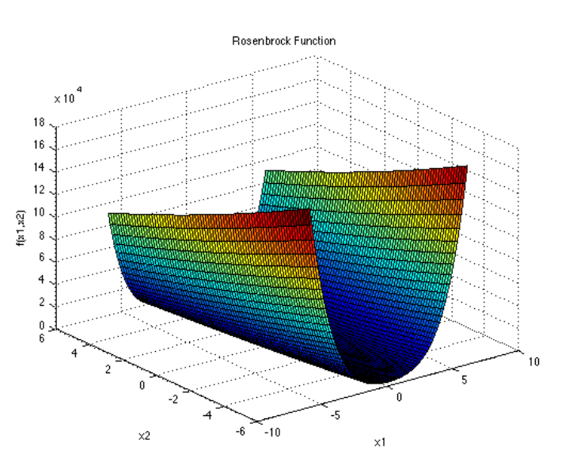
System Implementation
Using the Rosenbrock Function
The Rosenbrock Function is a unimodal function which is popularly used for testing optimization algorithms such as DE. It is also known as the Banana Function. It is given as:
F(x) = ∑_{i = 1}^{d-1} [100(x_{i+1} – x_{i}²)² + (x_{i} – 1)²]

Slide 12
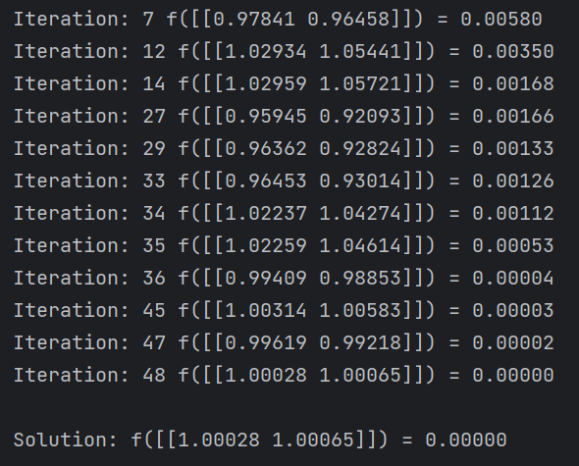
System Implementation using the Rosenbrock Function

Slide 13
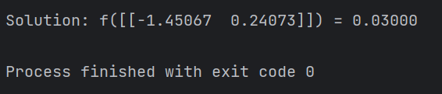
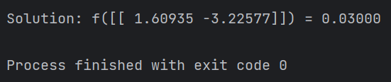
System Implementation
Excluding Inventory Cost
Including Inventory Cost

Slide 14
Conclusion
For this project, I have studied the Supply Chain Management and the effect of e-commerce on the retail sector. Along with this, a basic cost optimization model has been developed. The objective function has been developed, which is the minimization of the total cost. This minimization is to be achieved using an iterative algorithm.
I have used the very widely popular Differential Evolution for this. I have implemented the algorithm using the Rosenbrock Function first, before implementing it using the collected real world data.
In conclusion, such a solution strategy is a very viable option for such optimization problems.

