Slide 1
Debugging
&
Debuggers
By
- Dhruval Shah

Slide 2
Debugging & Debuggers
What is debugging?
Why debugging?
Types of debugging
Types of debugger

Slide 3
Debugging Approach
Basic steps in debugging are:
  Recognize that a bug exists
  Isolate the source of the bug – Main point
  Identify the cause of the bug
  Determine a fix for the bug
  Apply the fix and test it

Slide 4
Debug Environment
Common terms used in Debugging
    JTAG, Emulator, Simulator
Types of Debuggers
  Windows based: DevCpp, Visual Studio, GHS Multi
  Linux based: GDB, DDD, Trace32

Slide 5
What is GDB???
GDB
GNU Debugger

Slide 6
GDB - Contents
Using GDB
Watching Execution
Call Stack
Breakpoints
Watchpoints

Slide 7
Using GDB
Compile with debugging symbols
Compiling without O (optimized) flag
Run programs with the debugger
Supplying arguments to the program
Shell activity without quitting debugger
Exit the debugger

Slide 8
Watching Execution
stop execution
continue execution
see where my program stopped
step through my code line-by-line
examine variables
modify variables
call functions linked into my program
return from a function

Slide 9
Examine Call Stack
Get a backtrace
Change stack frames
Examine stack frames

Slide 10
Breakpoints
set a breakpoint on a line
set a breakpoint on a C function
get a list of breakpoints
disable breakpoints
Set commands on breakpoint

Slide 11
WatchPoints
set a read watchpoint for a variable
set a read/write watchpoint for a variable
disable watchpoints

Slide 12
Advanced options
How do I see what is in the processor registers ?
How do I step through my code at the instruction level ?
How do I see the assembly code my program is running ?
Can I debug the kernel level programs?

Slide 13
Debugging multi threaded app
Getting info about threads
Switching to some other thread
Breakpoints in threaded application

Slide 14
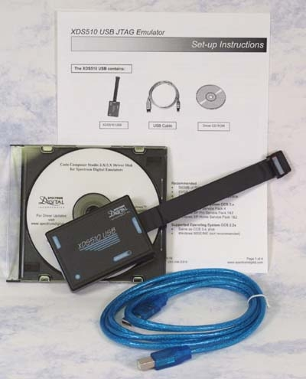
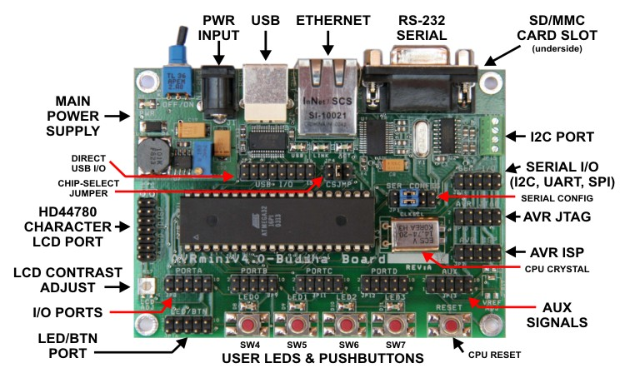
EMULATOR & JTAG

Slide 15
Q & A

Slide 16
Thank You
Email: dhruval.shah@einfochips.com

