Slide 1
Netflix Data Analysis Azure Cosmos DB – Multi Model

Slide 2




Team
Kunal Desai
Sravya Ganda
Haarika Sai K
Raja Nikshith
Data Engineer
002193570
Application Developer
002103774
Data Engineer
002964238
Application Developer
002726577

Slide 3
Objective
Study the statistics of different shows and movies released in Netflix
Evaluating and comparing all released materials
Identifying the underlying trends and patterns
Using Azure Cosmos DB for Data Access and Data Analytics
Visualizing the data using Power BI

Slide 4
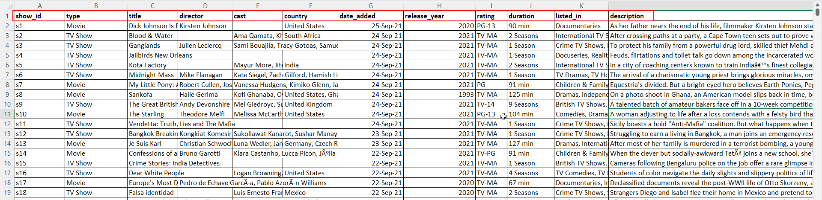
Sample Dataset

Slide 5








Architecture Diagram

Slide 6
ETL Steps

Slide 7
Document DB

Slide 8
01
Load the CSV file into S3_input Bucket

Slide 9
02
01
Load the CSV file into S3_input Bucket
Used Lambda function to create Json file

Slide 10
02
01
03
Load the CSV file into S3_input Bucket
Used Lambda function to create Json file
Inject the Json file into S3_Output Bucket via previous Lambda function

Slide 11
02
01
04
03
Load the CSV file into S3_input Bucket
Used Lambda function to create Json file
Azure Data Factory Pipeline to transfer data from S3 to Cosmos DB
Inject the Json file into S3_Output Bucket via previous Lambda function

Slide 12
02
01
04
03
Load the CSV file into S3_input Bucket
Used Lambda function to create Json file
Azure Data Factory Pipeline to transfer data from S3 to Cosmos DB
Inject the Json file into S3_Output Bucket via previous Lambda function
05
Pipeline picks S3_Output file and loads it into Azure Cosmos DB

Slide 13
02
01
04
03
Load the CSV file into S3_input Bucket
Used Lambda function to create Json file
Azure Data Factory Pipeline to transfer data from S3 to Cosmos DB
Inject the Json file into S3_Output Bucket via previous Lambda function
05
Pipeline picks S3_Output file and loads it into Azure Cosmos DB
06
Cosmos DB Document Data is passed to PowerBI for Analysis

Slide 14
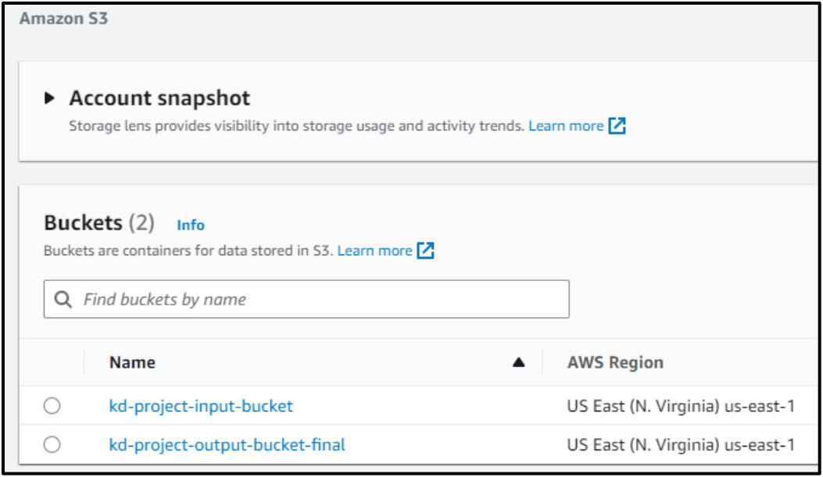
S3 Buckets

Slide 15
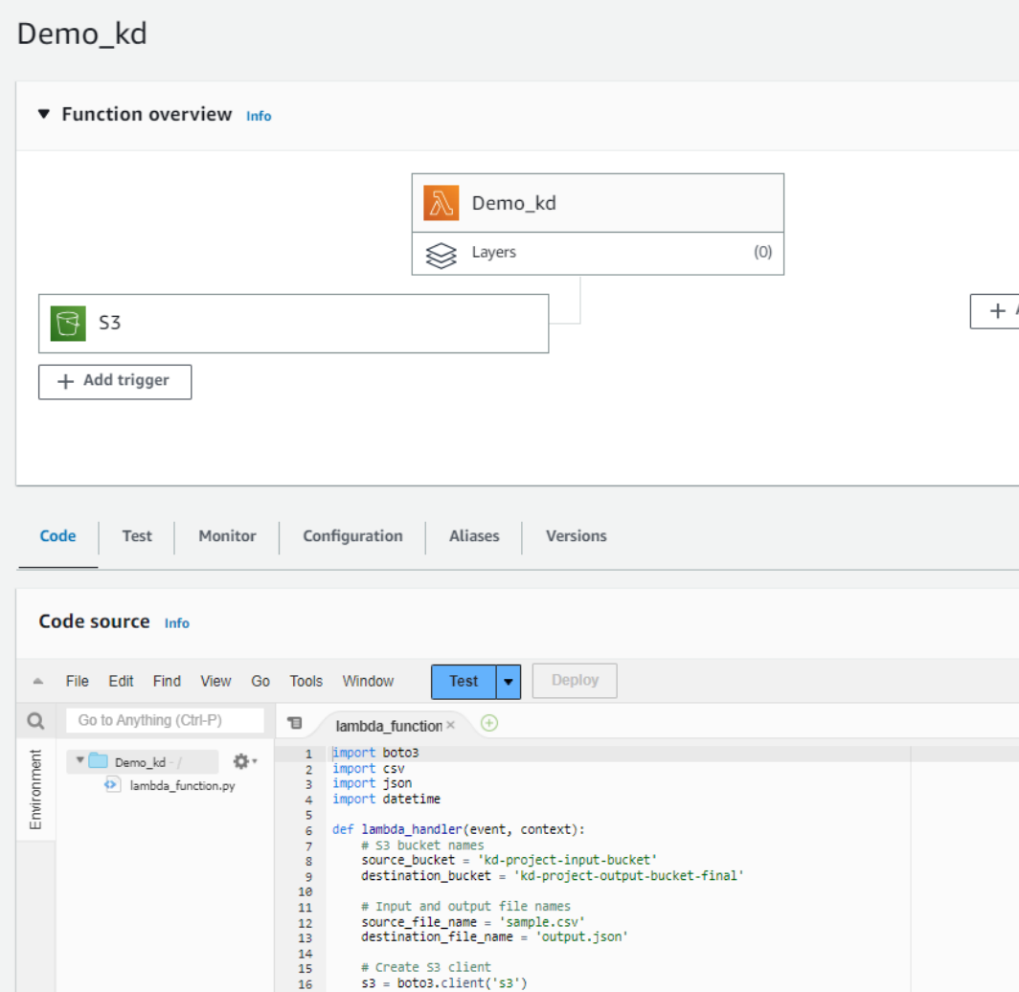
AWS Lambda Function

Slide 16
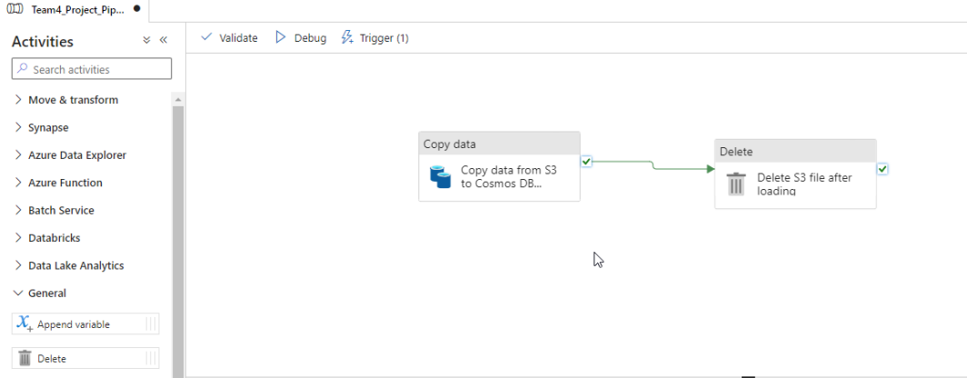
Azure Data Factory Pipeline

Slide 17
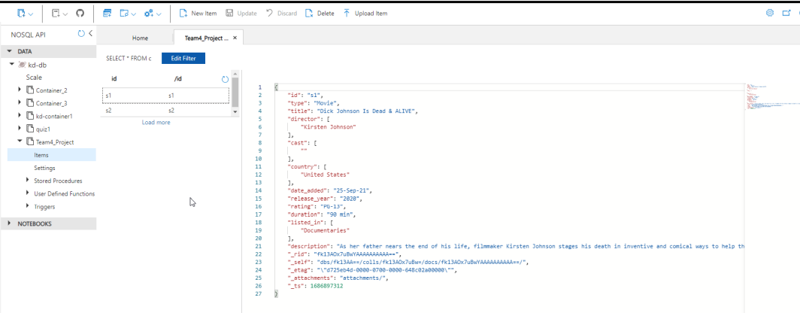
Documents in Cosmos DB

Slide 18
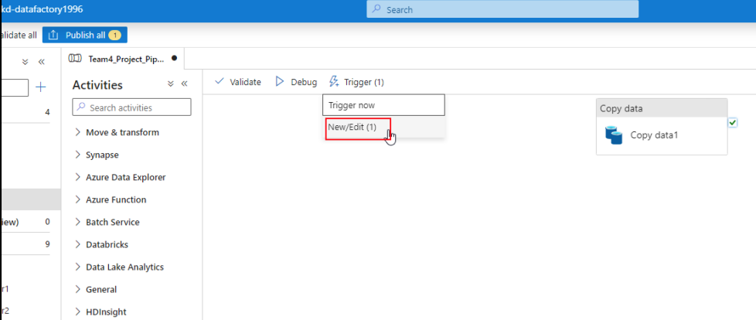
ADF Trigger

Slide 19
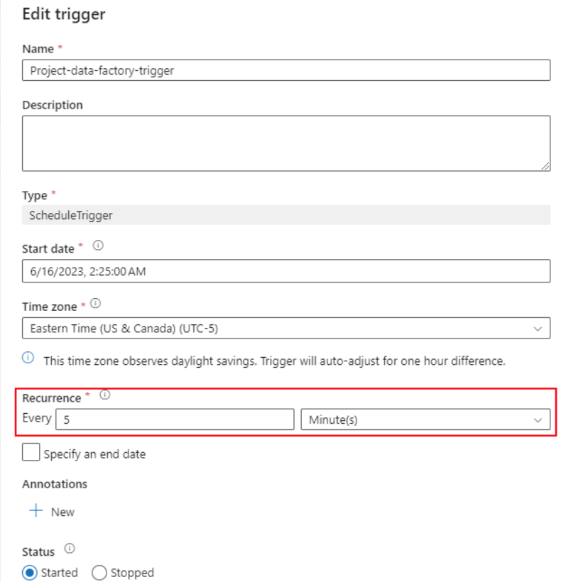
ADF Trigger

Slide 20
Graph DB

Slide 21
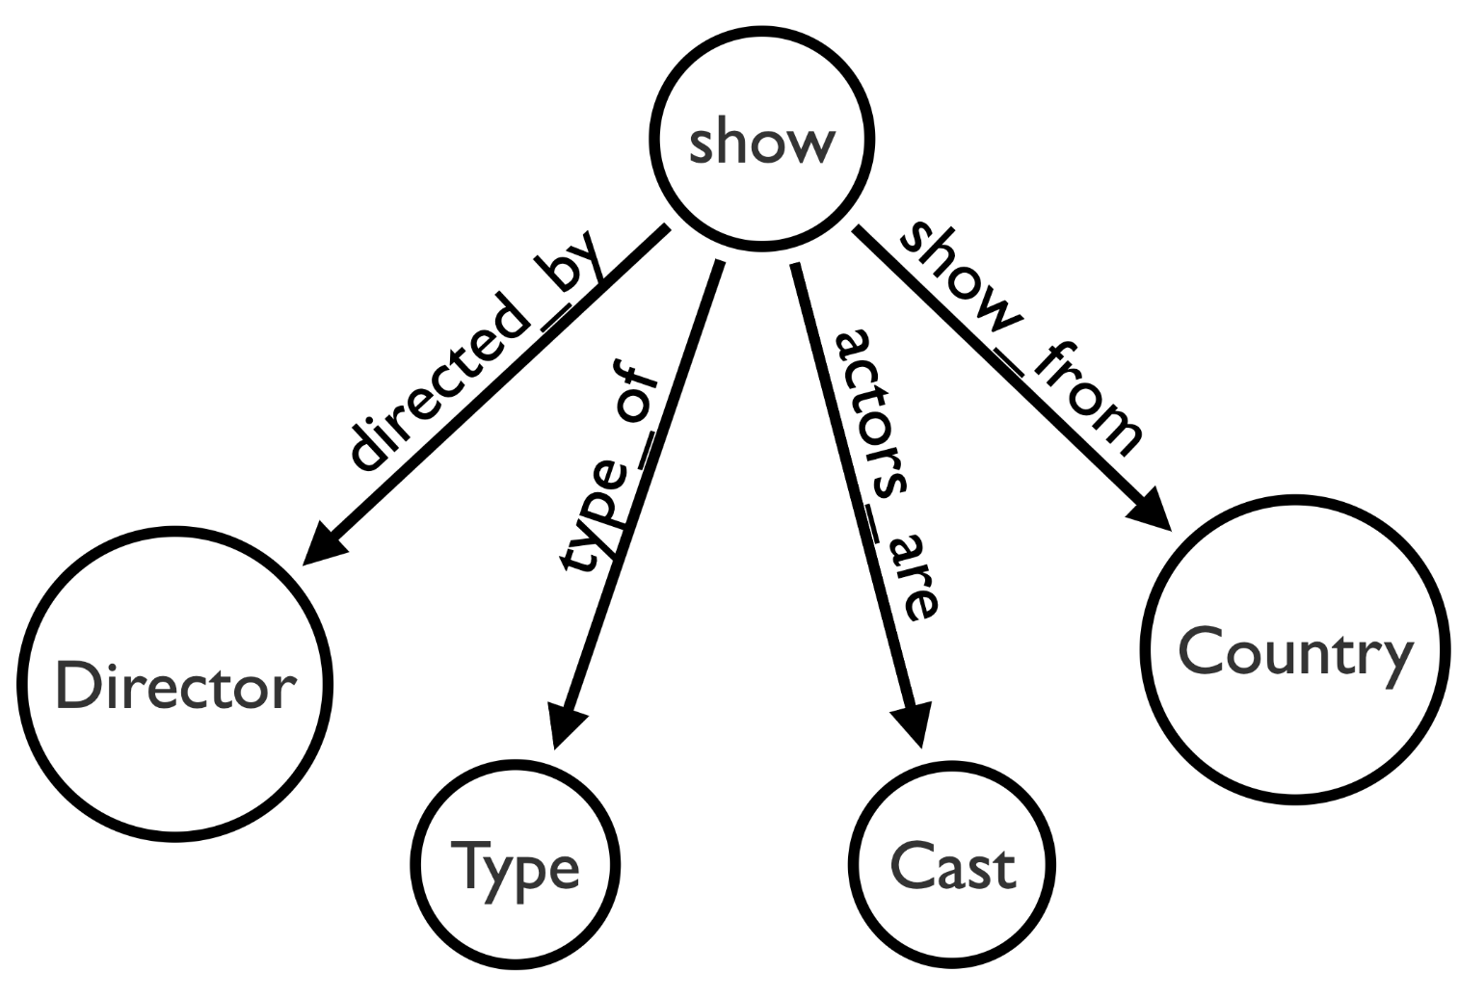
Graph ERD

Slide 22
01
Create a graph database in azure cosmos db

Slide 23
02
01
Create a graph database in azure cosmos db
Load the dataset(csv) file in the respective S3 bucket

Slide 24
02
01
03
Create a graph database in azure cosmos db
Load the dataset(csv) file in the respective S3 bucket
Lambda function is triggered when a new version of csv file is uploaded to S3 bucket

Slide 25
02
01
03
04
Create a graph database in azure cosmos db
Load the dataset(csv) file in the respective S3 bucket
Lambda function executive the python script which creates nodes and edges out of csv file data in the graph database
Lambda function is triggered when a new version of csv file is uploaded to S3 bucket

Slide 26
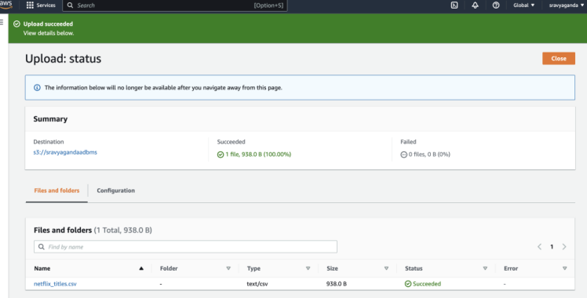
S3 Bucket

Slide 27
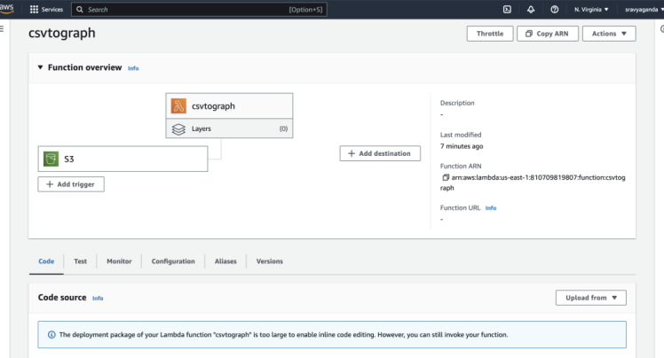
Lambda Function configuration

Slide 28
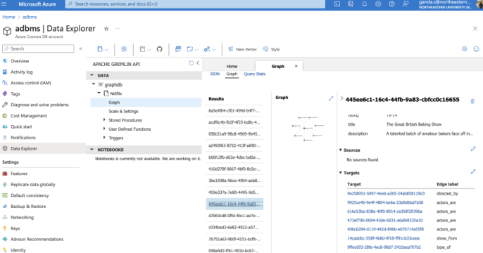
Cosmos GraphDB - Nodes and Edges

Slide 29
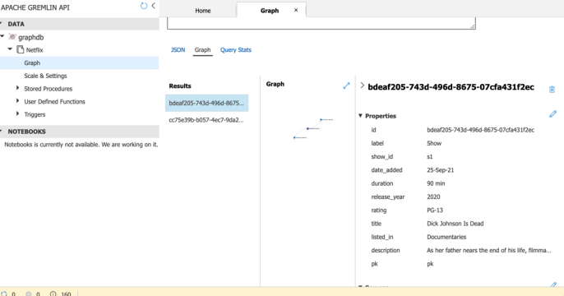
Data Refresh

Slide 30
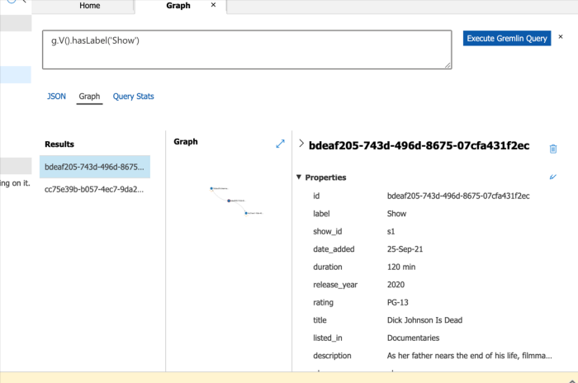

Slide 31
Visualization
Power BI

Slide 32
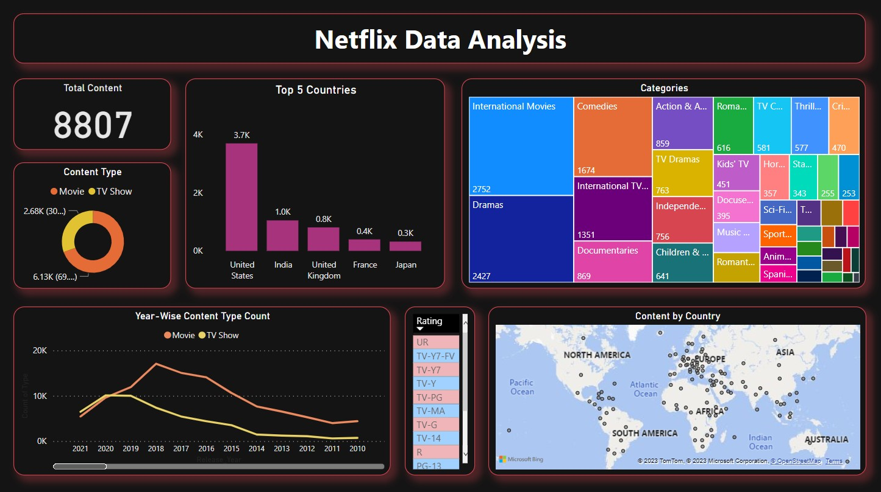
Visualization
Power BI

Slide 33
Questions?

