Slide 1
Create Your Own Jupyter Notebook Workshop
By Doug Purcell

Slide 2
What’s the Hype About Jupyter Notebook
It’s an open source software released under BSD license
Interactive computing (accepts input as it runs)
Can render text/html
Can plot charts
Can display mathematical symbols LaTEX
Language agnostic. Supports various other languages such as R, Julia,Haskell, Ruby, and of course Python

Slide 3
Why Learn Jupyter Notebooks?
It’s the industry standard for scientific computing and data science
A great tool for research
Can seamlessly embed math, multimedia, and plain text
Solid tool for prototyping
A great tool for teaching coding (can run code in isolation)

Slide 4
Quick Background
Started in 2014
By Fernardo Pérez
Spinoff of IPython
IPython continues to exist as shell and kernel for Jupyter
Kernel and language agnostic parts moved under Jupyter Name

Slide 5
About Project Jupyter
Supports interactive computing
Born from IPython in 2014
Supports data science computing
Donations managed by Numfocus
Community driven initiative
Hosts JupyterCon

Slide 6
Different Products
Project Jupyter
Jupyter Lab: Next generation web-based user interface for Project Jupyter
Jupyter Hub: A way to server Jupyter Notebooks to multiple users
Jupyter Notebook: A web-based environment for creating Jupyter Notebooks

Slide 7
Installing Jupyter Notebook
$ pip install jupyter notebook
To open: Run the following in terminal: $ jupyter notebook
$ conda install -c conda-forge notebook

Slide 8
How to install additional packages for Jupyter?
Run the following: $pip install module
Could also do within the Jupyter Notebook using the following syntax:
!pip install module
For example, if you want to install numpy do
$!pip install numpy

Slide 9
Additional Packages to Install
$ pip install numpy
$pip install matplotlib
$pip install pandas

Slide 10
Opening up Jupyter Notebook
$ jupyter notebook

Slide 11
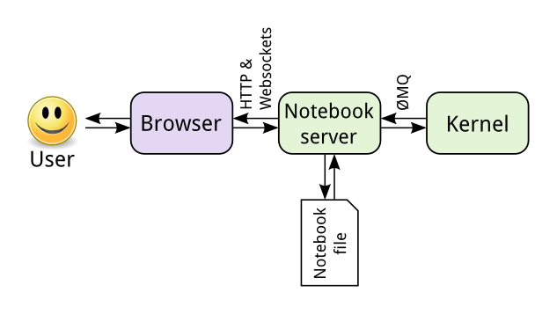
Jupyter Notebook Interface

Slide 12
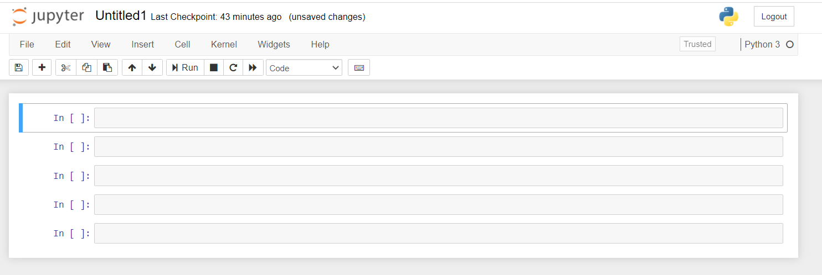
How Jupyter Notebook Looks When Ran on localhost

Slide 13
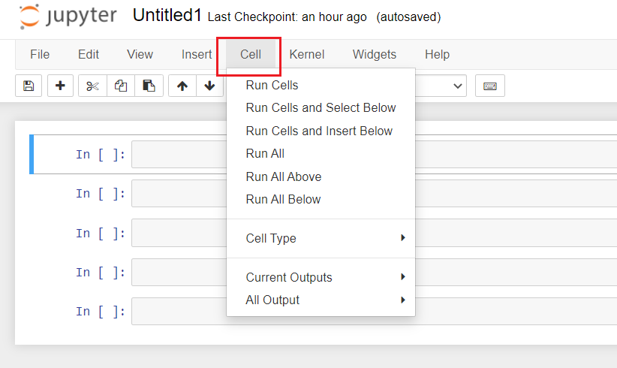
A Cell
Cell: Where statements in your code go to

Slide 14
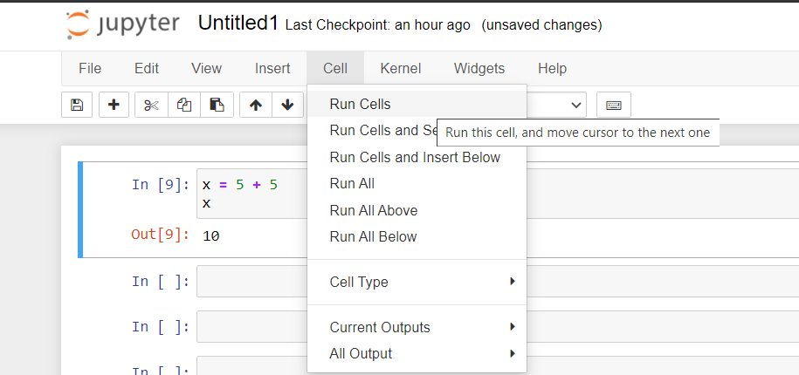
To Run Cell
Cell -> Run Cells
of keyboard shortcuts
Ctr + Enter
Or
Shift + Enter

Slide 15
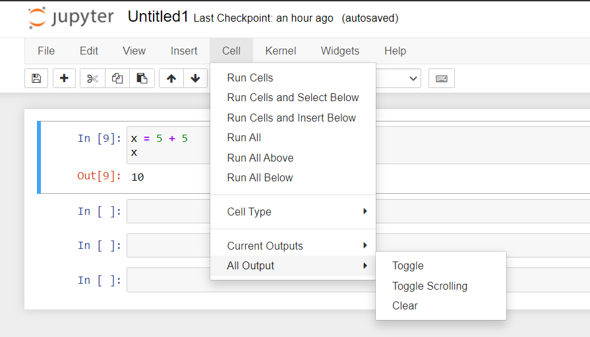
To Clear Cell
Want to clear a cell of its output? Cell -> Current Outputs -> Clear
Or to clear all
Cell -> All Output -> Clear

Slide 16
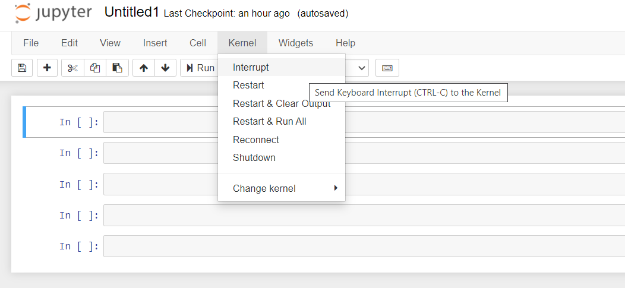
A Kernel
A notebook kernel is an operating system process that communicates through several ZeroMQ connections. It receives code snippets to execute, run them, and return them. Not related to OS kernel!

Slide 17
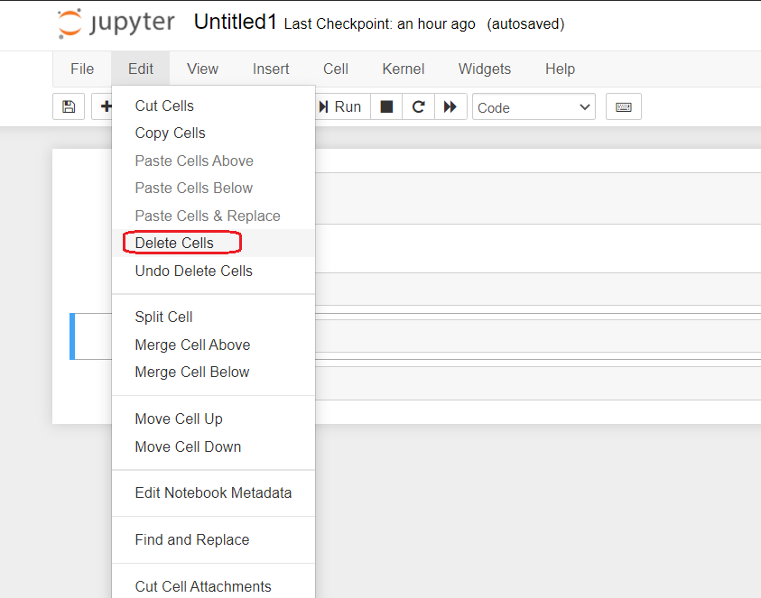
Want to Delete a Cell?
Click Edit -> Delete Cells

Slide 18
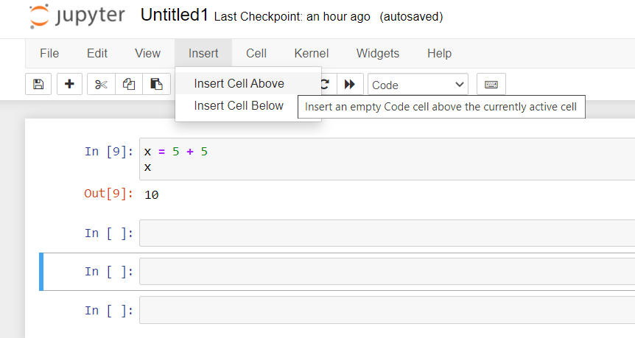
Insert Cells
Inserting cells allows you to reformat your Jupyter Notebook.
Insert -> Cell Above
Insert -> cell Below

Slide 19
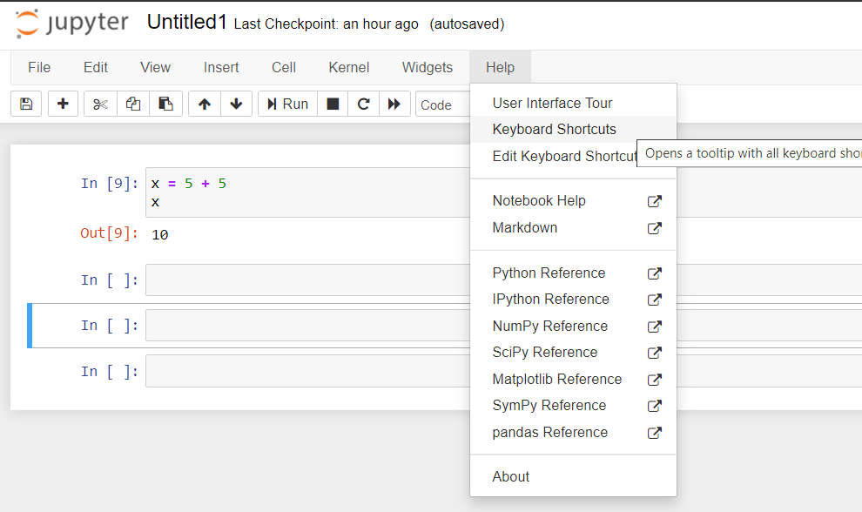
Need Help With Jupyter Notebook?
Want all keyboard shortcuts?
Help -> Keyboard shortcuts
Want a UI your?
Help -> User Interface Tour
Notebook Help?
Help -> Notebook Help

Slide 20
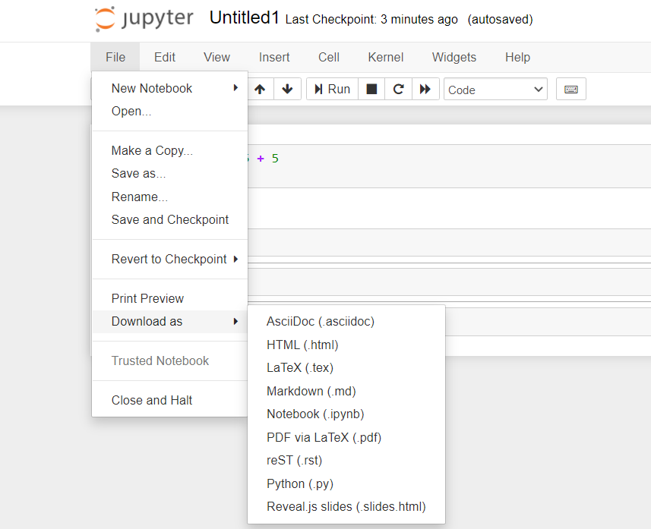
Want to Export to Other file formats?
Default format is .ipynb
Can download as
HTML
LaTEX
Markdown
.rst
Reveal.js (slides)

Slide 21
Let’s Build A Jupyter Notebook Together!
Let’s first do some imports and run them
Import pandas
Import matplotlib

Slide 22
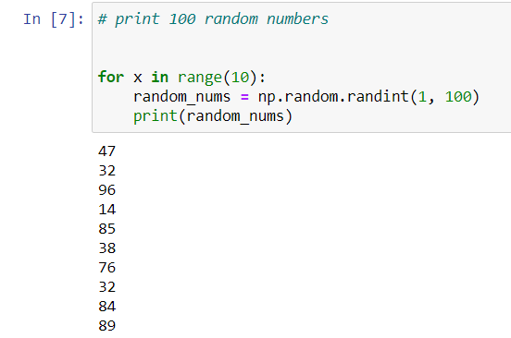
Generate Random Numbers with numpy

Slide 23
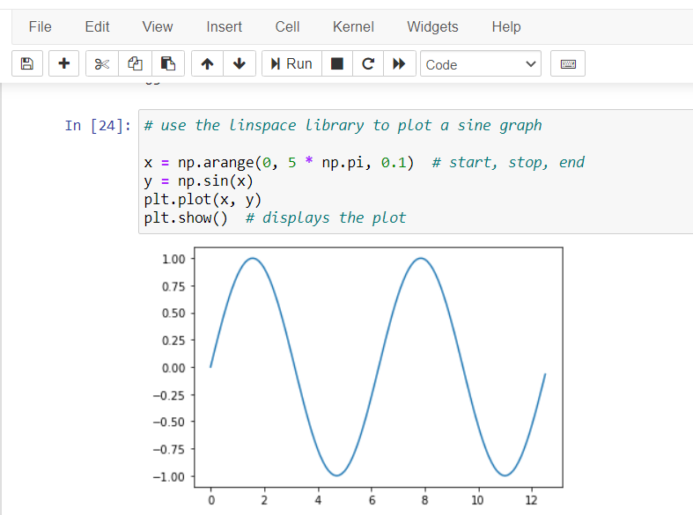
Do Data Visualization With Matplotlib
Can Add interactive plots to Jupyter Notebooks easily!
Must import matplot.pyplot as plt
arange is a function which returns evenly spaced values given an interval

Slide 24
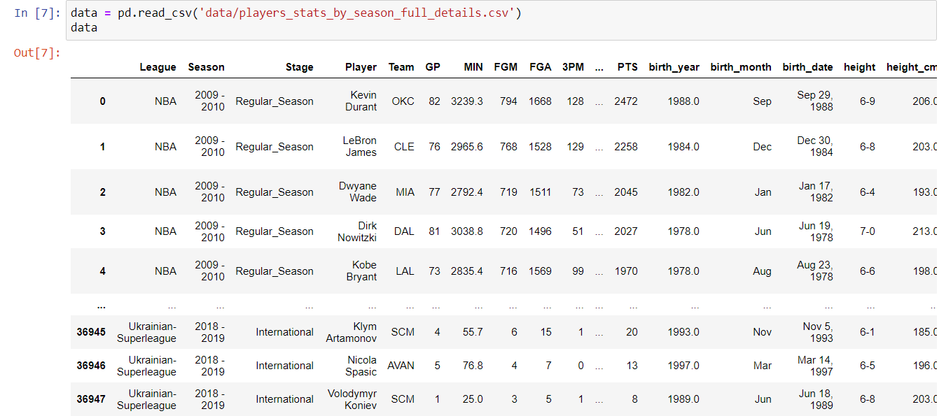
Can Do Data Analysis With Jupyter Notebook
Can get various datasheets online for free, sue something like Kaggle
Read in a csv file using pd.read_csv(file)
Perform data exploration
pd.head()
pd.tail()
pd.describe()
pd.plot()

Slide 25
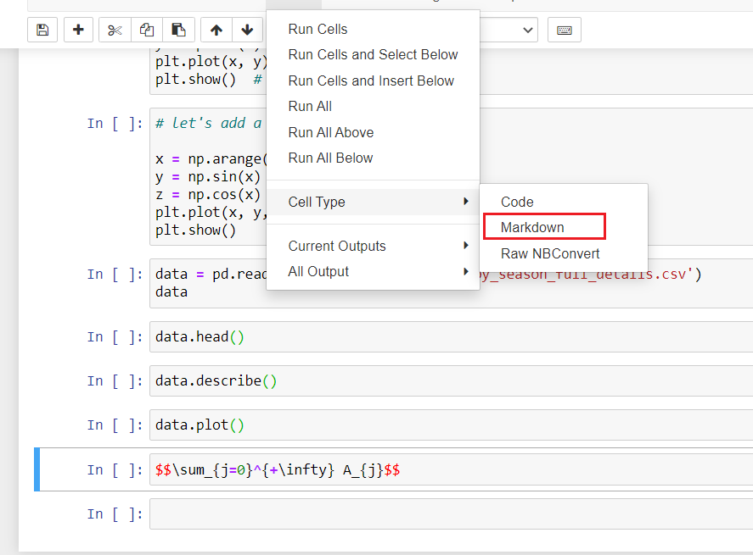
Add Math to Jupyter Notebook
Real easy!
Add LatTex like you normally would
Wrap code in $$ $$
Run -> Cell Type -> Markdown
Once generated the LaTex code snippet can’t be reused

Slide 26

Embed YouTube Videos in Jupyter Notebook
Find YouTube video you want to embed
Copy part after v?
Pass it into YouTubeVideo from IPython.display
Optionally set dimensions

Slide 27
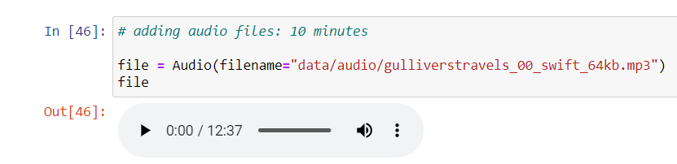
Add Audio in Jupyter Notebook
Embed audio in your Jupyter Notebook
Use the Audio constructor
Pass in path to mp3 file

Slide 28
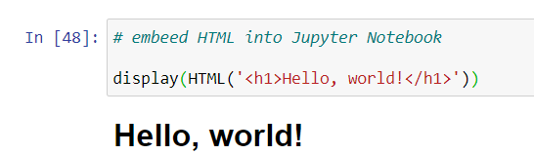
Embed HTML in Jupyter Notebook
from IPython.core.display import display, HTML
Pass in the HTML tag you want to display

Slide 29
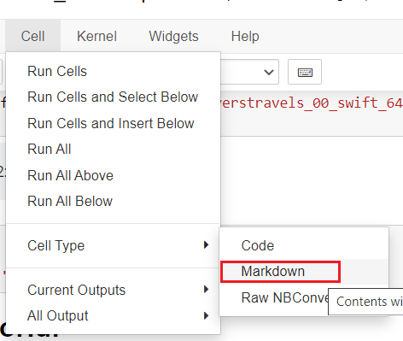
Embed Markdown in Jupyter Notebook
Markdown is a popular markup language
Used in README.md files in GitHub
Type them the way you normally would, and then do the following

Slide 30
Advantage of Jupyter Notebooks? All of This in A Single File!

Slide 31
Resources
Jupyter Community: https://jupyter.org/community
Why Jupyter Notebook sucks; https://towardsdatascience.com/5-reasons-why-jupyter-notebooks-suck-4dc201e27086
Jupyter Notebook interface diagram: https://jupyter.readthedocs.io/en/latest/projects/architecture/content-architecture.html

Slide 32
Let’s Now Switch to Jupyter Notebooks

