Slide 1
Algorithms of Adaptation in Inductive Inference
Jan-Philipp Fränken, Nikos Theodoropoulos, Neil Bramley

Slide 2
Agenda
Refresher – Zendo
Research Questions
Algorithms
No order effects / adaptation (computational level):
Simulated normative learner
All-or-none-dependence (computational level / process hybrid lacking recipe for resampling):
Win-stay, lose-sample
Graded dependence (process models):
Tree Regrowth (TR-Learner)
Tree Surgery (TS-Learner)
Modeling results
Brief qualitative comparison
More important: quantitative comparison:
How to present / ``sell’’ our work?

Slide 3
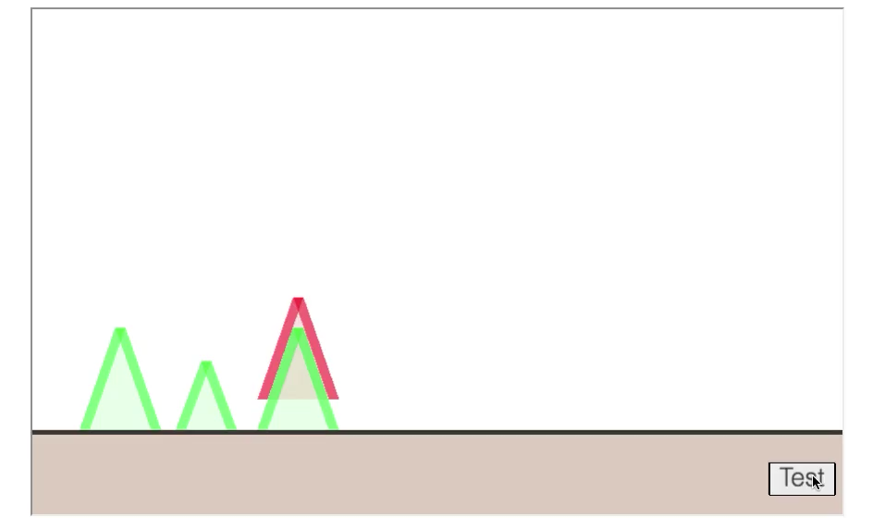
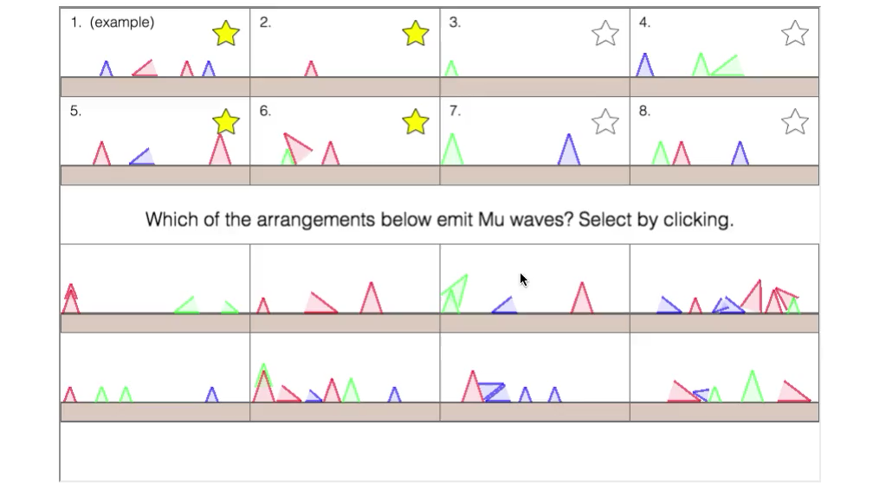
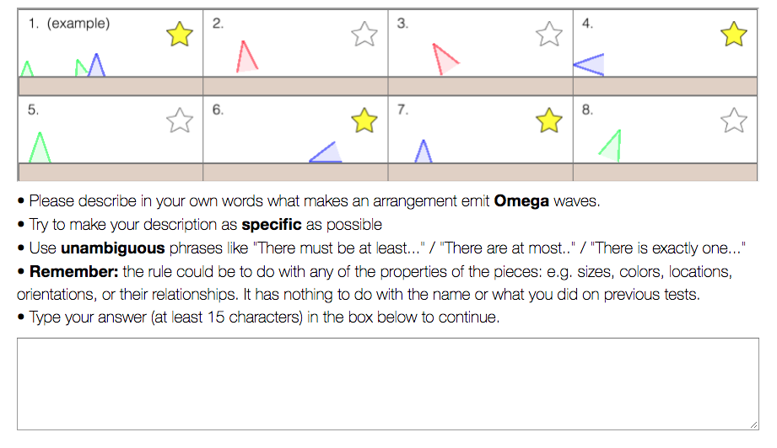
Zendo
1 Initial (active) learning phase
Observe 1 example scene, then generate 7 test scenes to ``discover’’ hidden rule
2 Initial generalizations / rule guess
Generalize to 8 new scenes and provide best guess of hidden rule

Slide 4
Zendo
3 Revised learning phase
Create new test scenes on your own (Experiment 1; solo learning)
Observe Scenes created by another person (Experiment 2; dyadic yoked learning)
Observe another person’s initial generalizations (Experiment 3; dyadic judgments)
4 Revised generalizations / rule guess
Generalize again and provide revised rule guess
REVISED RULE GUESS
Experiment 1
Experiment 2
Experiment 3

Slide 5
Main Question(s) of the paper
How can we arrive at participants’ revised rule guesses given their initial rule guess?
Initial rule:
``there exists a red object’’
Revised rule:
``there exists a small red object’’
Initial rule:
``there exists a blue object’’
Revised rule:
``there exists exactly one blue object’’

Slide 6
Main Question(s) of the paper
Given their initial rule guesses, how can we get participants’ revised rule guesses given additional data?
Do they generate a new rule from scratch? (No order effect)
Simulated normative learner
Do they keep their initial rule if its correct and ``resample’’ otherwise?
Win-stay, lose-sample
Do they adapt their initial rules by small / local changes under consideration of new data?
Tree surgery / Tree regrowth

Slide 7
Main Question(s) of the paper
Sanity check for symbolic cognition:
Can we use participants’ revised rule guesses to predict their revised generalizations?

Slide 8
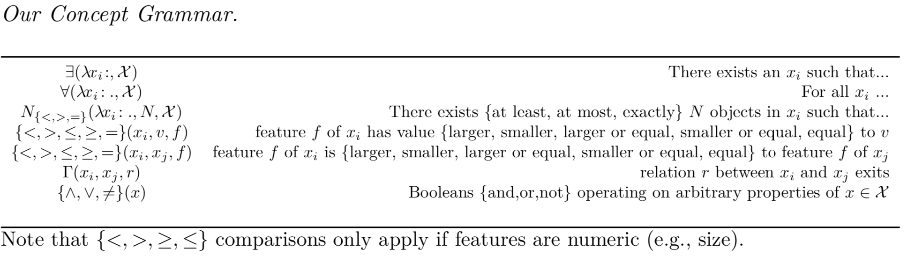
Algorithms – Rule Representation

Slide 9
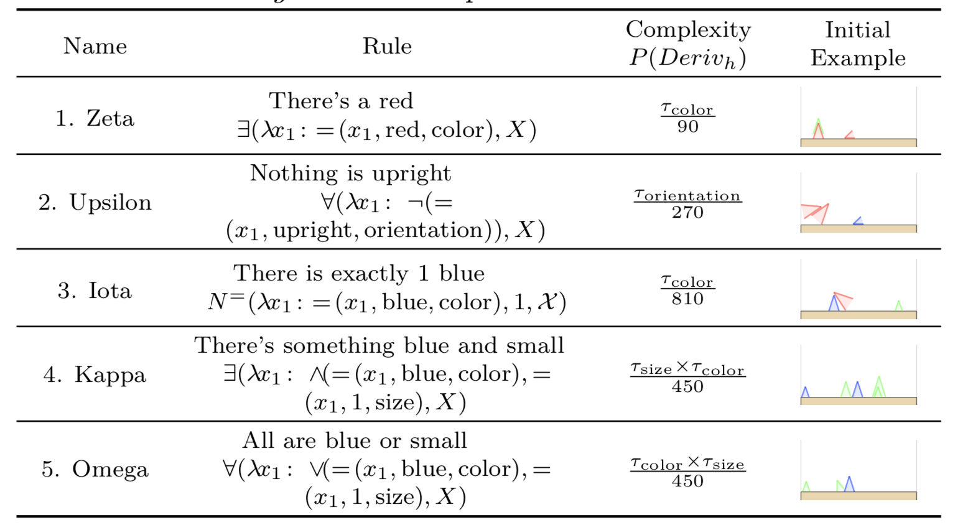
Algorithms – Rule Representation
Experiment 1
N = 90 -> 450 trials (248 unambiguously translated)
Experiment 2
N = 41 -> 210 trials (129 unambiguously translated)
Experiment 3
N = 40 -> 200 trials (82 unambiguously translated)

Slide 10
Algorithms – Normative simulations
Do they generate a new rule from scratch? (No order effect)
``just’’ combine new data with initial data and run long MCMC chain to generate a posterior sample of rules
independent of participants’ initial rule guesses

Slide 11
Algorithms – Win-stay, lose-sample (WSLS)
Do they keep their initial rule if its correct and ``resample’’ otherwise?
Check if initial rule is good at explaining new data
If yes, keep initial rule
If not, generate new posterior sample using same steps as normative simulations

Slide 12
Algorithms – Tree Regrowth and Tree Surgery
Do they adapt their initial rules by small / local changes under consideration of new data?
Check if initial rule is good at explaining new data
If yes, keep initial rule
If not, adapt initial rule under consideration of new data

Slide 13
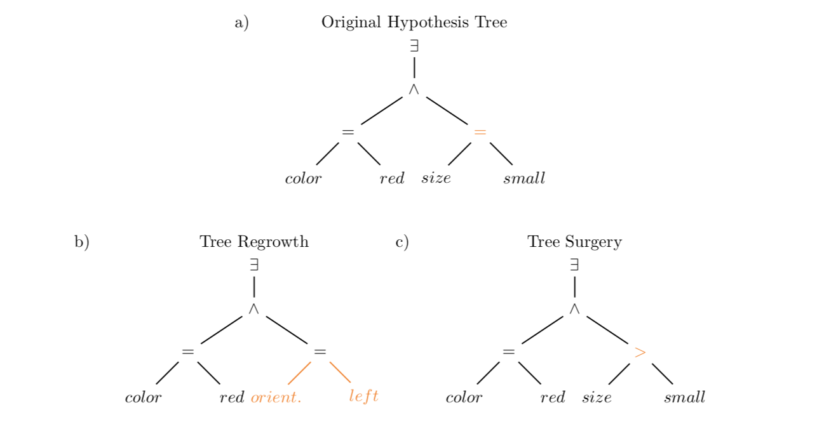
Algorithms – Tree Regrowth and Tree Surgery

Slide 14
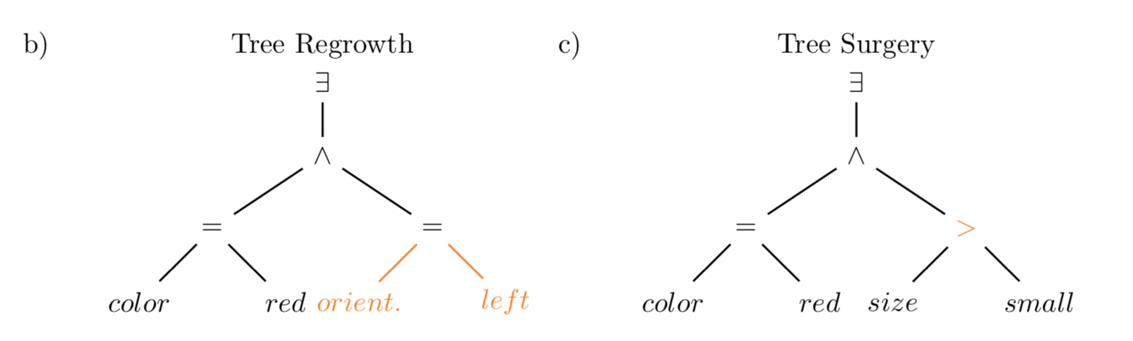
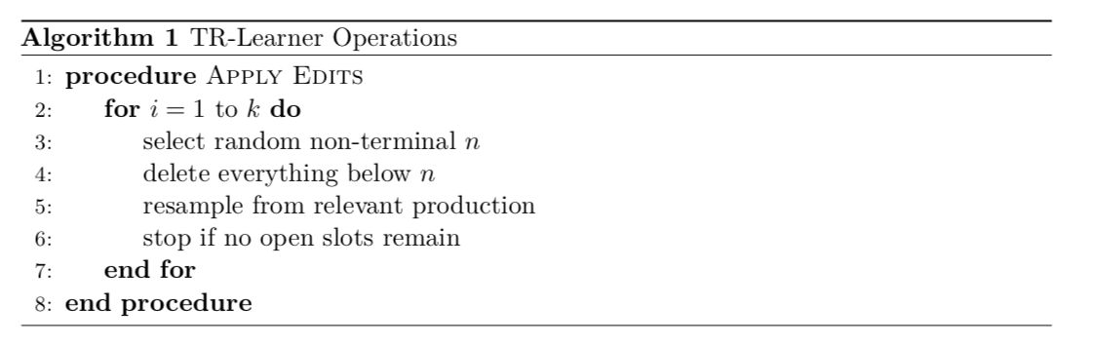
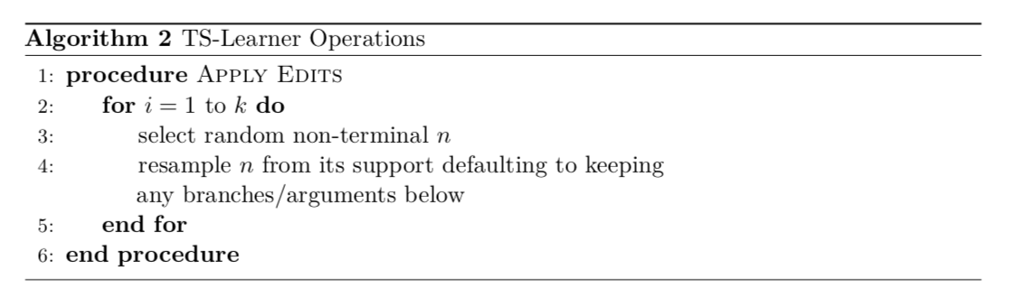
Algorithms – Tree Regrowth and Tree Surgery

Slide 15
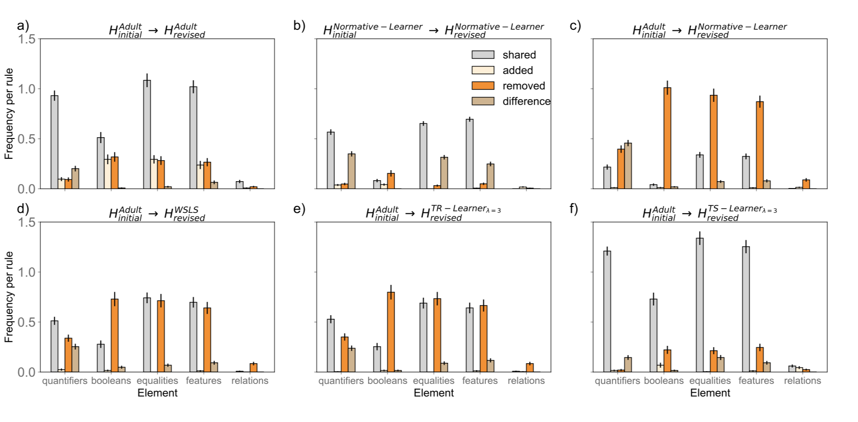
Modeling results – qualitative rule changes (exp1 only)
Initial rule:
∃(λx1 := (x1, red, color), X) (“there exists a red object”)
This rule contains 1 quantifier, 0 Booleans, 1 equality, 1 feature, and 0 relational properties.
Revised rule:
∃(λx1 : ∧(= (x1, red, color),(x1, small, size)), X) (“there exists a small red object”)
This rule contains 1 quantifier, 1 Boolean, 2 equalities, 2 features, and 0 relational properties.
Contrasting rules gives the following frequency scores:
quantifiers: 1 shared, 0 added, 0 removed, 0 difference
Booleans: 0 shared, 1 added, 0 removed, 0 difference
equalities: 0 shared, 1 added, 0 removed, 0 difference
relations: 0 shared, 0 added, 0 removed, 0 difference.

Slide 16
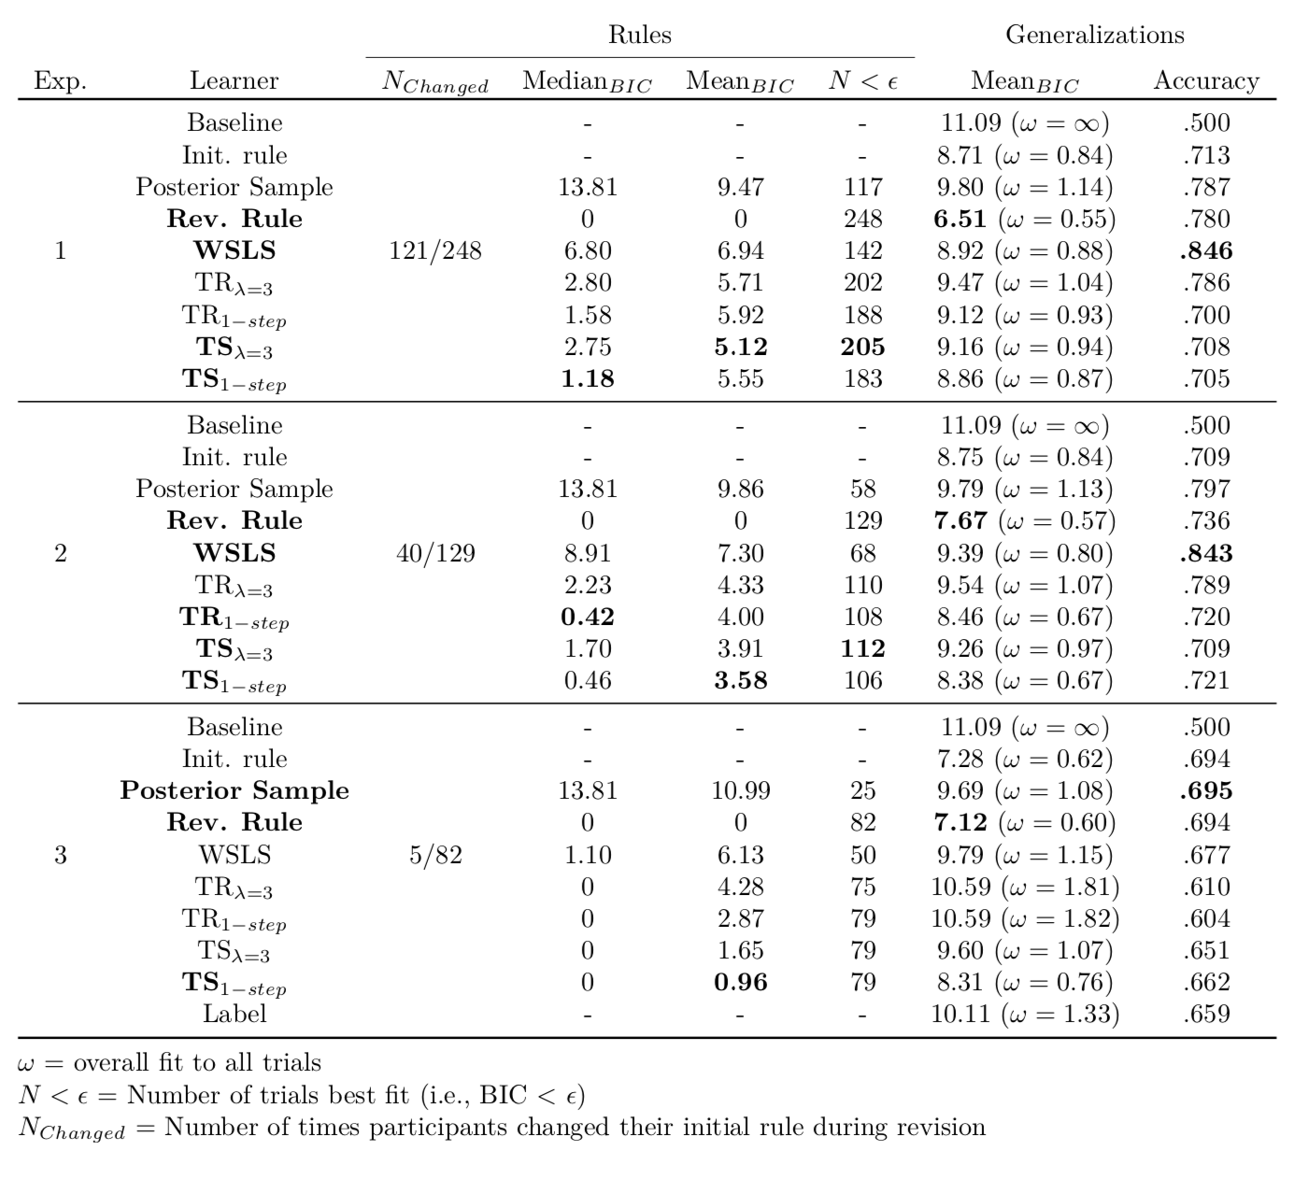
Modeling Results
Sanity check for symbolic cognition:
Can we use participants’ rule guesses to predict their generalizations?

Slide 17
Modeling Results
Now – how do we get the revised rule?
Posterior sample from normative simulations (no order effect)?
WSLS (all-or-none dependence)
TR-Learner (graded dependence, more radical edits)
TS-Learner (graded dependence, local edits)

Slide 18
Rule Details

Slide 19
Complexity and fit

