Slide 1
SQL
April 22th, 2002

Slide 2
Agenda
Union, intersections
Sub-queries
Modifying the database
Views
Modifying views
Reusing views

Slide 3
Union, Intersection, Difference
(SELECT name
FROM Person
WHERE City=“Seattle”)
UNION
(SELECT name
FROM Person, Purchase
WHERE buyer=name AND store=“The Bon”)
Similarly, you can use INTERSECT and EXCEPT.
You must have the same attribute names (otherwise: rename).

Slide 4
Exercises
Product ( pname, price, category, maker)
Purchase (buyer, seller, store, product)
Company (cname, stock price, country)
Person( per-name, phone number, city)
Ex #1: Find people who bought telephony products.
Ex #2: Find names of people who bought American products
Ex #3: Find names of people who bought American products and did
not buy French products
Ex #4: Find names of people who bought American products and they
live in Seattle.
Ex #5: Find people who bought stuff from Joe or bought products
from a company whose stock prices is more than $50.

Slide 5
Subqueries
A subquery producing a single tuple:
In this case, the subquery returns one value.
If it returns more, it’s a run-time error.
SELECT Purchase.product
FROM Purchase
WHERE buyer =
(SELECT name
FROM Person
WHERE ssn = “123456789”);

Slide 6
Can say the same thing without a subquery:
This is equivalent to the previous one when the ssn is a key; otherwise they are different.
SELECT Purchase.product
FROM Purchase, Person
WHERE buyer = name AND ssn = “123456789”

Slide 7
Subqueries Returning Relations
Find companies who manufacture products bought by Joe Blow.
SELECT Company.name
FROM Company, Product
WHERE Company.name=Product.maker
AND Product.name IN
(SELECT Purchase.product
FROM Purchase
WHERE Purchase .buyer = “Joe Blow”);
Here the subquery returns a set of values

Slide 8
Subqueries Returning Relations
Equivalent to:
SELECT Company.name
FROM Company, Product, Purchase
WHERE Company.name= Product.maker
AND Product.name = Purchase.product
AND Purchase.buyer = “Joe Blow”
Is this query equivalent to the previous one ?
Beware of duplicates !

Slide 9
Removing Duplicates
SELECT Company.name
FROM Company, Product, Purchase
WHERE Company.name= Product.maker
AND Product.name = Purchase.product
AND Purchase.buyer = “Joe Blow”
←Multiple copies
SELECT DISTINCT Company.name
FROM Company, Product, Purchase
WHERE Company.name= Product.maker
AND Product.name = Purchase.product
AND Purchase.buyer = “Joe Blow”
← Single copies

Slide 10
Removing Duplicates
SELECT DISTINCT Company.name
FROM Company, Product
WHERE Company.name= Product.maker
AND Product.name IN
(SELECT Purchase.product
FROM Purchase
WHERE Purchase.buyer = “Joe Blow”);
SELECT DISTINCT Company.name
FROM Company, Product, Purchase
WHERE Company.name= Product.maker
AND Product.name = Purchase.product
AND Purchase.buyer = “Joe Blow”
Now
they are
equivalent

Slide 11
Subqueries Returning Relations
You can also use: s > ALL R
s > ANY R
EXISTS R
Product ( pname, price, category, maker)
Find products that are more expensive than all those produced
By “Gizmo-Works”
SELECT name
FROM Product
WHERE price > ALL (SELECT price
FROM Purchase
WHERE maker=“Gizmo-Works”)

Slide 12
Question for Database Fans and their Friends
Can we express this query as a single SELECT-FROM-WHERE query, without subqueries ?
Hint: show that all SFW queries are monotone (figure out what this means). A query with ALL is not monotone

Slide 13
Conditions on Tuples
SELECT DISTINCT Company.name
FROM Company, Product
WHERE Company.name= Product.maker
AND (Product.name,price) IN
(SELECT Purchase.product, Purchase.price)
FROM Purchase
WHERE Purchase.buyer = “Joe Blow”);

Slide 14
Correlated Queries
Movie (title, year, director, length)
Find movies whose title appears more than once.
correlation
SELECT DISTINCT title
FROM Movie AS x
WHERE year < ANY
(SELECT year
FROM Movie
WHERE title = x.title);
Note (1) scope of variables (2) this can still be expressed as single SFW

Slide 15
Complex Correlated Query
Product ( pname, price, category, maker, year)
Find products (and their manufacturers) that are more expensive than all products made by the same manufacturer before 1972
Powerful, but much harder to optimize !
SELECT DISTINCT pname, maker
FROM Product AS x
WHERE price > ALL (SELECT price
FROM Product AS y
WHERE x.maker = y.maker AND y.year < 1972);

Slide 16
Conserving Duplicates
The UNION, INTERSECTION and EXCEPT operators
operate as sets, not bags.
(SELECT name
FROM Person
WHERE City=“Seattle”)
UNION ALL
(SELECT name
FROM Person, Purchase
WHERE buyer=name AND store=“The Bon”)

Slide 17
Modifying the Database
Three kinds of modifications
Insertions
Deletions
Updates
Sometimes they are all called “updates”

Slide 18
Insertions
General form:
INSERT INTO R(A1,…., An) VALUES (v1,…., vn)
Example: Insert a new purchase to the database:
INSERT INTO Purchase(buyer, seller, product, store)
VALUES (‘Joe’, ‘Fred’, ‘wakeup-clock-espresso-machine’,
‘The Sharper Image’)
Missing attribute → NULL.
May drop attribute names if give them in order.

Slide 19
Insertions
INSERT INTO PRODUCT(name)
SELECT DISTINCT Purchase.product
FROM Purchase
WHERE Purchase.date > “10/26/01”
The query replaces the VALUES keyword.
Here we insert many tuples into PRODUCT

Slide 20
Insertion: an Example
Product(name, listPrice, category)
Purchase(prodName, buyerName, price)
prodName is foreign key in Product.name
Suppose database got corrupted and we need to fix it:
Purchase
Product
prodName | buyerName | price
camera | John | 200
gizmo | Smith | 80
camera | Smith | 225
name | listPrice | category
gizmo | 100 | gadgets
Task: insert in Product all prodNames from Purchase

Slide 21
Insertion: an Example
INSERT INTO Product(name)
SELECT DISTINCT prodName
FROM Purchase
WHERE prodName NOT IN (SELECT name FROM Product)
name | listPrice | category
gizmo | 100 | Gadgets
camera | - | -

Slide 22
Insertion: an Example
INSERT INTO Product(name, listPrice)
SELECT DISTINCT prodName, price
FROM Purchase
WHERE prodName NOT IN (SELECT name FROM Product)
name | listPrice | category
gizmo | 100 | Gadgets
camera | 200 | -
camera ?? | 225 ?? | -
Depends on the implementation

Slide 23
Deletions
Example:
DELETE FROM PURCHASE
WHERE seller = ‘Joe’ AND
product = ‘Brooklyn Bridge’
Factoid about SQL: there is no way to delete only a single
occurrence of a tuple that appears twice
in a relation.

Slide 24
Updates
Example:
UPDATE PRODUCT
SET price = price/2
WHERE Product.name IN
(SELECT product
FROM Purchase
WHERE Date =‘Oct, 25, 1999’);

Slide 25
Data Definition in SQL
So far we have see the Data Manipulation Language, DML
Next: Data Definition Language (DDL)
Data types:
Defines the types.
Data definition: defining the schema.
Create tables
Delete tables
Modify table schema
Indexes: to improve performance

Slide 26
Data Types in SQL
Character strings (fixed of varying length)
Bit strings (fixed or varying length)
Integer (SHORTINT)
Floating point
Dates and times
Domains (=types) will be used in table declarations.
To reuse domains:
CREATE DOMAIN address AS VARCHAR(55)

Slide 27
Creating Tables
Example:
CREATE TABLE Person(
name VARCHAR(30),
social-security-number INTEGER,
age SHORTINT,
city VARCHAR(30),
gender BIT(1),
Birthdate DATE
);

Slide 28
Deleting or Modifying a Table
Deleting:
Example:
DROP Person;
Altering: (adding or removing an attribute).
ALTER TABLE Person
ADD phone CHAR(16);
ALTER TABLE Person
DROP age;
Example:
What happens when you make changes to the schema?

Slide 29
Default Values
Specifying default values:
CREATE TABLE Person(
name VARCHAR(30),
social-security-number INTEGER,
age SHORTINT DEFAULT 100,
city VARCHAR(30) DEFAULT ‘Seattle’,
gender CHAR(1) DEFAULT ‘?’,
Birthdate DATE
The default of defaults: NULL

Slide 30
Indexes
REALLY important to speed up query processing time.
Suppose we have a relation
Person (name, age, city)
Sequential scan of the file Person may take long
SELECT *
FROM Person
WHERE name = “Smith”

Slide 31
Indexes
Create an index on name:
B+ trees have fan-out of 100s: max 4 levels !
Adam | Betty | Charles | …. | Smith | ….

Slide 32
Creating Indexes
Syntax:
CREATE INDEX nameIndex ON Person(name)

Slide 33
Creating Indexes
Indexes can be created on more than one attribute:
CREATE INDEX doubleindex ON
Person (age, city)
Example:
SELECT *
FROM Person
WHERE age = 55 AND city = “Seattle”
Helps in:
SELECT *
FROM Person
WHERE city = “Seattle”
But not in:

Slide 34
Creating Indexes
Indexes can be useful in range queries too:
B+ trees help in:
Why not create indexes on everything?
CREATE INDEX ageIndex ON Person (age)
SELECT *
FROM Person
WHERE age > 25 AND age < 28

Slide 35
Defining Views
Views are relations, except that they are not physically stored.
For presenting different information to different users
Employee(ssn, name, department, project, salary)
Payroll has access to Employee, others only to Developers
CREATE VIEW Developers AS
SELECT name, project
FROM Employee
WHERE department = “Development”

Slide 36
A Different View
Person(name, city)
Purchase(buyer, seller, product, store)
Product(name, maker, category)
We have a new virtual table:
Seattle-view(buyer, seller, product, store)
CREATE VIEW Seattle-view AS
SELECT buyer, seller, product, store
FROM Person, Purchase
WHERE Person.city = “Seattle” AND
Person.name = Purchase.buyer

Slide 37
A Different View
We can later use the view:
SELECT name, store
FROM Seattle-view, Product
WHERE Seattle-view.product = Product.name AND
Product.category = “shoes”

Slide 38
What Happens When We Query a View ?
SELECT name, Seattle-view.store
FROM Seattle-view, Product
WHERE Seattle-view.product = Product.name AND
Product.category = “shoes”
SELECT name, Purchase.store
FROM Person, Purchase, Product
WHERE Person.city = “Seattle” AND
Person.name = Purchase.buyer AND
Purchase.poduct = Product.name AND
Product.category = “shoes”

Slide 39
Types of Views
Virtual views:
  Used in databases
  Computed only on-demand – slow at runtime
  Always up to date
Materialized views
  Used in data warehouses (but recently also in DBMS)
  Precomputed offline – fast at runtime
  May have stale data

Slide 40
Updating Views
How can I insert a tuple into a table that doesn’t exist?
Employee(ssn, name, department, project, salary)
CREATE VIEW Developers AS
SELECT name, project
FROM Employee
WHERE department = “Development”
If we make the
following insertion:
INSERT INTO Developers
VALUES(“Joe”, “Optimizer”)
It becomes:
INSERT INTO Employee
VALUES(NULL, “Joe”, NULL, “Optimizer”, NULL)

Slide 41
Non-Updatable Views
CREATE VIEW Seattle-view AS
SELECT seller, product, store
FROM Person, Purchase
WHERE Person.city = “Seattle” AND
Person.name = Purchase.buyer
How can we add the following tuple to the view?
(“Joe”, “Shoe Model 12345”, “Nine West”)
We need to add “Joe” to Person first. One copy ? More copies ?

Slide 42
Answering Queries Using Views
What if we want to use a set of views to answer a query.
Why?
  The obvious reason…
  Answering queries over web data sources.
Very cool stuff! (i.e., I did a lot of research on this).

Slide 43
Reusing a Materialized View
Suppose I have only the result of SeattleView:
SELECT buyer, seller, product, store
FROM Person, Purchase
WHERE Person.city = ‘Seattle’ AND
Person.per-name = Purchase.buyer
and I want to answer the query
SELECT buyer, seller
FROM Person, Purchase
WHERE Person.city = ‘Seattle’ AND
Person.per-name = Purchase.buyer AND
Purchase.product=‘gizmo’.
Then, I can rewrite the query using the view.

Slide 44
Query Rewriting Using Views
Rewritten query:
SELECT buyer, seller
FROM SeattleView
WHERE product= ‘gizmo’
Original query:
SELECT buyer, seller
FROM Person, Purchase
WHERE Person.city = ‘Seattle’ AND
Person.per-name = Purchase.buyer AND
Purchase.product=‘gizmo’.

Slide 45
Another Example
I still have only the result of SeattleView:
SELECT buyer, seller, product, store
FROM Person, Purchase
WHERE Person.city = ‘Seattle’ AND
Person.per-name = Purchase.buyer
but I want to answer the query
SELECT buyer, seller
FROM Person, Purchase
WHERE Person.city = ‘Seattle’ AND
Person.per-name = Purchase.buyer AND
Person.Phone LIKE ‘206 543 %’.

Slide 46
The General Problem
Given a set of views V1,…,Vn, and a query Q, can we answer Q using only the answers to V1,…,Vn?
Why do we care?
  We can answer queries more efficiently.
  We can query data sources on the WWW in a principled manner.
Many, many papers on this problem.
The best performing algorithm: The MiniCon Algorithm, (Pottinger & (Ha)Levy, 2000).

Slide 47
Querying the WWW
Assume a virtual schema of the WWW, e.g.,
  Course(number, university, title, prof, quarter)
Every data source on the web contains the answer to a view over the virtual schema:
UW database: SELECT number, title, prof
FROM Course
WHERE univ=‘UW’ AND quarter=‘2/02’
Stanford database: SELECT number, title, prof, quarter
FROM Course
WHERE univ=‘Stanford’
User query: find all professors who teach “database systems”

Slide 48
Aggregation
SELECT Sum(price)
FROM Product
WHERE maker=“Toyota”
SQL supports several aggregation operations:
SUM, MIN, MAX, AVG, COUNT

Slide 49
Aggregation: Count
SELECT Count(*)
FROM Product
WHERE year > 1995
Except COUNT, all aggregations apply to a single attribute

Slide 50
Aggregation: Count
COUNT applies to duplicates, unless otherwise stated:
SELECT Count(name, category) same as Count(*)
FROM Product
WHERE year > 1995
Better:
SELECT Count(DISTINCT name, category)
FROM Product
WHERE year > 1995

Slide 51
Simple Aggregation
Purchase(product, date, price, quantity)
Example 1: find total sales for the entire database
SELECT Sum(price * quantity)
FROM Purchase
Example 1’: find total sales of bagels
SELECT Sum(price * quantity)
FROM Purchase
WHERE product = ‘bagel’

Slide 52
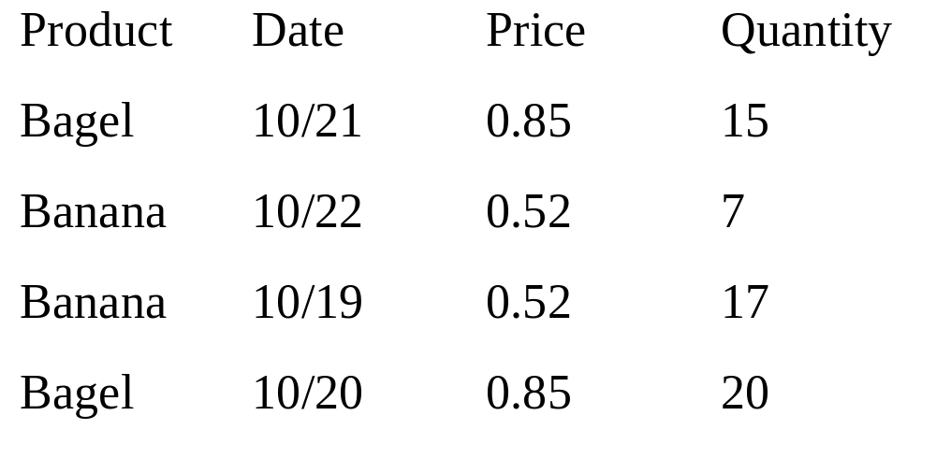
Simple Aggregations

Slide 53
Grouping and Aggregation
Usually, we want aggregations on certain parts of the relation.
Purchase(product, date, price, quantity)
Example 2: find total sales after 9/1 per product.
SELECT product, Sum(price*quantity) AS TotalSales
FROM Purchase
WHERE date > “9/1”
GROUPBY product

Slide 54
Grouping and Aggregation
1. Compute the relation (I.e., the FROM and WHERE).
2. Group by the attributes in the GROUPBY
3. Select one tuple for every group (and apply aggregation)
SELECT can have (1) grouped attributes or (2) aggregates.

Slide 55
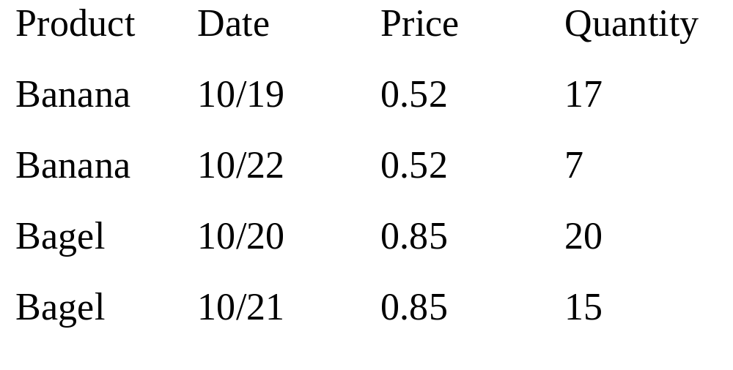
First compute the relation (date > “9/1”) then group by product:

Slide 56
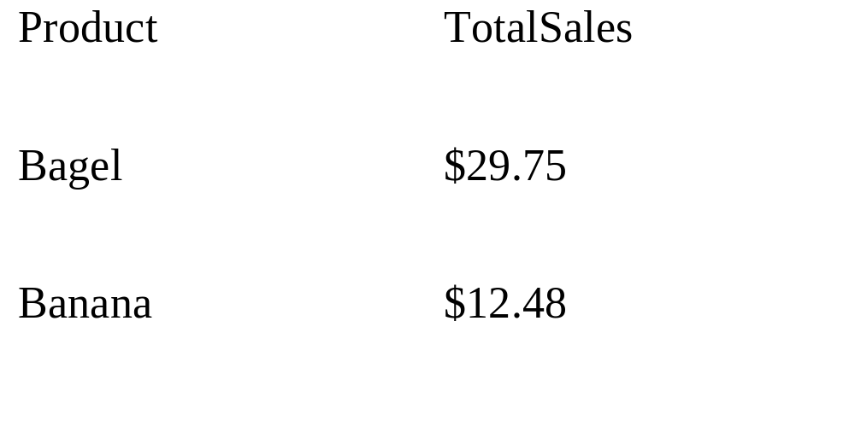
Then, aggregate
SELECT product, Sum(price*quantity) AS TotalSales
FROM Purchase
WHERE date > “9/1”
GROUPBY product

Slide 57
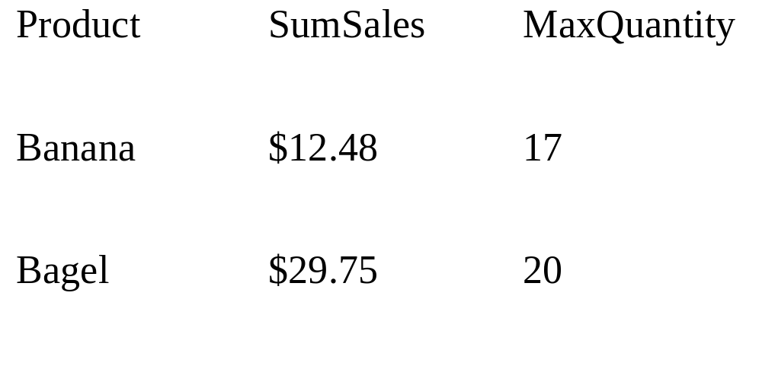
Another Example
For every product, what is the total sales and max quantity sold?
SELECT product, Sum(price * quantity) AS SumSales
Max(quantity) AS MaxQuantity
FROM Purchase
GROUP BY product

Slide 58
HAVING Clause
Same query, except that we consider only products that had
at least 100 buyers.
SELECT product, Sum(price * quantity)
FROM Purchase
WHERE date > “9/1”
GROUP BY product
HAVING Sum(quantity) > 30
HAVING clause contains conditions on aggregates.

Slide 59
General form of Grouping and Aggregation
SELECT S
FROM R₁,…,R_{n}
WHERE C1
GROUP BY a₁,…,a_{k}
HAVING C2
S = may contain attributes a₁,…,a_{k} and/or any aggregates but NO OTHER ATTRIBUTES
C1 = is any condition on the attributes in R₁,…,R_{n}
C2 = is any condition on aggregate expressions

Slide 60
General form of Grouping and Aggregation
SELECT S
FROM R₁,…,R_{n}
WHERE C1
GROUP BY a₁,…,a_{k}
HAVING C2
Evaluation steps:
Compute the FROM-WHERE part, obtain a table with all attributes in R₁,…,R_{n}
Group by the attributes a₁,…,a_{k}
Compute the aggregates in C2 and keep only groups satisfying C2
Compute aggregates in S and return the result

Slide 61
Aggregation
Author(login,name)
Document(url, title)
Wrote(login,url)
Mentions(url,word)

Slide 62
Find all authors who wrote at least 10 documents:
Select author.name
From author, wrote
Where author.login=wrote.login
Groupby author.name
Having count(wrote.url) > 10

Slide 63
Find all authors who have a vocabulary over 10000:
Select author.name
From author, wrote, mentions
Where author.login=wrote.login and wrote.url=mentions.url
Groupby author.name
Having count(distinct mentions.word) > 10000

Slide 64
Null Values and Outerjoins
If x=Null then 4*(3-x)/7 is still NULL
If x=Null then x=“Joe” is UNKNOWN
Three boolean values:
  FALSE = 0
  UNKNOWN = 0.5
  TRUE = 1

Slide 65
Null Values and Outerjoins
C1 AND C2 = min(C1, C2)
C1 OR C2 = max(C1, C2)
NOT C1 = 1 – C1
SELECT *
FROM Person
WHERE (age < 25) AND
(height > 6 OR weight > 190)
Rule in SQL: include only tuples that yield TRUE

Slide 66
Null Values and Outerjoins
Unexpected behavior:
SELECT *
FROM Person
WHERE age < 25 OR age >= 25
Some Persons are not included !

Slide 67
Null Values and Outerjoins
Can test for NULL explicitly:
  x IS NULL
  x IS NOT NULL
SELECT *
FROM Person
WHERE age < 25 OR age >= 25 OR age IS NULL
Now it includes all Persons

Slide 68
Null Values and Outerjoins
Explicit joins in SQL:
Product(name, category)
Purchase(prodName, store)
SELECT Product.name, Purchase.store
FROM Product JOIN Purchase ON
Product.name = Purchase.prodName
Same as:
SELECT Product.name, Purchase.store
FROM Product, Purchase
WHERE Product.name = Purchase.prodName
But Products that never sold will be lost !

Slide 69
Null Values and Outerjoins
Left outer joins in SQL:
Product(name, category)
Purchase(prodName, store)
SELECT Product.name, Purchase.store
FROM Product LEFT OUTER JOIN Purchase ON
Product.name = Purchase.prodName

Slide 70
Product
Purchase
Name | Category
Gizmo | gadget
Camera | Photo
OneClick | Photo
ProdName | Store
Gizmo | Wiz
Camera | Ritz
Camera | Wiz
Name | Store
Gizmo | Wiz
Camera | Ritz
Camera | Wiz
OneClick | -

Slide 71
Outer Joins
Left outer join:
  Include the left tuple even if there’s no match
Right outer join:
  Include the right tuple even if there’s no match
Full outer join:
  Include the both left and right tuples even if there’s no match

Slide 72
SQL: Constraints and Triggers
Chapter 6 Ullman and Widom
Certain properties we’d like our database to hold
Modification of the database may break these properties
Build handlers into the database definition
Key constraints
Referential integrity constraints.

Slide 73
Declaring a Primary Keys in SQL
  CREATE TABLE MovieStar (
  name CHAR(30) PRIMARY KEY,
  address VARCHAR(255),
  gender CHAR(1));
OR:
  CREATE TABLE MovieStar (
  name CHAR(30),
  address VARCHAR(255),
  gender CHAR(1)
  PRIMARY KEY (name));

Slide 74
Primary Keys with Multiple Attributes
  CREATE TABLE MovieStar (
  name CHAR(30),
  address VARCHAR(255),
  gender CHAR(1),
  PRIMARY KEY (name, address));

Slide 75
Other Keys
  CREATE TABLE MovieStar (
  name CHAR(30),
  address VARCHAR(255),
  phone CHAR(10) UNIQUE,
  gender CHAR(1),
  petName CHAR(50),
  PRIMARY KEY (name),
  UNIQUE (gender, petName));

Slide 76
Foreign Key Constraints
CREATE TABLE ActedIn (
Name CHAR(30) PRIMARY KEY,
MovieName CHAR(30)
REFERENCES Movies(MovieName),
Year INT);

Slide 77
Foreign Key Constraints
OR
CREATE TABLE ActedIn (
Name CHAR(30) PRIMARY KEY,
MovieName CHAR(30),
Year INT,
FOREIGN KEY MovieName
REFERENCES Movies(MovieName)
MovieName must be a PRIMARY KEY

Slide 78
How do we Maintain them?
Given a change to DB, there are several possible violations:
  Insert new tuple with bogus foreign key value
  Update a tuple to a bogus foreign key value
  Delete a tuple in the referenced table with the referenced foreign key value
  Update a tuple in the referenced table that changes the referenced foreign key value

Slide 79
How to Maintain?
Recall, ActedIn has FK MovieName...
  Movies(MovieName, year)
  (Fatal Attraction, 1987)
  ActedIn(ActorName, MovieName)
  (Michael Douglas, Fatal Attraction)
  insert: (Rick Moranis, Strange Brew)

Slide 80
How to Maintain?
Policies for handling the change…
  Reject the update (default)
  Cascade (example: cascading deletes)
  Set NULL
Can set update and delete actions independently in CREATE TABLE
MovieName CHAR(30)
REFERENCES Movies(MovieName))
ON DELETE SET NULL
ON UPDATE CASCADE

