Slide 1
Big Data Final Project
Fall, 2019
r. hughes

Slide 2
Course Final Project
My hope for this course is that it will give you practical data analytics tools to use, if and when you need them, whether in a future research project or as a data scientist in industry. The Final Project is a chance for you to demonstrate that you have learned enough to handle a machine learning task - on your own!
Goals:
The project should be one in which machine learning/advanced algorithms can be brought to bear on an interesting problem, either to "solve" that problem, or at least deliver meaningful insights regarding the problem.
The projects will all be single person projects.
The projects should be science oriented.
The deliverables do not include a final report but instead a working jupyter notebook as well as a single page “Poster” (in ppt/pdf form only).

Slide 3
Project Choices:
You have the choice of attempting a predefined project or coming up with your own. In either case, it will be necessary that the project has some reasonable connection to science. I am comfortable with the possibility that this connection may not be obvious, but if so you will need to make the case in your project proposal that such a connection with science exists.
Already existing project: For these you can use the resources of the Kaggle website (or other similar online resources). Kaggle hosts open machine learning competitions for both commercial and non-profit organizations. They provide data, background information, an evaluation metric, and a forum for each competition. There are (as of Oct 8, 2019) 14 open competitions and 341 completed competitions. You can choose an open OR an already completed competition. I anticipate that you may need to substantially modify the goals as stated on the Kaggle website in order to be able to complete your project in the allotted time.
You choose the project: Here you are free to choose something from current research that you are doing, or perhaps something you have been interested in learning about. You are also allowed to combine this project with a project from another class, though you must fulfill all requirements of this project. More on this below in the FAQ.

Slide 4
Machine Learning Project Checklist
Define the problem: what exactly are you trying to do?
Get the data. (Sometimes this means creating your data!)
Explore the data with an eye to learning how you might use the data to solve your problem.
Prepare the data: this may include normalizing, augmenting, modifying (cropping, centering, etc) the data.
Investigate a number of different models and choose 2 or 3 that seem particularly good.
Fine tune the models and either choose the best or combine them.
Present your solution to the problem using your final model.
Launch your system with your final model and monitor results.

Slide 5
Project Timeline
Proposal: This describes the project that you will do, as well as outlining your proposed approach. This approach may change as you learn more!
Due date: 5pm Thursday October 31, 2019
Mid-term "Report": This is a checklist of things you have managed to complete, as well as a preliminary version of your poster (see below). The primary purpose of this is to make sure you are on track to complete the project.
Due Date: 5pm Thursday November 14, 2019
Completed project: A completed project will be comprised of a jupyter notebook(s) as well as a final poster in pdf/ppt form, all residing in your github folder:
Due Date: 5pm Monday December 9, 2019

Slide 6
Project Proposal
This describes the project you will do, as well as outlining your proposed approach. This approach may change as you learn more! Sources for possible projects are listed.
* Due date: **5pm Thursday October 31, 2019**
* Deliverables: Completed proposal form; see the file "Project Proposal Template.doc" in the finalProject/docs folder in your github repo.
* Grading: This is a completion based grade, worth 10% of the project points, if all parts are done and it is turned in on time. You will lose 25% (of the 10%) for each day it is turned in late. I encourage you to share with me your proposed project ahead of the due date if you have any concerns that it is not appropriate.

Slide 7
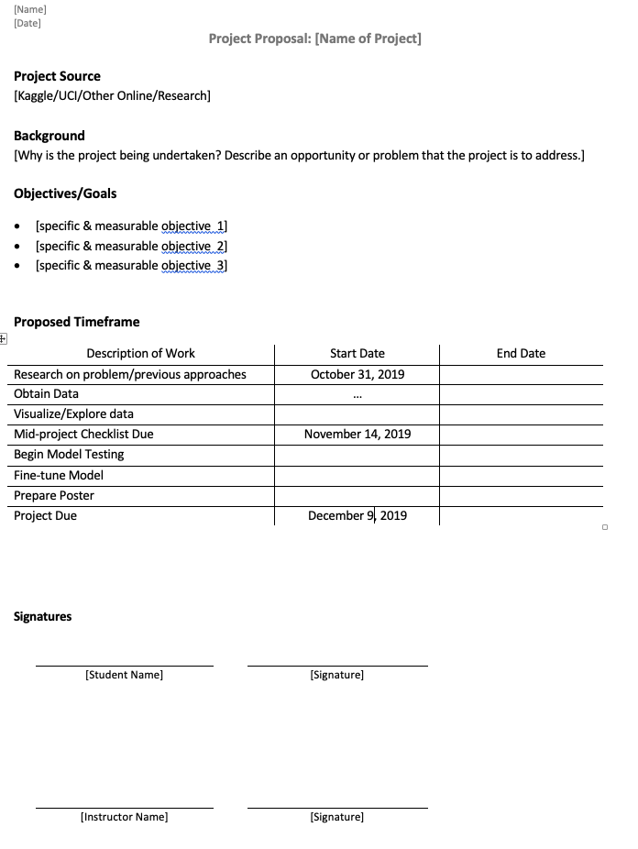
Project Proposal

Slide 8
Mid-term "Report"
This is checklist of things you have managed to complete, as well as a preliminary version of your poster (see below). The primary purpose of this is to make sure you are on track to complete the project.
Due Date: **5pm Thursday November 14, 2019**
Deliverables: Completed checklist (see finalProject/docs folder in your github repo); associated items highlighted in checklist; current version of your poster (see finalProject/poster folder in your github repo). It is ok if most of your poster is placeholders at this point.
Grading: This is a completion based grade, worth 10% of the project points. Completion means:
the entire checklist is filled out
At least 3 of the item in the checklist are marked as completed AND the associated jupyter notebooks are in the github folder

Slide 9
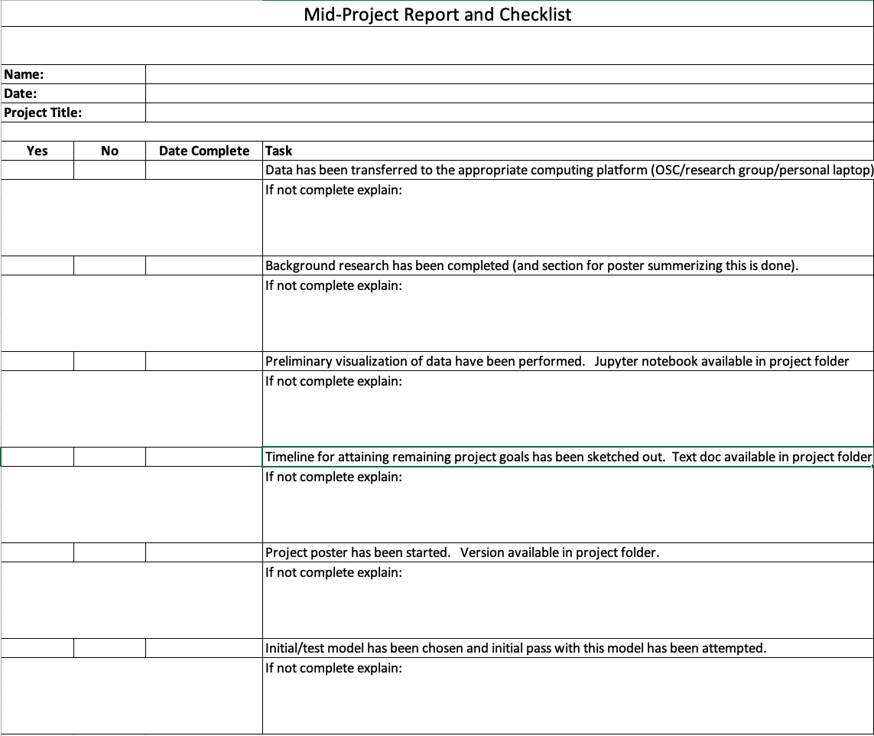
Mid-term "Report"

Slide 10
Completed project: Due Date: 5pm Monday December 9, 2019
A completed project will be comprised of the following, all residing in your github folder:
An annotated jupyter notebook (one or more) which can be used to recreate your project. Some parts of the project may end up using bash scripts and full python files in addition to or instead of jupyter notebooks.
A final poster (in ppt *and* pdf form only - there is no formal poster session). The final poster should be in a form such that you could give a copy to an interested party (future employer or research advisor) to give them insight into the kind of work you are capable of.
Grading: A rubric will be available soon.

Slide 11
Resources
Here are some online sources:
The Kaggle competition [website](https://www.kaggle.com/competitions).
The UCI machine learning repository [website](http://archive.ics.uci.edu/ml/index.php)
The Stanford CS229 project [website](http://cs229.stanford.edu/projects.html). The section titled "Previous projects" has hundreds of example projects from past years. Note that posters only appear to be available for years 2015-present, and reports (something I am not asking you to do) are available for all years. Many (though not all) of these projects are also based on Kaggle competitions. Some particularly good examples of posters are:
Large-scale Protein Atlas Compartmentalization Analysis]
A Data-Driven Approach for Predicting Elastic Properties of Inorganic Materials]
Galaxy Morphology
Modeling and Optimization of Optical Devices using a Variational Autoencoder

Slide 12
FAQ(1)
1. I found on the web a complete working solution to my project problem. Can I use it?
No. As mentioned above, each Kaggle competition has a forum of questions and answers devoted to that particular competition. We encourage you to consult that forum! However, as much as is practical, we strongly urge you to **not** consult any posted solutions. This will defeat the whole purpose of the project: The value the project has as a learning experience is **much** more important than its contribution to your final grade in this course!
2. Can I do this project as part of a team with another student?
No. However, we do anticipate that many students in the class may end up working on the same subset of projects. Consulting with these students about problems you run into and methods you are trying is fine. But the work you submit as your project must be **overwhelmingly** your own. You should be able to explain and justify every choice that is made in the course of completing your project.
3. Is it okay to use a dataset that is not public ?
Yes. We don't mind you using a dataset that is not public, as long as you have the required permissions to use it. We don't require you to share the dataset either as long as you can accurately describe it in the Final Report.

Slide 13
FAQ(2)
4. Are the final presentations public?
Yes. All projects will be viewable by fellow students via our classroom github repo. We will also host final posters (just like the CS229 website above). Let us know if this is not possible (because the data is private) or desired for your project. We want to advertise this course and its potential to future students!
5. Can I combine this project with another class project?
Yes. In general it is possible to combine your project for this course and another class, but with the following caveats:
* You should make sure that you follow all the guidelines and requirements for this project (in addition to the requirements of the other class). So, if you'd like to combine this project with a class X but class X's policies don't allow for it, you cannot do it.
* You cannot turn in an identical project for both classes, but you can share common infrastructure/code base/datasets across the two classes.
* Clearly indicate in your mid-project report as well as an addendum (text document) to your final poster, which part of the project is done for this class and which part is done for a class other than this one. For shared projects, we also require that you submit the final report from the class you're sharing the project with.

Slide 14
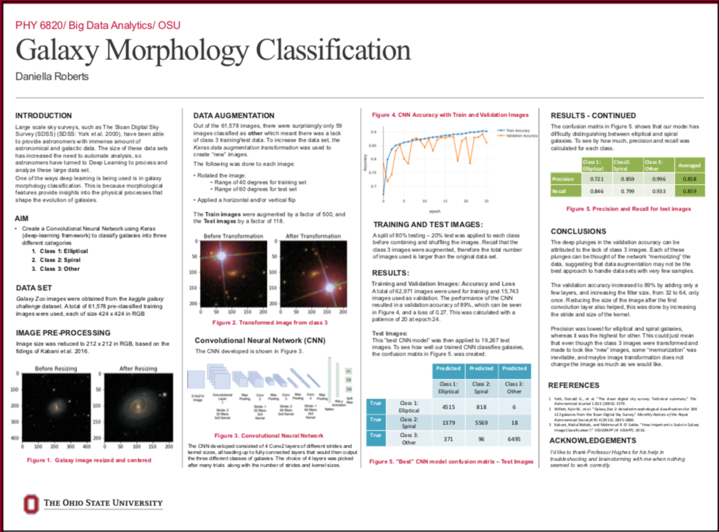
Example project from 2018

Slide 15
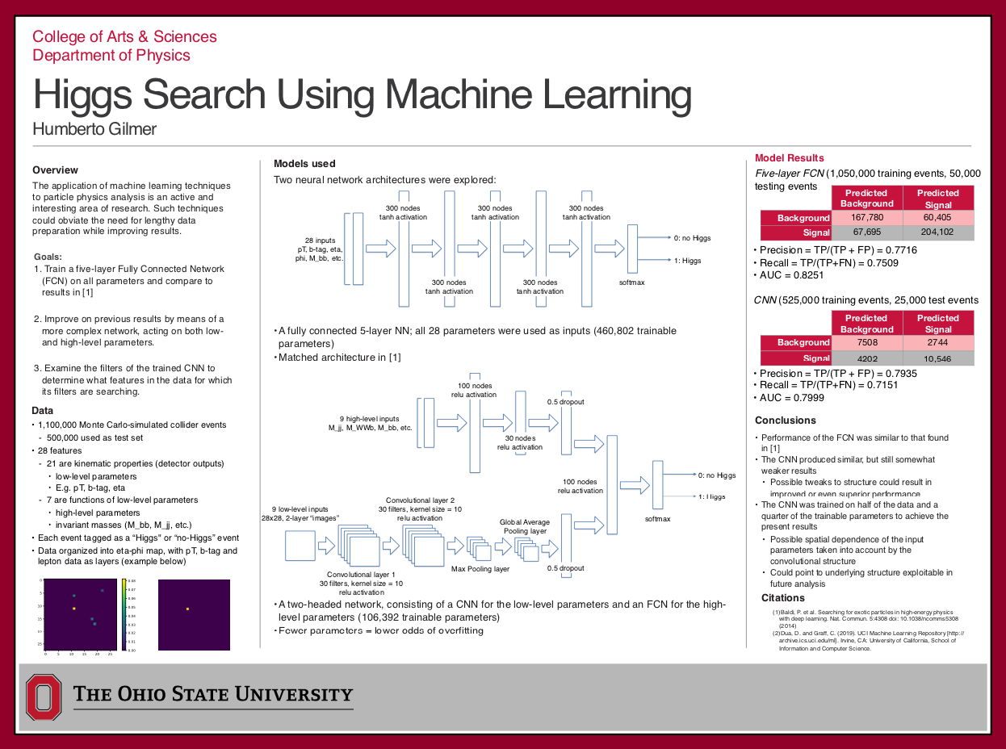
Example project from 2018

Slide 16
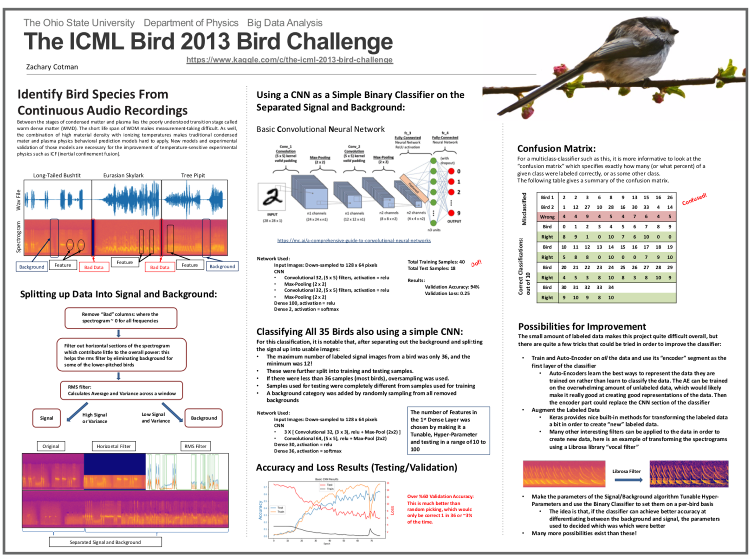
Example project from 2018

Slide 17
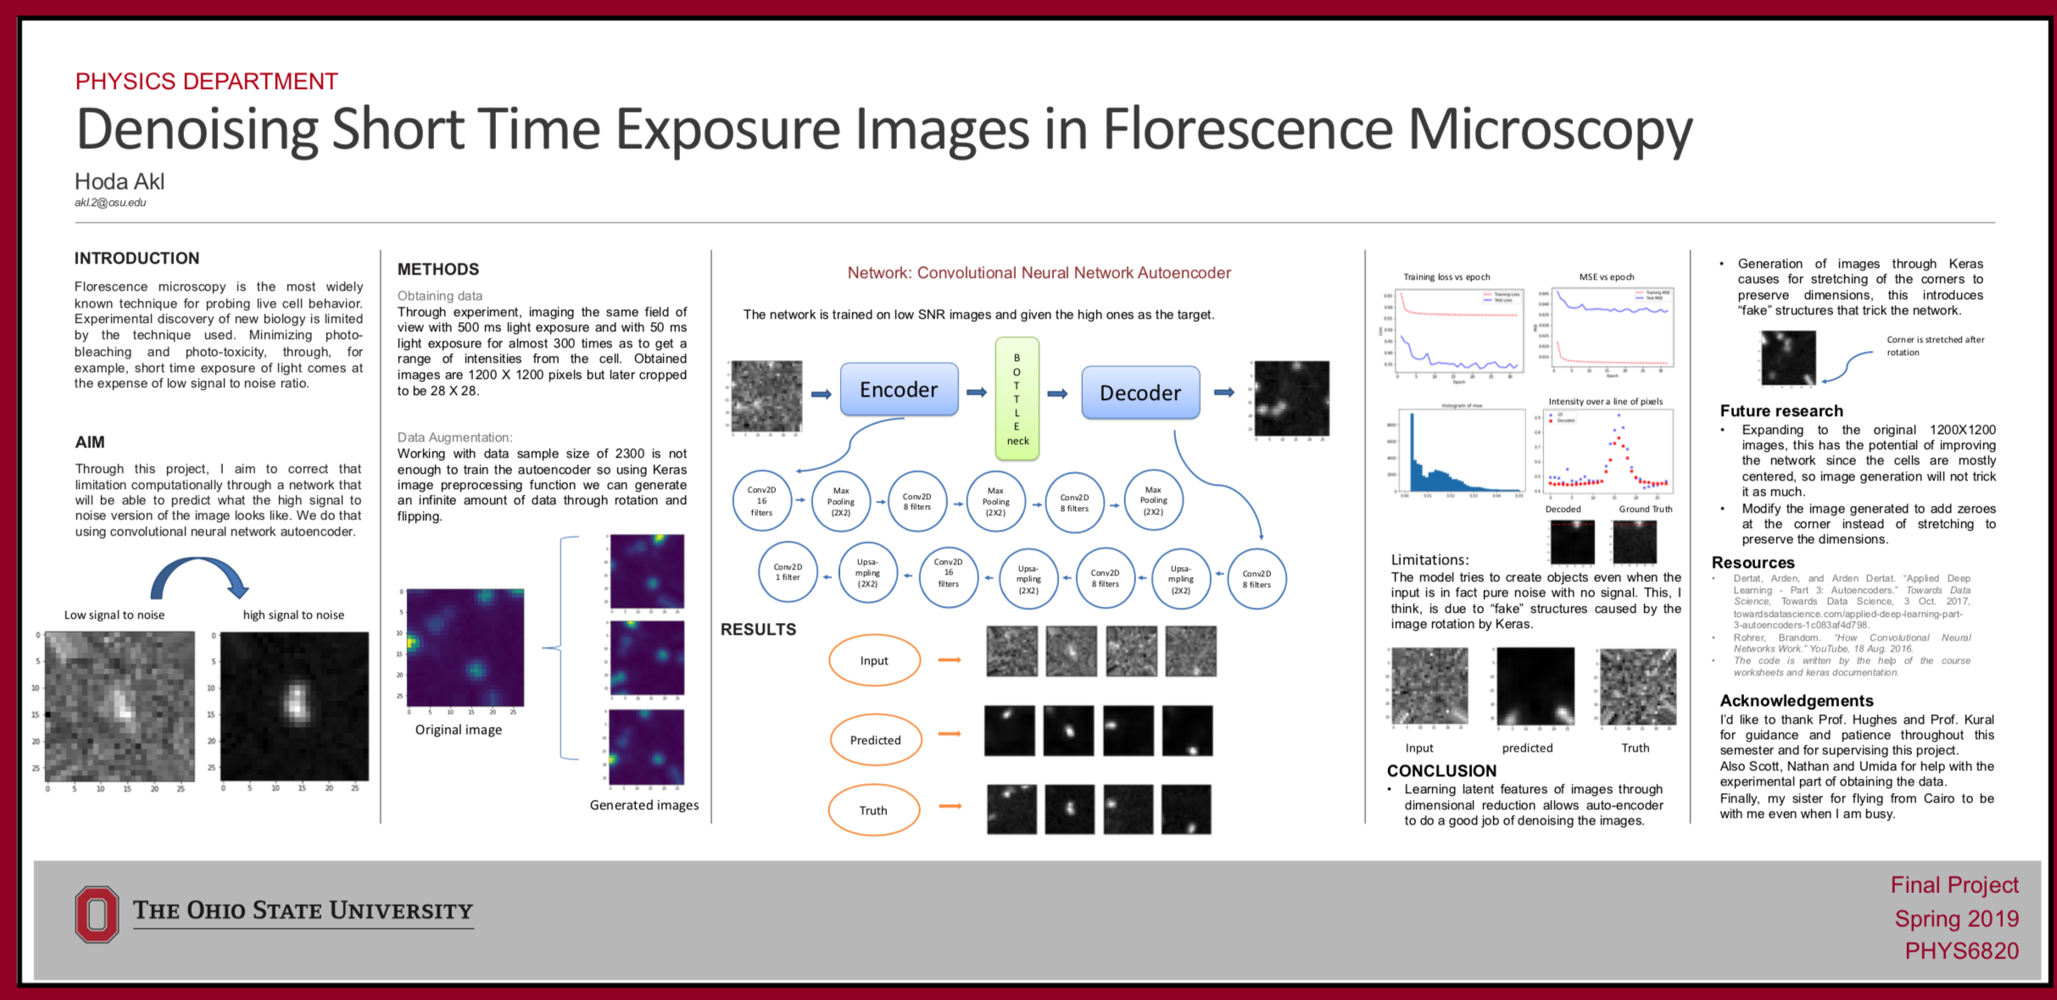
Example project from 2018

