Slide 1
React & Redux Technical concepts
What is React?
What is Virtual DOM?
What is Redux and why we need it?
Data flow in redux

Slide 2
1. What is React?
React is a JS library which helps to develop complex UIs with minimal efforts. It is component based, it efficiently render an appropriate component depending on the data changes.
Eg: usehttps://descholar-us-cities-catalogue.netlify.app/ to explain this concept

Slide 3
2. What is Virtual DOM?
The virtual DOM: is a programming concept where an ideal, or “virtual”, representation of a UI is kept in memory and synced with the “real” DOM by a library such as ReactDOM.

Slide 4

3. What is Redux and why we need it?

Slide 5
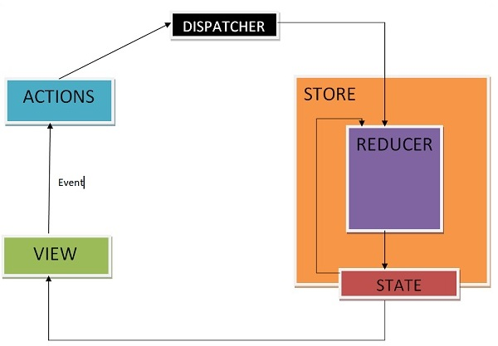
4. Data flow in redux

Slide 6
4. Data flow in redux cont’d...
1. An action is dispatched when a user interacts with the application.
2. The root reducer function is called with the current state and the dispatched action. The root reducer may divide the task among smaller reducer functions, which ultimately returns a new state.
What is a reducer? A reducer is a function that determines changes to an application's state. It uses the action it receives to determine this change.
3. The store notifies the view by executing their callback functions.
4. The view can retrieve updated state and re-render again.

