Slide 1
DESCITE
TEACHING TOOLS
Team members:
AMRITA KUMARI
RAJU VISHWAKARMA

Slide 2
Problem Statement
Interaction between the students and teacher
is the major problem which affects the education system
The reason of less interaction between teachers and students is that students feels uncomfortable in clearing their doubts in classroom itself.

Slide 3
SOLUTION
Developing powerful teaching tools
The main aim of this project to help the student to keep in touch with teachers not only in the classroom but also they can clear their doubts outside the classroom
Basically we are creating a webpage or platform where students can clear doubts by simply accessing the webpage without any hesitation and ping the teacher in comfortable manner

Slide 4
Demo/How it works
The website called “DESCITE” which is the LATIN word means learn
This the platform where students can learn their respective subjects and clear doubts regarding subject which they are unable to clear in the classrooms due to certain reasons
The website contains the different schools
Under different schools different subjects are there which contains the teacher details specified in different subjects where students can ask their queries freely and comfortably.

Slide 5

Strength
This will lead to build the healthy relationship
between teachers and students
Long distance interaction without the classroom
Effective education practice
Variety of programs and courses
More comfortable learning enviornment
More interaction and greater ability to concentrate
Improve your skills

Slide 6
Weakness
Little or no more face-to-face interaction
Intense requirement for self-discipline
Distance learning is isolated
Distance learning does not offer immediate feedback
Distance learning does not give students the opportunity to work on oral communication skills

Slide 7
Opportunities
The students who are comfortable with their own subject teacher can ask their queries to other teacher whom they are comfortable
The students can ask their doubts at home who are not interact with the teachers in the classrooms
It will be like correspondence courses in which students prepare their subject by their own and simply clearing the doubts
The students who want to learn some other subjects which are not in their course can clear their doubts on the site while learning that subject

Slide 8
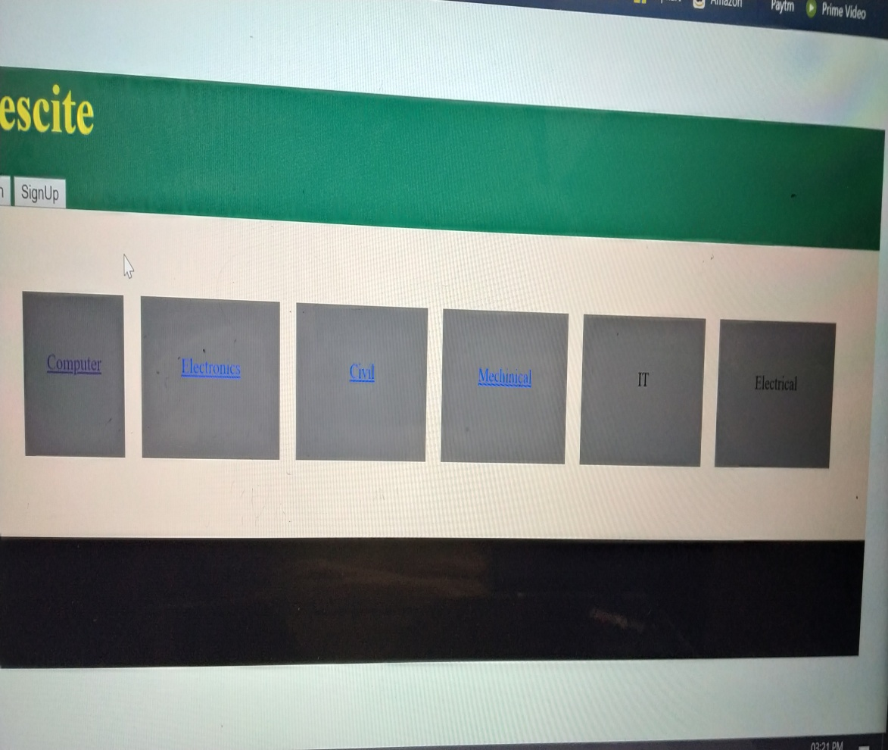
Execution of Idea
1.This is the first page of our website it include all the information ,details and all the available school.
2.And some information regarding the website.

Slide 9
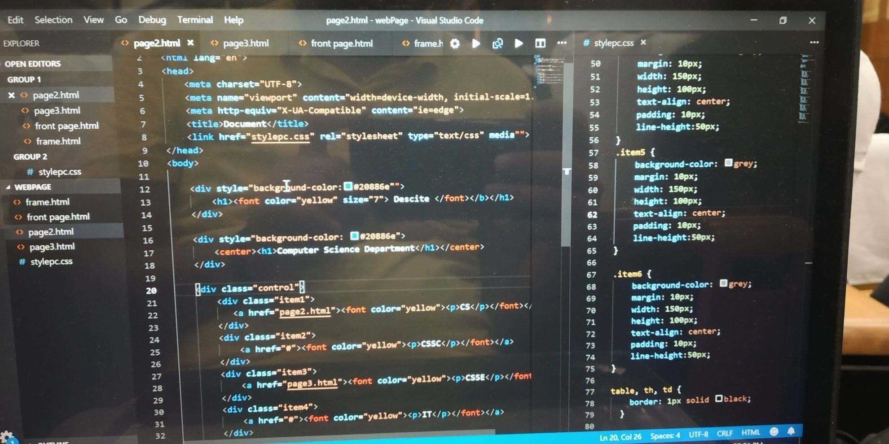
1.We have all the coding in HTML AND CSS .
2. Platform we used is Visual Stdio.

Slide 10
THANK YOU

